Slide 1
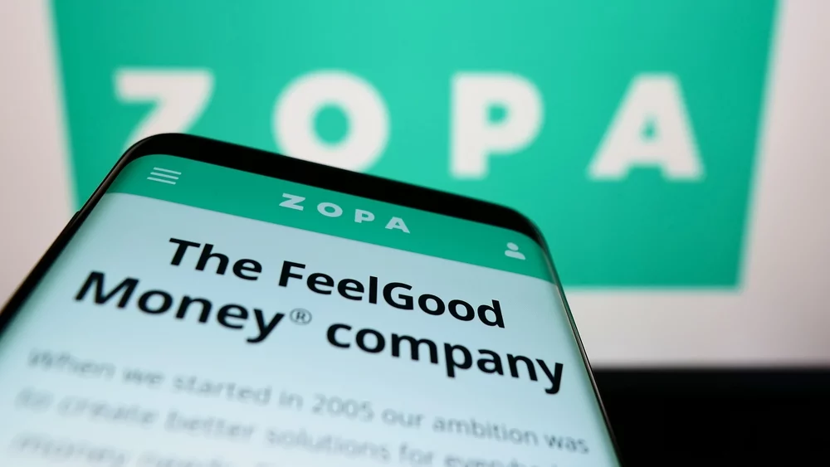
Gax
Name: Andreea Oana Vlasceanu Module code: BMSW5103
Student id: 2108084
Understanding and Engaging in the Customer Experience
01

Slide 2
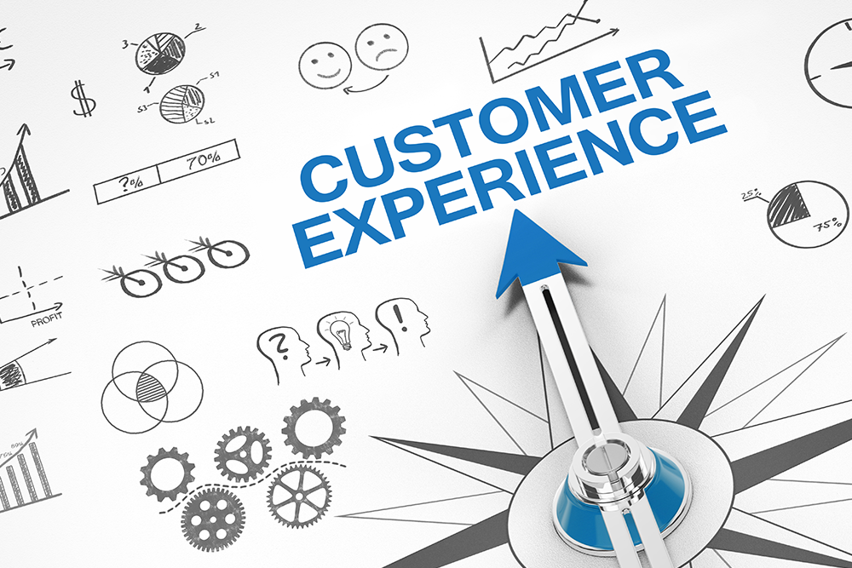
Introduction
Customer experience (CX) refers to all interactions a customer has with a business, from first contact to last encounter.
It includes a number of factors, including as the corporate website, customer support, and the quality of the goods and services provided.
02

Slide 3
Company Background-About Zopa
Zopa came into existence
Zopa successfully raised £100 million
2005
2007
2012
Peer-to-peer lending platform by Zopa was introduced
(Zopa, 2023)
Notes:
© Copyright www.free-ppt-templates-download.com

Slide 4
Company Background-About Zopa
Zopa stopped offering peer-to-peer business loans
2016
2020
2021
Zopa submitted its application for a banking license
Zopa was granted a banking license
(Zopa, 2022)
Notes:
© Copyright www.free-ppt-templates-download.com

Slide 5

Key findings-Customer Experience
Putting an emphasis on providing pleasant customer experiences across all touchpoints, including the website, chatbot, app, and social media.
Adjusting to Zopa's technological participation on social media and digital platforms (Aichner and Gruber, 2017).
Promoting proactive assistance and communication to foster customer satisfaction.
Positive touchpoints are the key to driving retention, referrals, and brand loyalty (Barbu et al., 2021).
02

Slide 6





Omni Channel Integration
0
Proactive Interaction
Recommendations
P
Recommendations
T
M
Training Employees
E
Measuring KPI
Enabling Employees
Notes:
© Copyright www.free-ppt-templates-download.com

Slide 7
Key findings-Customer and Brand Experience
Have an effect on retention and loyalty
Increase referrals and customer lifetime value (CLV)
Builds emotional connections, trust, and perception with consumers
Determines brand distinction, visibility, and image in the IT industry
Obtain a competitive advantage via repeat business, and favorable referrals
(Gonzalez and McAleer, 2011)
02

Slide 8
Recommendations
Purchasing a fully digital experience
Establishing a trustworthy reputation for the brand
Making an effort to establish a personal connection with consumer
Effective utilization of consumer data
(McKnight and Fish, 2016)

Slide 9

Challenges regarding recommendations
Challenging and requiring reliable solutions to integrate data from diverse sources.
Taking time and resources to create and update customized content.
Resulting from providing continual training and empowerment resources from constraining budgets (Gonzalez and McAleer, 2011).

Slide 10

Continue………
Keeping brand message and values constant despite shifting market trends (Kumar and Reinartz, 2018).
Using client data while protecting data privacy and security.
Limiting overstepping and customisation while weighing possible privacy risks (Kubwalo-Chaika, 2016).

Slide 11

Conclusion
Zopa UK recognizes its impact areas for narrowly improving the client experience and advancing technology for top-notch service.
Customer interaction is transformed when co-creation ideas are used, creating a collaborative lending process.
Through specialized services, Zopa sets itself apart in a cutthroat industry.

Slide 12
References
Aichner, T. and Gruber, B. (2017) Managing customer touchpoints and customer satisfaction in B2B mass customization: A case study. International journal of industrial engineering and management, 8(3), p.131.
Barbu, C.M., Florea, D.L., Dabija, D.C. and Barbu, M.C.R. (2021) Customer experience in fintech. Journal of Theoretical and Applied Electronic Commerce Research, 16(5), pp.1415-1433.
Gonzalez, L. and McAleer, K. (2011) Determinants of success in online social lending: a peak at US prosper & UK ZOPA.
Kubwalo-Chaika, M. (2016) Realising increased value from using knowledge management to improve customer relationship management in a retail banking environment: the case of Standard Bank in Malawi (Doctoral dissertation, University of Bolton).
Kumar, V. and Reinartz, W. (2018) Customer relationship management. Springer-Verlag GmbH Germany, part of Springer Nature 2006, 2012, 2018.
McKnight, J. and Fish, A.R. (2016) Zopa's lambs: video ads, internet banks, and the financialization of affect. Ephemera: Theory and Politics in Organization, 16(4), pp.33-49.
Zopa (2022). Blog. Retrieved from https://www.zopa.com/blog
Zopa (2023). Zopa: Personal Loans & Investing. Retrieved from https://www.zopa.com/

