Slide 1

Name: Touheed Ali
Student Number: 1913303
Module Title: Marketing Management
Module Code: LCMB7001
Lecturer Name: Efua Adams
Assignment Title: Presentation

Slide 2
Contents
Introduction
Theory 1 - Marketing Mix Theory how organisations are using this theory - Johnson & Johnson
Theory 2 - Maslow's Hierarchy of Needs how organisations are using this theory - Akosombo Industrial Company Limited
Theory 3 - Porter's Five Forces how organisations are using this theory - Newmont Mining Company
Conclusion
References

Slide 3
Introduction
Theories describe the structure of a particular element of human interaction or achievement, making predicting that action possible. Concepts and ideas make up a theory. Several marketing theories include; porters five forces, the Ansoff matrix, the balanced scorecard, the marketing mix, Maslow's hierarchy of needs, the communications matrix, stakeholder mapping, Mendelow's matrix, the marketing environment, and segmenting consumer markets.
This paper examines three theories (the marketing mix, Maslow's hierarchy of needs, and Porter's five forces) and evaluates how Johnson & Johnson's pharmaceutical company, Newmont mining company, and Akosombo Industrial Company are using these theories in their operations.
Notes:
Marketing involves enterprises' activities to draw a target population to its goods or services, employing compelling messaging. Marketing attempts to offer independent benefits to customers and prospects via content alongside the ultimate objective of showing the product's value, enhancing brand loyalty, and eventually boosting sales.

Slide 4
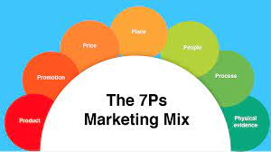
Theory 1 - Marketing Mix Theory
According to Huang et al. (2021), another name for marketing mix theory is the 4 Ps of marketing strategies. To effectively market a good or service, the 4 Ps are the main factors that must be carefully examined and put into practice; price, product, promotion, and place. They include a span of elements that are to consider when marketing an item, like what customers would like, the way the goods or services fulfill or fail to satisfy consumers' desires, how the goods or services are viewed worldwide, the way they stand out from the competitors, and the way the business that generates the products connects with its consumers. More Ps, such as people, procedures, and physical evidence, have been discovered because the 4 Ps initially appeared in the 1950s.
Notes:
Hailu et al. (2021) posit that the four fundamental components of the drug advertising mix, commonly known as the 4Ps of marketing, were first proposed by Borden in 1964. For a company to achieve the desired amount of sales in the market that it is targeting, the 4Ps must be linked to one another so that doctors can generate orders for prescriptions and for the product to find its way to customers.

Slide 5

How organisations are using this theory - Johnson & Johnson
The pharmaceutical industry's leading income and earnings source is prescription drug marketing. To boost sales of drugs, Johnson & Johnson pharmaceutical company frequently use various marketing techniques. Since manufacturers view doctors as making medication sales decisions, eighty-four percent of drug advertising campaigns focus on them. The majority of drugs company and wholesaler businesses invest a lot of time and resources in marketing to persuade doctors to use their products.
Notes:
Hailu et al. (2021) further state that despite the descriptions of drugs' medical procedures and WHO algorithms of morals governing the marketing of drugs prescriptions, there are still unjust business actions that affect prescribers' choices by promoting biased data marketing and further involved in making higher gains to the organization. The company uses a variety of strategies to advertise its goods, including giving away gifts, providing free meals, promotions, and funding schooling and vacations as incentives that motivate physicians to give a prescription with no scientific proof. These physician-directed marketing campaigns are now under increasing public inspection as pharmaceutical spending rises and drug safety concerns multiply. Therefore, drug manufacturers must develop their marketing mix tactics to maintain their ethical standards. They must comprehend how their marketing strategies affect prescribing drug preferences of physicians.

Slide 6
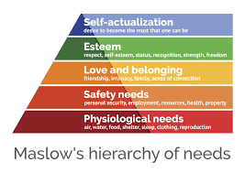
Theory 2 - Maslow's Hierarchy of Needs
According to Nyarko et al. (2021), Maslow's hierarchy of needs asserts that all people must meet basic needs. These can vary from safety and physiological requirements to more intangible ones like affection, esteem, or self-actualization. In spite of being imaged as a pyramid in common customs, study reveals that not all requirements are met for the other to be fulfilled, thus offering businessmen a platform to select each market specifically, and each customer tries to suffuse it. Maslow's requirements give you a framework for your marketing strategy.
Notes:
You can tailor your marketing to attract an individual's requirement for respect, affection, and fulfillment or their fundamental survival requirements. In spite of probable customs contrast, research shows that these needs are universal. The comprehensiveness of this hierarchy of needs provides endless options used in marketing strategies and specifically for the buyer persona. Nyarko et al. (2021) claim that Ghanaian market women strategically identify prints from Africa to increase sales since the populace values symbolism and admires artwork supported by ideologies. Over the decades, researchers have drawn influence from Maslow's hierarchy of needs. Academics across many fields have studied renowned models but have yet to focus on speculative textile fabric design.

Slide 7


How organisations are using this theory - Akosombo Industrial Company Limited
Akosombo Industrial Company Limited, based in Ghana, relies highly on Maslow's hierarchy of needs in its operations. To inspire the innovative skills of linen designers and Ghana's textile manufacturing industries to satisfy consumer demands, thus contrast textile surface aesthetics with philosophical viewpoints. Maslow's hierarchy of needs is investigated using a research methodology rooted in the art studio for conceptual textile surface design; following a market analysis, five concepts of textile fabric designs were produced at the workshop to represent the different stages of Maslow's hierarchy of needs. The worth of the locally produced prints would increase if philosophies were incorporated into textile surface designs. Therefore, companies printing textiles within the locality are advised to adopt conceptual linen designs in their works to appeal to the locals.
Notes:
The authors further state that American executives use philosopher Maslow's order of wants through instances of job reinvention initiatives at TI and leadership instruction at marketing agency children, and Rubicam, he shows how a team of managerial experts applies the framework of needs to administration. The order of wants stayed with executives, and there is a dispute since it appeared to provide both a solid lead for executives, with feasible repercussions for building leadership educating and job frameworks, with a wider interpersonal concept that claimed to clarify evolving social principles and monetary events in America. The company offered both a perfect environment for individuals to satiate their most basic emotional requirements and the ideal location to research and foster motivation, according to leadership theorists who cited the hierarchy of wants. The history of mental health that this essay adds to demonstrates how psychology rose to prominence in American society as a whole.

Slide 8
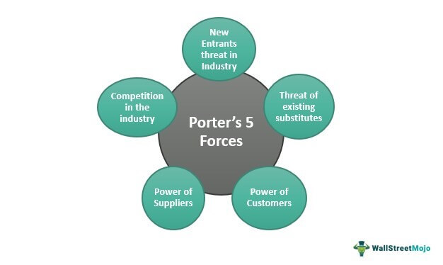
Theory 3 - Porter's Five Forces
According to Juliana et al. (2019), Porter, a specialist, and educator at the University of Harvard, developed the model known as Porter's Five Forces in 1979 to define the structure as an evaluation of a company's growth. Both small and large companies, those that are already operating and those that are just getting started, can use this strategy. In business analysis, Porter created the most crucial factor analytic model. He additionally contributed to the broad concept of competence and competitive advantages.
Notes:
The paradigm comprises five key components: The negotiating power of sellers, the ability to bargain with buyers, Threats posed by new competitors, Threats posed by substitute goods or services, and Competition among businesses.

Slide 9

How organisations are using this theory - Newmont Mining Company
Isabelle et al. (2020) allude that the mining business is chosen to compare it with the information technology sector because it is a costly, resource-driven industry. It is working in discovering, removing, and manufacturing mineral substances. The mineral extraction sector has strong historical origins in global commerce, economics, and business. The world's most prominent forty mining firms earned 683 billion United States dollars in income in 2018. Newmont Mining Company which is based in the United States is one of the firms that relies much on Porter's five forces. The mining industry's raw minerals support the fourth manufacturing revolution. Mining requires significant global involvement because it is based on resources business. Only certain geological regions are home to minerals and metals, which restricts activities there before being shipped and sold worldwide. Consequently, for it to operate, a global network is needed.
Notes:
Isabelle et al. (2020) further claim that the overall activities of mining companies comprise four different cycle phases: discovery, creation, manufacturing, and closure. Although every mining site goes through this phase of life, some businesses have been prompted to grow through acquisitions and mergers due to the high costs of initial evaluation, exploration, and building. We frequently witness global corporations integrating more localized, smaller businesses into their operations. Therefore, globalization is already a significant factor to extractive firms that must succeed. Foreign exchange risk is an essential factor to take into account for any foreign business venture, but it is necessary for the mining sector because of the wide geographic distribution of its players; therefore, Porter's five forces help ensure the smooth running of the mining industries.

Slide 10

Conclusion
It is important to understand marketing theories because you can better comprehend the requirements of your buyers, inspiration, and goals by using theories of marketing. They also help in your understanding of the industry in your job. You consequently make comprehensive social media plans. The four 4 Ps of marketing are helpful when an entrepreneur needs to set up a business; the four factors need to be put into consideration; porters five forces help manage both large and small businesses, while Maslow's hierarchy of needs aids in identifying the needs of consumers basing on their importance.

Slide 11
References
Hailu, A.D., Workneh, B.D. and Karissa, M.H., 2021. The influence of pharmaceutical marketing mix strategies on physicians' prescribing behaviors in public and private hospitals, Dessie, Ethiopia: a mixed study design. BMC public health, 21(1), pp.1-15.
Huang, M.H. and Rust, R.T., 2021. A strategic framework for artificial intelligence in marketing. Journal of the Academy of Marketing Science, 49, pp.30-50.
Isabelle, D., Horak, K., McKinnon, S. and Palumbo, C., 2020. Is Porter's Five Forces Framework Still Relevant? A study of the capital/labor intensity continuum via mining and I.T. industries. Technology Innovation Management Review, 10(6).
Juliana, J.P.E. and Nyoman, Y.N., 2019. Factors influencing the competitiveness of small and medium industry of Bali: Porter's five forces analysis. Russian Journal of Agricultural and Socio-Economic Sciences, 89(5), pp.45-54.
Nyarko, M.O., Fobiri, G.K., Schall, M., Asare, T.O. and Yussif, A.R.S., 2021. Maslow's theory of needs is a spice in conceptual textile surface designing. IDA: International Design and Art Journal, 3(2), pp.234-245.

