Slide 1

Name: Adenike Kuku-ogunfeibo
Student Number: 2329249
Care, Empowerment and Support Needs of Older People

Slide 2

INTRODUCTION
An ageing population in the UK refers to a demographic change in which the proportion of older people, typically those aged 65 and over, increases relative to younger age groups. This results in a rise in the medium age of the population and reflects factors such as increased life expectancy and declining birth rates (Centre for Ageing Better, 2023).
Ageing involves physical, psychological and social changes. In the UK, older people have different needs depending on their health, income, housing and family support. Many remain active and independent, while others require health and social care.
Empowerment enables older adults to make informed choices, maintain independence and participate in decisions about their care. The Care Act 2014 promotes wellbeing, dignity, personal choice and independence, improving older people’s quality of life. (Great Britain, 2014).

Slide 3
Why does the ageing population matter in the UK?
Increased life expectancy: More people are surviving to older ages due to improvements in healthcare, living conditions and medical treatment.
Growth in the oldest age groups: The Office for National Statistics (ONS, 2025b) estimated that approximately 625,000 people in the UK were aged 90 and over in 2024, representing a 53.7% increase compared with 2004.
More people living to 100: Around 16,600 people in the UK were aged 100 and over in 2024, highlighting the growth of the oldest population groups (ONS, 2025b).
Greater demand for care services: As more people live into older age, demand may increase for primary healthcare, rehabilitation, residential care and domiciliary care.
Housing and independent living: Older people may require home adaptations, accessible transport, assistive technology and support with daily activities to maintain independence.
Pressure on health and social care: An ageing population can increase demand for care workers, healthcare professionals and long-term care funding, particularly when people live with multiple long-term conditions.
Individual differences: Not all older people require care. Their needs depend on their physical and mental health, financial situations, social networks and living environment.

Slide 4

Health and Social Care Needs of Older Adults
Physical needs: Providing assistance with bathing, dressing, mobility, continence, nutrition and medication management, while promoting independence, maintaining personal hygiene, ensuring comfort and preventing falls.
Psychological needs: Offering emotional support to individuals experiencing dementia, anxiety, depression or bereavement, while promoting mental wellbeing, providing reassurance, reducing distress and maintaining dignity.
Social needs: Encouraging individuals to maintain relationships, reduce loneliness, participate in community activities, enjoy meaningful interactions and remain connected with family, friends and wider society. (National Institute for Health and Care Excellence, 2015)

Slide 5
Life Course Theory of Ageing and Appplication
Understanding ageing: Life course theory explains how experiences, opportunities and life changes impact physical health, psychological wellbeing and social circumstances in later life (Elder, 1998).
Employment and income: Employment history and lifetime earnings affect financial security and health. Physically demanding work may cause chronic pain, while low income can limit access to care.
Housing and living conditions: Poor housing and financial difficulties can affect safety, independence and wellbeing, making it harder for older people to meet their care needs.
Discrimination and inequality: Discrimination and disadvantage can limit access to education, employment and healthcare, contributing to poorer health outcomes and increased vulnerability during later life.
Caring responsibilities: Long-term caring responsibilities can cause emotional stress, physical exhaustion and financial difficulties, potentially affecting pension savings and personal wellbeing during retirement.
Access to healthcare: Restricted healthcare access can result in untreated conditions and complications, affecting an individual's mobility, independence and overall quality of life in later life.
Application social care and health practice: Practitioners consider individuals' life histories and circumstances to understand their needs, recognise accumulated disadvantages and provide appropriate, personalised support.
Benefits of the theory: The theory promotes person-centred care by recognizing individual life experiences and helping practitioners develop support plans reflecting personal circumstances, preferences and needs.

Slide 6
Continuity Theories of Ageing
Continuity Theories of Ageing
Understanding continuity theory: Atchley’s continuity theory suggests that older people adapt to later life by maintaining familiar identities, routines, relationships and values, supporting stability and wellbeing (Atchley, 1989).
Person-centred care: Care staff should understand individuals’ life histories, preferred routines, cultural backgrounds, religious beliefs, hobbies and relationships to provide personalised care that respects their identity (Kitwood, 1997).
Application in care settings: In residential and home care, maintaining familiar routines, consistent staff and reliable visit times can build trust, promote independence and help individuals feel secure and valued (Atchley, 1989).
Limitations of the theory: Continuity theory may not suit everyone, as some individuals prefer new experiences or need different routines. Care staff should respect personal choices and avoid imposing familiar routines (Atchley, 1989; Kitwood, 1997).

Slide 7
Applying Continuity and Life course Theories
Understanding personal history: Life course theory helps experts understand how past experiences, employment, income and social inequalities influence an individual's circumstances in later life (Elder, 1998).
Maintaining identity: Continuity theory encourages care staff to preserve familiar routines, relationships, values and interests that support older people's identity and emotional wellbeing (Atchley, 1989).
Person-centred care planning: Combining both theories helps experts develop personalised care plans that consider life experiences, individual preferences, cultural backgrounds (Elder, 1998; Atchley, 1989).
Limitations and individual needs: Practitioners must avoid stereotypes by respecting personal choices, conducting appropriate assessments, fulfilling safeguarding responsibilities and adapting care as individuals' needs and preferences change (Kitwood, 1997).

Slide 8

Care Act 2014
Person-centred care and wellbeing: The Care Act of 2014 prioritises each person's well-being in England's adult social care system. This fosters self-respect, autonomy, mental and physical well-being, individual autonomy, interpersonal connections, and community involvement. Local governments must also evaluate qualified care requirements and provide assistance to carers.
Prevention and implementation: The Act fosters collaboration between health and social care agencies and early intervention to stop needs from getting worse. Despite their legal rights, people may find it difficult to get the care they require due to a lack of funds, staffing shortages, and service availability (Care Act 2014).

Slide 9

Equality Act 2010
.
Protection from discrimination: People are protected against illegal discrimination, including that based on age and disability, by the Equality Act of 2010. In order to guarantee that older folks receive fair and appropriate care, it encourages equitable access to services and mandates acceptable accommodations for disabled individuals in pertinent situations.
Equality in practice: Health and social care providers should accept diversity, treat people equally, and remove obstacles that stand in the way of equitable access to services. Nonetheless, discrimination may still happen in real life, underscoring the significance of employee education, easily accessible resources, and efficient complaint processes (Equality Act 2010).

Slide 10
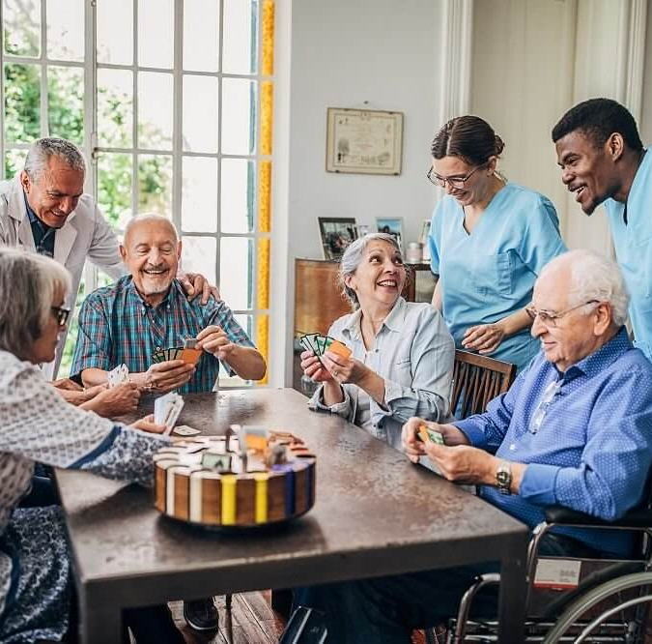
Current Health and Social Care Services for Older People
C
NHS services: The NHS provides primary healthcare, hospital treatment, rehabilitation, dementia assessments and palliative care to support older people's health and wellbeing (CQC, 2024).
Local authority and community services: Local authorities assess care needs, organize safeguarding and arrange eligible support, while charities provide supporting, transport, advocacy and social activities (Age UK, 2024).
Coordination and access challenges: This depends on eligibility, finances, local availability and family support. Lack of coordination between health and social care can leave older people without appropriate support (CQC, 2024; Age UK, 2024).
Residential and Nursing Homes: Residential homes provide accommodation and personal care, while nursing homes also offer professional nursing care.

Slide 11
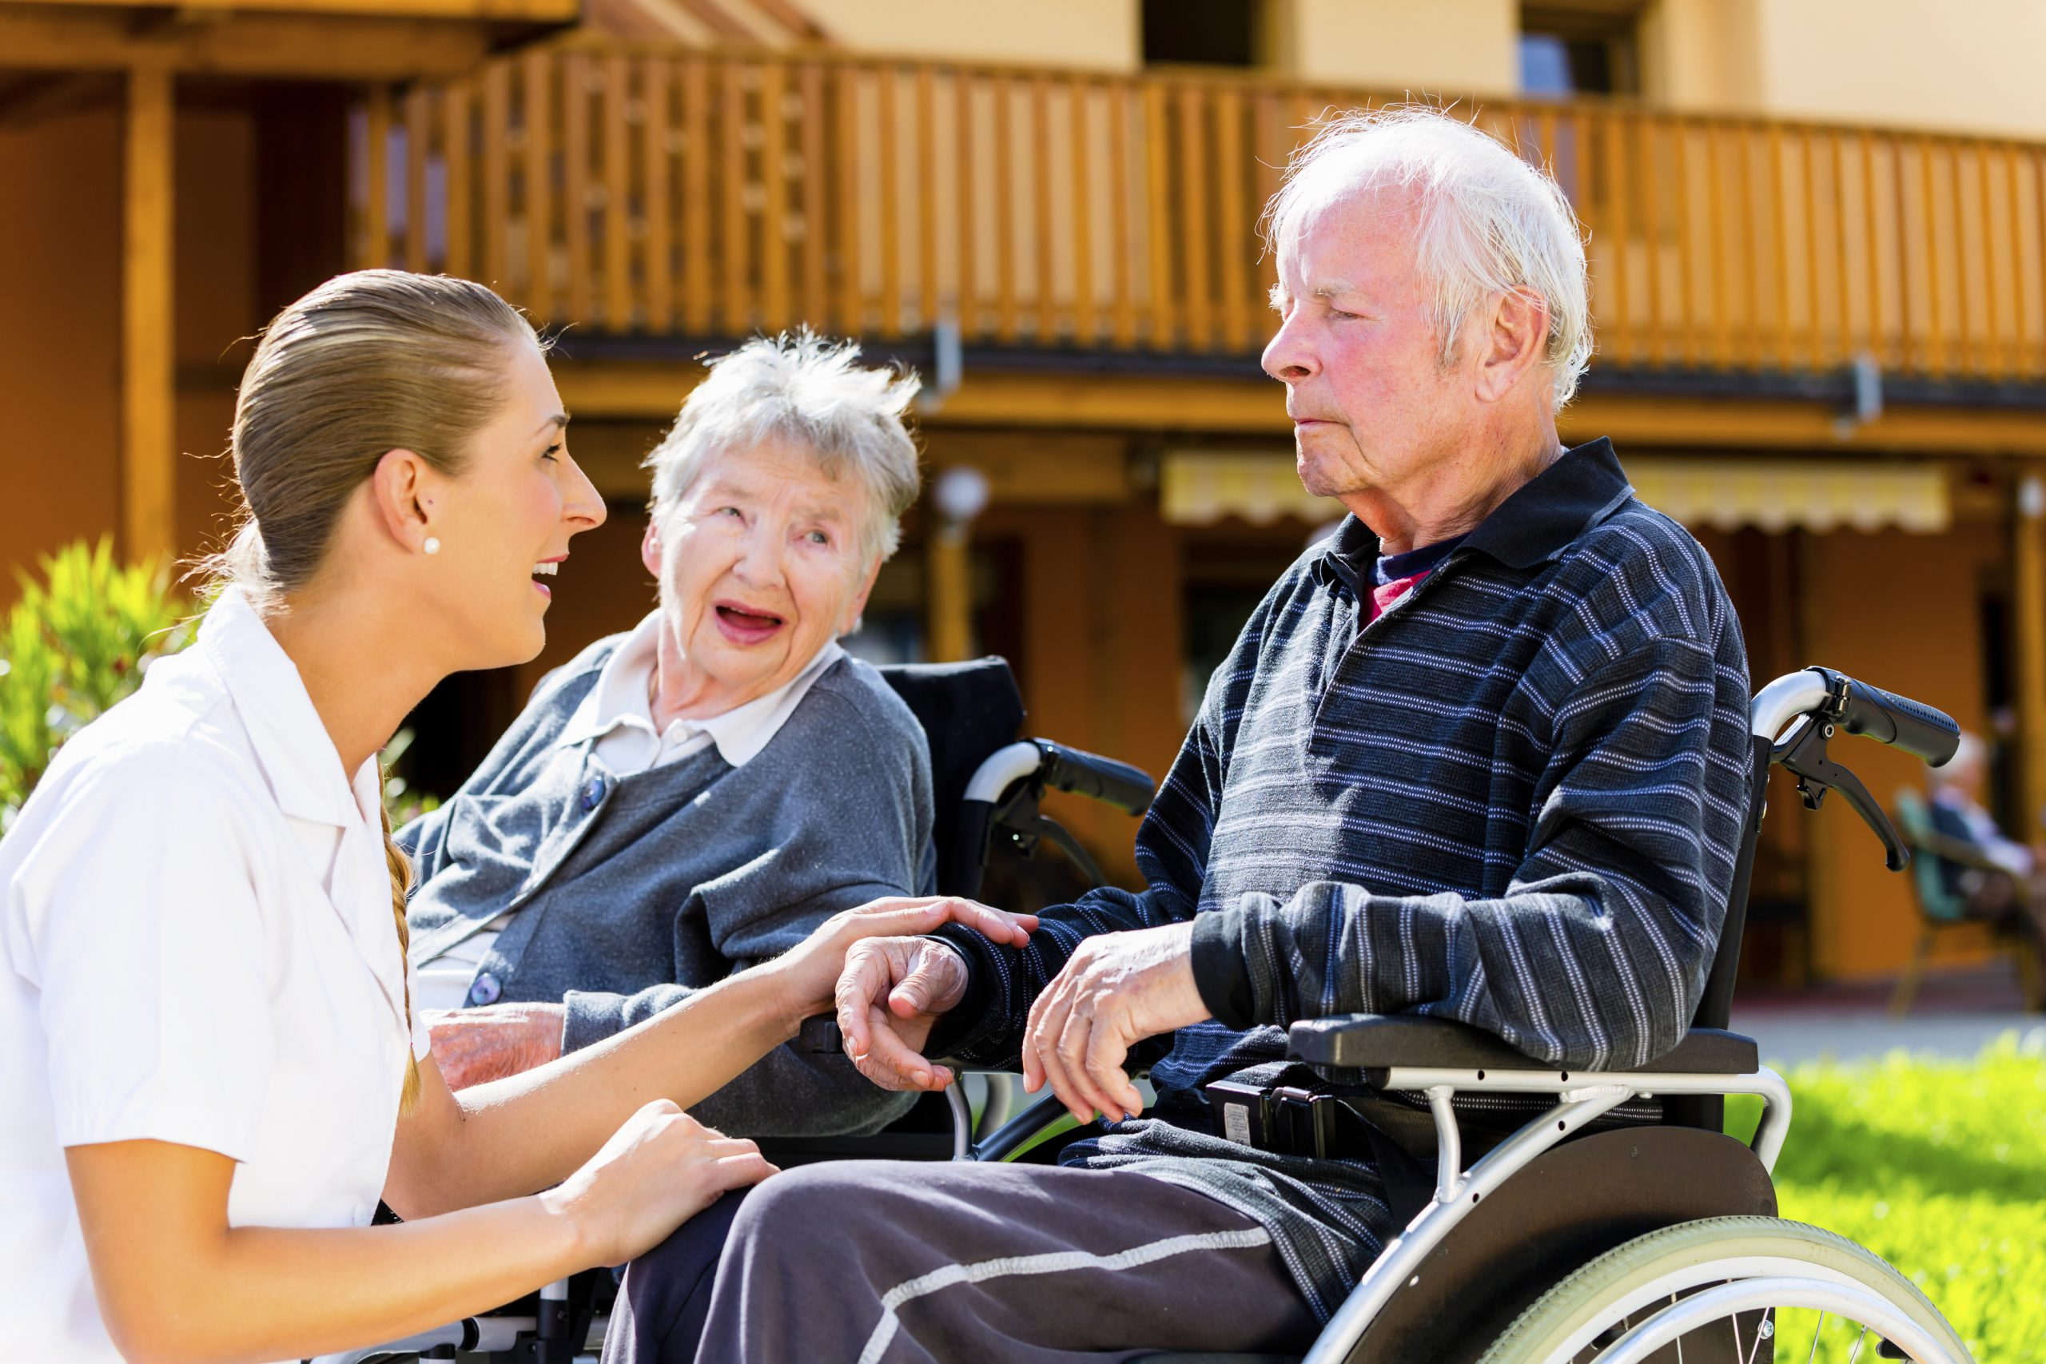
Residential Care for Older People, Support, Benefits and Challenges
Residential Care
Definition: Residential care involves living in a care home where staff provide accommodation, meals, personal care and daily support to older people who need assistance.
Benefits: Residential care offers continuous support, supervision, regular meals and opportunities for social interaction, helping older people maintain safety, receive assistance and reduce loneliness.
Limitations: Moving into residential care may affect privacy, independence, familiar routines and community relationships. The suitability of care depends on individual needs, preferences and circumstances (CQC, 2024).
Domiciliary Care, Support , Benefits and Challenges
Definition: Domiciliary care, also called home care, involves care workers visiting individuals in their own homes to assist with personal care, medication and daily activities.
Benefits: Home care allows older people to remain in familiar surroundings, maintain relationships, preserve independence and follow preferred routines while receiving personalised assistance (CQC, 2024).
Limitations: Short visits, missed appointments and changing care workers may affect safety, continuity and emotional wellbeing. Suitability depends on assessed needs, home safety and available support (CQC, 2024).

Slide 12

Challenges in Adult Social Care
Challenges in care needs: Age UK (2024) estimated that two million people aged 65 and over in England had unmet needs, including difficulties dressing, bathing and walking.
Delays in care provision: CQC (2024) reported that care-home bed and home-care waiting times accounted for 45% of delays affecting patients hospitalised for at least 14 days.
Staffing shortages: Skills for Care (2025) reported a 6.8% vacancy rate in England's adult social care sector during 2024/25, highlighting workforce recruitment and retention challenges.
Limited care choices: Unmet needs, staffing shortages and service delays can restrict access to suitable care. Consequently, older people may struggle to obtain affordable home or residential support.

Slide 13

Remote Monitoring
Definition: Telehealth uses telephone or video consultations, while remote monitoring tracks health readings, helping professionals assess patients and provide follow-up care remotely (NHS England, 2023).
Virtual wards: Virtual wards allow selected patients to receive hospital-level care at home through clinical supervision, health monitoring and clear plans for responding to deterioration (NHS England, 2023).
Benefits: Telehealth reduces travel, improves access for people with mobility difficulties and supports earlier identification of health problems through regular monitoring (WHO, 2015).
Limitations: Poor internet access, digital skills, costs, disabilities and privacy concerns can prevent older people from benefiting equally from telehealth services (WHO, 2015).
Safe implementation: Telehealth should complement face-to-face care through staff training, informed consent, accessible technology, clear escalation procedures and alternative in-person appointments (CQC, 2024).

Slide 14

Benefits, Risks and Ethical Considerations of Assistive Technology for Older People
Benefits: Assistive technology, including personal alarms, fall detectors and medication reminders, can improve safety, independence and confidence, helping older people remain in their own homes (NICE, 2015).
Risks and limitations: Devices may fail because of battery problems, poor connectivity or false alarms. Therefore, technology cannot guarantee safety and requires regular checks and maintenance (WHO, 2015).
Privacy and evaluation: Continuous monitoring may affect privacy, consent and autonomy. Care professionals should ensure technology meets individual needs, preserves human contact and improves quality of life (NICE, 2015; WHO, 2015

Slide 15

Case Study Mrs P 85
Assessment of needs: Mrs P physical health, emotional wellbeing, daily activities, home environment and personal preferences should be assessed to identify appropriate support (Care Act 2014).
Home safety: An occupational therapist can recommend grab rails, adaptations to reduce falls, improved lighting and other, increase confidence and support independence (NICE, 2013).
Personalised care: Home-care visits, medication reviews and personal alarms can support daily living, improve treatment safety and provide reassurance with Mrs P. consent (CQC, 2024).
Technology and healthcare: Telehealth can support diabetes monitoring and follow-up appointments, while regular reviews ensure her care remains safe, effective and responsive to changing needs (NHS England, 2023; WHO, 2015).

Slide 16

The Six Principles of Safeguarding
Empowerment: Support individuals to make informed decisions about their care and safety, respecting their wishes, choices and consent wherever possible (DHSC, Care and Support Statutory Guidance).
Prevention: Take early action to prevent abuse, mistreatment, financial scams, medication misuse and carer stress before situations become more serious (DHSC, Care and Support Statutory Guidance).
Proportionality: Ensure safeguarding responses are appropriate to the level of risk and use the least intrusive intervention necessary to protect the individual (DHSC, Care and Support Statutory Guidance).

Slide 17
The Six Principles of Safequarding
Protection: Provide appropriate support, advocacy and representation to individuals experiencing abuse or neglect, particularly those who are vulnerable or unable to protect themselves (DHSC, Care and Support Statutory Guidance).
Partnership: Encourage cooperation between health professionals, social workers, local authorities, families and other agencies, sharing information lawfully to protect individuals (DHSC, Care and Support Statutory Guidance).
Accountability: Ensure safeguarding decisions are clearly documented, responsibilities are understood and practitioners are answerable for their actions. Technology alerts must be investigated sensitively rather than treated as proof of abuse (DHSC, Care and Support Statutory Guidance).

Slide 18
Recommendations for Improving Older People’s Care
Prevention and early intervention: To preserve independence, lower risks, and enhance wellbeing, invest in fall prevention, strength and balance programs, home modifications, and social prescribing (NICE, 2013; WHO, 2015).
Workforce and care options: Improve staff training, working conditions and career progression while providing malleable home care, enablement and residential care to meet individual needs (Skills for Care, 2025; CQC, 2024).
Inclusive technology: Provide accessible digital equipment, training, privacy protection and non-digital substitutes to ensure older people can benefit from technology without exclusion (WHO, 2015; NHS England, 2023).
Person-centred outcomes: Assess care based on people's self-assurance, independence, relationships, and personal preferences. To enhance lived experiences, address personnel constraints, budget shortfalls, and disjointed services (Care Act 2014; CQC, 2024).

Slide 19
Conclusion
The ageing UK population creates increasing demands and opportunities for health and social care services. Older people may experience physical health problems, loneliness, reduced independence and difficulties accessing suitable care (Age UK, 2024; CQC, 2024). The biopsychosocial model, life course theory and continuity theory help explain how physical health, personal experiences, social relationships and familiar routines influence wellbeing in later life (Engel, 1977; Elder, 1998; Atchley, 1989).
Services such as residential care, domiciliary care, telehealth and assistive technology can support older people to live safely and independently (NHS England, 2023; CQC, 2024). However, challenges including staff shortages, high costs, unequal access and digital exclusion must be addressed (Skills for Care, 2025; Age UK, 2024). Improving staff training, communication and collaboration between services can help ensure effective and coordinated care.
Ultimately, chronological age alone does not determine an individual's needs. Care should be person-centred, respecting each person's dignity, culture, preferences and right to make choices (Care Act 2014; Equality Act 2010). By combining appropriate support with meaningful relationships and opportunities for independence, health and social care services can improve quality of life and help older people feel valued, included and supported in society (Atchley, 1989; Kitwood, 1997).

