Slide 1


Group project
M5X00400
15/05/2020
Gareth Williams 1302811

Slide 2

Introduction
Logic One Automation is a small company based in Cross Hands, employing 7 staff in total.
Logic One Automation Ltd specialise in the design & manufacture of special purpose machinery mainly for the automotive industry.
Logic One Automation are an appealing option for our customers as we are able to take a project from a concept idea, through design & manufacture and right through to commissioning, all in house.
This presentation looks back at a project Logic One carried out for a local customer Marelli Automotive, and shows how the team was put together.

Slide 3



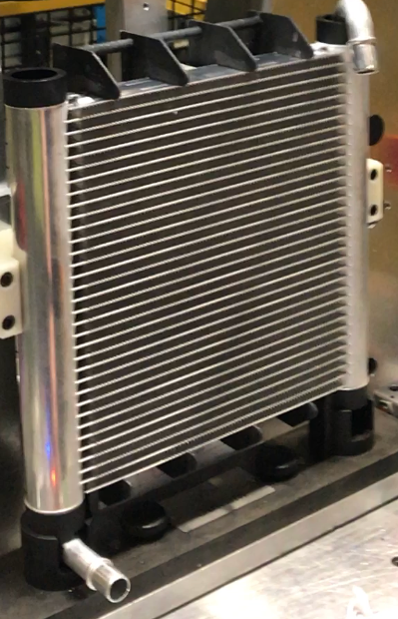
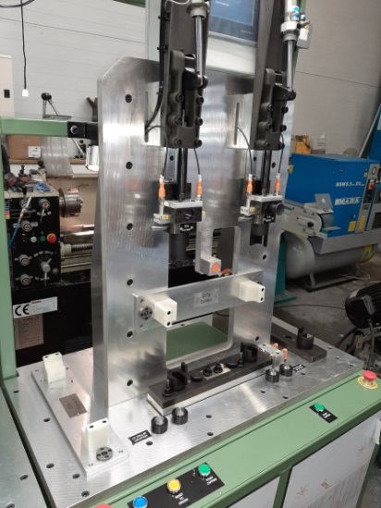
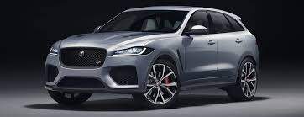
Initial Problem
Main Customer
OEM
Tier 1 Supplier
Media.jaguarlandrover.com (Mahwah, 2020)
(Automotive, 2019)
(Automation, 2020)
Daily Target – 800 Units | Day 1 | Day 2 | Day 3 | Day 4 | Day 5 | TOTAL
PASS | 752 | 769 | 758 | 753 | 746 | 3778
FAIL | 48 | 31 | 42 | 47 | 54 | 222
% FAILED | 6.38 | 4.031 | 5.54 | 6.24 | 7.24 | 5.88

Slide 4
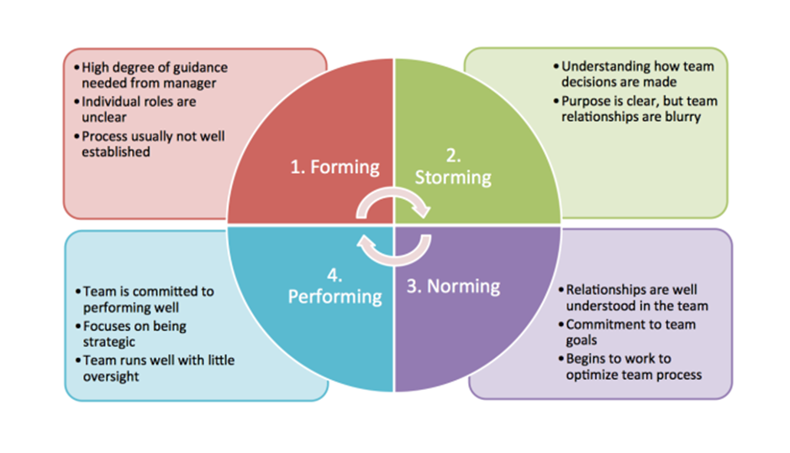
Tuckman’s Theory
(Carter, 2014)

Slide 5
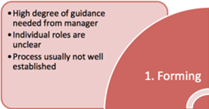
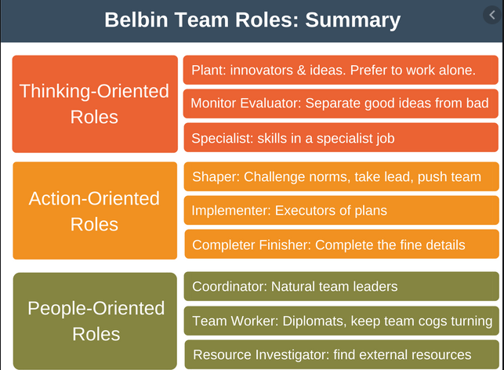
Setting up the team
(Management, 2017)

Slide 6
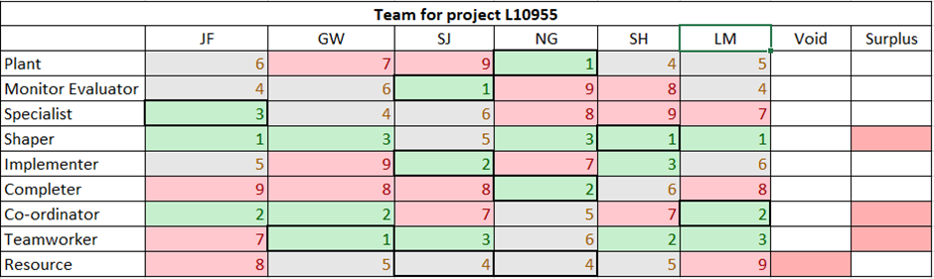
Self Perception Inventory
Individual | Position | Project Role | Belbin Role
Person A – LM | NPI Engineer – Marelli | Project Leader | Coordinator
Person B – NG | Electrical Engineer – Marelli | Electrical Process & Safety | Plant
Person C – SJ | Quality Engineer – Marelli | Test & Operation | Monitor Evaluator
Person D – SH | Director – Logic One | Project Manager | Implementer/Shaper
Person E – GW | Design Engineer – Logic One | Design | Team Worker/Resource Investigator
Person F – JF | Software Engineer – Logic One | Software Instillation | Specialist
Person G – JW | Automation Technician – Logic One | Manufacturing | Completer Finisher

Slide 7
SMART Objectives
S | SPECIFIC | To reduce % of failed parts from 5.88% to under 2%
M | MEASUREABLE | Daily shift test reports
A | ACHIEVABLE | Marelli & Logic One have agreed this to be achievable
R | RELEVANT | The current problem needs rectifying as too many parts are failing pressure test
T | TIME BOUND | New end capping machine to be completed by May 2020

Slide 8
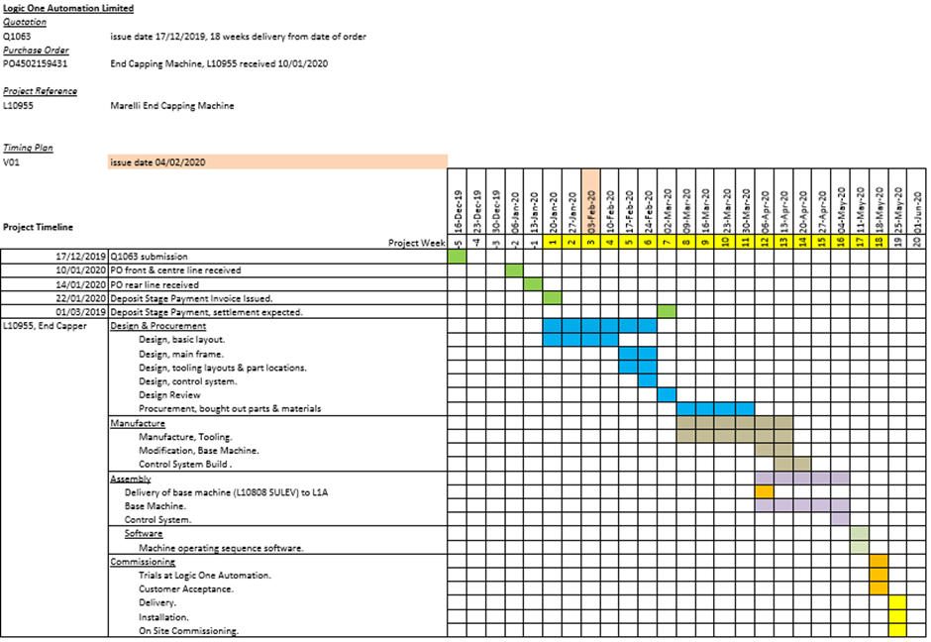
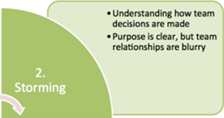
Timing Plan

Slide 9
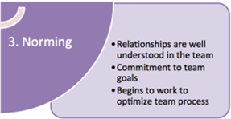
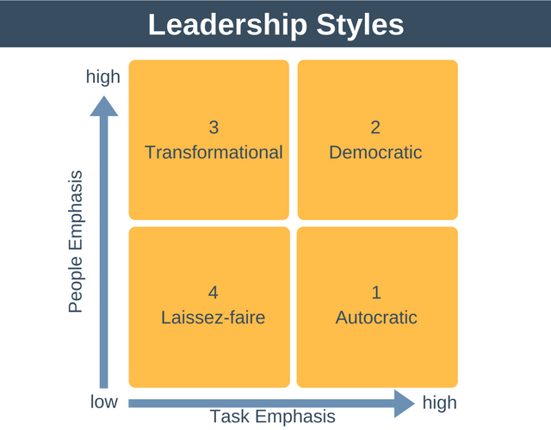
Leadership Styles
(Management, 2020)

Slide 10
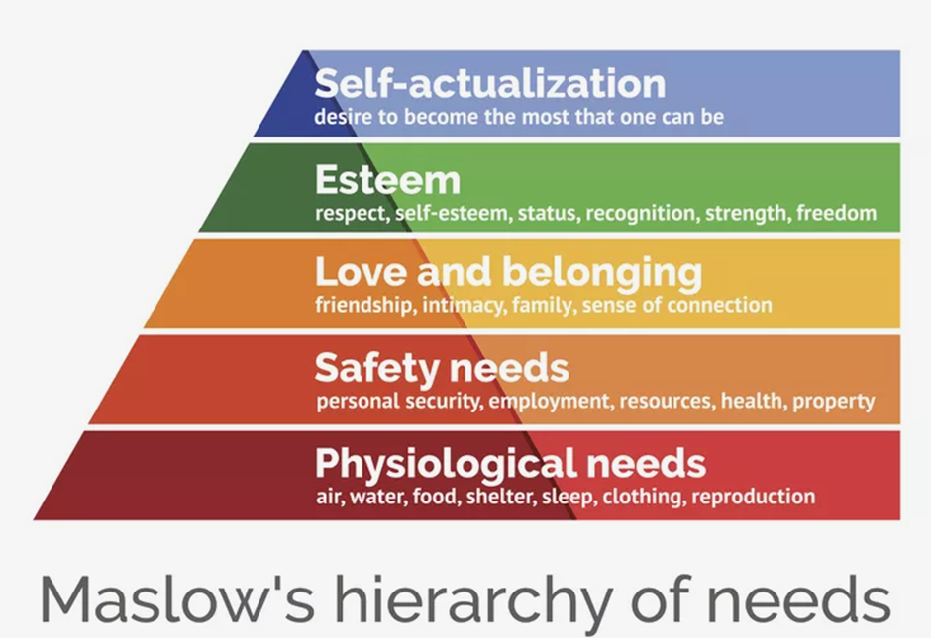
Maslow’s Hierarchy of Needs
(Hopper, 2020)

Slide 11
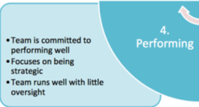
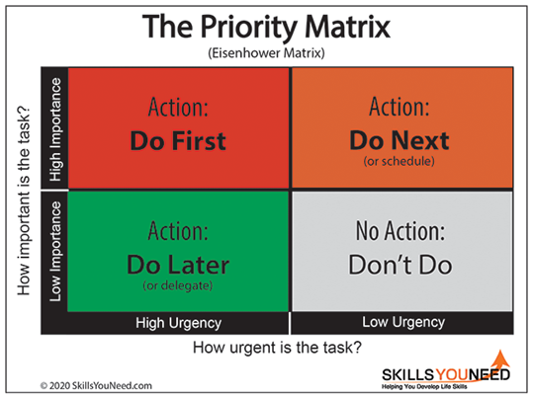
Time Management
(Need, 2020)

Slide 12
Conclusion
Test Result from new end capping machine.
Daily Target – 800 Units | Day 1 | Day 2 | Day 3 | Day 4 | Day 5 | TOTAL
PASS | 782 | 785 | 789 | 786 | 783 | 3925
FAIL | 18 | 15 | 11 | 14 | 17 | 75
% FAILED | 2.30 | 1.91 | 1.39 | 1.78 | 2.17 | 1.45

Slide 13
References
Automation, L. O., 2020. Logic1. [Online]
Available at: http://www.logic1.co.uk/
[Accessed 03 05 2020].
Automotive, M., 2019. Marelli-corporation. [Online]
Available at: https://www.marelli-corporation.com/en/global-network/group-companies/
[Accessed 03 05 2020].
Mahwah, N., 2020. Jaguar Land Rover. [Online]
Available at: https://media.jaguarlandrover.com/en-us/news/2020/04/jaguar-land-rover-announces-steps-support-customers-response-covid-19
[Accessed 03 05 2020].
Management, E. P., 2020. EPM. [Online]
Available at: https://expertprogrammanagement.com/2017/02/leadership-styles/
[Accessed 03 05 2020].
Carter, J., 2014. Team Building Activity. [Online]
Available at: https://www.teambuildingactivity.com/tuckmans-model/
ManagementCentre, 2010. [Online]
Available at: https://www.managementcentre.co.uk/high-performing-teams-belbins-team-roles/
Need, S. Y., 2020. Skills You Need. [Online]
Available at: https://www.skillsyouneed.com/ps/time-management.html
[Accessed 19 04 2020].
Hopper, E., 2020. Maslow's Hierarchy of Needs, s.l.: Getty Images.

Slide 14
Q&A

