Slide 1
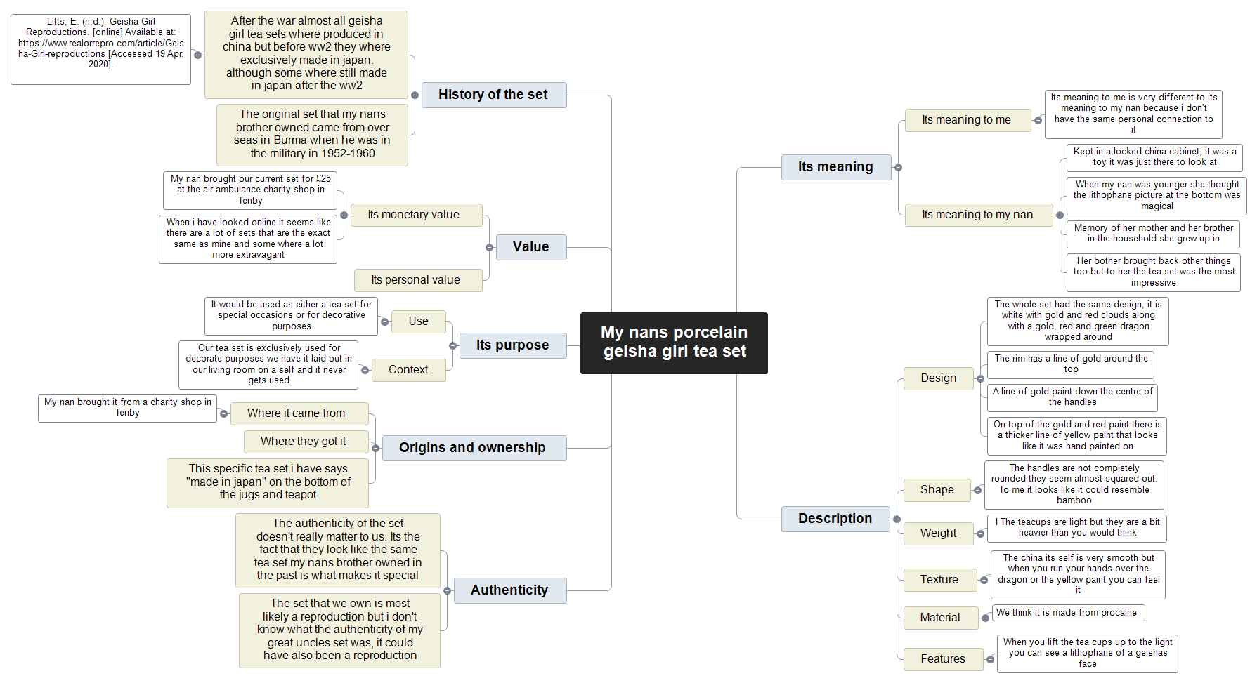

Slide 2
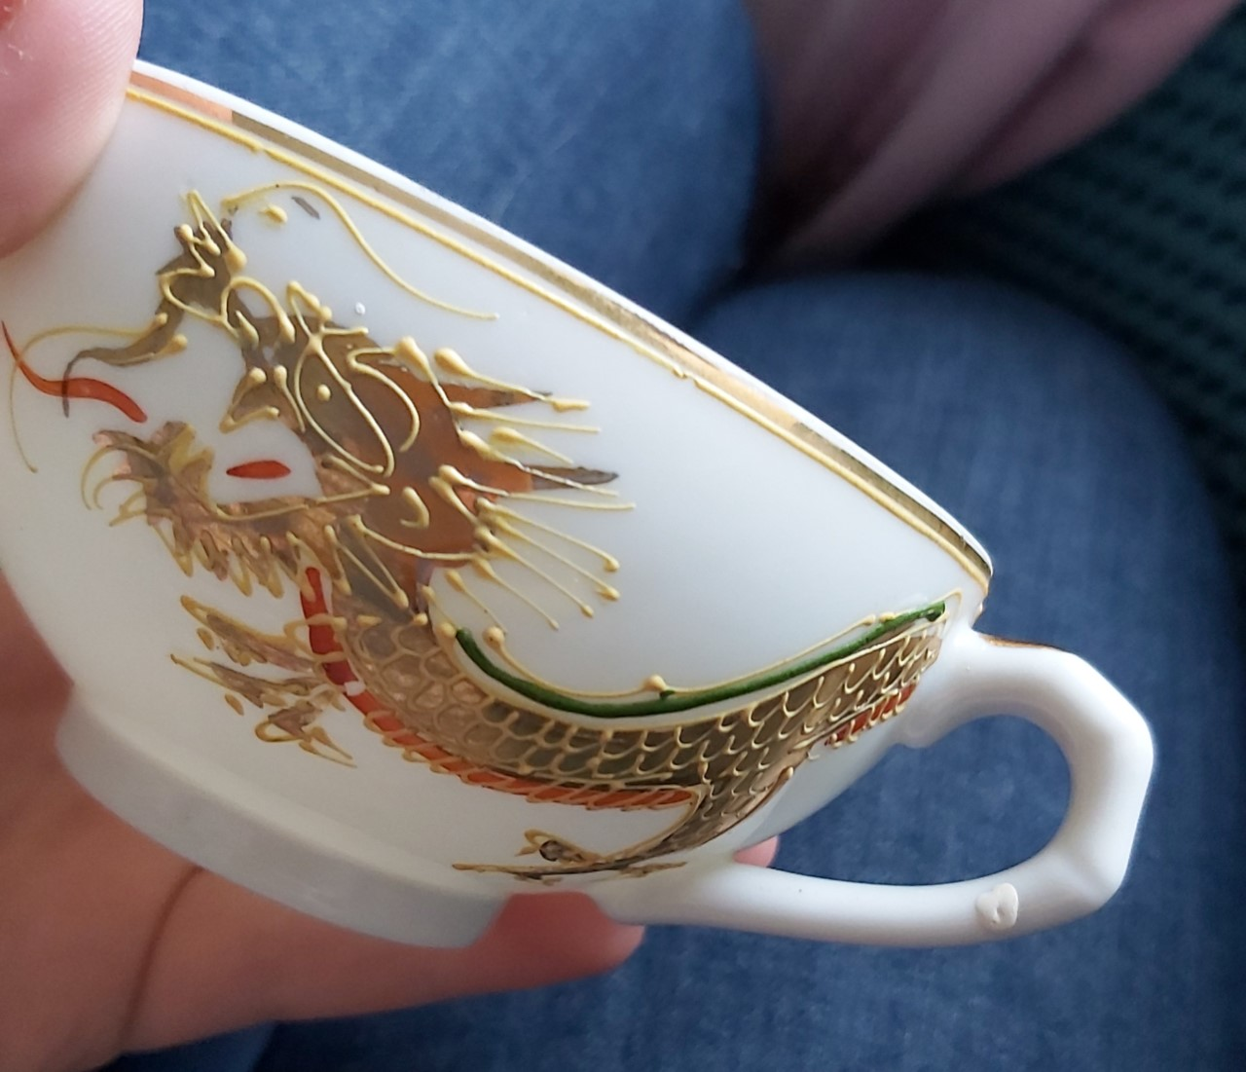
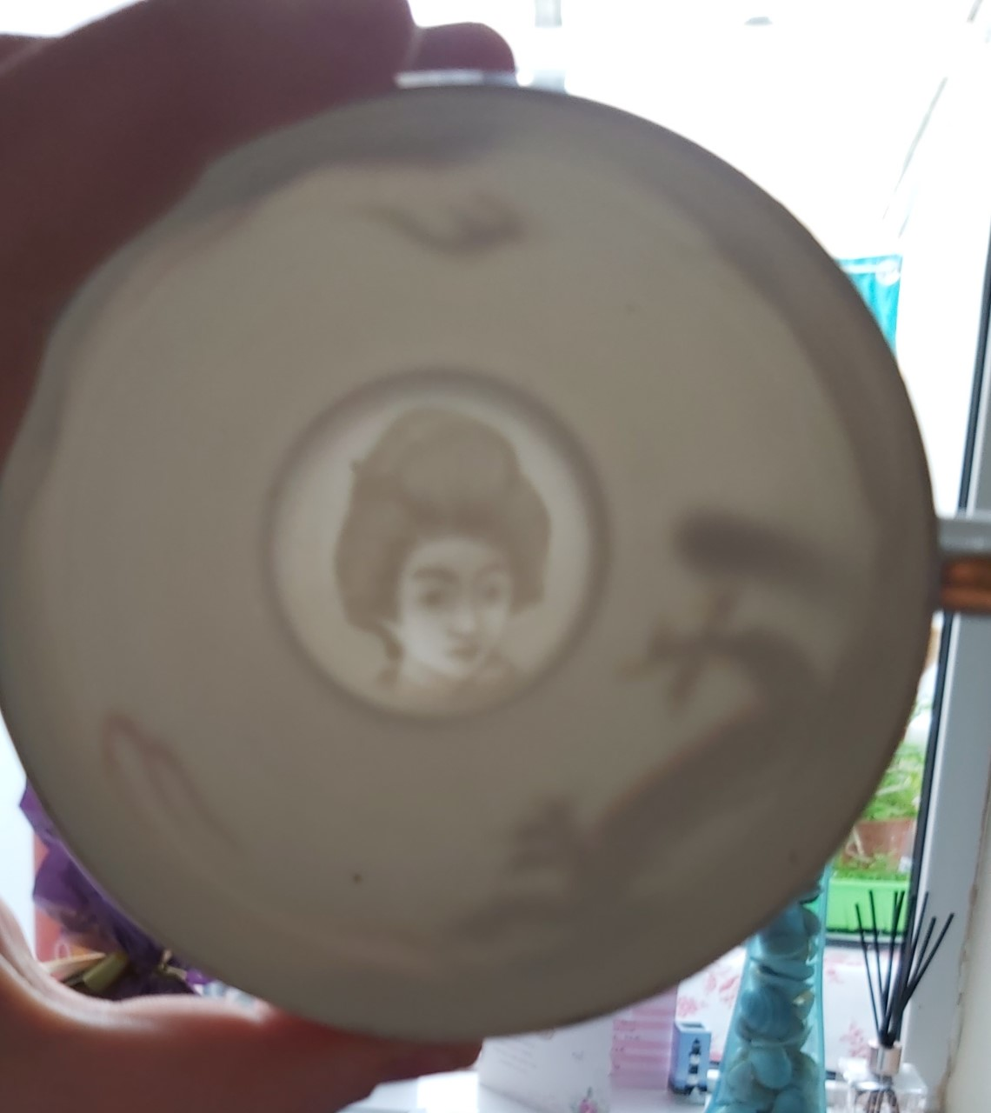
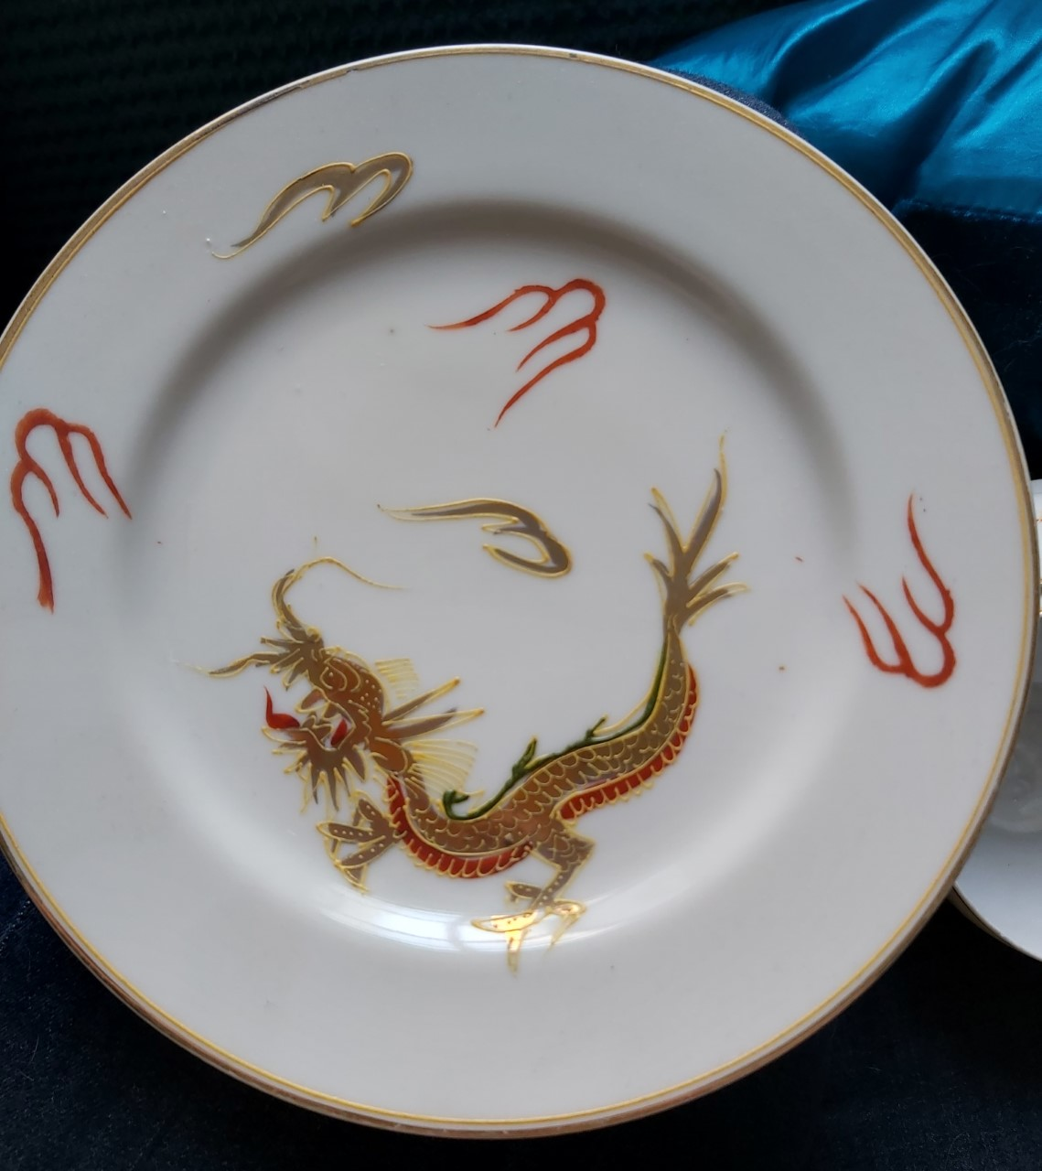
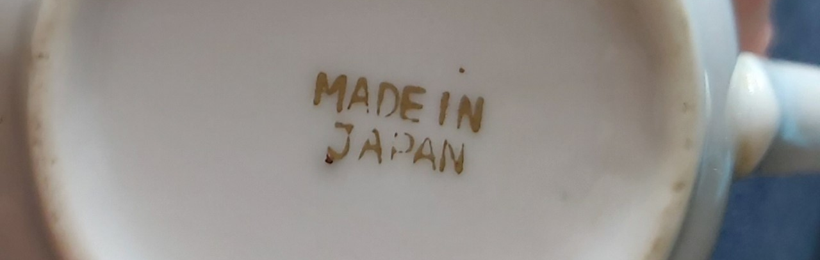
Pictures of the tea set
Figure 1
Figure 3
Figure 1 – this is the side of the tea cup showing the handle that could be shaped like bamboo with the front half of the dragon that wraps around the cup
Figure 4
Figure 2
Figure 3 – figure 3 shows the face of the geisha when it is held up the light, the face of geishas vary on the different kinds of tea set you have. Ours is called Pensive geisha.
Figure 2 – the made in japan scele, there was no stamping with a pattern just this
Figure 4 – this is a picture of the plate in the set that shows the dragon fully

Slide 3
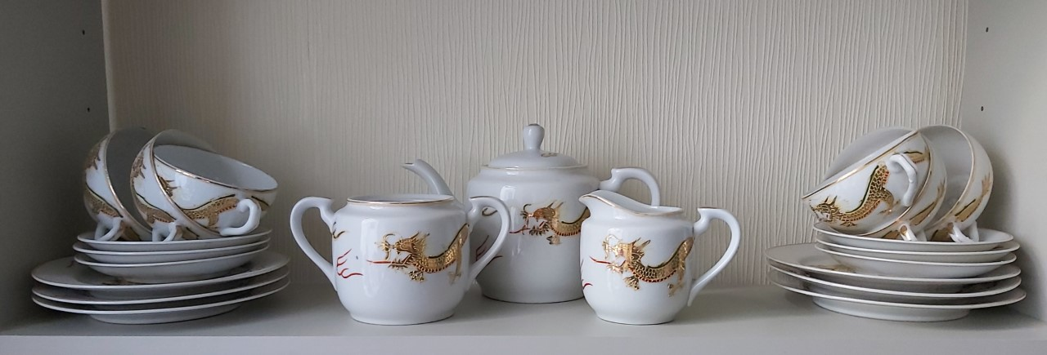
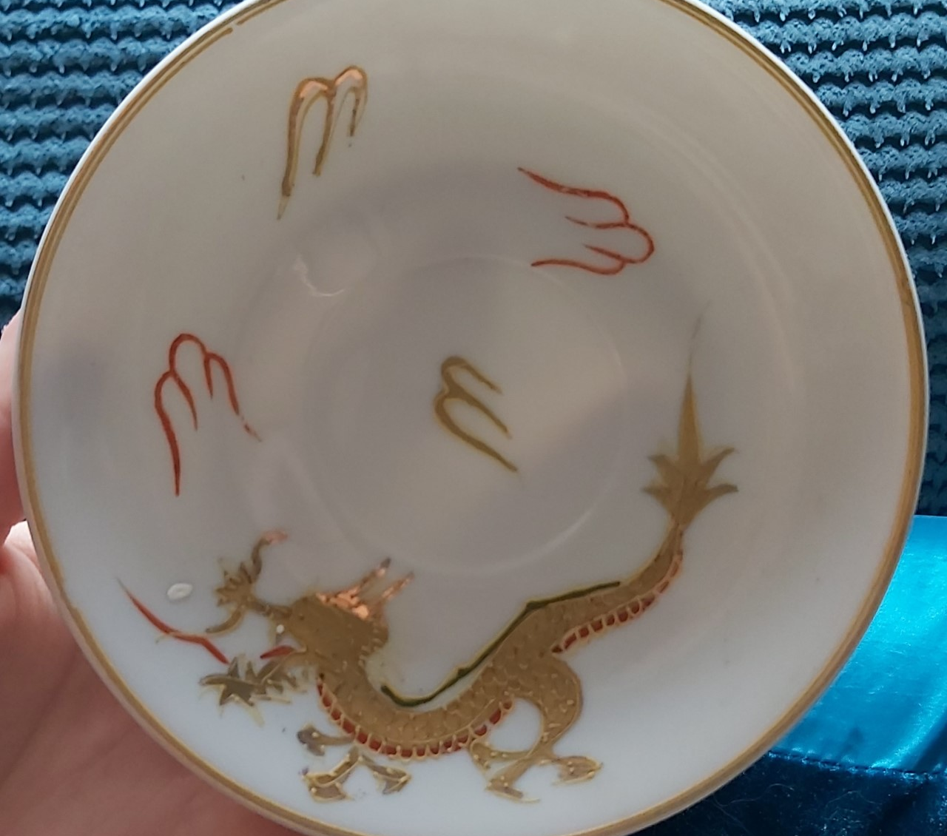
Figure 5
figure 5 – the saucers. The tea set as a whole Is called dragon wear
Figure 6 – a picture of the full tea set that is in out living room
Figure 6

Slide 4
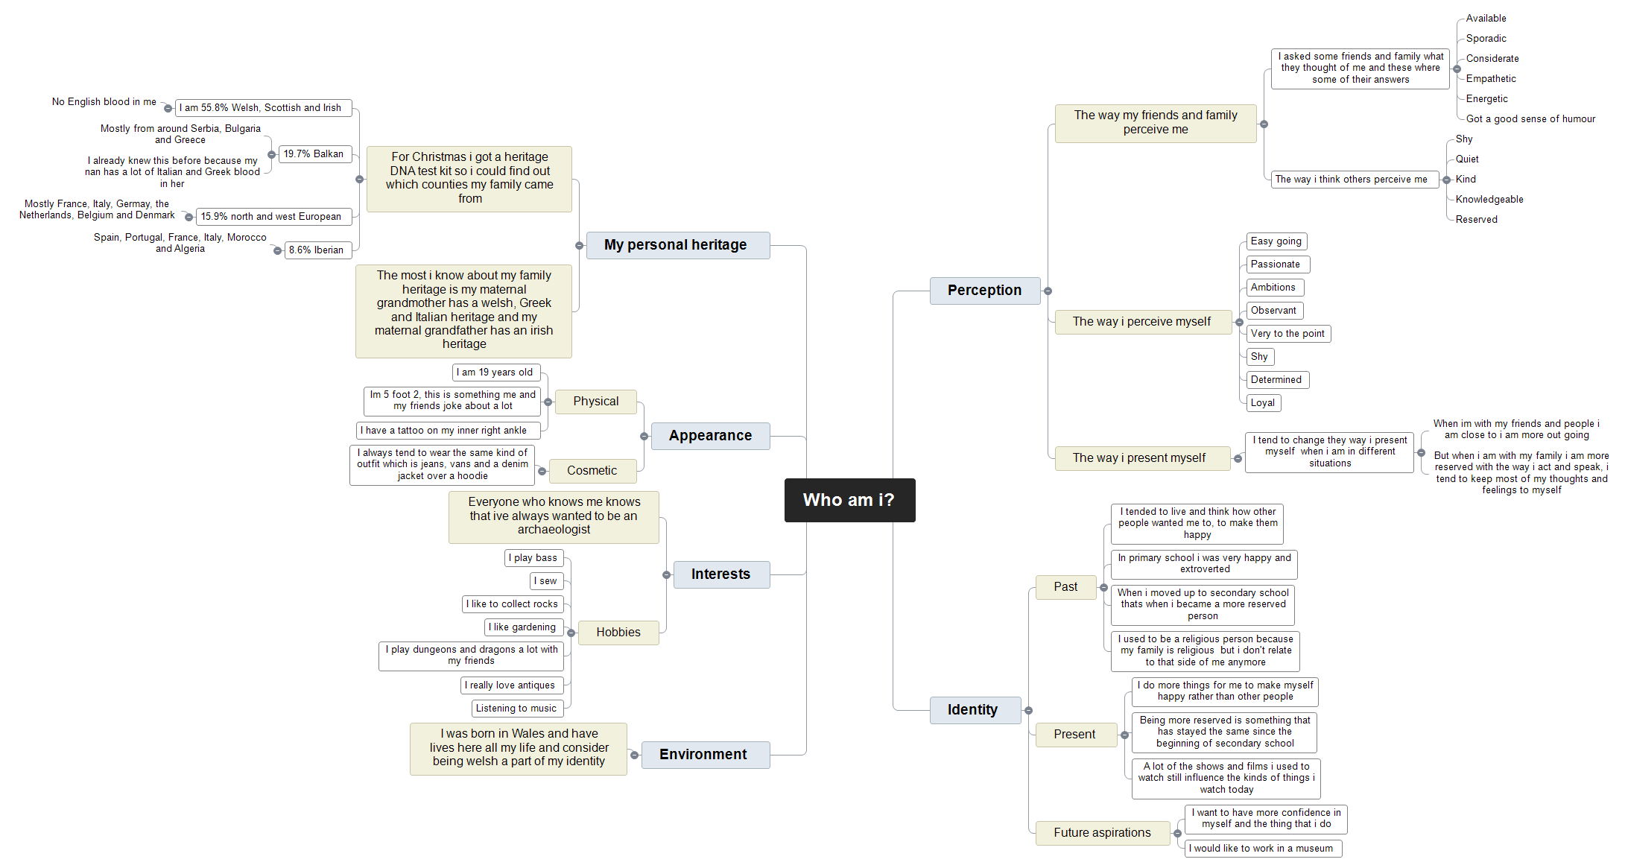

Slide 5


