Slide 1
LCHS4001
Academic and Employability Skills (ACE)
Time Management & Motivation

Slide 2
Aims of this session:
Discuss Time-Management and Motivation in a university setting
Understand the importance of effective time management to successful study
Understand the importance of maintaining motivation for success as a student

Slide 3
Discuss
In pairs or trios:
How would you personally define time management and motivation?
Why do you think time management and motivation are so important for university students?
What are some techniques you use for time management?
What are some ways you try and motivate yourself at work if you are feeling demotivated?

Slide 4
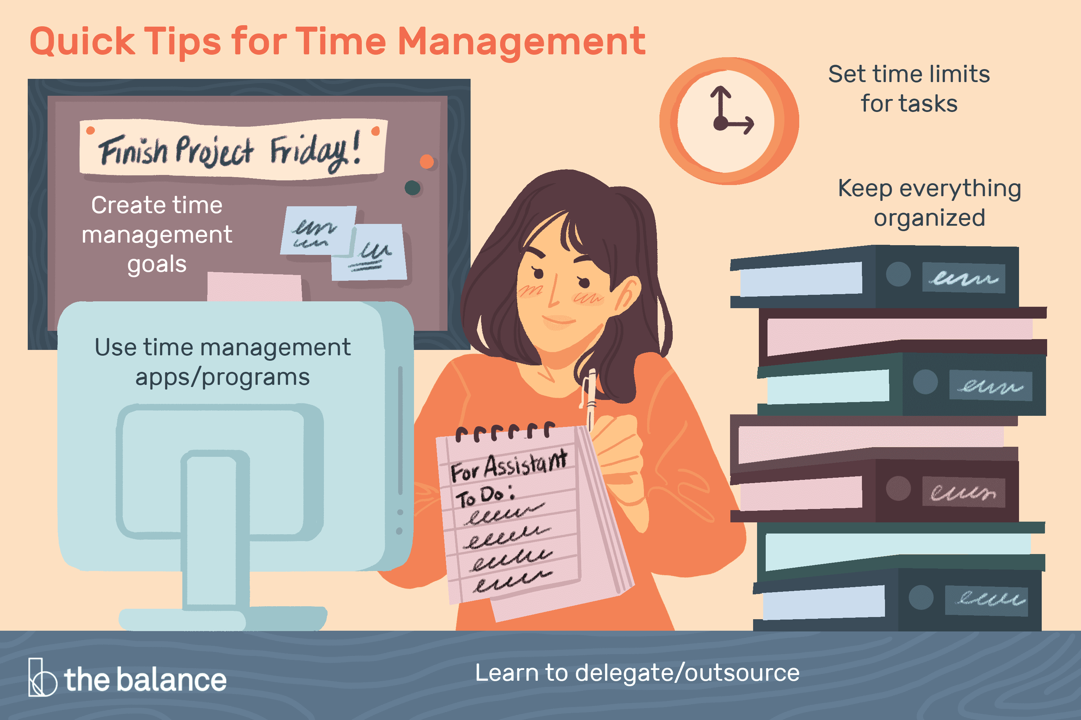
Time Management
Allocating time to study
Using that time effectively
Balancing the time requirements of different aspects of your life

Slide 5
Importance of time management
Time management increases your productivity and efficiency.
Time management can give you a sense of fulfilment.
Time management can decrease stress and anxiety.
Time management allows you to prioritise and complete activities to deadlines.
  (Cottrell, 2018)

Slide 6
Basic time management principles
You should direct your effort appropriately, that is, towards the things that are most important
You should direct your effort efficiently, that is, maximise what is achieved by the expenditure of time and energy
You should reduce time wastage
(Cameron, 2002)

Slide 7
Tools & Techniques
For Time Management
To-Do Lists
The Eisenhower Method/Matrix
Pomodoro Technique
SMART Goals

Slide 8
Motivation
Intrinsic Motivation: the drive to do something because it is enjoyable or interesting, not because of external rewards.
Extrinsic Motivation: the drive to do something because of external rewards or pressures, such as grades, money, or recognition.
Discuss: Which type of motivation do you think has been a stronger force for you in your life? Can you give some examples?

Slide 9
Importance of motivation
“Your level of motivation will affect your success. No matter how much you love your subject or want to gain a good degree, there may be times when you don’t feel like studying or wonder whether you would be better off doing something else. You need strong motivation to keep yourself going at such times”
(Cottrell, 2019, p.113)

Slide 10
Motivation: Influences
Motivation to study is affected by such things as:
★ Clarity of purpose
★ Being on the right course
★ Managing the ‘boring bits’
★ Confidence of the outcome
★ Using time well.
(Cottrell, 2019, p.113)

Slide 11
Extension Activity: Review your use of time
Do I use time efficiently?
How do I waste time?
What or who distracts me from study?
Do I need to plan out my time: for the year? The term? The week? The day? Each piece of work?
Do I waste time getting started?
Do I make the most of spare moments?
Do I find time passes and I don’t know what has happened?
For each question answer honestly and consider if you need /want to make improvements and what they might be.
(Cottrell, 2019)

Slide 12
Extension Activity: Assess your Motivation
P.g.113 in Cottrell’s (2019) The Study Skills Handbook: How Strong is Your Motivation
UWTSD Home Page>Study> Library & Learning Resources> Search: Cottrell, Select The Study Skills Handbook Proquest online text

Slide 13
REFERENCES
Cottrell, S. (2019). The study skills handbook. 5th edn. London: Red Globe Press.

Slide 14
Useful sources
Mindtools. (2019) What Is Time Management? Available at: https://www.mindtools.com/pages/article/newHTE_00.htm (Accessed: 8th of June 2023)
Zantal-Wiener, A. (2016). How to Make the Most of Your To-Do List: 7 Styles to Try. Available at: https://blog.hubspot.com/marketing/organize-to-do-list (Accessed: 9th of June 2023).
Bontempi, E. (2019). Intrinsic and Extrinsic Motivation: Implications in School, Work, and Psychological Well-Being. Available at: https://www.excelsior.edu/article/types-of-motivation/
University of Nottingham (2019). Undergraduate applicants’ area: Tips to stay motivated at university. Available at: https://www.nottingham.ac.uk/ugapplicants/applicant-transition/blogs/tips-to-stay-motivated-at-university.aspx

