Slide 1
Giving and receiving feedback

Slide 2
BA Management Skills for the Workplace
BMSK5002
Developing Relationships & Workplace Achievement
Online Session 9

Slide 3
Developing Relationships and Workplace Achievement
Critically assess the potential benefits to the organisation and the individual of personally developing individuals in the workplace
Manage the individual's expectations in respect of personal development
Critically evaluate development vehicles available to an organisation appropriate to the development needs of the individual
Generate a detailed plan to meet the development needs of the individual in the workplace
Common Assessment Criteria
Engagement with Literature Skills. 20
Knowledge and Understanding Skills 30
Cognitive and Intellectual Skills 30
Practical Application Skills 10
Transferable Skills for Life and Professional Practice 10

Slide 4
Session 9 – Workplace Relationships
To introduce the facets and elements of feedback in organisations, including the appropriate feedback to individuals, mechanisms, and the importance of confidentiality.

Slide 5

TRUST – A KEY DIMENSION FOR IMPROVING THE ORGANIZATIONAL CLIMATE
Trust as a key dimension to improve the organisational climate is the perception of freedom to communicate openly with members at higher organizational levels and co-workers about sensitive or personal issues with the expectation that the integrity of such communications will not be violated.

Slide 6
TRUST – A KEY DIMENSION FOR IMPROVING THE ORGANIZATIONAL CLIMATE
LEVELS OF TRUST
Trust within organizations
Trust among peers and co-workers

Slide 7
TRUST – A KEY DIMENSION FOR IMPROVING THE ORGANIZATIONAL CLIMATE
TRUST
Trust within organizations
Trust among peers and co-workers

Slide 8
TRUST – A KEY DIMENSION FOR IMPROVING THE ORGANIZATIONAL CLIMATE
Trust within organizations
Trust is a primary factor in how people work together, listen to one another, and build effective relationships (Bindra, 2014). And although it seems obvious, business is conducted through relationships, so that trust is the foundation of effective relationships.
Trust as a crucial aggregative force in the workplace:
Employees need to trust in the organisation
Employees need to trust in management
For employees: Get a sense of purpose and meaning in their work
For organisations: Successful cooperation and effectiveness
Trust as a crucial aggregative force in the workplace

Slide 9
TRUST – A KEY DIMENSION FOR IMPROVING THE ORGANIZATIONAL CLIMATE
Trust within organizations
Trust has been found to have a powerful impact: studies show that productivity, income and profits are positively or negatively impacted depending on the level of trust in the work environment.
↑ Level of Trust in the work environment
↑ Productivity
↑ Income
↓ Level of Trust in the work environment
↓ Productivity
↓ Income
↑ Profits
↓ Profits
(Bindra, 2014).
Trust Impact on Organisational Level
Notes:
Bindra, V., 2013. Everything About Leadership. 1st ed. Delhi, India: Diamond Pocket Books.

Slide 10
TRUST – A KEY DIMENSION FOR IMPROVING THE ORGANIZATIONAL CLIMATE
Trust within organizations
Trust develops gradually and incrementally, reinforced by previous trusting behaviour and previous positive experiences. However, it can also be destroyed through the same type of perceptions.
(Blomqvist and Ståhle, 2011)
Pessimism, doubt and anxiety
Employees do not come forward fully, pulling back and withdraw rather than cooperate
Lack of trust in organisation and leaders/superiors
Slow progress or even stagnation
Consequences of lack of trust in organisation and leaders/superiors
Notes:
Blomqvist, K. and Ståhle, P., 2011. Building Organizational Trust. [online] ResearchGate. Available at: <https://www.researchgate.net/publication/242769066_Building_Organizational_Trust> [Accessed 7 October 2020].

Slide 11
TRUST – A KEY DIMENSION FOR IMPROVING THE ORGANIZATIONAL CLIMATE
Trust within organizations
Trust develops gradually and incrementally, reinforced by previous trusting behaviour and previous positive experiences. However, it can also be destroyed through the same type of perceptions
(Blomqvist and Ståhle, 2011)
Management take in consideration staff’s interests
Employees work with enthusiasm, are energetic, cooperative and work with their best capacity
Employees having trust in their leadership
Positive growth
Higher productivity and increased performance and quality
Consequences of employees having trust in their leadership

Slide 12



TRUST – A KEY DIMENSION FOR IMPROVING THE ORGANIZATIONAL CLIMATE
Trust within organizations
It is beyond doubt that the degree to which employees feel that they can trust in the organization they belong to, has significant dependence on the manner in which the manager or supervisor communicates himself/herself. And consequently, the nature of relationships established and cultivated within the organization.

Slide 13

TRUST – A KEY DIMENSION FOR IMPROVING THE ORGANIZATIONAL CLIMATE
Trust within organizations
Leaders must demonstrate:
Voluntary openness towards employees’ vulnerability: openness in helping employees and hearing them when sharing concerns
Candid communication
Care
Less strict hierarchy
Clear social-cultural values: Integrity, character and authenticity
Allow employees to report in an honest way the mistakes and errors that eventually occurs which has a positive impact on the performance of the business (Stolzer, Halford and Goglia, 2016).
Notes:
Stolzer, A., Halford, C. and Goglia, J., 2016. Implementing Safety Management Systems In Aviation. 3rd ed. Abingdon, UK: Routledge.

Slide 14
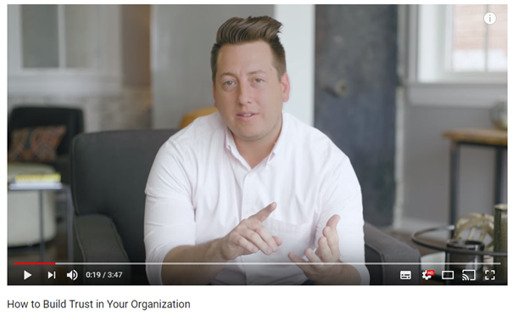
TRUST – A KEY DIMENSION FOR IMPROVING THE ORGANIZATIONAL CLIMATE
ACTIVITY: HOW TO BUILD TRUST IN YOUR ORGANIZATION – ROUNDTABLE
This video explores how leaders/managers can build positive relations in organisational environment regarding open communication and mostly trust.
5 ways of building and maintaining trust in the workplace are presented, namely:
be congruent,
be reliable,
take ownership,
listen for understanding,
solicit and share feedback.
Link: https://www.youtube.com/watch?v=Awpzz-clb_c

Slide 15
TRUST – A KEY DIMENSION FOR IMPROVING THE ORGANIZATIONAL CLIMATE
TRUST
Trust within organizations
Trust among peers and co-workers
Levels of Trust

Slide 16

TRUST – A KEY DIMENSION FOR IMPROVING THE ORGANIZATIONAL CLIMATE
Trust among peers and co-workers
Trust is one of the vital variables that should exist between co-workers in order to achieve a common goal or objective
(Chanal and Poonam, 2015)
Trust as a key dimension that determines team’s knowledge acquisition and consequent development
Trust is important for sharing knowledge (that act as a driver for inclusive growth)
If co-workers trust each other, they tend to share more information and knowledge (allied with an open communication)
Notes:
Chanal, H. and Poonam, B., 2015. The Impact Of Employee Sycophantic Behaviour On Organisation Environment. [online] Pdfs.semanticscholar.org. Available at: <https://pdfs.semanticscholar.org/d0e0/98d64af5590cbf560fdd7a4d85487fdeedaa.pdf> [Accessed 8 October 2020].

Slide 17

TRUST – A KEY DIMENSION FOR IMPROVING THE ORGANIZATIONAL CLIMATE
Trust among peers and co-workers
Mutuality (or collectivity) of views
Trust-building is an interactive process that involves (at least) 2 individuals learning about each other’s trustworthiness. So, it cannot be seen as a personal decision: there must be an original mutuality (or collectivity) of views.
Here, it is important to stress that there is a direct relationship between the degree of trust (existing within a team) and the team’s capacity to share work/ divide tasks among its members.

Slide 18
TRUST – A KEY DIMENSION FOR IMPROVING THE ORGANIZATIONAL CLIMATE
Trust among peers and co-workers
Even with an open and trustworthy organisational climate…
Horizontal trust as a “stress-release”
Contribute to psychological safety
Related with the amount of concern peers demonstrate one to another
Peers
Co-workers
Managers
Superiors
Leaders
Level of Trust when communicating
Different levels of trust when communicating

Slide 19
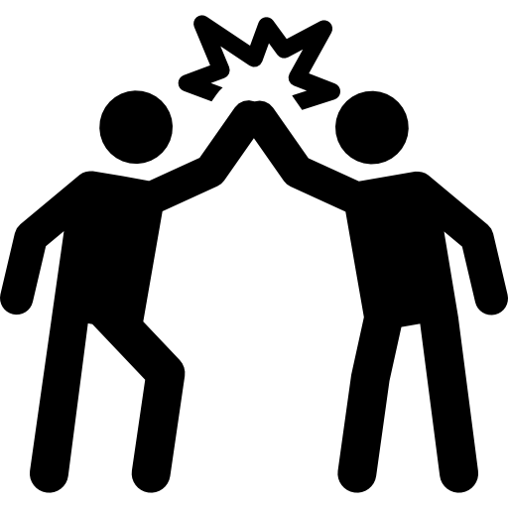
TRUST – A KEY DIMENSION FOR IMPROVING THE ORGANIZATIONAL CLIMATE
Trust among peers and co-workers
Consequences
Decrease of turnover intentions
Greater affective commitment
Improvement of individual and organisational effectiveness
Peers and co-workers’ trust
Consequences of trust among peers and co-workers

Slide 20

SUPPORT – A KEY DIMENSION FOR IMPROVING THE ORGANIZATIONAL CLIMATE
Activity:
• In case one of the players with information decides to talk, he/she wins a prize and the other gets nothing.
• If they both talk, they both lose, but receive a small consolation prize.
• If they both keep silent and no information is extracted from them, they both win and receive a double prize.
• The third player has to convince the other two to disclose their information, players are aware of what is at stake and what they might gain/loose in each possible outcome

Slide 21

SUPPORT – A KEY DIMENSION FOR IMPROVING THE ORGANIZATIONAL CLIMATE
ACTIVITY: ‘CAN DO’ COMPANY (GROUP DYNAMIC)
Divide into groups and develop an idea for a company such as candy bars for cats or water bottles for dogs.
On completion, each member is assigned to specific job functions ie:
designing,
marketing,
distributing, etc.
Each “mini-company” has to collaborate and prepare a presentation on their product and business plan.

Slide 22

SUPPORT – A KEY DIMENSION FOR IMPROVING THE ORGANIZATIONAL CLIMATE
What happened to Hewlett-Packard?
How did one of the “100 Best Companies to Work for in America” in 1998 become, essentially, one of the worst companies to work for by 2010?
In particular, what happened to employee trust in the company?
Notes:
In 1998, The Hewlett-Packard Company (i.e., HP) was listed in the top ten of Fortune Magazine’s inaugural ranking of the “100 Best Companies to Work For.” This ranking was designed to provide a measure of employee trust, and revealed that HP employees felt high trust in an organization that had been historically defined as a “people first” company. Yet, by 2002, HP had completely fallen off of the list, and it has not returned in the ensuing 10 years. Analysis suggests that HP’s downfall was not due, primarily, to a reduction in trust with employees, but to an increase in distrust by employees. In particular, it was found that, through both behaviours and language, HP leaders communicated values of disrespect, dissatisfaction, and unfairness to employees that led them to distrust the company. Recent findings suggest that trust and distrust are distinct social realities that may exist independently of each other. Findings suggest that employee trust and distrust may also require separate and distinct attention by managers.

Slide 23
SUPPORT – A KEY DIMENSION FOR IMPROVING THE ORGANIZATIONAL CLIMATE
BUILDING A POSITIVE WORK ENVIRONMENT
Respect
Recognition
Success
Talent
Support
Cooperation
Give the benefit of the doubt

Slide 24
Managing Situations
“What is there in your approach or way of managing the situation that might be contributing to the problem or getting in the way of its resolution?”
(Block and Nowlan, 2011)
Attribution of negative personal characteristics
Tendency to reduce contact with superiors
Diminished self-confidence
Hyper vigilance of Boss behavior
Takes feedback with “a grain of salt”
Tendency to bring up the past
Reputation as “the person most likely to disagree with the boss”
Tendency to engage in covert lobbying
Notes:
Block, P. and Nowlan, J., 2011. Flawless Consulting. 2nd ed. San Francisco, Calif.: Jossey-Bass.

Slide 25
Difficult vs Good Superiors (Peers)
Difficult
Negative, mean spirited
Autocratic
Stickler for details, intolerant, impossible to please
Intimidating, treats people as resources
Unrealistic
Stubborn; impossible to influence
Manipulative
Meddlesome; untrusting
Control freak; micro manager; evaluative
Uncommunicative; aloof; unsupportive
Weak, prone to favoritism; low performance standards
Impatient; temperamental; unpredictable
Ignorant bureaucrat; clueless; defensive
Stifling my development
Great/Good
Development-oriented
Intuitive; decisive
Has high expectations and aspirations
Driven
Demanding; has high aspirations
Single-minded; focused
Politically astute
Helpful; caring
Encouraging; coaching; informed; close to the pulse
Thoughtful, busy
Allows self-discovery
Passionate; incisive; mercurial; (at worst) impulsive
Realistic; better judge; aware of interdependencies; victim of a poorly sold change
Considerate; letting me recover

Slide 26
Observed Behaviours
Giving critical feedback
Making a unilateral decision
Instructing work to be redone
Imposing discipline
Setting stretch targets
Sticking with a doubtful course of action
Sending mixed signals
Giving unsolicited advice
Asking specific questions
Delaying response to proposal/ request
Not condemning a big mistake
Losing temper in public
Resisting a proposed change
Giving a routine assignment
Action | Intent | People See | inferred
Discounting feedback | Effectiveness | Ignored feedback | Anti-learning, lacks potential & respect
Bringing up the past | Avoid repetition | Water under the bridge | Lacks judgment & maturity
Holding ground with Peers | To be heard | Challenging, foolish resistance | Lacks judgment, self-control & discipline
Covert lobbying | To make things better | Personal betrayal | Lacks loyalty and integrity

Slide 27
Session 9 – Workplace Relationships
Questions?

Slide 28
Review
Respect for Co-Workers
Organizing Relationships: Traditional and Emerging Perspectives on Workplace – Sias, P. M. WSU, 2009. Sage Pubs.
Explore
Organising Workplace Relationships
Supervisor/Subordinate Relationships
Draw parallels and highlight similarities to your organisation.
What can be done to;
Improve
Change/Adapt

Slide 29
References
Bindra, V., 2013. Everything About Leadership. 1st ed. Delhi, India: Diamond Pocket Books.
Block, P. and Nowlan, J., 2011. Flawless Consulting. 2nd ed. San Francisco, Calif.: Jossey-Bass.
Blomqvist, K. and Ståhle, P., 2011. Building Organizational Trust. [online] ResearchGate. Available at: <https://www.researchgate.net/publication/242769066_Building_Organizational_Trust> [Accessed 7 October 2020].
Chanal, H. and Poonam, B., 2015. The Impact Of Employee Sycophantic Behaviour On Organisation Environment. [online] Pdfs.semanticscholar.org. Available at: <https://pdfs.semanticscholar.org/d0e0/98d64af5590cbf560fdd7a4d85487fdeedaa.pdf> [Accessed 8 October 2020].
Stolzer, A., Halford, C. and Goglia, J., 2016. Implementing Safety Management Systems In Aviation. 3rd ed. Abingdon, UK: Routledge.

