Slide 1

MODUL NAME: MANAGING ENTERPRISE IN THE 21ST CENTURY
MODUL code: (BMSW 4006)
LECTURER’S NAME: DR OLU ADEGBITE
STUDENT NAME AND ID:
GEORGI IVAYLOV YORDANOV (2019300)
ZACHURY SHANE JASSI (2017021)
SABELA SIMMS (1906017)
IVAYLO EVGENIEV MITEV (2018995)
ROZA ASPARUHOVA SHIMOVA (2016896)
SILVIYA PAVLOVA TODOROVA (2020322)
VERINA PETROVA KATSARSKA (2015831)
Mohammed Abid Sultan (2018840)

Slide 2

Executive Summary
We would like to present you the newest concept of revolutionary tailoring service. Our passion is to add value to the useful things in life by using the useful things in life. The average British consumer of fashion throws away about 3.1kg of textiles every year. CLOTHRENEW TM aims to reduce the waste in fashion by recycling with the aid of modern technology.

Slide 3


Company Overview
1.Business name: CLOTHRENEW TM
2.Company Ownership: Partnership of 7 people
3.Company History: A company formed by 7 friends with passion to add value to the useful things in life.
4.Company Location: Birmingham, UK, QUAY PLACE, B1 2RA, FLOOR 2, Office 5
5. Mission/Vision Statement:
-Mission: The company aims to repair and recycle all types of old and damaged clothes for saving global resources, and for introducing a new vision in the fashion industry
-Vision: Our vision is to become the number one supplier of recycled garments in the world

Slide 4
Product and Services:
Here is the list of some of the services we provide:
Trousers shorten or lengthen, half pocket, full pocket, taper legs and take in or take out
-Skirts shorten/ or lengthen and take in/ take out
-Dresses shorten or lengthen and shorten from waist
-Jackets shorten or extend sleeves
-Coats shorten length of extend length
-Zips- Made in house with 3D assisted TECH
-Replace buttons
-Re-sew buttonholes
-Customize clothes to your needs
-Repair all sorts of rips and tears no matter the size
- Repair weak or torn seams
-Add pockets
-Add designs: Embellishment by AI TECH
Notes:
Our company takes pride in offering many tailoring services. We offer a wide range of clothing repairs, size changing, customizations and many other altercations, we work closely with our customers to fulfil your every need weather that be for example adding a hood to your new jacket, to repairing your torn trousers no job is too big or small for us.
We provide quick and easy service with direct access to speak to our colleagues at any time to specify all your needs in detail and we can also advise you. We operate from an easily accessible store
So, you can come down anytime within our opening hours
And rest assured all our staff are experienced tailors so you’re in good hands
We can take bookings, or you can pop in if your demands are urgent, we also offer a delivery service once clothes have been repaired or altered

Slide 5
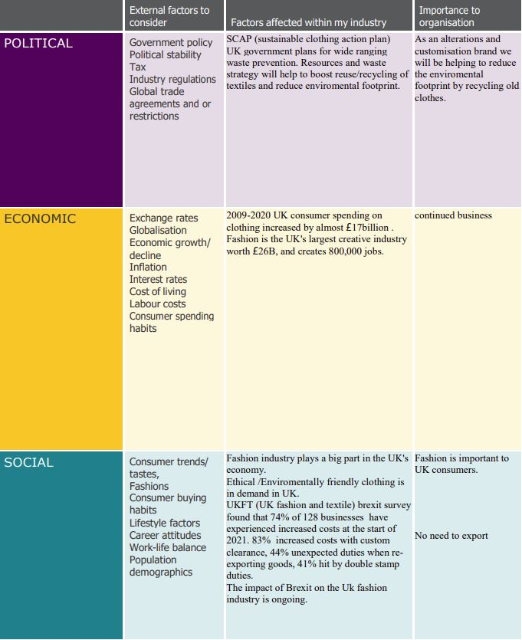
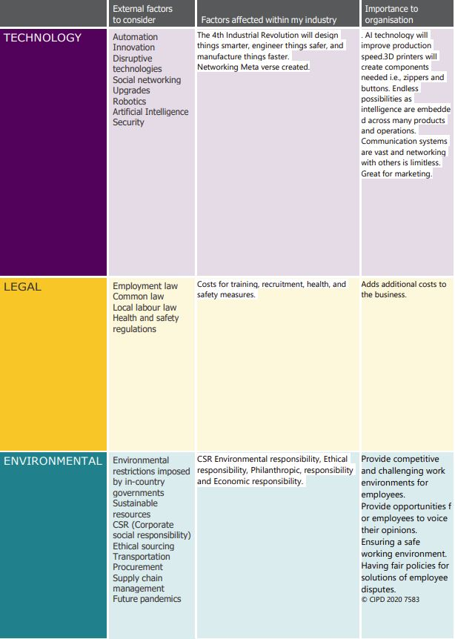
PESTLE ANALYSIS

Slide 6
SWOT analysis for CLOTHRENEW
S
Strengths
Restoration of all garments for men, women and children.
Automation of activities by AI and 3D technologies.
Highly experienced staff.
Loyal returning customers.
Unique and exclusive product creation.
Accessible source of raw materials.
T
Threats
Changes in trading regulations.
Intense competition from rival businesses.
Imitation of product services by competitors.
New tec used by competitors.
Established brands
O
Opportunities
Invest in new technologies
Ability to develop additional stores.
Affiliate relations with local retail stores.
Franchise the business.
E-commerce business
W
Weaknesses
Lack of clients
Seasonal trading
Established fashion culture
Possibility of ‘brick and mortar’ business Closure to c19 pandemic

Slide 7
Competitive Market
MISS TAYLOR
CALLAGHAN TAILOR
City Tailoring
WHAT THEY DO?
Clothing Repairs Get in touch with one of the leading clothing repair shops.
Dry Cleaning, we excellent high-quality dry-cleaning services. For curtains or duvets to suits and wedding dresses, we can dry clean whatever you need
Competitive repairs.
We can beat high street shops prices
Women Only
Wedding Dresses normal day dress and other women’s clothing
Ages Between 18+
Online shopping and indoor shopping available.
WHAT THEY DO?
Tailoring
Adjusting
Suit wear
Getting you ready for occasions
Ideally for men with blazers suits trousers and casual wear
Good laboring friendly staff
Not every day wear ideally for someone who attends business meetings parties and other events
18+
With over 52 years’ experience combined in tailoring.
Repairs and altercations
If you like that extra special luxury hand finished, inside and out option then choose us.
Competitors
Slaters Moss Hugo Boss and many more designer brands.
WHAT THEY DO?
Custom garments
Repairs and altercations
Round-the-clock service
Fast and reliable servicing for all customers
Restyling for an awesome look
Great location in the heart of Birmingham city center
Fair prices
Quality
Efficiency
Great customer reviews
For all clothing

Slide 8
TARGET MARKET
Fashion studio CLOTHRENEW TM produces and presents stylish and elegant clothing and remakes old clothes into your specific requirement needs. Original designs by clients are protected by our copyright policy, alongside CLOTHRENEW TM high quality tailoring services.

Slide 9
QUESTIONNAIRE
1) Gender
Male ☐
Female ☐
Prefer not to say ☐
2) How old are you?
18-28 ☐
28-38 ☐
38-48 ☐
48-above ☐
3) What is your profession?
………………………………………………..
4) Where did you hear about us?
Friend or family ☐
Advertisement ☐
Social media ☐
Other ☐
5) What is your household income?
………………………………………………..
6) What is your household size?
……………………………………………….
7) What are your hobbies and interest’s
…………………………………………….....
8) Which of our service's would you most likely be interested in?
Recycling old clothes ☐
Customization ☐
Repairs ☐
Size changing ☐
9) How much would you be willing to pay for our services ?
£5 ☐
£10 ☐
£15 ☐
£20 ☐
More ☐
Notes:
This is the questionnaire we made to found out what is the specific target market, regarding our business.

Slide 10
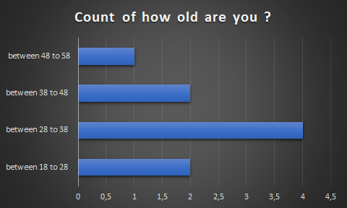
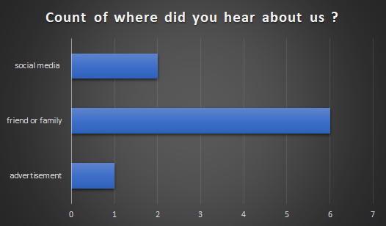
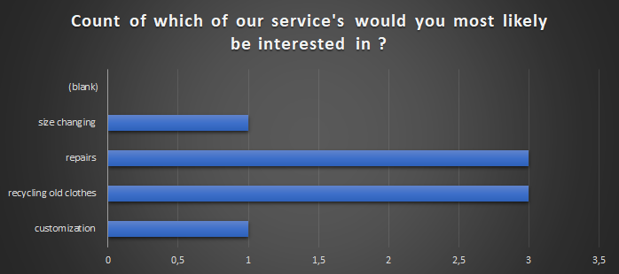
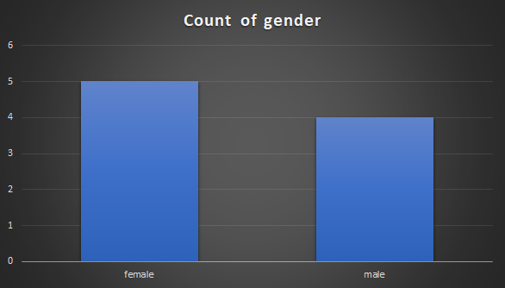

Slide 11

Marketing Plan
Demonstrating to investors how company can grow and offers returns
Identifying the beneficial target markets for our service
Evaluating industry environment
Pricing strategy
Promotion plan and budged
This Photo by Unknown Author is licensed under CC BY-SA

Slide 12
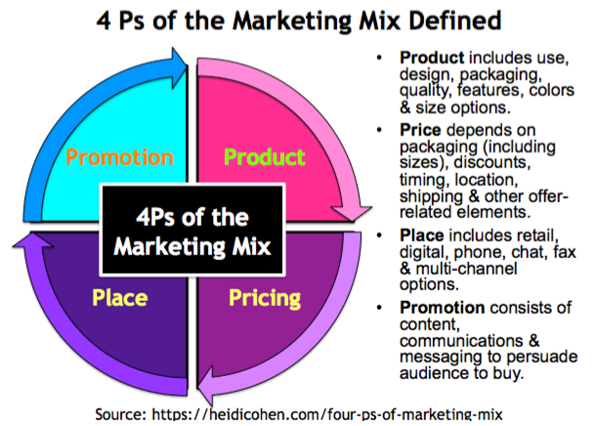

Slide 13

Focus on the Customer
What are their viewing?
What are their patterns?
What will be the appeals to them?
What doesn`t?
What audience will be interested from our service?
Solid research to make effectiveness advertising.
This Photo by Unknown Author is licensed under CC BY-SA

Slide 14

E - Marketing and Social Network
Brand spiraling-branding strategy to drive traffic to online sites
Blog-appears periodically on the internet a journal
Blogosphere-term used for all the blogs
Advertising in the social network can help our business to growing faster
This Photo by Unknown Author is licensed under CC BY-SA

Slide 15

MANAGEMENT TEAM
Georgi Yordanov
Job roles: Inventory Control Specialist
Qualification :Certificate in Higher Education :Skills for the workplace
Skills :team management skills in the business environment, problem solving skills, leadership and communication, skills to achieve financial and business goals, customer service skills ,communications skills analytics , organization skills.
Verina Katsarska
Job roles: Sales Associate and Consultant
Qualification :Certificate in Higher Education :Skills for the workplace
Skills: good communication skills, work as a team player, fast and effective problem-solving skills, ability to adapt and learn quickly, organizational skills and attention to detail, mathematical and financial knowledge.
Roza Shimova
Job roles :Assistant Store Manager
Qualification :Certificate in Higher Education: Skills for the workplace
Skills: ability to manage a team in the business environment, problem solving skills, leadership and communication, ability to achieve financial and business goals, ability to implement and maintain company policies and procedures, customer service skills ,basic mathematics and financial knowledge.

Slide 16

Ivaylo Mitev​​
Job roles: Store Manager ​
Qualification :Certificate in Higher Education :Skills for the workplace.​
Skills: skills to lead a team in the sales network, problem-solving skills, leadership and communication, ability to set and achieve financial and business goals, understanding of sales, promotions, customer service skills, ability to create and maintain employee schedules​.
Silviya Todorova
Job roles: Cashier
Qualification :Certificate in Higher Education: Skills for the workplace
Skills: customer service skills, experience with on-site sales and cash handling systems, organizational skills and attention to detail, fast and effective problem-solving skills, basic mathematical and financial knowledge.

Slide 17

Zachury Jassi ​​
Job roles :Visual Merchandiser
Qualification :Certificate in Higher Education :Skills for the workplace​.
Skills :Has the ability to think creatively and strategically,​
ability to meet deadlines and cope with multiple tasks at once, work with suppliers and manufacturers,​
ability to cope with physical activity,​ability to work in a team and independently​.
Sabela Simms​​
Job roles :Customer Service Representative
Qualification :Certificate in Higher Education: Skills for the workplace​.
Skills :communication skills​,Quick and effective problem-solving skills​,great energy and infective enthusiasm​
Organizational skills and attention to detail​,ability to work as a team player and independently​,basic computer skills and familiarity with point-of-sale systems​.
Mohammed Sultan
Job roles: Buyer
Qualification :Certificate in Higher Education :Skills for the workplace
Skills :ability to negotiate, ability to effectively research, evaluate and analyze products based on various factors such as price and quality, experience in working with suppliers, organizational skills and attention to detail, ability to maintain and track purchase orders and inventory levels .

Slide 18

FINANCIAL PLAN

Slide 19
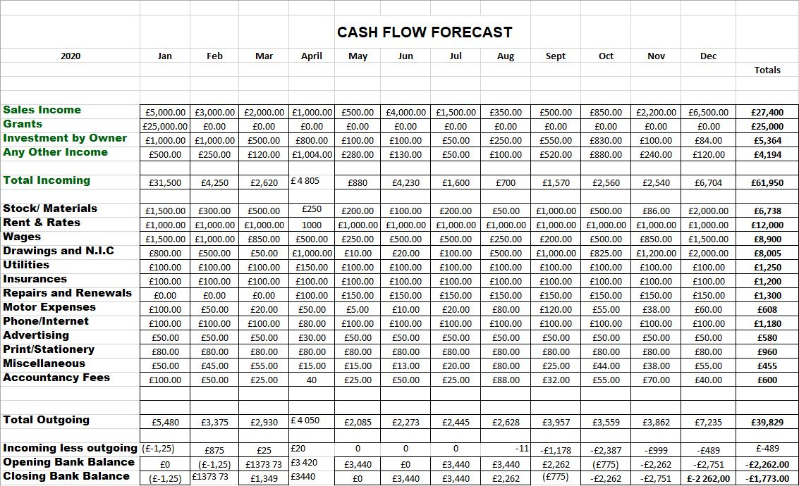



Slide 20

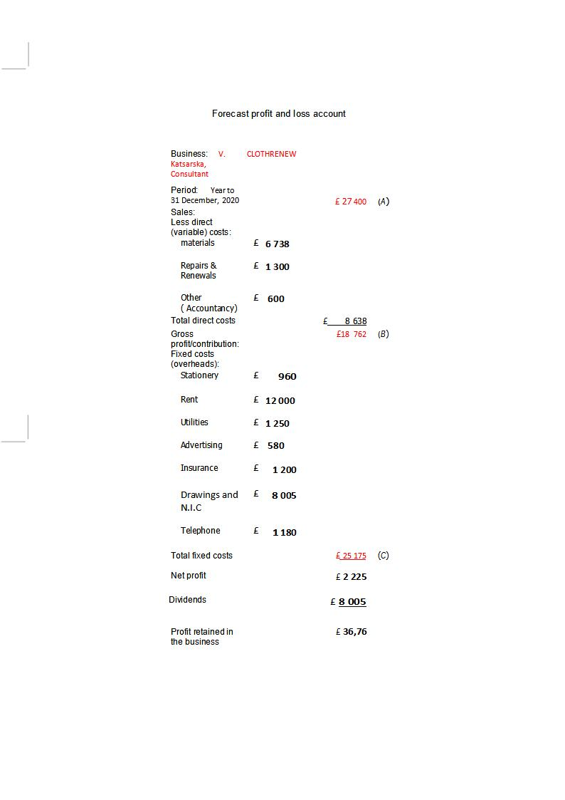
Profit and Loss

Slide 21
References:
Bhagat & Singh , 2015: Students awareness of learning styles and their perceptions to a mixed method approach for learning

