Slide 1
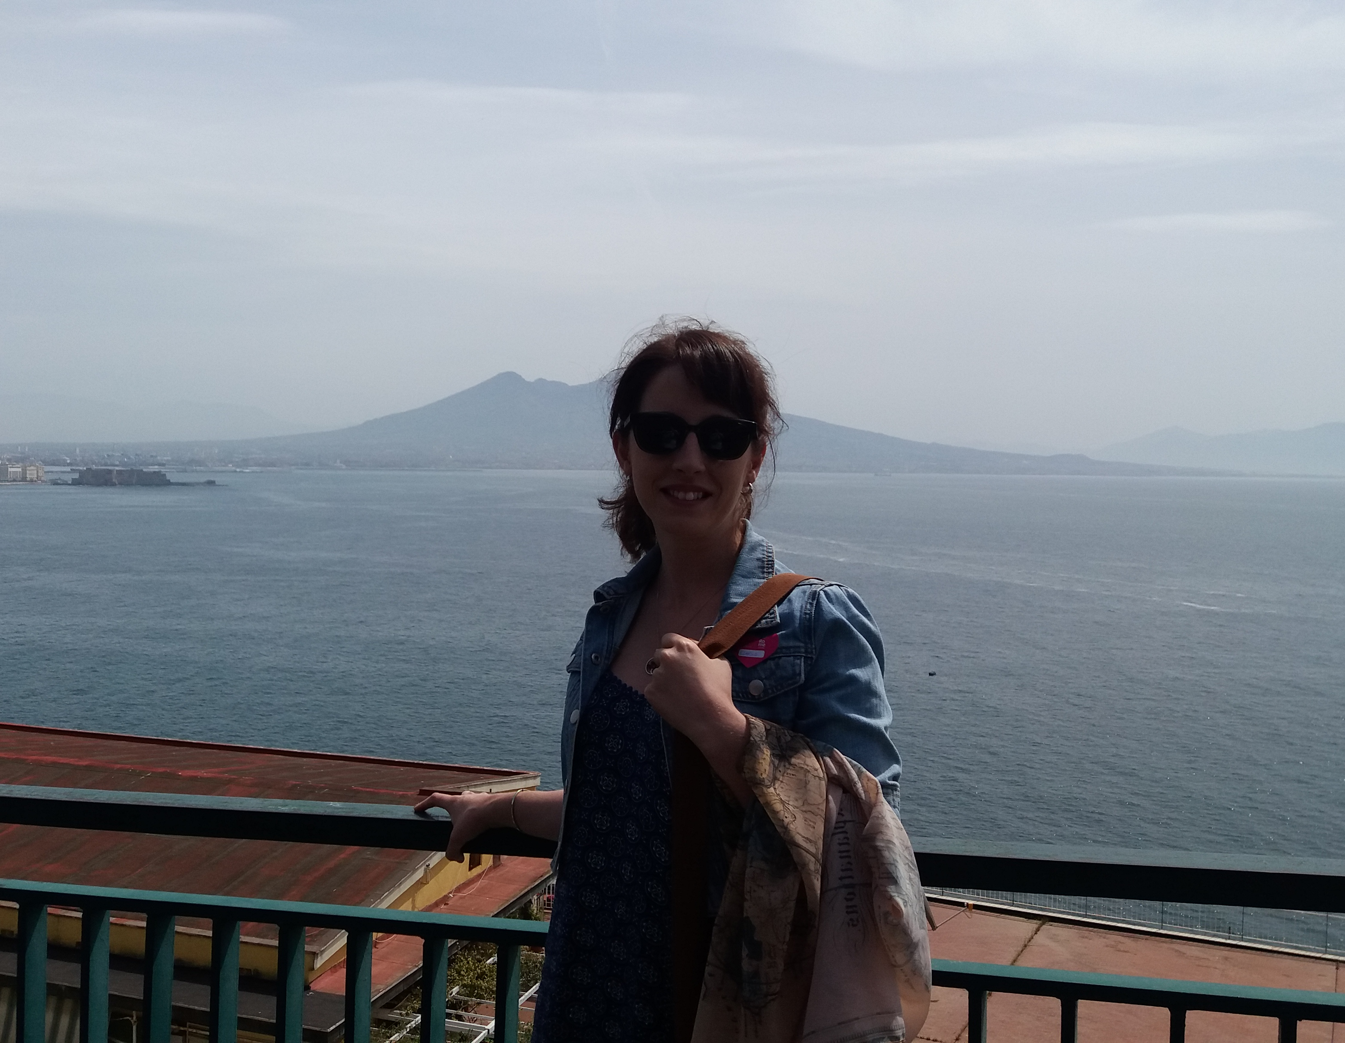


Rose Owen
I am a 27 year old female from Chepstow, Wales. I have a love of the outdoors and enjoy reading. I am told I have a calm nature.
Amdana i
About Me
PGCE Geography
Profiad addysgu blaenorol
Previous teaching experiences
2 Years as an apprentice TA at Dene Magna Secondary School (English Dept).
Volunteered as a TA at The Dell Primary school.
Y math o athro hoffaf bod
The kind of teacher I aspire to be
Proficient
Fair
Knowledgeable
Approachable
Cefndir academaidd
Academic history
BSc Geology- University of Glamorgan.
GCSEs, A levels (Geography, History, Physics)- Chepstow Comprehensive.
NVQ lvl 3 supporting teaching and learning- Gloucester College.
Rhesymau dros ddewis addysgu fel proffesiwn
Reasons for entering the teaching profession
I have a love of knowledge and wish to work in an academic surrounding.
I wish to have a positive contribution to society by supporting younger generations.
I want to embark on a career that offers day to day variation.
Meysydd / pynciau medraf eu haddysgu
Areas / subjects I could teach
Geography
Geology
History
English

