Slide 1
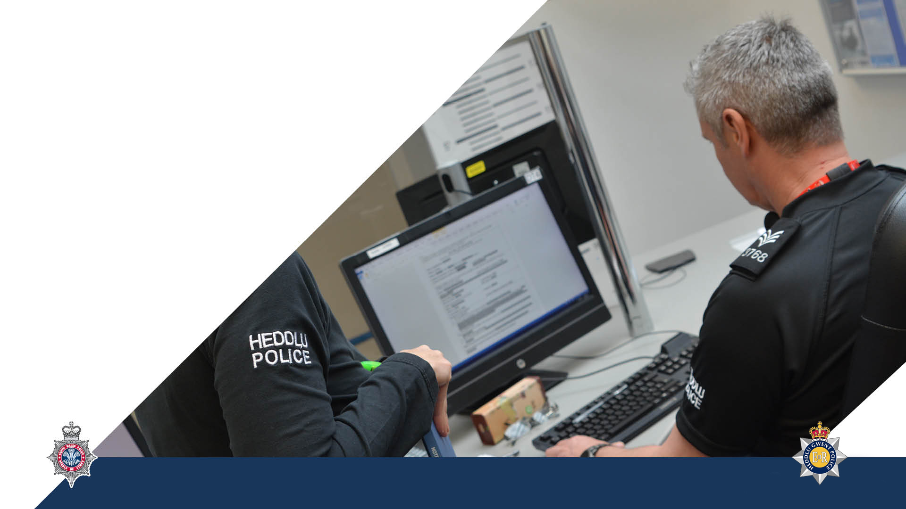

Investigation & Recording of Crime Subtitle
Speaker
Notes:
By the end of the lesson learners will be able to:
State the standards required when recording an incident
Explain the process for the ethical recording of policing incidents
State why witnesses are valuable
State how the Golden Hour Principles apply to crime reporting and recording

Slide 2
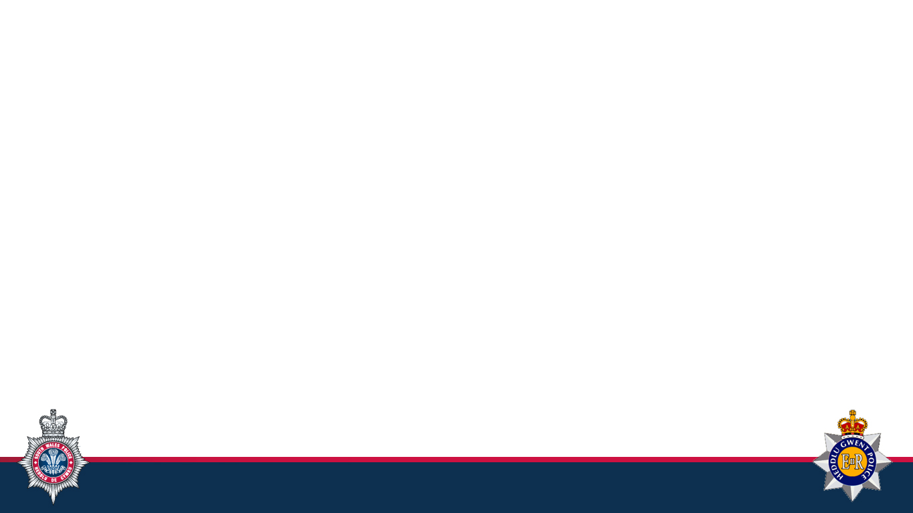

Initial Investigation
What exactly has occurred?
Is the incident a crime?
If so, what sort of crime?
Notes:
The initial investigation of crime is all about obtaining the core information regarding an incident which will enable all those involved in the process to determine:
What exactly has occurred?
Is the incident a crime?
If so, what sort of a crime?
e.g. an individual may contact the police stating they have been robbed.
If the appropriate questions are not asked by the first contact then the response may be totally out of proportion to the incident
The caller may have stated that they have ‘been robbed’ when in fact their purse has disappeared sometime the previous day.
To the member of the public this is one and the same thing, but the initial actions are totally different.
If a true robbery has occurred then a rapid response is required, a full description of the offender and the items taken needs to be circulated and consideration may need to be given to any injuries sustained.
If it is a lost purse, then the individual should be told that an officer will take details at some point during the day and in the meantime, the injured party should cancel all bank cards, and make a list of all property that was in the purse.
Remember that you may not be the officer carrying out the investigation, so as much detail as possible should be entered on the crime report to assist those who end up doing the investigating.
Remember also that, in terms of evidence, the crime report is primary evidence of the incident, as it will usually consist of the formal account of the incident by the aggrieved or victim.

Slide 3
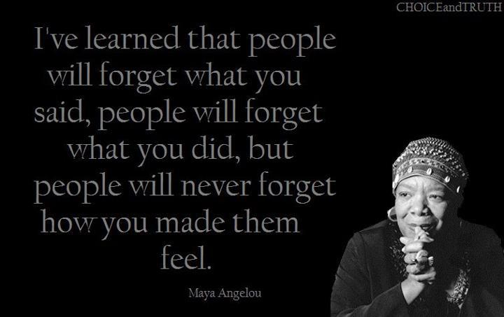

Slide 4
Initial Investigation
National Crime Recording Standards (NCRS):
Evidential
Prima facie
National Crime Recording Standards (NCRS)
Notes:
`Historically, the recording of crime was approached differently by forces and fell into two categories
Evidential
Prima facie
The ‘evidential’ approach implied crimes were being recorded when there was clear evidence to support the allegation that a crime had occurred.
The ‘prima facie’ approach led to the recording of a crime whenever suspicion arose that a crime had occurred, whether there was proof of this or not.
The National Crime Recording Standard (NCRS) implemented by all forces on 1st April 2002 deliberately steers away from the issue of ‘evidential’ versus ‘prima facie’ to adopt a more victim focused approach to crime recording with a desire to improve consistency.
Greater emphasis is placed on what the victim perceives as a crime, which is in line with the approach taken for hate crime.
Where the victim believes that a crime has occurred, this will usually be enough to record a crime, even if no investigation is wished for.

Slide 5
National Crime Recording Standards (NCRS)
The 3 basic principles are:
All reports from victims, witnesses or third parties will result in creation of an incident report
An incident will be recorded as a crime if, on the balance of probability (a) the circumstances as reported amount to a crime by law and (b) there is no credible evidence to the contrary
Once recorded, a crime will remain recorded unless there is credible evidence to disprove that a crime has occurred
Notes:
The National Crime Recording Standards (NCRS) set out three basic principles for the recording of crimes by forces.
It is important that the Standard supports a victim focused approach to crime recording where the public’s call for service is met, as opposed to a proactive one where the police are required to trawl for potential crimes.
This does not mean that every single incident will be recorded as a crime. An example would be where an incident involving a small scale disturbance in the street is seen on a public CCTV, and officers attend but all parties have left the scene and there are no obvious injuries.
This should be recorded as a crime related incident for intelligence purposes, but this is not a recorded crime

Slide 6

National Crime Recording Standards (NCRS)
Reasons not to record a crime:
The incident reported does not amount to a crime in law
The initial incident report is not confirmed by the victim
On the balance of probabilities a crime has not been committed

Slide 7

Modus Operandi (M.O.)
The method by which a crime is committed
The method by which a known criminal operates
Notes:
The modus operandi or (M.O.) is the method by which a crime is committed.
This can be compared to the method by which a known criminal operates.
When these two methods are found to be very similar, identification can be made.
This method of identification requires full and accurate information to be supplied. This information will be submitted when a crime report is completed and by police officers when a criminal is arrested.
An analyst may link details regarding numerous crimes in an area to show a pattern and the modus operandi.
This information may be circulated via briefings and intelligence bulletins.

Slide 8

The 10 Points of the Modus Operandi System
S tyle
T ime
O bjective
P al
C lass
R eason
I nstrument
M ode
E ntry
S ignature
Notes:
The points to be borne in mind when collecting information for the M.O. of a crime report are :
Style – the style of the deception used in deception cases, e.g. dressed as a gas official, documents claiming to be an insurance collector
Time – relative to an event (not to the clock), e.g. crime only committed on market days, early closing days or certain days of the month
Objective – the objective of the crime, e.g. gain, lust, revenge
Pal – is there an accomplice or friend?
Class – the class of person or property attacked
Reason – reason for being in the area, the criminals self-account
Instrument – instrument used to commit the crime, e.g. crowbar, screwdriver, bodily force
Mode – mode of transport used to commit the crime(s)
Entry – the actual point where entry was made
Signature – something unusual done by the criminal, their ‘signature’ e.g. creates an escape route by wedging doors open, closes curtains, eats food from the fridge.
When a crime report is submitted as many of these details should be included, if applicable, to the crime.
It may then be possible to match an offender to a crime because of a similar modus operandi (M.O.)

Slide 9

Crime Reports
Means of disposal of offence
Officers attending scene
Persons wanted or suspected
Circulations if appropriate
Date and by whom victim was informed of result
Notes:
Means of disposal of offence – used for statistical purposes and is generally completed by a supervisor and relates to whether or not the crime was detected)
Officers attending the scene
Persons wanted or suspected
Circulations if appropriate
Date and by whom victim was informed of the result of the investigation. If you are involved in the investigation of the offence it is important to keep the victim unformed of progress

Slide 10
Police Actions
Obtain all possible information from victims and witnesses
Complete a crime report and submit before going off duty
Inform supervising officers, specialist teams or CID dependent upon type or seriousness of the offence
Notes:
Officers should take the following general action in all cases when a crime is reported.
The most important factor relating to any information obtained is its accuracy.
Inadequate or incomplete information could seriously affect the course of enquiries.
For example, criminals are frequently known to commit certain extraordinary acts, which are no way associated with the crime, for example consuming food or urinating on the floor. This must be recorded. The smallest detail of information may help identify a criminal.
Completing the crime report is the first function along the investigative trail. There should be an emphasis on obtaining information, evidence and intelligence, rather than simply recording allegations.
If this is not the case, it is unlikely that the resulting crime reports will be detailed or accurate enough to enable correct assessment.
Therefore, the quality of actions taken and recorded bears greatly upon the successful resolution of a case. If the initial gathering of witness details, collection of physical evidence, identification of lines of enquiry, conducting searches and the arrest of outstanding offenders is poor, it can affect the outcome of the investigation.
In addition, poor or inadequate initial and/or primary investigations are likely to have an adverse impact on the confidence that the public have in the police, and will do little to reassure the community.
In conclusion, Police Officers, PCSOs and police staff attending all types of crime scenes should do more than simply record details.
Officers should conduct investigations, reassure the community and maximise forensic opportunities.

Slide 11
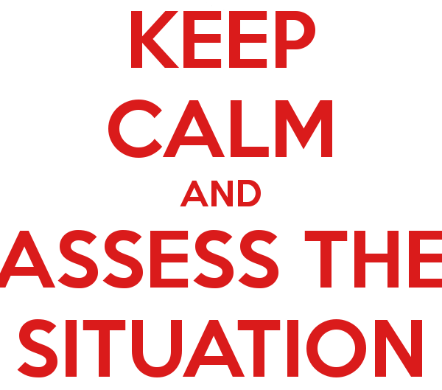
Arriving at the Scene
Notes:
You have a duty under the Health and Safety Act and a Common Law duty of care, which means that you must consider the health and safety of your team and members of the public
Officers need to consider their own safety and that of the public at all times.
For example, at a large fight in a club, bringing the scene under control is not best effected by an officer wading into the middle of the disturbance and grabbing someone at random, but how often do you think that happens? All it tends to do is provoke more violence.
Whilst we have a positive duty to uphold every person’s right to life and when responding to calls for assistance must not unduly place any person’s life at risk, there remains a requirement for all officers to conduct a dynamic risk assessment concerning the activity they are undertaking to ensure that they do not endanger the lives of themselves first.
Remember you should not go into an unsafe situation, there is no point in becoming a casualty yourself.
Conduct a ‘Dynamic Risk Assessment’
Take careful note of the situation while taking any immediate necessary action.
But in reality, how easy is it to do this?
How easy is it not to get caught up in the events that are ongoing?

Slide 12
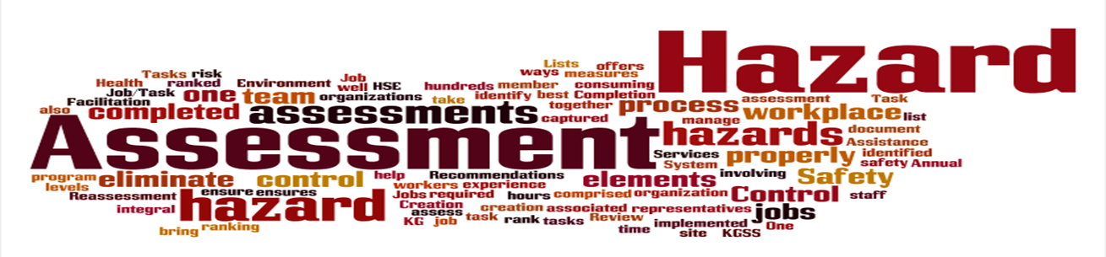
Dynamic Risk Assessment
The continuous assessment of risk in rapidly changing circumstances of an operational incident, in order to implement the control measures necessary to ensure an acceptable level of safety
Notes:
This is:
the continuous process of identifying hazards, assessing risks, taking action to eliminate or reduce risk, monitoring and reviewing, in the rapidly changing circumstances of an operational incident,
the type of ongoing risk assessment that staff on-the-job can, with suitable awareness training, undertake for themselves, and
particularly important where work situations develop and change very quickly, requiring those involved to make timely decisions about the safety of themselves and those around them, including those members of the public who may be disorderly or even violent, but to whom there is still a duty of care.
To minimise risk, individuals must ensure that they:
are competent to perform the tasks assigned to them,
operate as an effective member of a team and are self-disciplined and capable of working within accepted working practices, and
are adaptable to changing circumstances, vigilant for the safety of themselves and others and able to recognise their own abilities and limitations.
On arrival at the incident the person in charge needs to gather information, evaluate the situation and apply professional judgement in determining the most appropriate course of action. This judgement will involve a weighing of the benefits of each course of action against the attendant risks. A wrong decision in the initial stages may have irreversible effects

Slide 13
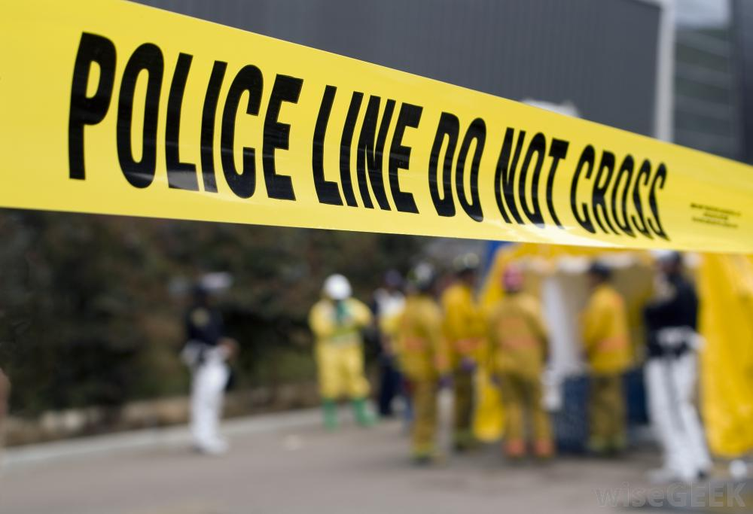
Health & Safety
Agitated victim/witness/suspect
Weapons
Chemicals – drugs
Bodily Fluids
Sharp Objects
Structural Damage
Poor Lighting

Slide 14
Crime Reports

Slide 15
Crime Reports - INFORMATION
Details of offence
Victims name and address, date and place of birth, occupation and sex
Victims contact details (landlines, mobiles, works, email)
Time, date and place offence committed
Circulations if appropriate
Victim update policy
Victim injury and type of weapon used
Value of property stolen, recovered or damaged
Identifiable, non identifiable and recovered property
Person(s) wanted or suspected
Notes:
The following details will be included in a crime report:
Victims details – name and address, date and place of birth, occupation, sex
Place of offence, time and date committed
Details of the offence – including type of offence and M.O.
Injury to victim and type of weapon used
Value of property stolen, recovered, damaged
Property stolen identifiable, non-identifiable, recovered

Slide 16
Arriving at the Scene
Assess
Protect/Secure
Notes:
When entering the scene you will need to consider health and safety again – yourself and anyone else at the scene. Remember our first priority is to protect life, including any suspects.
At many scenes of crime or emergency you will get onlookers. They can be a help or a hindrance. Control of peoples’ movements is essential. Some may be able to provide help and assistance. But passers-by who are curious to see what is going on can impede the arrival of backup and other emergency services. Be prepared to move them on.
It could also be a crime scene that needs protecting.
If there is an offender at the scene you must try to prevent their escape
Get medical aid for injured persons. This could mean calling an ambulance if the injury is serious or just giving advice to see a doctor.
Get assistance if necessary. For example a senior officer, CID, emergency services, etc
Get the names of witnesses. You may not be able to interview them at the time of the incident

Slide 17
Taking Control
Establish crime scene area
First Aid
Coordinate arriving units
Notes:
Establish perimeter and secure area.
Render aid to victims and ensure scene is safe for medical personnel.
Coordinate arriving units.
Record names and unit numbers of fire/rescue, medical personnel, and LEOs on scene.
Remove unnecessary personnel from scene as soon as possible.
Assign officer to escort or ride with victim to hospital - Secure clothing and evidence. - Obtain tape recorded statement, if possible.
Initial assessment. Does this appear to be a crime? If so, what type of crime. • Assign officer to suspect. - Assess need for immediate suspect arrest. Does probable cause exist? - Is evidence present on the suspect? Collect perishable evidence from suspect if exigency exists. - Is it necessary to bag hands, etc?

Slide 18
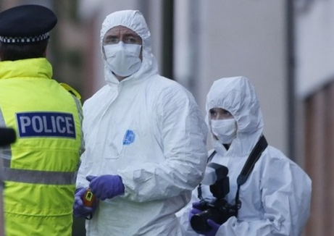
Preserving Evidene
‘The Golden Hour’
Notes:
The ‘Golden Hour’ is a term for the period immediately following the commission of an offence when material is abundant and readily available to the police.
Positive action in the period immediately following the report of a crime minimises the attrition of material and maximises the chance of securing evidence that will be admissible in court.
This is a short hand term that describes many actions.
Some key ‘Golden Hour’ considerations are:
Victims - You will need to identify victims and preserve the scene quickly so that evidence is still fresh and undisturbed.
Scenes – Identify, preserve, assess and commence log. For example, blood stains, foot prints etc. may need to be covered in poor weather conditions.
Suspects – Identify, arrest and preserve any evidence. For example, weapons they have used, blood stained clothing.
Witnesses – Identify, support and prioritise. They will need to be interviewed while their recollections are still clear in their mind. Record first account and any descriptions of suspect(s) provided.

Slide 19
‘The Golden Hour’
Victims
Scenes
Suspects
Witnesses
Log
Family/Community
Physical Evidence
Intelligence
Contamination
Responsibility
Notes:
The ‘Golden Hour’ is a term for the period immediately following the commission of an offence when material is abundant and readily available to the police.
Positive action in the period immediately following the report of a crime minimises the attrition of material and maximises the chance of securing evidence that will be admissible in court.
This is a short hand term that describes many actions.
Some key ‘Golden Hour’ considerations are:
Victims - You will need to identify victims and preserve the scene quickly so that evidence is still fresh and undisturbed.
Scenes – Identify, preserve, assess and commence log. For example, blood stains, foot prints etc. may need to be covered in poor weather conditions.
Suspects – Identify, arrest and preserve any evidence. For example, weapons they have used, blood stained clothing.
Witnesses – Identify, support and prioritise. They will need to be interviewed while their recollections are still clear in their mind. Record first account and any descriptions of suspect(s) provided.

Slide 20
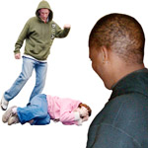
Witnesses
Value contribution
Gather relevant information
Make notes
Take names, addresses, etc.
Notes:
There is no legal obligation for members of the public to give information to the police, but the information they give them could bring a criminal to justice, therefore it is important to value the information that you are given by witnesses, not simply expect it as a right.
Remember some individuals may have had or heard of someone who has had negative experiences of the criminal justice system.
You should always act in a professional manner and respect what you are being told no matter how insignificant the information might be; the witness is only trying to help.
Remember the LEAPS model and follow it.
Make short, relevant notes if you have to and keep all information gathered confidential.
Take contact details of all possible witnesses so that you can contact them later if need be; remember statements come later, your first action should be to move onlookers etc. away from the scene as soon as possible to help preserve any evidence.

Slide 21
Preserving Evidence
The Golden Hour
Notes:
Log – Document decisions and rationale, circumstances, resources and conditions
Family/Community – Identify, inform, primary support
Physical evidence – Preservation. If evidence such as CCTV is still available and should be secured from the outset even if it is not certain that it will be needed in a prosecution.
Intelligence – identify, prioritise, maximise, exploit, consider. Remember information, intelligence and evidence are not always the same thing, but you might not know which it is at the outset of an investigation.
Prevent contamination – Victims, scenes, witnesses, suspects
Lines of responsibility – Identify, inform, brief, co-ordinate and review
The quality of the initial investigation which you carry out as first responder is a significant factor in gathering material that leads to the detection of a crime. The first opportunity to locate and gather material may be the only opportunity. Scenes that are not identified and secured will deteriorate quickly; witnesses who are not identified and interviewed straight away may discuss events with others and thus contaminate their recollection of the event or may leave the area and be difficult to trace later. The acronym CCSC refers to the actions you should take to ensure

Slide 22
The Golden Hour
Confirm exactly what has taken place
Cordon off the crime scene
Secure the crime scene
Control the crime scene
Notes:
The quality of the initial investigation which you carry out as first responder is a significant factor in gathering material that leads to the detection of a crime.
The first opportunity to locate and gather material may be the only opportunity.
Scenes that are not identified and secured will deteriorate quickly; witnesses who are not identified and interviewed straight away may discuss events with others and thus contaminate their recollection of the event or may leave the area and be difficult to trace later.
The acronym CCSC refers to the actions you should take to ensure that the opportunity to obtain relevant and important material during the ‘Golden Hour’ is not lost.
Confirm exactly what has taken place
Cordon off the scene
Secure the crime scene
Control the crime scene

Slide 23
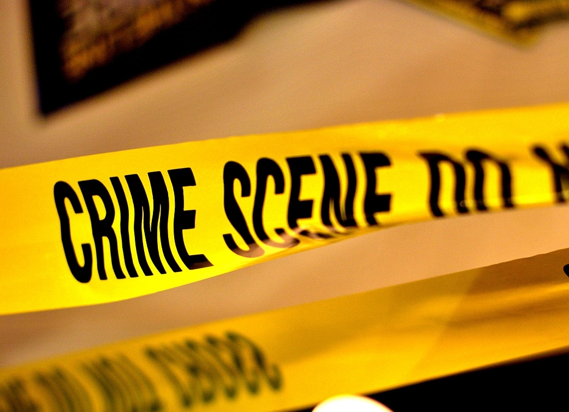
Protect
Do not allow the victim / witnesses to clean up
Do not walk around and move things yourself
Common Approach Path
Protect other evidence
Firearms
Bodies
Notes:
Here are a number of considerations when protecting the scene.
Show slide
Do not allow the victim/witnesses to clean up - by doing so they may disturb or contaminate evidence. Whilst many victims of offences such as burglary will want to clean up as soon as possible they should be discouraged from doing so if at all possible.
Do not walk around and move things yourself - again, similar to the above, by doing so you may contaminate or disturb evidence relating to the offence.
Common Approach Path – If you do need to move around the scene, you might want to consider a Common Approach Path – Protecting the scene by establishing a route in and out of the scene and ensure everyone is aware and follows it.
Think about the path the offender is most likely to have taken and try to avoid it so that you don’t contaminate or damage any evidence.
Protect other evidence – give consideration to protecting any evidence that may have been left at the scene by the offender. For example, if you notice a footprint in a flowerbed directly below the window where entry was gained, you may want to consider covering it in order to protect it from the weather. This can be done using items such as panes of glass, dustbin lids etc.
Firearms – If possible leave alone and call the specialist; If you have to move it glove up; grasp rough surface of the handle be careful not to discharge the weapon; If you move the weapon inform CSI and the Investigating officer of its original location (Consider marking/Draw plan).
There was an incident where an officer moved a shotgun which started a murder inquiry when in fact the owner had accidently killed himself cleaning it.
Bodies - If not obviously dead check for signs of life then leave alone for experts making sure you glove up first. If the death looks suspicious – leave it alone and seek help; If it is obvious that it is not suspicious – leave until life pronounced extinct by doctor or FMO.

Slide 24
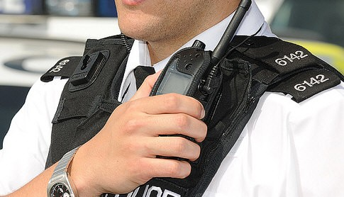
Arriving at the Scene
Assess
Protect
Communicate
Notes:
Communicate
Efficient communication is essential to the successful conduct of all aspects of operational policing, and to the health and safety of officers.
Communication skills are thus part of the professional equipment of every officer.
One of the most annoying things when trying to communicate is someone taking ages delivering a message.
This can be when the officer hasn’t got all the information before making the call, for example when asking for a person check not having all the relevant information means they have to keep going back to the person the want to check to ask for further details.
Then there are those that use long wordy phrases like ‘ I wonder if you wouldn’t mind….’
The language that might be used in normal conversation, however, it will just take too long especially when it is an emergency situation.
The main thing to remember about using the police radio system is to be (show slide) accurate, brief and clear.

Slide 25
Communications should be ….
Accurate
Brief
Clear
Notes:
The main thing to remember when using the police radio system is to be (show slide) accurate, brief and clear with any message sent.

Slide 26


