Slide 1
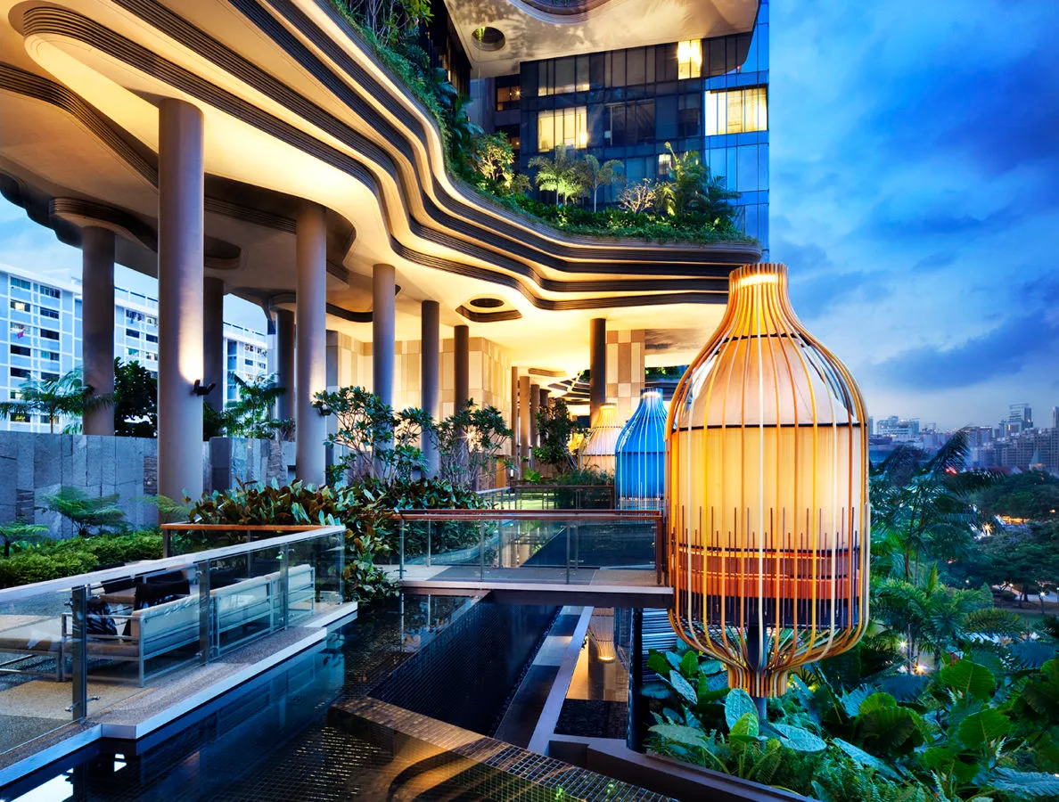

HOTEL TRINITY
BEACH PARTY

Slide 2
HOTEL TRINITY: About us
THE LUXURY HOTEL OFFERS WORLD CLASS SERVICE WITH RESTURANT AND LOUNGE FACILITIES, MULTI PURPOSE SERVICES, MEETING ROOMS AND DINING FACILITIES. These guest rooms contain furniture, artwork and more
Facilities:
Swimming pool
Catering
Shopping Mall
WIFI
Beach View
AC room
Couple room

Slide 3

SPECIAL EVENT:
BEACH PARTY
Double and single rooms available £40 all inclusive (breakfast, dinner and drinks, extra £5 for alcoholic beverages) FRESHLY MADE SANGRIA AVAILABLE AFTER 12PM for £4.50
Tapas will be served to embrace the Spanish culture (vegan and vegetarian options available) £7 for single and £15 for 2 – 3 people
Special guests !!!!!! DJ SPARK AND DJ CORREY – glow sticks to buy at reception for £2.50. VIP SEATS AT ADDITTIONAL COST OF £10
theme: beach vibes, bright colours, swimwear
£28 entrance per head

Slide 4
References:
https://linkedin.com/in/dipayan-mondal-256369202 (2022) What Is Hotel Event Planning: Checklist, Duties & Salary. [Online] [online]. Available from: https://www.hotelmanagementtips.com/hotel-event-planning/ (Accessed 7 June 2023).
Johnson, I. (2022) How to price tickets for an event: The best pricing strategies for event planners. [Online] [online]. Available from: https://www.tickettailor.com/blog/how-to-price-tickets-for-an-event-the-best-pricing-strategies-for-event-planners (Accessed 7 June 2023).
Morand, T. (2021) How to Plan an Event: a Complete Guide. [Online] [online]. Available from: https://www.wildapricot.com/blog/how-to-plan-an-event (Accessed 7 June 2023).
Paradise, A.N. (2020) Popular Spanish Food – 15 Traditional Dishes Everyone Should Try - Nomad Paradise.
Anon (n.d.) 7 tips for hotel event planners | Mews. [Online] [online]. Available from: https://www.mews.com/en/blog/hotel-event-planner (Accessed 7 June 2023).

