Slide 1

Freight Transport Interchanges

Slide 2

University of Wales Trinity Saint David
School of engineering
Transport Policy and Professional Competence
M4X01276
Students:
Ian Newberry
Georgiana Cune
James Smith
Krystian Hales
Wayne Thomas

Slide 3
We declare that this assignment is all our own work and that we have acknowledged all materials used from the published or unpublished works of other people. All references have been duly cited.
The presentation was realised with collaboration between the co-authors using emails and Facebook Messenger as communication and file sharing modes.

Slide 4
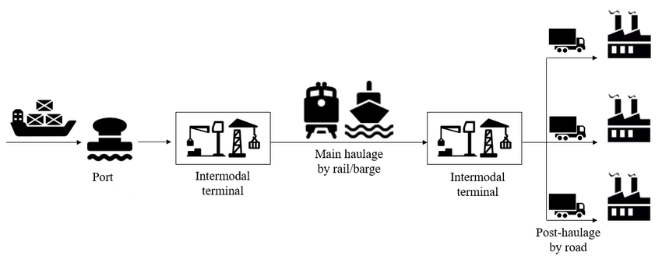
Introduction
Intermodal freight is the use of two forms of transport to ship a consignment. A typical example of this is road and rail. This is made possible through the use of intermodal or transport hubs.
Example of intermodal freight transport (ResearchGate, 2019)
Ian Newberry

Slide 5
A transport hub forms the link between the two forms of freight. A train would arrive with the consignment in an ISO container (Lowe, 2011), which is a shipping container that conforms to an international sizing standard, this sizing standard allows for the whole container to be lifted from one form of transport to another (Rushton et al, 2010).
With the container lifted from the train it would be loaded onto a truck and trailer to be transported via the road network to the next step in the freight process (Lowe, 2011).
Ian Newberry

Slide 6

One of the key drivers for transport hubs is to do with government incentives. These incentives are based around sustainability and reducing road traffic in 2012.
Ian Newberry

Slide 7
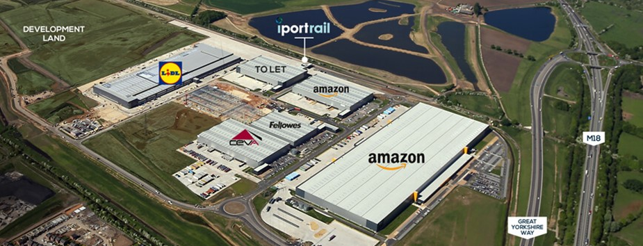
Doncaster Iport (Iport UK, 2019)
This is now being expanded on with the IPort Doncaster project. At IPort, the transport hub has 570,000 square feet of warehousing facilities with it’s own railway facilities. The idea behind this is that the IPort is connected via rail to all major ports and the channel tunnel, this should make logistics much easier (Doncaster Council).
Ian Newberry

Slide 8
The environment
One of the required aspects in choosing the intermodal freight transport is to reduce ‘adverse environmental pollution caused by vehicle exhaust emissions and noise’ (Lowe and Pidgeon, 2018, p.669).
Georgiana Cune
Notes:
Choosing the best combination of transport modes involves moving freight to the final destination using the most operationally efficient and cost-effective transport mode, as well as reducing the impact on the environment (Lowe, 2005). Reducing the air pollution, noise and vibration is one of the main benefits of switching freight transportation from the deficient and overcrowded transport road networks to rail or waterway systems within EU and UK.

Slide 9
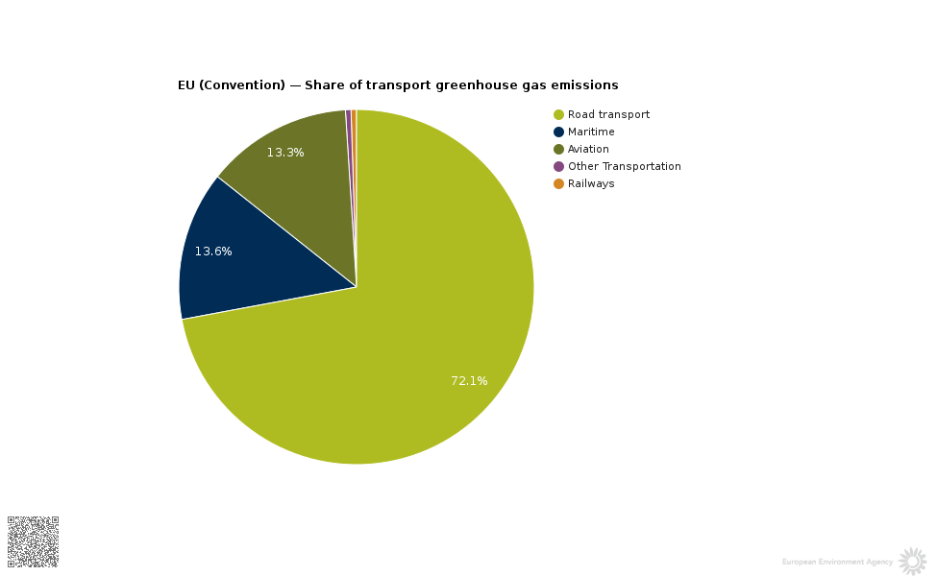
Share of transport greenhouse emissions - EU Convention (European Environment Agency, 2019).
Georgiana Cune
Notes:
The figure presents the share of transport GHG per tonne-km in percentage for the transport modes. While greenhouse emissions are one of the main concerns relating the climate change, the transport modes also vary in terms of the impacts in the air pollution.

Slide 10
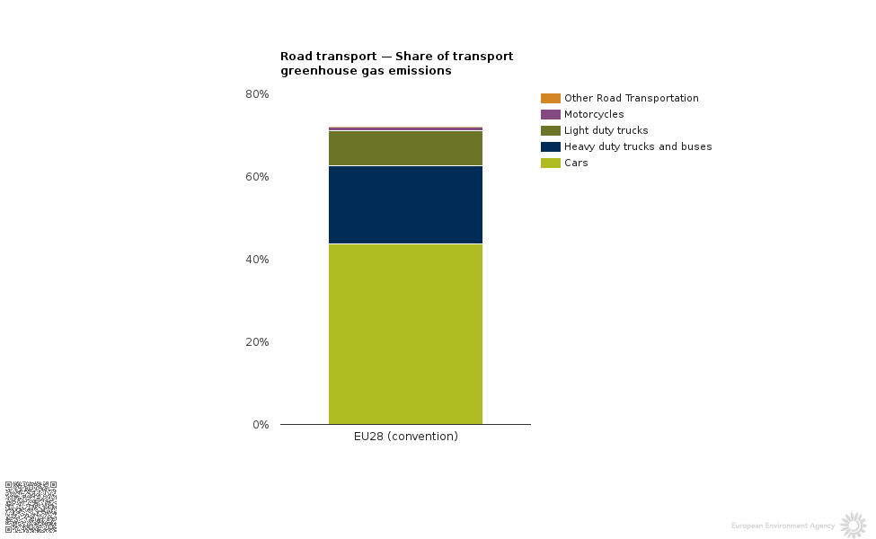
Road Transport - Share of transport greenhouse emissions - EU Convention (European Environment Agency, 2019).
Georgiana Cune

Slide 11
The European Commission has designed support programmes such as Marco Polo and Marco Polo II, which aims to reduce traffic road congestion and to improve the environmental aspects of the freight transport system. The objective of the programme is to promote intermodal freight transport, by shifting freight from road to other transport modes such as rail, inland waterways, short sea, and the motorways of the sea (Lowe, 2005).
Georgiana Cune
Notes:
The Marco Polo Programme is a budget and scope ambitious programme which also promotes commercial actions in the market for freight transport service.

Slide 12
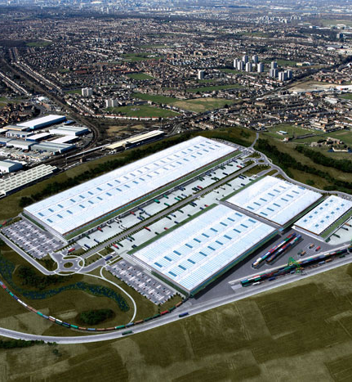
Commercial and Environmental Trade-offs for an Interchange Hub
Interchange Hubs are a large site that can accommodate vast quantities of freight including storage of freight, this means that large areas of land are needed for sites.
Howbury Park, London (Reconnections. London Transport and Beyond, 2012)
James Smith

Slide 13
Hubs are built close to main commercial routes including railway lines, airports, seaports and motorways to allow for quick turnaround. However not all modes are present at a hub so even a seaport maybe close to an interchange hub road transport is required and this could add more traffic to local roads.
James Smith

Slide 14
Most transportation of freight is carried during the night for the transportation channels are generally quieter, so more freight can be moved.
Government has supported the shift road to rail with MSRS grants so set up costs to use intermodal are reduced.
MSRS – Mode Shift Revenue Support
James Smith
Notes:
Most transportation of freight is carried during the night for the transportation channels are generally quieter, so more freight can be moved. For example, train loads move at night as it means the trainlines are used far less for passenger trains. The trade-off is trainlines that pass by residential areas that at one time may not have been used as much maybe become busier so cause more noise pollution. Same with airports.

Slide 15
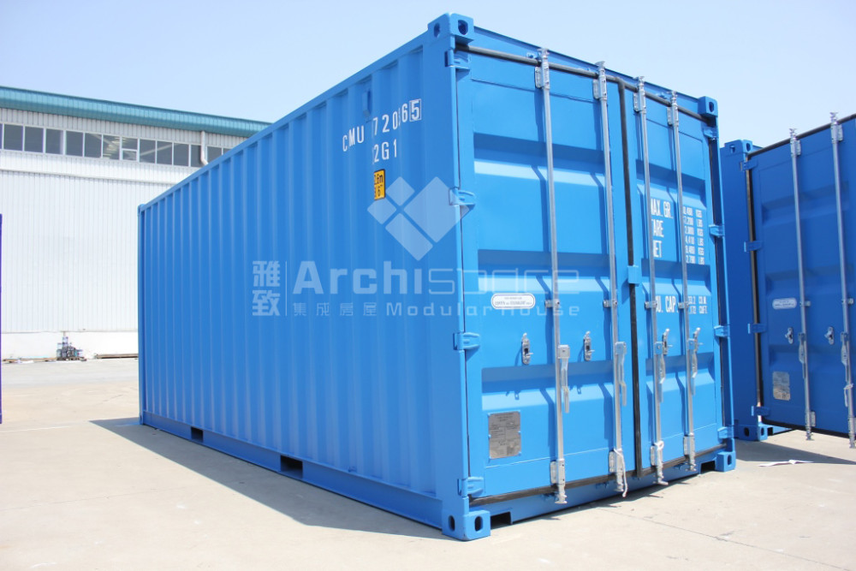
The invention of the ISO container changed the global attitude towards choosing the right mode of transport as now combining different modes together is often easier than sticking to one mode of transport through the entire journey (Gattorna, 1997).
Krystian Hales
Notes:
Transporting cargo nowadays differs a lot from what it used to be. The invention of the ISO container changed the global attitude towards choosing the right mode of transport as now combining different modes together is often easier than sticking to one mode of transport through the entire journey (Gattorna, 1997). While myself and the co-authors of the presentation agree that building transport hubs has a strong impact on the environment it needs to be noted that all investments are potentially bad for the environment

Slide 16
Intermodal transport has a clear environmental advantage over, for example road transport. This is because transporting cargo on rails is cheaper, more efficient and reduces the carbon footprint when Ikea, for example, states that freight trains emit 70 % less CO2 than road lorries would carrying the same amount of cargo (Manners-Bell, 2016).This shows that allowing trains to do part of the job is more beneficial that relying purely on lorries. Using this advantage would not be possible without the existence of transport hubs.
Krystian Hales

Slide 17
Conclusion
Increasing pressure from EU sources, i.e. Marco Polo 2, with funding incentives from such schemes ensure that there is proliferation of the Freight hubs to cope with year on year freight movement increases (ORR, 2011) which benefits off site logistical business more than the local stakeholders which will have a negative commercial and environmental impact on the freight interchange hub stakeholders’ local areas.
Wayne Thomas
Notes:
The conclusion of the information previously mentioned, and the analysis of the papers and articles read by the co-authors of this presentation does confirm the need of freight interchange hubs due to increasing pressure from E U sources i.e. Marco Polo 2 with funding incentives from such schemes to ensure that there is proliferation of the Freight hubs to cope with year on year freight movement increases (ORR, 2011) which benefits off site logistical business more than the local stakeholders which will have a negative commercial and environmental impact on the freight interchange hub stakeholders’ local areas.

Slide 18
The downside of these Freight hubs is the effect on the environment be it good or damaging usually siding on the damaging aspect (Hall, P., 2008) but this can be offset using carbon offset schemes to reduce the emission produced (McKinnon A, 2007).
Wayne Thomas

Slide 19
With more and more freight being moved via Intermodal methods the need for a more integrated understanding between the aspects mentioned is evermore important and that all stakeholders associated with the operation of Freight interchange Hubs need to invest more in gaining an improved resolution the associated problems such as the environmental and commercial aspects.
Wayne Thomas

Slide 20
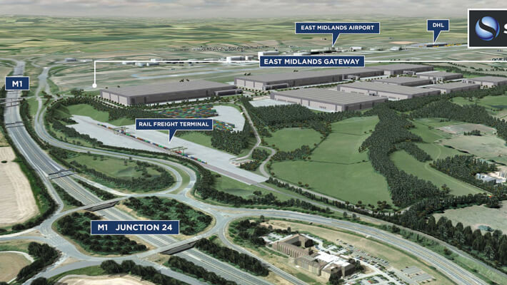
Notes:
EAST MIDLANDS GATEWAY RAIL FREIGHT INTERCHANGE
‘A 700 ACRE `INLAND PORT’ WHICH COMBINES LINKS TO THE M1 AND EAST MIDLANDS AIRPORT WITH A MAJOR NEW RAIL FREIGHT TERMINAL. BUILT IN SIX PHASES, ALL WORK DUE TO BE COMPLETED BY THE END OF 2019’ (SPATIALGLOBAL ,2019).

Slide 21
References
Allan Woodburn (2008) Intermodal Rail Freight in Britain: A Terminal Problem, Planning Practice & Research,
Council, D. (2019). iPort - Doncaster Council. [online] Doncaster.gov.uk. Available at: http://www.doncaster.gov.uk/services/transport-streets-parking/iport [Accessed 23 Feb. 2019].
European Environment Agency. (2019). Share of transport greenhouse gas emissions. [online] Available at: https://www.eea.europa.eu/data-and-maps/daviz/share-of-transport-ghg-emissions-1#tab-chart_1 [Accessed 26 Feb. 2019].
Gattorna, J. 1997. Handbook of Logistics and Distribution Management 4th edition. Sydney: Gower.
Hall, P., 2008. Global logistics and local dilemmas. In Proceedings of the international conference on gateways and corridors.
London Reconnections. (2019). London & Freight Part 2: The Freight Must Flow - London Reconnections. [online] Available at: https://www.londonreconnections.com/2012/london-freight-part-2-the-freight-must-flow/ [Accessed 24 Feb. 2019].
Lowe, D. (2011). The transport manager's & operator's handbook 2011. London: Kogan Page.

Slide 22
Lowe, D. and Pidgeon (2018). The transport manager's & operator's handbook 2018. London: Kogan Page
Lowe, D., 2006. Intermodal freight transport. Routledge.
Manners-Bell, J. (2016). Introduction to Global Logistics.
McKinnon A 2007,Transport and Climate Change: CO2 emissions from freight transport in the UK (2007)
ORR, 2011. National Rail Trends Yearbook 2011
ResearchGate. (2019). ResearchGate | Share and discover research. [online] Available at: https://www.researchgate.net [Accessed 24 Feb. 2019].
Rushton, A., Croucher, P. and Baker, P. (2010). The handbook of logistics and distribution management. 4th ed. London: Kogan Page.
Spatialglobal.com. (2019). East Midlands Gateway Rail Freight Interchange. [online] Available at: https://www.spatialglobal.com/news/2017/11/20/east-midlands-gateway-rail-freight-interchange/ [Accessed 25 Feb. 2019].

