Slide 1
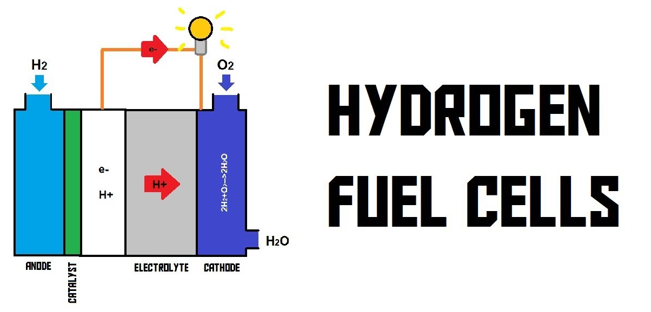
Student name : Maulik Dave student number : 2106684
Hybrid Vehicle Presentation
Hybrid Powertrain and Control
Lecturer: Mark Sandford

Slide 2
Introduction
Fuel cells convert the chemical energy of hydrogen into electrical and thermal energies
Full cell have 2 consists of two electrodes, the cathodes (positive)
And the anode(negative) connected by an electrolyte.
Hydrogen is a colourless, odourless, tasteless and nontoxic gas.
Hydrogen is renewable fuel we can make hydrogen with different sources
Non-polluting buggy.

Slide 3
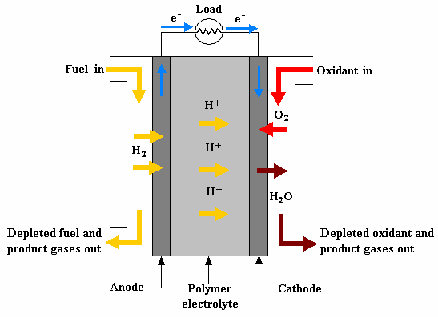

Proton exchange membrane fuel cell.
Proton exchange fuel cell is most suited for automobiles, due to its relatively low temperature(about 80c)
Operation , high power density.
rapid change in power om demand.
quick start-up .

Slide 4
Value from previous assignment
In previous assignment we calculated some values.
Battery current = 50A
Battery voltage = 48 v
Average power =2.75 kw.
With help of this value we can find how much size we consider for our buggy.
In hydrogen we can get around 33000 + watt. Hour/ Kg in petrol we have 12000 + gasoline (petrol)

Slide 5
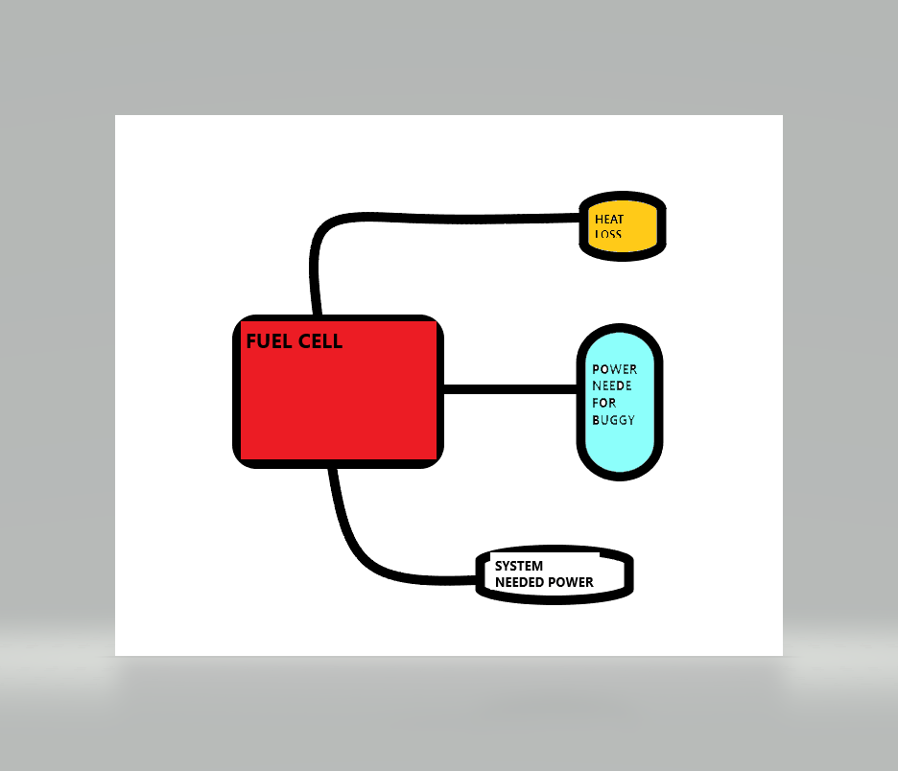
Methodology
In figure we can se that in fuel cell there is three power out put.
First normal buggy power is around = 3.25kw
1.17kw is a heat loss
0.5kw use by (PEMFC) system.
So we need total around 4.42kw to
run buggy.

Slide 6
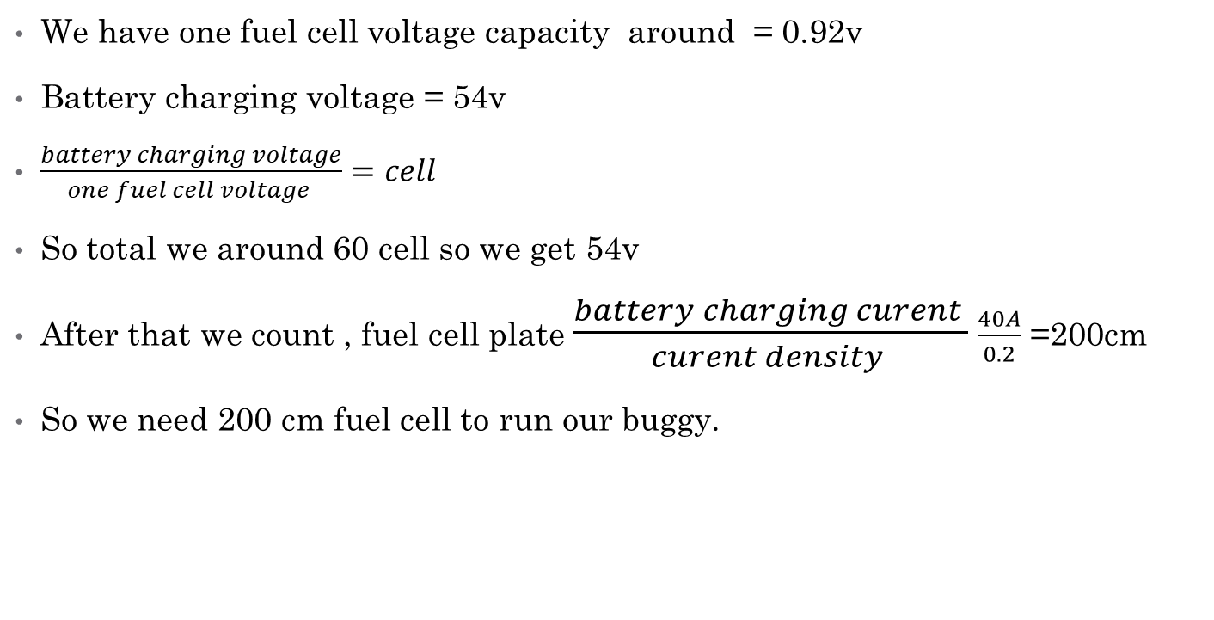
How much fuel cell we need ?
We have one fuel cell voltage capacity around = 0.92v
Battery charging voltage = 54v
$\frac{battery charging voltage}{one fuel cell voltage }=cell$
So total we around 60 cell so we get 54v
After that we count , fuel cell plate $\frac{battery charging curent }{curent density }$ $\frac{40A}{0.2}$ =200cm
So we need 200 cm fuel cell to run our buggy.

Slide 7
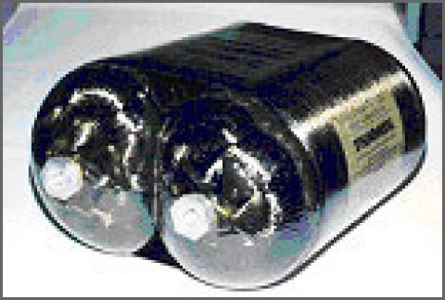
HOW IS HYDROGEN STORED?
Hydrogen can be stored in a variety of ways like
Compressed gas
cold?/ cryo compressed
Liquid H2
Compressed Gas and Cryogenic Liquid Storage
Hydrogen can be physically stored as either a gas or a liquid. Storage as a gas typically requires high-pressure tanks (5000–10,000 psi tank pressure). Storage of hydrogen as a liquid requires cryogenic temperatures because the boiling point of hydrogen at one atmosphere pressure is -252.8°C

Slide 8
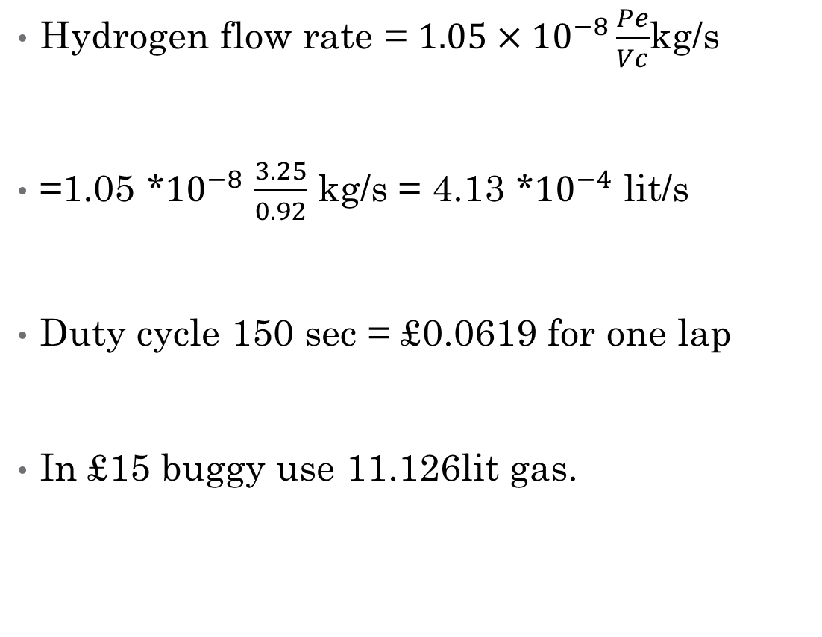
Costing
Hydrogen flow rate = $1.05×{10}^{−8}\frac{Pe}{Vc}$kg/s
=1.05 *${10}^{−8}$ $\frac{3.25}{0.92}$ kg/s = 4.13 *${10}^{−4}$ lit/s
Duty cycle 150 sec = £0.0619 for one lap
In £15 buggy use 11.126lit gas.

Slide 9
Conclusion
hydrogen, when compared to gasoline is more flammable, explosive, buoyant and diffusive.
Hydrogen has very low density as well.
Hydrogen has the potential to be an alternative energy carrier for future fuel needs. The of hydrogen as a fuel requires development in several industry segments, including production, delivery, storage and use.
Fundamental to the creation of a hydrogen economy is a viable, safe and affordable hydrogen system for buggy.

Slide 10
References
Hydrogen fuel by Ram b Gupta.
https://www.electrichybridvehicletechnology.com/
https://www.hyper-motive.com/
http://www.ukh2mobility.co.uk/
https://www.energy.gov/eere/fuelcells/hydrogen-storage-basics-0

