Slide 1
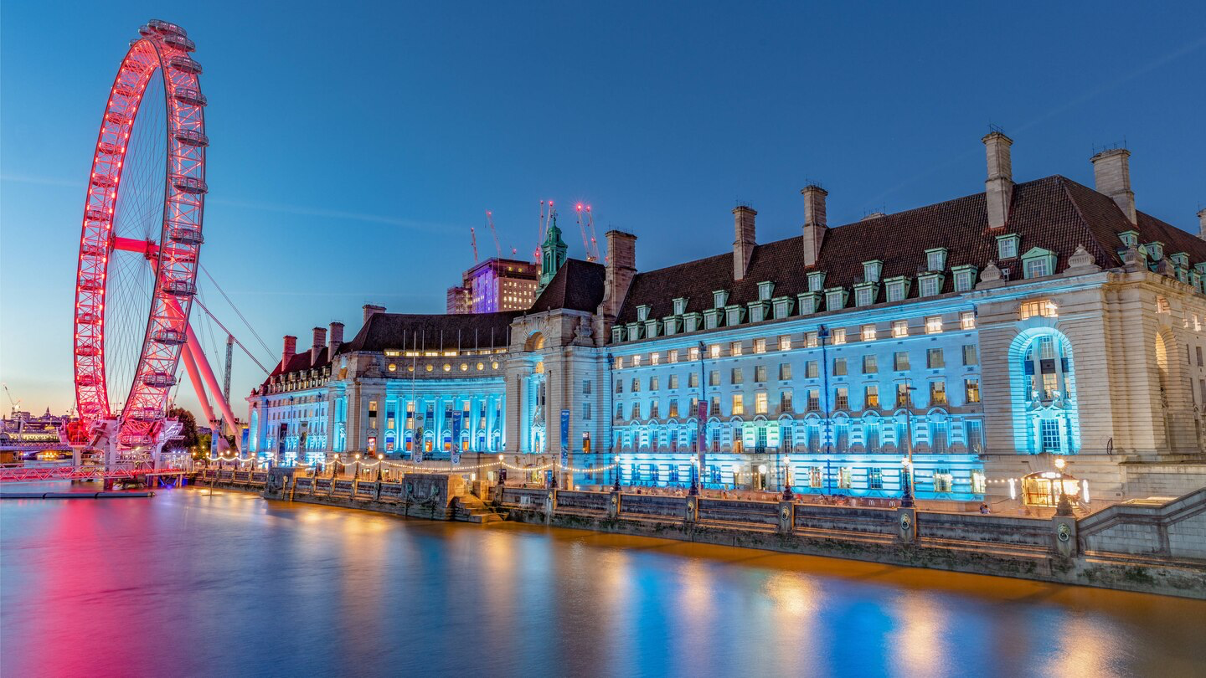
London Marriott Hotel
County Hall
Notes:
Marriott international - operates in 130 countries, has more than 6,700 properties and over 30 brands.

Slide 2
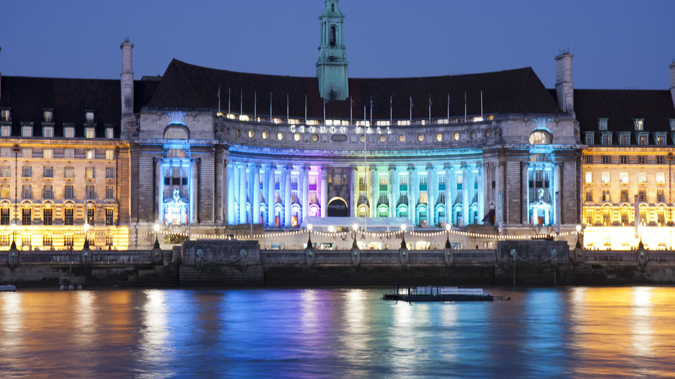
About the hotel
Property details – 6 floors, 192 rooms, 14 suites
12 Meeting Rooms, 834 square metres of meeting space
First opened 6th July 1998
Renovated in 2016 ‘capturing the subtle essence of great British style’
Gillrays Steakhouse & Bar
Indoor 25m Pool
Gym for guests
Notes:
The 5* hotel is situated in the heart of Central London
Over-looking the River Thames
4 Mins to London Eye
8 Mins to Big Ben

Slide 3
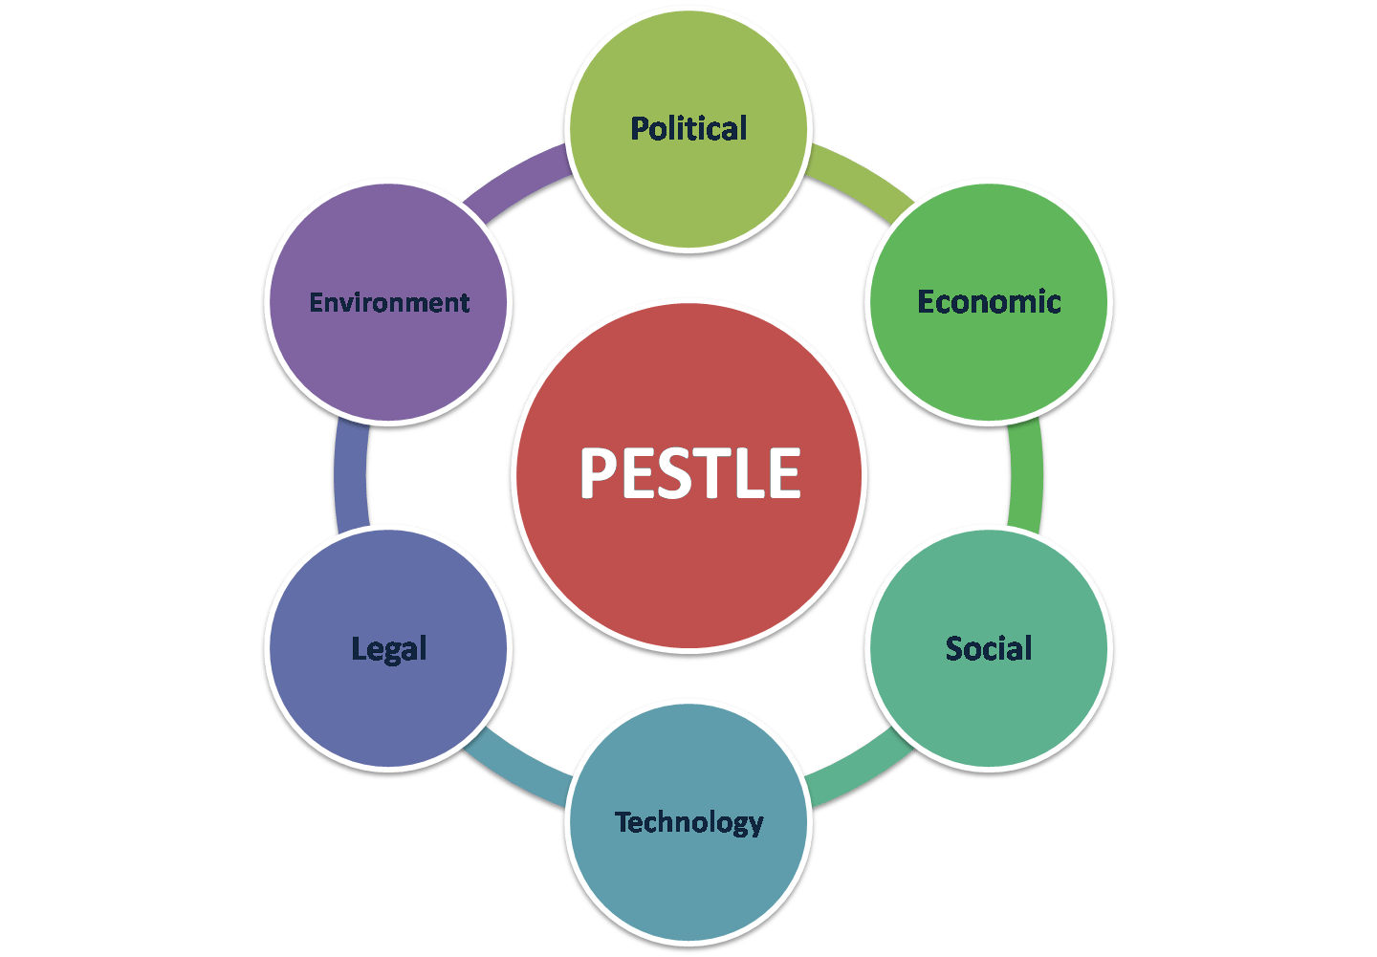
PESTLE Analysis
A PESTLE analysis is a framework or tool used to analyse and monitor the macro-environmental factors that may have a profound impact on an organisation's performance.
Notes:
Help highlight any strengths/weaknesses of a business
Resulting in making changes
Identify trends in political, social & technological landscape

Slide 4
Political Factors affecting the Hotel
Brexit
Sourcing of skilled workers
Travelling abroad – unappealing
Notes:
Brexit may affect sourcing of skilled workers, industry relies a lot on foreign employees
Brexit may result in migrants being forced home, jobs filled by Brits
Causing higher wages and labour costs – forced onto customers
Brits more inclined for staycation – boosting UK hotel industry

Slide 5
Economic factors affecting the Hotel
Cost of living in London
Will the tourism industry survive?
Cheaper to travel to Britain
Notes:
Wages & Cost of Living in London – a lot higher in city centre
Whether travel and tourism industry is sustainable, and how business will continue. Be cheaper for international tourists to come to Britain

Slide 6
Social factors affecting Hotel
Where will you get your staff from?
High student numbers
Notes:
Advantageous for the business to take advantage of this and make the most of the opportunities
16% of whole UK student studying in London

Slide 7
Technological factors affecting the Hotel
Online Applications
How technologically advanced is the hotel?
Free Wi-Fi for guests
Express check in & check out
Video review billing
Notes:
Online job openings – able to filter the searches for staff
How tech advanced is the hotel –
Everyone today relies on use of social media in day to day life
Free wifi – advantageous for guests against competition
Express check in and out – guests want faster service

Slide 8
Legal factors affecting the Hotel
Legal Working Hours
Providing PPE for Staff
Workplace Equality
Data Protection
Notes:
Companies have rules and regulations they must obey to protect the well-being of staff, and further protecting the guests.
providing staff with appropriate protective equipment.
kitchen uniforms, or gloves for handling chemicals.
workplace equality act, this law is in place to protect any workplace discrimination against employees because of their gender, sex also sexual orientation.
protect the rights of customers and employees, the data protection act must be followed.

Slide 9
Environmental factors affecting the Hotel
How does the hotel affect the environment?
Switch to paper straws from plastic
Switching to green energy
Notes:
Paper straws are biodegradable
Switching to green energy
Using towels more than once
Automated lights in public areas

Slide 10
Importance of an Effective Recruitment Process
Attracts the right candidates
Increase employee productivity
Retain interest of candidates
Notes:
Looking for the right person for the job, not if you like them or not
Should fit the attitude and environment of the business
Effective recruitment process cuts time
Right candidates are hired – increases profitability and performance of a business

Slide 11
Principal factors that affect: Culture, Equality & Diversity
Language
Equal opportunities for each associate
Treating everyone with respect
Rewards, promotions and hiring right people for the job
Discrimination against associates
Notes:
diversity means employing individuals who are different from each other, and do not all come from the same background.
employing candidates from different nationalities, religion, gender or sexual orientation.
Cultural diversity plays a significant role in the hospitality industry, it is important due to having global customer related issues.
Due to the high volume of international tourism, having staff from various backgrounds and cultures would minimise the risk of communication barriers between customers and staff.
Having a variety of associates, provides a company with a variety of different perspectives.
too much diversity within a business could cause unhealthy competition between associates

Slide 12
Main methods of Performance Management
Staff Appraisals
Weekly Meetings with department heads & mangers
Analysis of companies’ accounts
Notes:
purpose of an appraisal is to achieve better work performance from employees
Regular meetings with department heads will also benefit the company, in order to gain an insight into how each department is working.
allowing any issues or concerns to be raised, and further resolving going forward.

Slide 13
Outline Plan offering Recommendations
Take care and great consideration when employing new staff.
Be sure to make the most of where the hotel is situated.
Ensure you follow the rules and laws set – in order to protect yourself as much as your staff.
Implement changes in ensuring the environmental sustainability of the Hotel.
Be sure to employ different cultures into the hotel, and treat each associate fairly.

