Slide 1

Memory for Assessment Feedback in Higher Education: does self-reported student motivation influence this process?
Ella Morris-fuge
MSc Applied Psychology
University of Wales Trinity Saint David School of Psychology
2021

Slide 2
Outline
Executive Summary
Systematic Literature Review
Research Paper
Reflective Chapter

Slide 3
Executive Summary
Research Context
The revised UK Quality Code for Higher Education (QAA, 2018), states that students should have the opportunity to experience high-quality education to attain a qualification of high standards through their degree. Feedback can support this principle since it can enhance students learning potential if they engage with it effectively (Cutumisu & Schwartz, 2018).
Applied Research
A systematic literature review exploring whether type of feedback, amount of feedback and self-reported levels of motivation influence student’s memory for feedback in higher education was carried out.
A 2 x 4 cross-sectional mixed-subjects experimental quantitative design study was conducted.

Slide 4
Executive Summary
Applied Research
The study examined the effects of phrasing (positive/negative) and amount of feedback (limited/extended), as well as self-reported levels of motivation on memory for feedback comments provided on a hypothetical piece of work.
Key Findings
There were no significant differences in the students memory recall performance for positive and negative feedback.
Students memory recall performance for limited feedback comments was significantly better than for extended feedback comments.
Students who reported higher levels of motivation remembered more feedback than those who report lower levels of motivation, regardless of the type of feedback.

Slide 5


Systematic Literature Review
A systematic literature review exploring whether type of feedback, amount of feedback and self-reported levels of motivation influence student’s memory for feedback in higher education
Feedback
From a cognitive perspective feedback can be defined as information that is required for improvement (Wisniewski et al., 2020). Feedback has the potential to improve and facilitate a student’s attainment by closing any gaps in learning (Cutuisu & Schwartz, 2018).

Slide 6
Systematic Literature Review
Aim of Review
To examine feedback content (in terms of type and length), students processing of feedback, and the influence motivation has on student’s engagement with feedback.
Purpose of Review
To provide an overview of existing studies that explore type of feedback (positive and negative), amount of feedback (limited and extended), the influence student motivation has on engagement with feedback, memory recall and how this is measured, with consideration of the HE context.

Slide 7
Systematic Literature Review
Review Objectives
1. Explore studies relating to memory recall and how this is examined.
2. Evaluate the effects of type of feedback (positive and negative) on student engagement with feedback.
3. Evaluate the effects of amount of feedback (limited and extended) on student engagement with feedback.
4. Consider whether motivation plays a role in student engagement with feedback.
5. Review studies presented in this review in the context of HE where applicable.

Slide 8
Systematic Literature Review
The quality assessment of the included studies was completed using the Mixed Methods Appraisal Tool (MMAT) (Hong et al., 2018) for the qualitative, quantitative, mixed methods and a case study. The Critical Appraisal Skills Programme Criteria (CASP) (2018) for reviews was used to evaluate the reviews included in this review.
Method
Components | Search terms
Assignment feedback | Assignment feedback, Assessment feedback
Feedback type | Feedback type, Feedback amount, Feedback comments
Memory | Memory recall
Motivation | Motivation, Student engagement
Higher education | Higher education, Undergraduate

Slide 9
Systematic Literature Review
Results
Memory
Feedback Type
Feedback Amount
Motivation

Slide 10
Systematic Literature Review
Discussion
Students’ perception of feedback can be influenced by the type and amount of feedback given, subsequently their perception of feedback shapes their memory for feedback (Van der Kleij & Lipnevich, 2020).
Emotions are instrumental (Hill et al., 2021).
Students with high motivation are more likely to engage with their feedback due to goal orientation, increased effort and understanding (Li & Tsai, 2017)

Slide 11
Systematic Literature Review
Limitations
1. Limited studies containing all relevant elements
2. Gender bias
3. Self-reported measures
4. Sample size
5. Relevant papers potentially not located

Slide 12
Research Paper
Memory for Assessment Feedback in Higher Education: Does self-reported student motivation influence this process?

Slide 13
Research Paper
Current Study
The research questions:
To explore whether students will remember negative feedback more than positive feedback and whether memory will be worse for extended feedback comments compared to limited feedback comments.
To explore whether students who report higher levels of motivation remember more feedback comments than those who report lower levels of motivation, regardless of feedback type.
Research hypotheses
Students will remember significantly more negative feedback than positive feedback comments.
Memory of feedback comments will be significantly better when there are fewer comments.
Students who report higher levels of motivation will remember more feedback than those who report lower levels of motivation, regardless of feedback type

Slide 14
Research Paper
Methods
Participants
Design
Materials
Procedure

Slide 15
Research Paper
Results
High motivation group remembered more feedback than the low motivation group
Limited feedback was better remembered than extended feedback
No differences were found in memory performance recall between negative and positive feedback

Slide 16
Research Paper
Discussion
Suggestions for HE educators when giving feedback based on the findings of this study include giving limited feedback, and to assess student’s motivation levels. Following this assessment, any students lacking motivation could be supported to develop their motivation to engage so that they are more likely to utilise the feedback that they are given and achieve their desired outcomes.

Slide 17
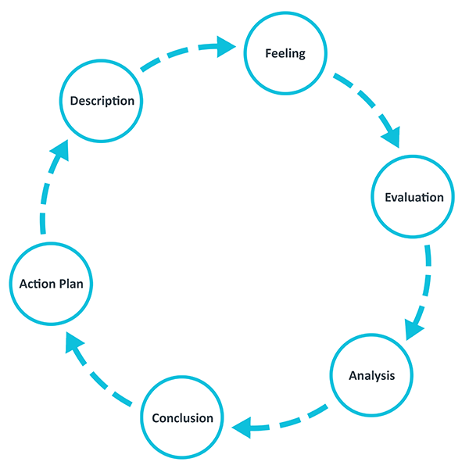
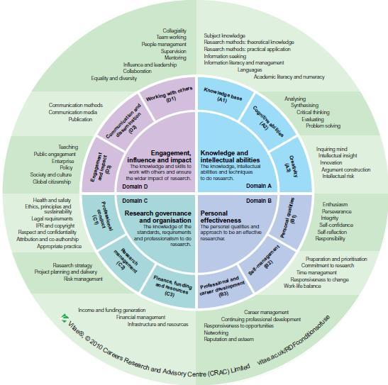
Reflective Chapter
Gibb’s (1988) Cycle and RDF framework (CRAC, 2011)

Slide 18
References
Careers Research and Advisory Centre (CRAC). (2011). Researcher Development Framework[Ebook] (2nd ed.). Retrieved 1 April 2021, from.
Critical Appraisal Skills Programme (2018). CASP (Review) Checklist. [online] Available at: URL. Accessed: Date Accessed.
Cutumisu, M., & Schwartz, D. (2018). The impact of critical feedback choice on students' revision, performance, learning, and memory. Computers In Human Behavior, 78, 351-367. https://doi.org/10.1016/j.chb.2017.06.029
Gibbs, G. (1988). Learning by Doing: A Guide to Teaching and Learning Methods. Further Education Unit.
Hill, J., Berlin, K., Choate, J., Cravens-Brown, L., McKendrick-Calder, L., & Smith, S. (2021). Exploring the Emotional Responses of Undergraduate Students to Assessment Feedback: Implications for Instructors. Teaching & Learning Inquiry, 9(1), 294-316. https://doi.org/10.20343/9.1.20
Hong QN, Pluye P, Fàbregues S, Bartlett G, Boardman F, Cargo M, Dagenais P, Gagnon M-P, Griffiths F, Nicolau B, O’Cathain A, Rousseau M-C, Vedel I. (2018) Mixed Methods Appraisal Tool (MMAT), version 2018. Registration of Copyright (#1148552), Canadian Intellectual Property Office, Industry Canada.
Li, L., & Tsai, C. (2017). Accessing online learning material: Quantitative behavior patterns and their effects on motivation and learning performance. Computers & Education, 114, 286-297. https://doi.org/10.1016/j.compedu.2017.07.007
Van der Kleij, F., & Lipnevich, A. (2020). Student perceptions of assessment feedback: a critical scoping review and call for research. Educational Assessment, Evaluation And Accountability, 33(2), 345-373. https://doi.org/10.1007/s11092-020-09331-x
Wisniewski, B., Zierer, K., & Hattie, J. (2020). The Power of Feedback Revisited: A Meta-Analysis of Educational Feedback Research. Frontiers In Psychology, 10. https://doi.org/10.3389/fpsyg.2019.03087

Slide 19
Thank you!
Acknowledgements to:
Dr Kate Williams
Dr Ceri Phelps
Dr Paul Hutchings
Participants
Friends and family

