Slide 1

Digital Skills for Success
Campus Wifi Connection
Downloading & Exploring UWTSD HwB App
Accessing Moodle
Accessible Campus Apps: Treasure Hunt Activity

Slide 2
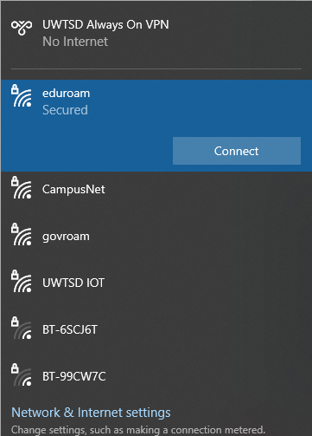
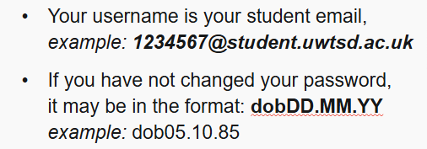
WiFi Login
Welcome to campus! You are going to need to be connected to campus WiFi for most activities. Let's get connected...
Step 2: You will need to enter your username and password.
Step 1: Open up your WiFi settings and find 'eduroam'. Connect.

Slide 3
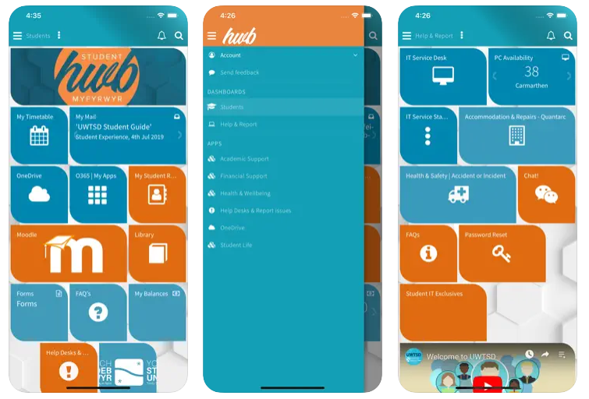
UWTSD HWB App
The UWTSD HWB app provides a simple to use, personalised and efficient way to access all the information you'll need during your time at UWTSD.
The app will include academic support, finance queries, campus life, health and wellbeing, and so much more... The one-stop shop for all your queries.

Slide 4

Accessing Moodle
Task 2: Access Moodle
You can access Moodle directly from the HWB App. If you've already downloaded (Task1) this will be very easy.
You can also access from the University Website:
www.uwtsd.ac.uk
Click on 'Current Students' tab (top right corner)
Click on Moodle tab
Sign in with student credentials
Moodle is the University's VLE (Virtual Learning Environment). You will need to access Moodle regularly. You'll be using Moodle to access lecture materials, find study materials, assignment information and to submit your assessments! Being confident with Moodle access will help you every week.

Slide 5
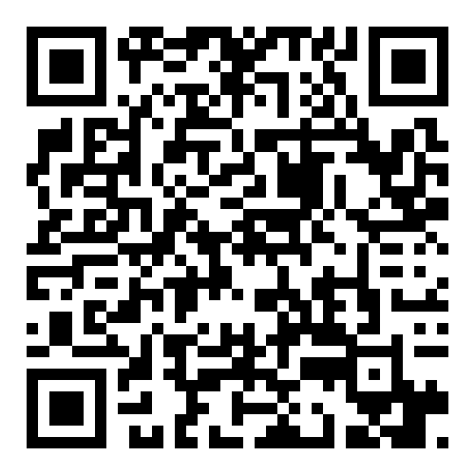
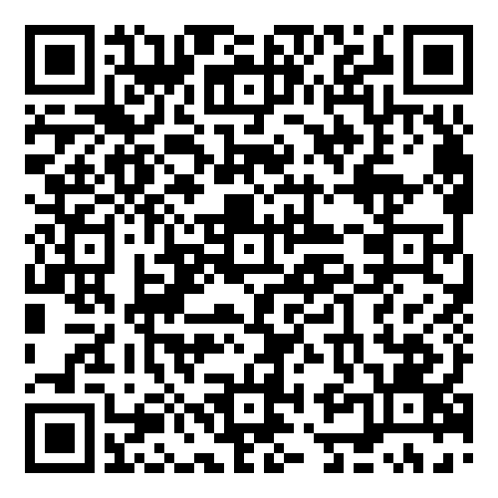


Task 1: Download and Explore the HWB App
Download UWTSD HWB App. Follow QR codes or just search for 'UWTSD HWB' in relevant App store. Or access from University Website if you prefer.
Sign-in with your Student Log-in credentials.
Can you find your timetable?
Feedback to the class one other area you've found on the HwB App. What have you discovered...?

Slide 6
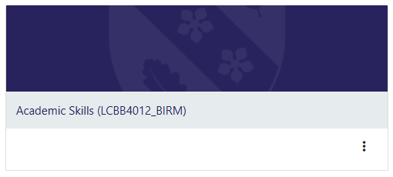
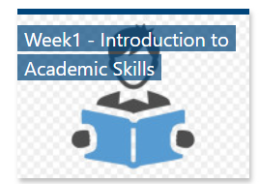

Task 3: Find your Week 1 lecture slides
Step 1: Log in to Moodle
Step 2: Find LCHS4002 Digital Skills and Research Methods Module
Step 3: Find Week 1 - Introduction/ Digital literacy and safety
Step 4: Find lecture PowerPoint files
Question: What are you doing after the break today?

Slide 7
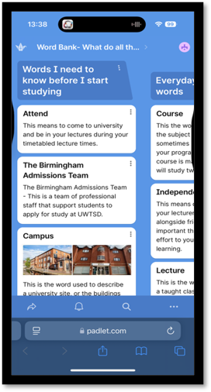
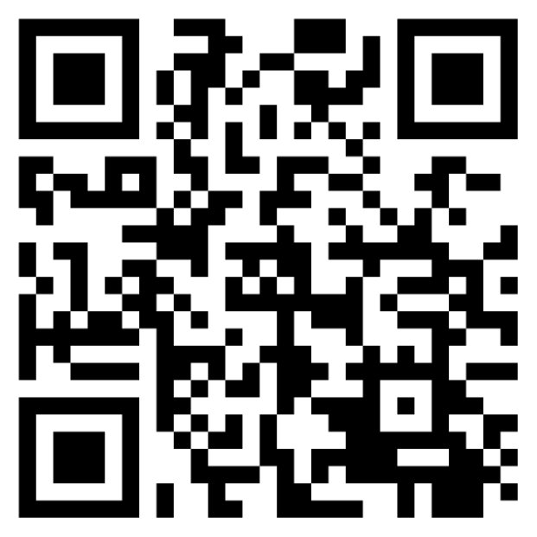
Campus Word-Bank
You're probably new to a University environment, meaning there are words and terms you might not have encountered before. If you are unsure of the meaning of University specific words, this word-bank will help.

Slide 8
Word-Bank Treasure Hunt
Task 4: Team up with the person next to you. Which pair can be quickest in answering the following questions?:
Where can you find financial support services?
Where is the 'Support Desk'.
What percentage do you need in your assignments to achieve a 'Distinction'

Slide 9
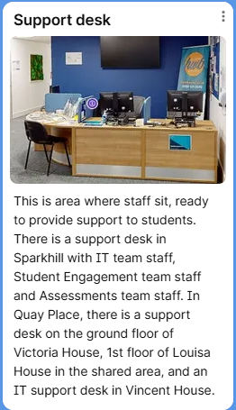
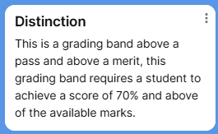
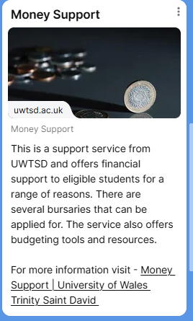

Answers
3.
1.
2.
Well Done!!

Slide 10
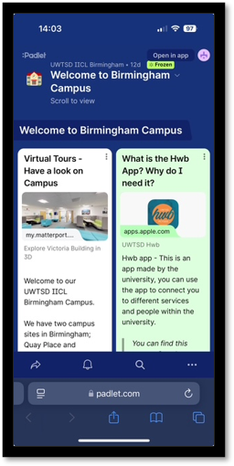
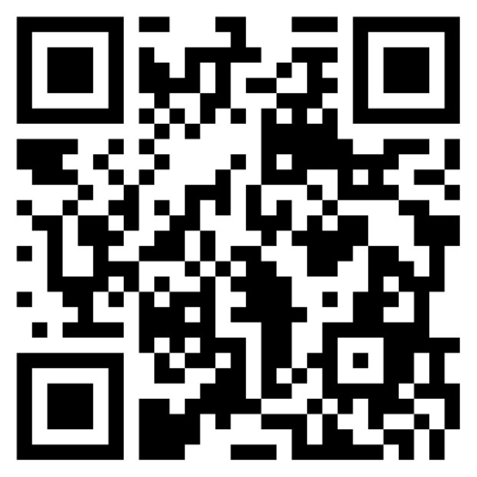
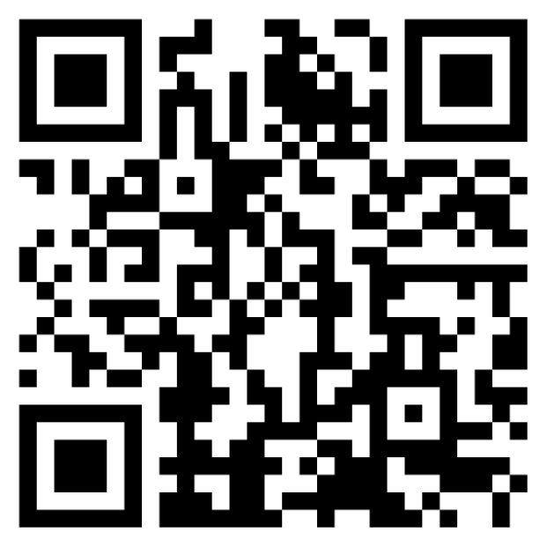
You like campus apps....?
Welcome to Birmingham

