Slide 1

The role of the Health Visitor.
Lisa Quinn
2314138

Slide 2

INTRODUCTION.
  This presentation will explain the role of the health visitor. The personal and professional skills needed, and the professional guidelines that should always be followed.

Slide 3

ACADEMIC SKILLS.
Health Visitors are specialist community public health nurses, who are firstly midwives or nurses, (healthcareers.nhs,2004)
This Photo by Unknown Author is licensed under CC BY-NC

Slide 4

PROFESSIONAL SKILLS & VALUES
Be an active member of the NMC, (Nursing Midwifery Council)
Healthy child programme (0-5) to ensure every child has the best start in life.
This Photo by Unknown Author is licensed under CC BY-SA-NC
This Photo by Unknown Author is licensed under CC BY-SA-NC

Slide 5
PERSONAL VALUES.
An interest in children and public health
Flexible and observant
Excellent communication skills
Able to work independently or as part of a team.
Well organised
Demonstrate leadership skills

Slide 6
COMMITMENT TO PROFESSIONAL
PRACTICE.
The 6c’s of care in nursing

Slide 7
GUIDELINES AND POLICIES.
Specialist community public health nursing (SCPHN)
The nursing and midwifery council (NMC)
Health education and improvement Wales (HEIW)
Healthy Child Wales Programme
Wales Safeguarding Procedures
First 1000 days – Public Health Wales

Slide 8
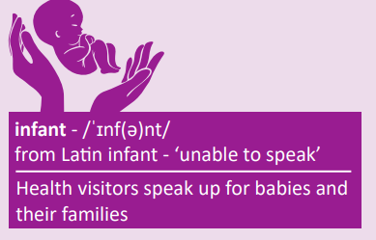

Slide 9
CONCLUSION
To conclude this presentation, we can see that the role of a health visitor can be a positive and rewarding career path to follow.
They must be qualified registered nurses or midwives firstly then they would need to complete the specialist community public health visiting course.
Strong personal values such an interest in children and public health, excellent communication and leaderships skills
They must uphold a commitment to their professional practice by following NMC guidelines and upholding the 6C’s of care and nursing.
A knowledge of related legislation procedures and standards and a commitment to health and safety.

Slide 10
ANY QUESTIONS ?

Slide 11
REFERENCES.
National careers (2024)https://www.nationalcareers.service.gov.uk (accessed March 20214)
Institute of Health Visiting(2023)https://www.ihv.org.uk(accessedat March 2024)
The National College (2024)https://www.cpdonline.co.uk(accessedat March 2024)
Nursing midwifery council https://www.nmc.org.uk(accessedat( March2024)
UK Health Security Agency (2024)https://www.ukhsa.blog.gov.uk(accessedat March2024)
Careers Wales https://www.careerswales.gov.wales(accessedat March 2024)
NHS Wales(2024) https://www.heiw.nhs.wales(accessedat March 2024
Welsh Government Services and Information(2024) https://www.gov.wales(accessedat March 2024)
Health Under 5s(2024) https://www.healthforunder5s.co.uk(accessedat March2024)
NHS(2024)https://www.nhs.uk.co.uk(accessedat March2024)

