Slide 1
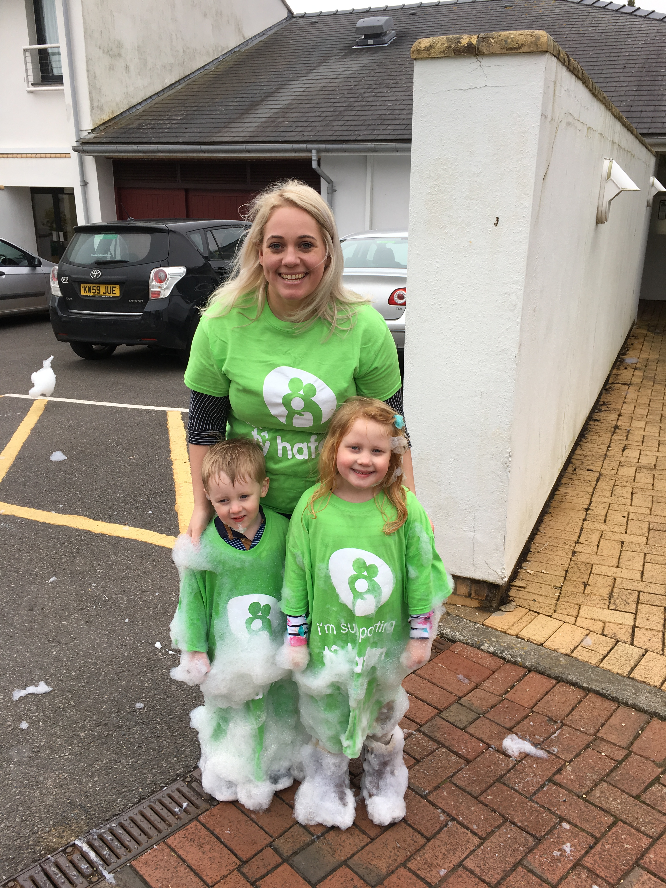


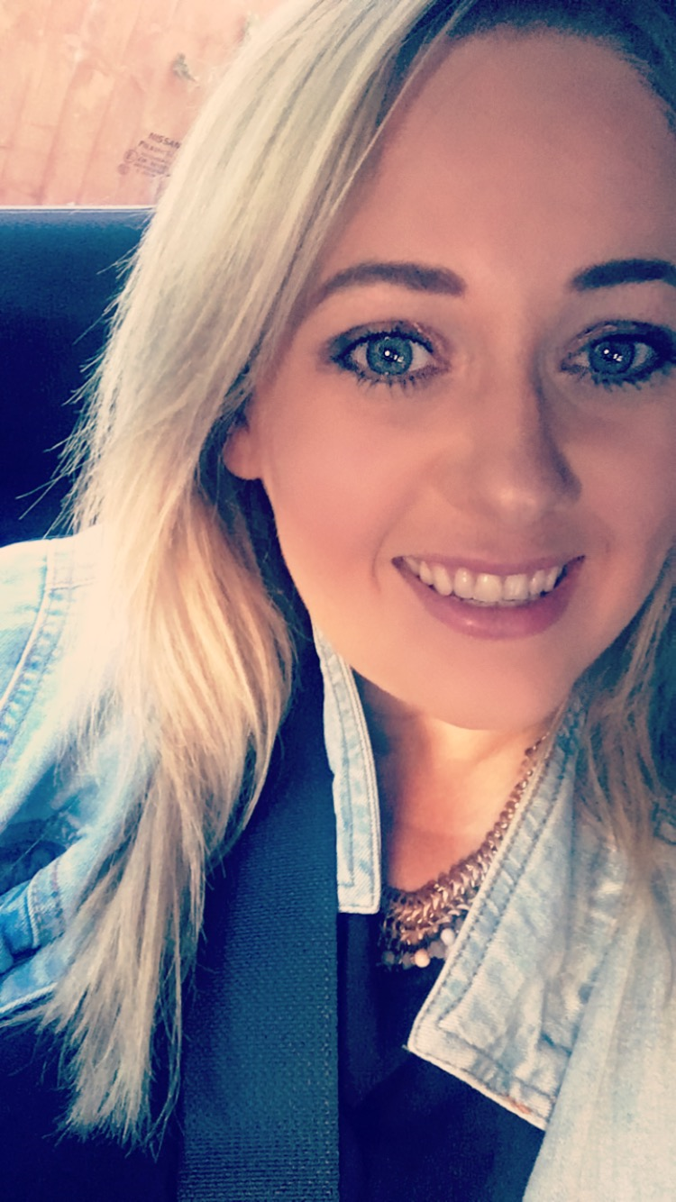
My name is Lauren James, I am 33 years old and live in Bedwas, Caerphilly with my two children Matilda 6 and Sam 4. I am a family ambassador for the CATS foundation, a charity fighting against Tay-Sachs a disease my son Archie sadly passed away from at the age of two and a half. I am a calm and empathetic person.
Amdana i
About Me
Rhesymau dros ddewis addysgu fel proffesiwn
Reasons for entering the teaching profession
I have always been passionate about teaching
I have been influenced by previous teachers enthusiasm and commitment to teaching
I want o be able to make a positive impact on children’s education and learning
Give children the opportunity to enjoy education whilst enjoying lessons.
Profiad addysgu blaenorol
Previous teaching experiences
2 and a half years working as a learning support assistant within the ALN department of a secondary school, running my own literacy and mathematics intervention groups. Providing pastoral support, involved in the KS2/KS3 transition day. Assisting the teacher and pupils in lessons.
Spent one term as a teaching assistant in the nursery class of my local school.
Meysydd / pynciau medraf eu haddysgu
Areas / subjects I could teach
I enjoy all subjects but I would say my strengths lie within History, Religious Education and English. I am happy to and excited to get involved in all subjects across the curriculum.
Lauren James
Y math o athro hoffaf bod
The kind of teacher I aspire to be
I aspire to be a teacher children remember.
I want to help child learn and enjoy education
Helping children of all social and economic backgrounds with their learning but also their social and emotional development.
Cefndir academaidd
Academic history
Graduated from Swansea University with a BA Hons in History
A levels in History, Psychology and Religious Studies
11 GCSE’S A-C

