Slide 1
Community Care and Development
Community Development Policy and Legislation

Slide 2
Learning objectives
Define discrimination, prejudice and non-discriminatory practice.
Identify different types of discrimination.
Discuss how aspects of different legislation are reflected in community care and development.
Evaluate the importance of non-discriminatory practice in community care and development.
Understand how key legislation supports community development.
Explore the Health and Care Act 2022 and its impact on integrated care and community health.
Learn how to apply safeguarding principles and non-discriminatory practices to enhance community wellbeing.

Slide 3

What is London to you?
Source: https://www.youtube.com/watch?v=K0I--En4pug

Slide 4

London - diversity and inclusive to everyone
Source: https://www.youtube.com/watch?v=ErLq9nir41E

Slide 5
Birmingham
WE ARE BIRMINGHAM
https://youtu.be/JKh6ItfMC2w
Killing me Softly- https://www.iambirmingham.co.uk/2022/01/30/video-brummie-revellers-performing-killing-softly-city-centre-street-goes-viral/

Slide 6

Discrimination, Prejudice and the Importance of Non-Discriminatory Practice
Research the following terms:
Discrimination
Prejudice
Non-discriminatory practice

Slide 7
Discrimination, Prejudice and the Importance of Non-Discriminatory Practice
Discrimination in community settings can occur in access to services, housing, or participation in local activities.
Non-discriminatory practice is essential in ensuring that all community members, regardless of background, are treated with respect and have equal access to community resources.

Slide 8
Discrimination
The unfair or prejudicial treatment of someone based on a characteristic that they cannot change.
For example, age discrimination might involve treating an older person less favourably simply because of their age.

Slide 9
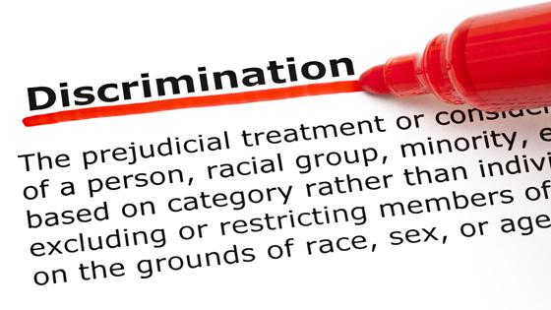
Think of 3 Examples of Discrimination

Slide 10
Different Types of Discrimination
Direct Discrimination – when you are treated less favourably than someone else in the same situation, just because for example you are old or a woman.
Indirect Discrimination – where the rules or conditions that apply to everyone can affect one group of people more than others without good reason: for example a company rule that says employees must do night shifts could exclude woman that have children

Slide 11
Positive Discrimination
This is a form of discrimination that favours someone by treating them differently in a positive way.
An example might be an organisation appointing someone from an underrepresented group into a role without considering whether they have right skills for the post.
Other candidates who are better qualified are passed over. Positive discrimination is unlawful discrimination.

Slide 12
Other Types of Discrimination
Harassment: this means offensive or intimidating behaviour, or bullying.
Victimisation: treating someone badly because they have made a discrimination complaint

Slide 13

What does the law say about discrimination?
Let’s research the Equality Act 2010 and what it means for Community Care and Development

Slide 14

What does the law say about discrimination?
Equality Act (2010)
The Equality Act says that public organisations and those undertaking services have to take action to make things equal for the people who work for them and for those who use their services.
The Equality Act talks about rights for those who may experience direct and indirect discrimination, harassment and victimisation and responsibilities on organisations to prevent and challenge such discrimination.

Slide 15

How Does The Equality Act 2010 Protect us From Discrimination?
The Equality Act says that people who fall into the following categories (people who have a ‘protected characteristic’) must not be discriminated against. The protected characteristics are:
• age
• disability
• gender reassignment (the definition includes all transgendered people)
• marriage and civil partnership
• pregnancy and maternity
• race
• religion and belief
• sex
• sexual orientation.

Slide 16
Equality and Diversity
Equality means having the right not to be discriminated against because of who you are or what makes you different from other people.
When we talk about diversity, we don’t just talk about race and ethnicity.
Diversity includes all different people, each contributing their own uniqueness, making Britain a more interesting place to live.
So diversity includes people of different gender, ages, sexual orientation, disability, religion, beliefs and more.
It is important that everyone respects and celebrates each other’s differences so we can all get along, learn from each other and share an exciting mix of cultures and experiences.
(Equality and Human Rights Commission, 2019)

Slide 17
Promoting Equality and Diversity in Communities
This can be achieved by…
Incorporating diverse cultural events in the community
Ensuring that local services (health, housing, education) are accessible to all community members, including those from disadvantaged or minority backgrounds

Slide 18
Promoting Equality and Diversity in Communities
This can be achieved in a number of ways including…
Inclusive Community Events
  Organising events that celebrate various cultures and traditions, such as community festivals for Diwali, Eid, Christmas, or Lunar New Year.
  These events allow diverse groups to share their customs and promote mutual respect and understanding.
  Offering multilingual support at events to ensure all community members can participate, especially those with limited English proficiency
Accessible Services for All
  Providing materials in different languages for community services, health clinics, and local support centers to ensure non-English speakers can access essential information.
  Ensuring physical accessibility by offering ramps, disabled parking, and sign language interpreters at community centers or public meetings. This shows a commitment to accommodating those with disabilities.
Cultural Sensitivity in Local Services
  Adapting care services to meet the religious and dietary needs of different groups.
  For instance, providing halal, kosher, or vegetarian meals in community care settings, schools, or local events.
  Creating safe spaces in the community where different groups can worship or gather according to their beliefs, such as meditation rooms or prayer spaces
Addressing Gender and Age Diversity
  Offering support groups for women, youth, and the elderly that focus on their specific needs—such as mental health services for young people or fitness programs for older adults.
  Promoting gender equality in leadership roles by creating mentorship programs for women and minority groups to support their advancement in community projects

Slide 19
Promoting Equality and Diversity in Communities
Reducing Barriers to Employment
  Hosting job fairs and skill-building workshops that specifically target underrepresented groups, such as people from ethnic minorities, women, and people with disabilities, to provide opportunities for education, training, and employment.
  Partnering with local businesses to promote fair hiring practices and support workplace diversity.
Celebrating Diversity through Arts and Media
  Showcasing diverse cultures through art exhibits, theater performances, and storytelling workshops that reflect the experiences and traditions of various community members.
  Launching community radio or social media platforms that broadcast in multiple languages and discuss topics relevant to different cultural, religious, and gender groups.
Promoting LGBTQ+ Inclusivity
  Organising LGBTQ+ support groups or social events, such as Pride parades, to ensure safe spaces where LGBTQ+ community members feel accepted and represented.
  Ensuring community policies and practices (e.g., health, housing) are inclusive of gender identity and sexual orientation, providing training for local service providers on supporting LGBTQ+ individuals.

Slide 20
Examples of Diversity in Health and Social Care
Examples of diversity in care would be providing meals that meet individuals’ preferences and giving individuals the support they need so that they can take part in activities.
You can work in ways that promote equality diversity and inclusion and therefore reduce the likelihood of discrimination, this should include providing care that is person centred, every individual you treat is unique and should be treated as such.
You should always work in non-judgemental ways and follow the agreed ways of working and work to ensure that everyone is able to take part and included.
When working in care you must challenge discrimination when you witness behaviour that you know is not right and doesn’t promote the wellbeing of individuals be courageous and willing to confront or challenge it. If you believe that any individual is being treated unfairly report it to your manager.

Slide 21
Key Legislation in Community Development
Equality Act 2010
Identifies protected characteristics (age, race, disability, etc.) and explains how public bodies must promote equality in community spaces.
Human Rights Act 1998
Think about the importance of dignity, respect, and inclusion in community projects.
Care Act 2014
Highlights the duty of local authorities to promote wellbeing, prevent abuse, and engage individuals in care decisions.
Health and Care Act 2022
This legislation states that there should be integration of health and social care services with community efforts.

Slide 22
Research
Research the Human Rights Act 1998 and what it means for Community Care and Development .
Consider why we need human rights and what it means within society and Community Development.

Slide 23

Human Rights Act 1998
The Human Rights Act 1998 is the main legislation that sets out the rights of people in the UK. You have the right to speak your mind and be kept safe from harm, as well as the right to respect, dignity and equality.
You should make sure an individual’s rights are respected, not only by yourself but by other people involved in their care.

Slide 24




Human Rights Make Sure People are:
Treated with dignity
Treated with respect
Treated fairly
Listened to and
have a say over
their lives

Slide 25
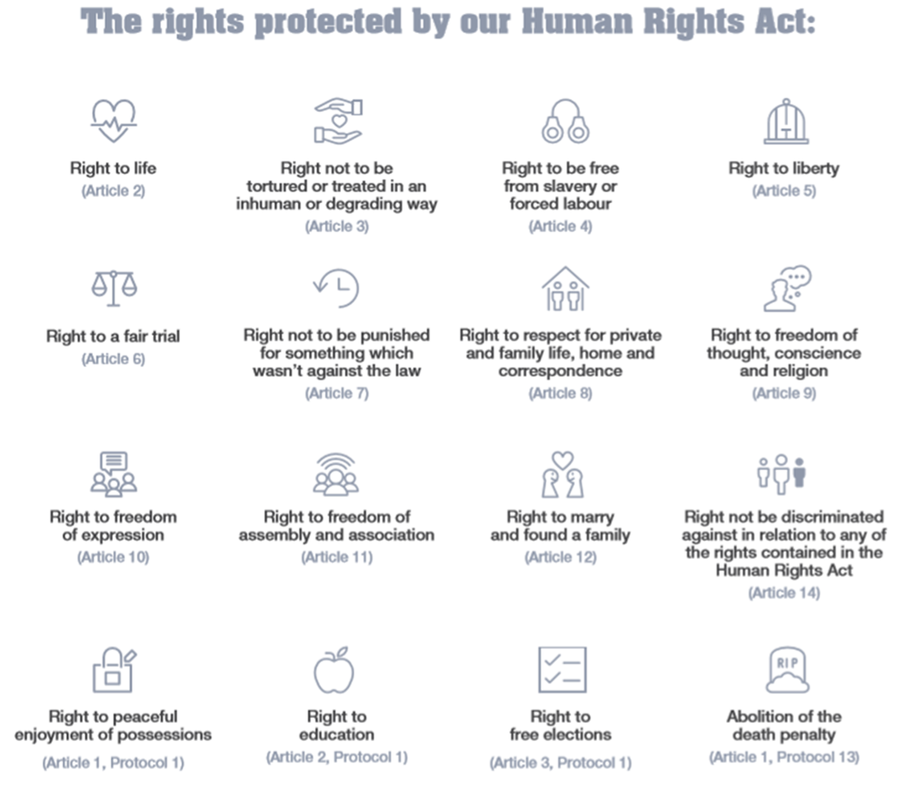

Slide 26

Privacy & Confidentiality
Everyone has a right to private space and time when they need it. Privacy affects how and where care and support is given, especially when it involves personal hygiene or intimate procedures. Privacy includes not talking to anyone about the individual’s private information unless they give confidentiality, and it is on a need-to-know basis to improve their care and support.
Confidentiality of information is a key part of maintaining dignity for those using health and social care and community services. There are some limits on confidentiality, and these apply where there is a risk of harm to other people.
Practitioners collect a wide set of information on service users to provide better health outcomes. This increases the importance to know how to maintain privacy and confidentiality.

Slide 27
What is safeguarding adults and why it matters?
Safeguarding adults means protecting a person’s right to live in safety, free from abuse and neglect.
All staff within health services have a responsibility for the safety and wellbeing of service users and colleagues. Living a life that is free from harm and abuse is a fundamental human right and an essential requirement for health and wellbeing.
Safeguarding adults is about the safety and wellbeing of all service users, providing additional measures for those least able to protect themselves from harm or abuse.

Slide 28
Abuse and Neglect of Children and Vulnerable Adults
Everyone has the right to live in safety, free from abuse and neglect.
Abuse and neglect can occur anywhere.
Safeguarding is a concept that was introduced several decades ago in the United Kingdom and refers to the collection of measures that ensure groups such as children, young people, and vulnerable adults are protected from abuse, harm and neglect in society.
These measures are wide ranging and ensure that everything from sexual abuse to malnutrition does not occur.
The Health and Social care sector is perhaps the sector most in tune with these practices, as it naturally includes many businesses and organisations that are responsible for looking after children, young people and vulnerable adults.

Slide 29


The Safeguarding Vulnerable Groups Act 2006
This Act deals with the vetting process for those that will be working with vulnerable people/children.
Safe recruitment (paid/unpaid position) is one of the most important safeguarding principles.

Slide 30
Safeguarding Vulnerable Groups in Community Development
Safeguarding is a key responsibility for anyone working in community development, especially when engaging with vulnerable populations, such as children, older adults, or individuals with disabilities.
The Safeguarding Vulnerable Groups Act 2006 plays a central role in ensuring that those who work with these groups are properly vetted and trained to protect them from abuse and neglect.
Community developers and workers have a critical role in creating safe, supportive, and inclusive environments.

Slide 31
Safeguarding Vulnerable Groups in Community Development
Community developers must ensure that anyone employed or volunteering in community-led projects involving vulnerable groups undergoes proper DBS checks.
The Act requires the establishment of processes and policies within community settings to ensure no individual posing a risk is employed in roles involving vulnerable individuals
A Community Development planner/officer must…
Maintain an open and transparent environment where safeguarding concerns are freely discussed.
Make sure that community members, staff, and volunteers should know that safeguarding is everyone’s responsibility.
Ensure that safeguarding processes are regularly reviewed, and any failings are addressed quickly. All staff should be held accountable for their role in protecting vulnerable people.

Slide 32
Role of the Community Developer
Health and Care Act 2022- Community developers should engage with Integrated Care Systems to address local health needs.
Equality and Human Rights- Ensure all community members are treated fairly and have access to the resources they need.
Wellbeing Promotion- Developers should work to reduce social isolation, encourage participation, and ensure mental and physical wellbeing.
Safeguarding- As community leaders, ensure vulnerable individuals are protected from abuse and neglect.

Slide 33

Care Act 2014
This Act places a general duty on local authorities to promote the wellbeing of individuals when carrying out care and support functions.
The definition of wellbeing includes:
personal dignity including treating individuals with respect
physical and mental health and emotional well being
protection from abuse and neglect
control by the individual over day-to-day life
participation in work, education, training or recreation
social and economic well-being
domestic, family and personal relationships
suitability of living accommodation
the individual’s contribution to society

Slide 34
Your Responsibilities & Principles of the Care Act 2014
Your Responsibilities & Principles of the Care Act 2014
As community developer, you have a duty of care to your community members. Safeguarding is everybody’s business. You have the responsibility to follow the 6 safeguarding principles enshrined within the Care Act 2014:
Principle 1 Empowerment – Personalisation and the presumption of person-led decisions and informed consent.
Principle 2 Prevention – It is better to take action before harm occurs.
Principle 3 Proportionality – Proportionate and least intrusive response appropriate to the risk presented.
Principle 4 Protection – Support and representation for those in greatest need.
Principle 5 Partnership – Local solutions through services working with their communities. Communities have a part to play in preventing, detecting and reporting neglect and abuse.
Principle 6 Accountability – Accountability and transparency in delivering safeguarding.

Slide 35
The Health and Care Act 2022:
Supporting Community Development
The Health and Care Act 2022 introduces major reforms aimed at integrating health and social care services in a way that benefits local communities.
It encourages collaboration between health organisations, local authorities, and community-based organisations to improve the quality of care and reduce inequalities

Slide 36
The Health and Care Act 2022:
Supporting Community Development
Integrated Care Systems (ICS): Communities can work with health and social care providers to create tailored local solutions.
Reducing Health Inequalities: Community groups can advocate for equal access to health services and address social determinants like housing and education.
Local Involvement: The Act encourages active involvement of community members in shaping health services

Slide 37
The Health and Care Act 2022:
Supporting Community Development
Community Involvement in Health Planning
Co-Production of Services-
What It Means: Co-production involves communities working together with healthcare providers to design, deliver, and evaluate services that are tailored to their needs.
Impact on Communities: Co-production ensures that services are more relevant, accessible, and effective for local populations. It empowers community members to have a say in the services they receive, making them active participants rather than passive recipients.
Example: A community group could partner with local GPs and hospitals to develop customised health promotion programs targeting high-risk groups, such as smoking cessation or diabetes prevention for specific ethnic communities.

Slide 38
Conclusion
Key laws like the Equality Act 2010, Human Rights Act 1998, Care Act 2014, and Health and Care Act 2022 provide a solid framework for promoting equality, safeguarding vulnerable groups, and integrating health and social care services.
These laws support community developers and H+SC practitioners in creating inclusive, safe, and thriving environments for all community members, especially those who are vulnerable or marginalised.

Slide 39
References
Equality Act 2010, c.1. (online). Available at: https://www.legislation.gov.uk/ukpga/2010/15/part/2/chapter/1 (Accessed: 8 November 2023).
Equality and Human Rights Commission (2019) Diversity (online). Available at: https://www.equalityhumanrights.com/en/secondary-education-resources/lesson-plan-ideas/lesson-4-diversity (Accessed: 8 November 2023).
GOV.UK (2021) Discrimination: your rights (online). Available at: https://www.gov.uk/discrimination-your-rights/discrimination-at-work
(Accessed: 8 November 2023).

