Slide 1
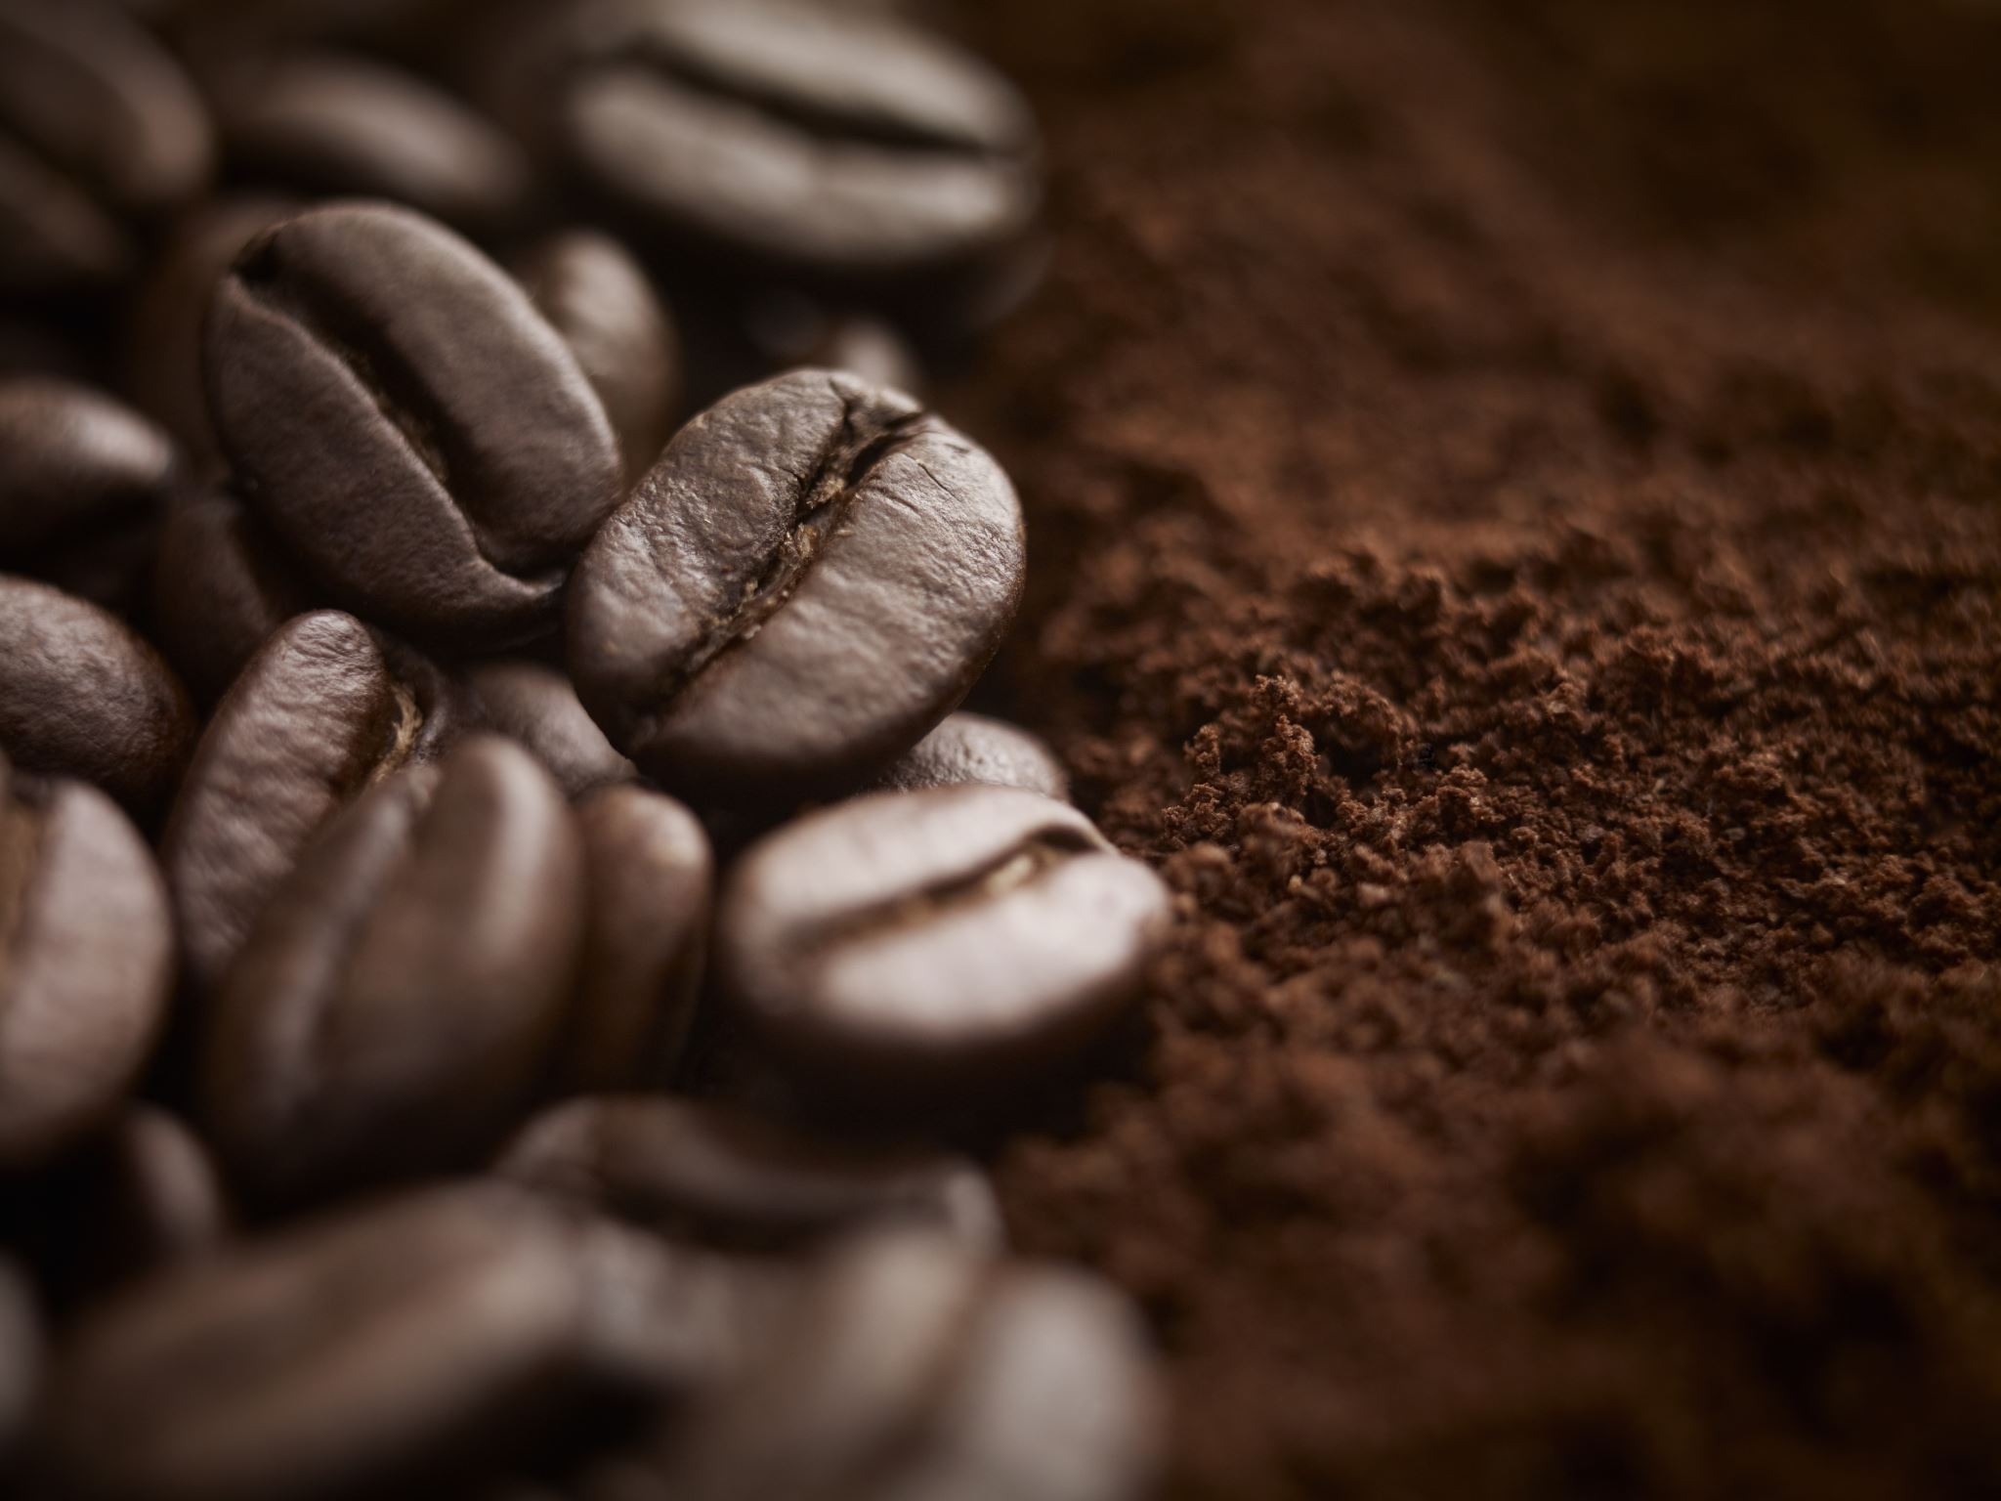
Valley coffee co. Weekly sales
To: Assistant
From: Mr A. Habib, Owner, Valley Coffee Co.
Subject: Last Week’s Sales Please Create a Report

Slide 2

Weekly sales total
Latte:42
Cappuccino:38
Tea:33
Americano:27
Hot chocolate :19
Most sold products: latte
Least sold products: Hot chocolate

Slide 3
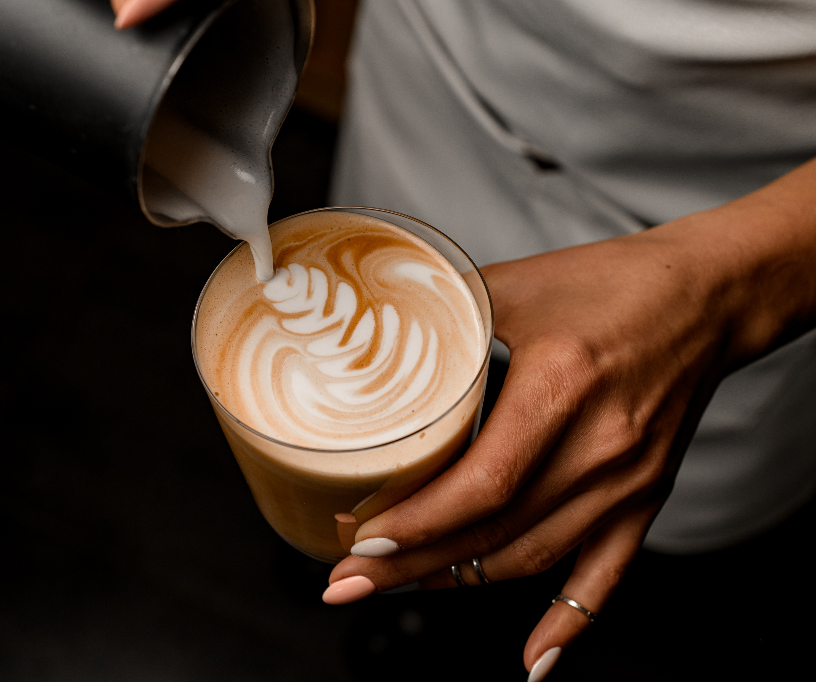
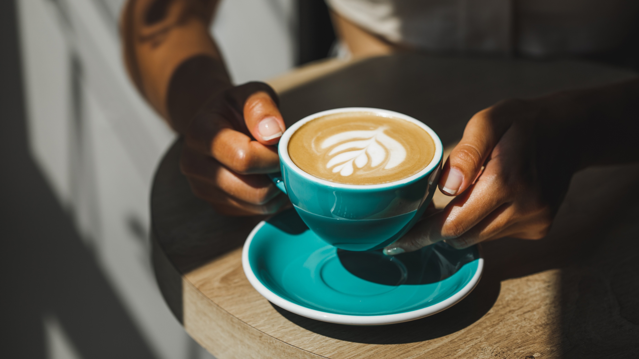



valley coffee. May have lost potential sales because some product were not as popular as other during the week.
Sales report shows that latte was the best-selling product with 42 sales, while hot chocolate was the least-selling product with 19 sales.
This means the café sold 25 fewer hot chocolate than latte showing a clear difference in customers may have chosen preferences.
The lower sales of hot chocolate could have happened because costumers may have preferred coffee drinks, especially during busy period when quick and popular options when chosen.
The café could have lost money if they prepared too much stock of hit chocolate ingredient that were not used or if time and resources were spent promoting a product that costumers less interested in.
Another reason could be that costumers were not aware of the hit chocolate options or there where not enough special offers encourage people to buy it.
To improve future sales, Mr. Habib could focus on promoting the less popular product by offering discount, creating special deals, or asking customers for feed back.
The café could also make sure they have enough of the most popular such as latte, available because they bring in more sales. By understanding customers choices and adjusting stock and promotion, valley coffee co. can reduce waste, increase profits, and improve overall business performance

Slide 4

I chose this café because is s verry important what you sell and that product you use also it could attract less costumers if the don’t like the “hot chocolate”.
By marketing and special offers attracting more customers and more people to your café making them feel comfortable and coming more often
Also I understood what happened though the week to the café and it was quite challenging.

