Slide 1
Myth and Art
Apollo

Slide 2
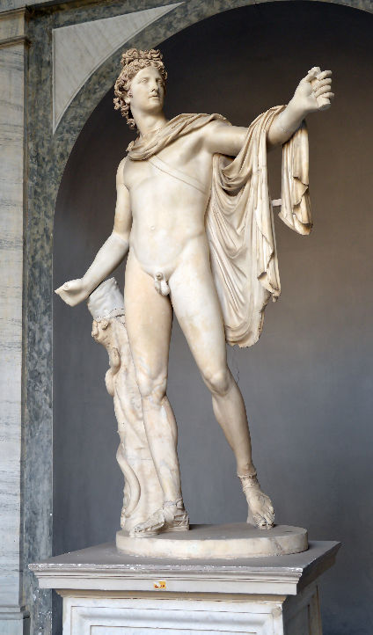
Apollo
Associated with:
  Music
  Prophecy
  Healing (and disease)
  Purification
  Archery
Represented as young, often holding a bow, lyre and laurel branches.
Apollo Belvedere, mid 2nd century CE
Copy of bronze statue, 330-320 BCE
Vatican Museum

Slide 3
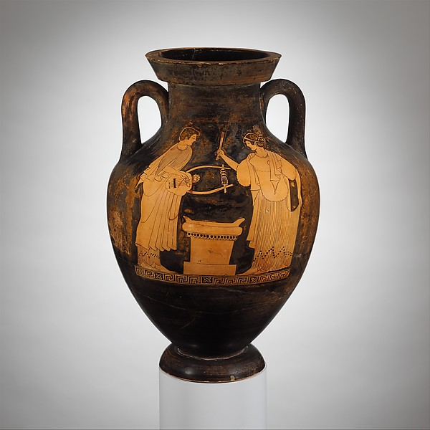
c. 490 BCE
Attic
Eucharides Painter
Met Museum

Slide 4
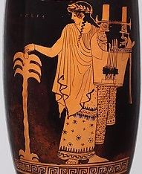
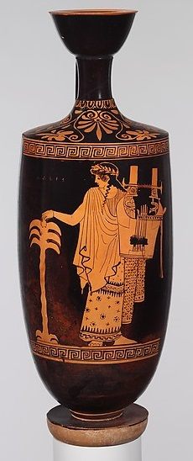
c. 460-450 BCE
Attic
Nikon Painter
Met Museum

Slide 5
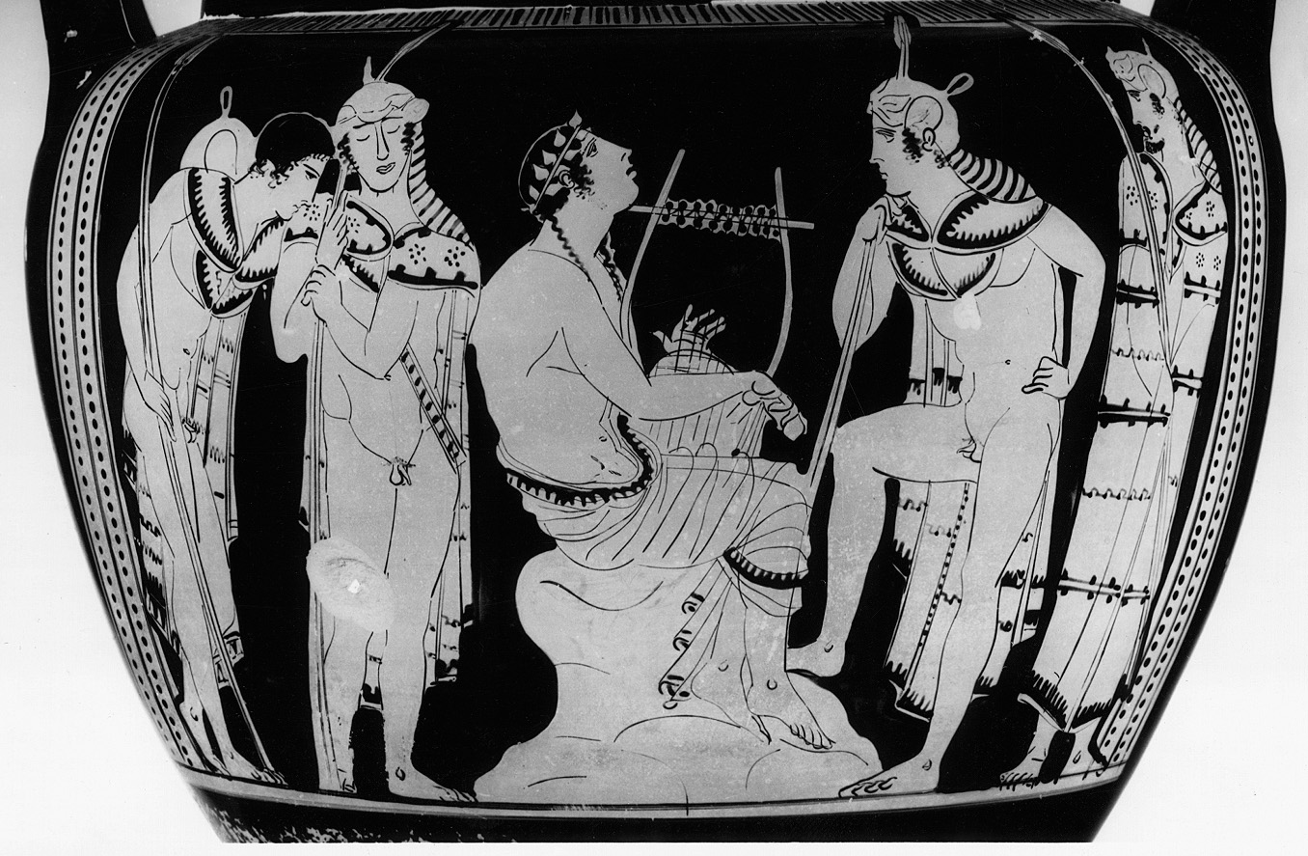
c. 440 BCE, Attic, Antikensammlung, Berlin

Slide 6
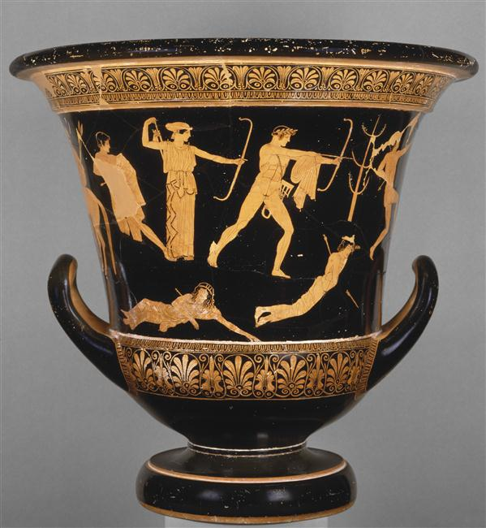
c 460-450 BCE
Niobid Painter
Louvre

Slide 7
Down from the peaks of Olympus he strode, angered at heart, bearing on his shoulders his bow and covered quiver. The arrows rattled on the shoulders of the angry god as he moved, and his coming was like the night. Then he sat down apart from the ships and let fly an arrow: terrible was the twang of the silver bow. The mules he assailed first and the swift dogs, but then on the men themselves he let fly his stinging shafts, and struck; and constantly the pyres of the dead burned thick.
Homer Iliad 1.43-52

Slide 8
Sanctuaries and Cult Sites
Polytheistic religion → many religious areas associated with various gods/heroes
  Narratives about the founding associated with deity/hero
Some specific to local area
Some important to a wider group.
  Four major panhellenic sites: Delphi, Isthmia, Olympia, Nemea

Slide 9
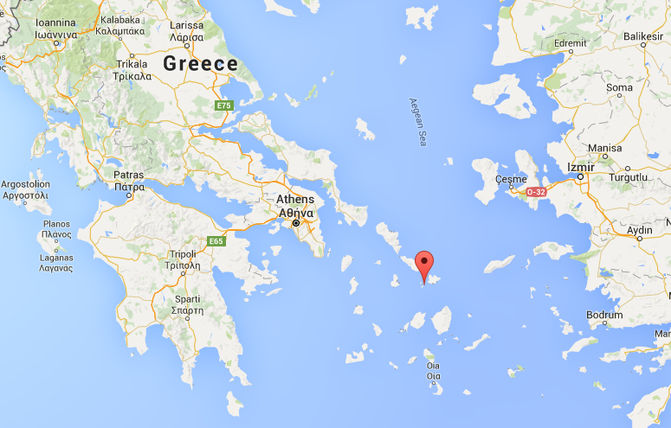
Apollo and Artemis’ Birth
Hera was jealous of Leto, so she chased her from place to place to cause her difficulty in giving birth
Eventually she arrived in Delos and was able to give birth to Apollo and Artemis

Slide 10
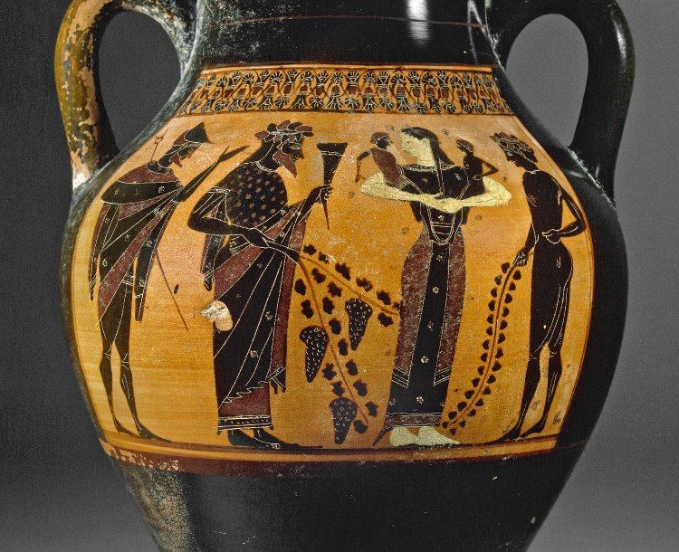
c. 520 BCE
Attic
The Towry Whyte Painter
British Museum

Slide 11
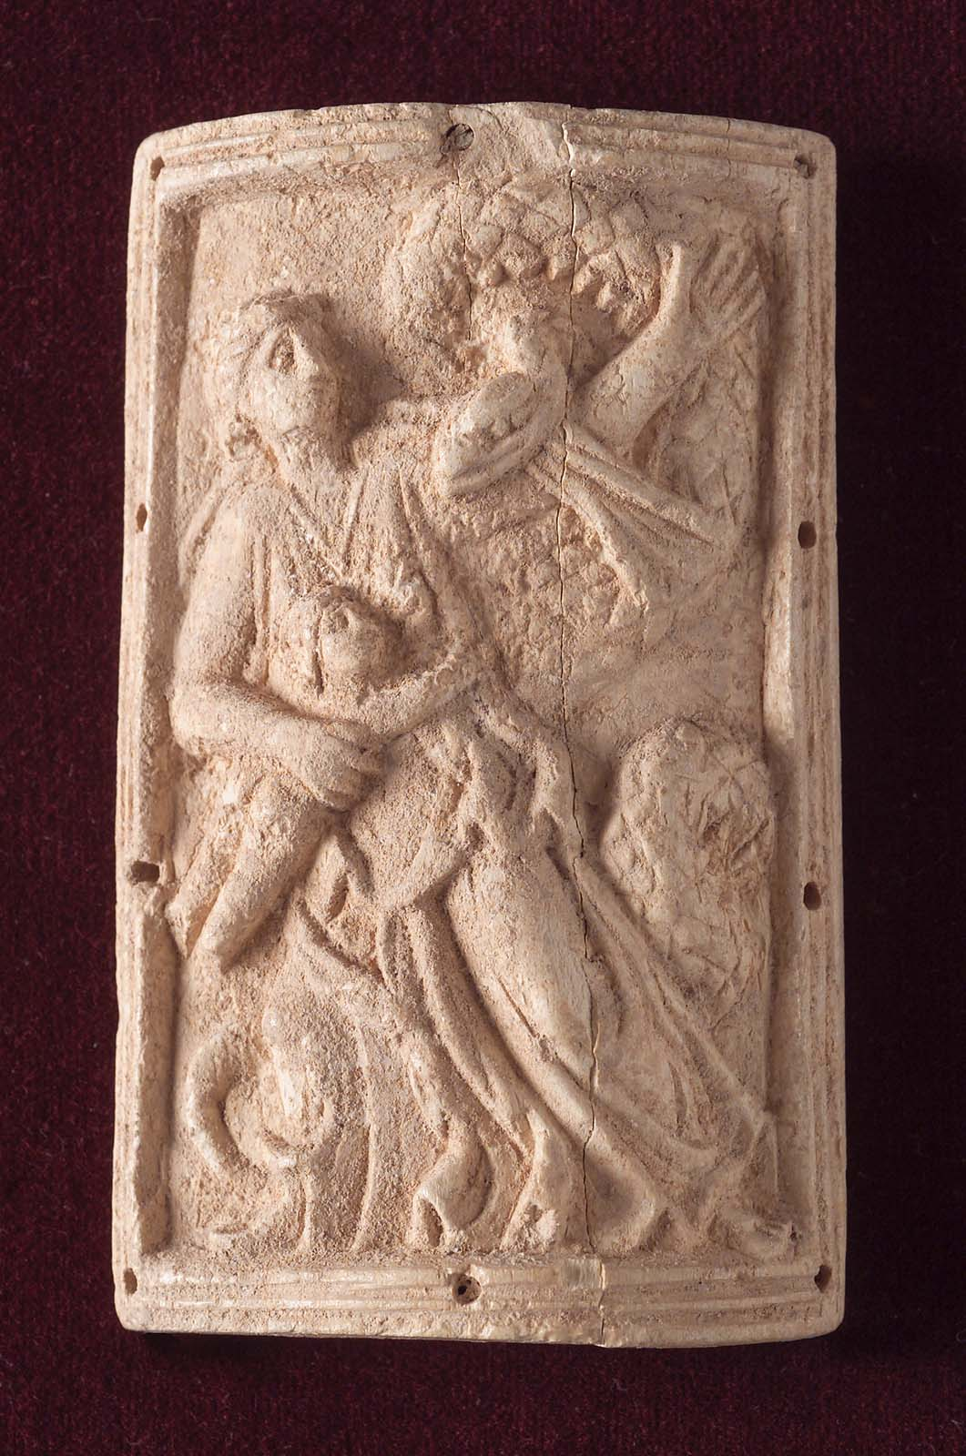
2nd century CE
Roman Egypt
Bone carving
approx. 5x8cm

Slide 12
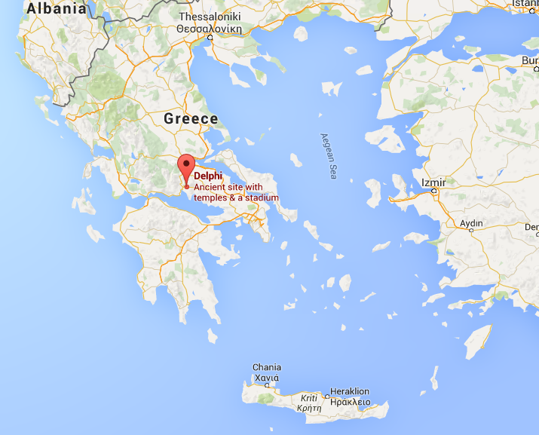
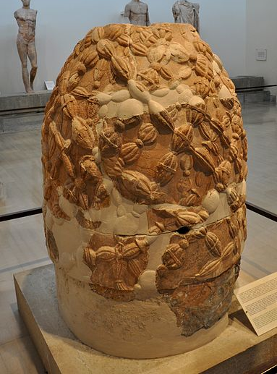
Delphi
People visited Delphi from all over Greece and beyond
Significant site from the Archaic period into the Roman Imperial period.

Slide 13
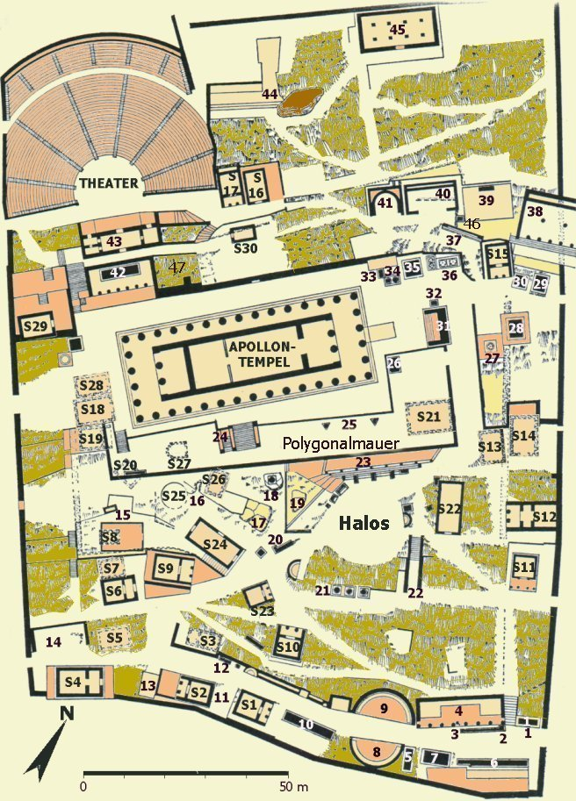
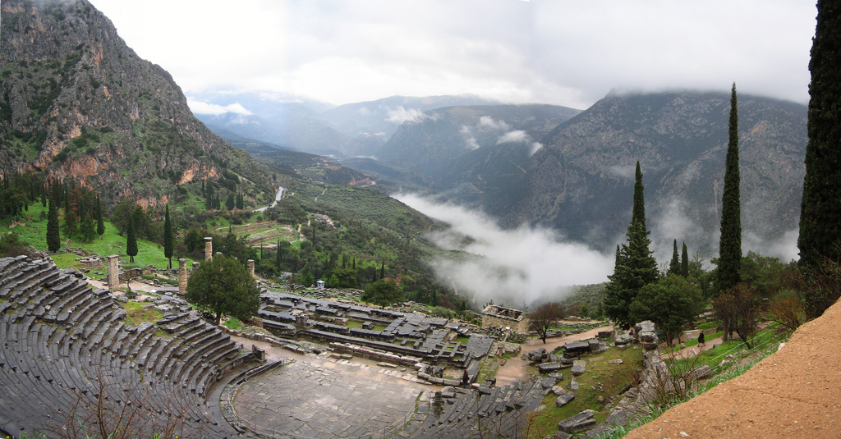

Slide 14
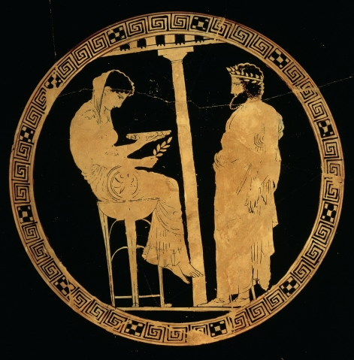
The Pythia
Oracles at Delphi were provided in the temple of Apollo
They were given by the Pythia, and interpreted by the prophetai
Several oracular sites in Greece, but Delphi was the preeminent one
440-430 BCE, Attic, Kylix, Codrus Painter, Staatlich Museen du Berlin

Slide 15
And when [Croesus] sent to test these shrines he gave the Lydians these instructions: they were to keep track of the time from the day they left Sardis, and on the hundredth day inquire of the oracles what Croesus, king of Lydia, son of Alyattes, was doing then; then they were to write down whatever the oracles answered and bring the reports back to him. Now none relate what answer was given by the rest of the oracles. But at Delphi, no sooner had the Lydians entered the hall to inquire of the god and asked the question with which they were entrusted, than the Pythian priestess uttered the following hexameter verses:
“I know the number of the grains of sand and the extent of the sea,
And understand the mute and hear the voiceless.
The smell has come to my senses of a strong-shelled tortoise
Boiling in a cauldron together with a lamb's flesh,
Under which is bronze and over which is bronze.”
Having written down this inspired utterance of the Pythian priestess, the Lydians went back to Sardis. … when he read the Delphian message, he acknowledged it with worship and welcome, considering Delphi as the only true place of divination, because it had discovered what he himself had done. For after sending his envoys to the oracles, he had thought up something which no conjecture could discover, and carried it out on the appointed day: namely, he had cut up a tortoise and a lamb, and then boiled them in a cauldron of bronze covered with a lid of the same.
Herodotus Histories 1.47-48

Slide 16
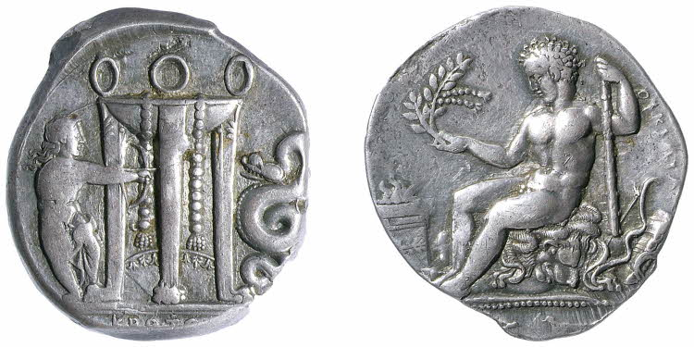
425-350 BCE, from Croton (Italy), silver. British Museum.

Slide 17
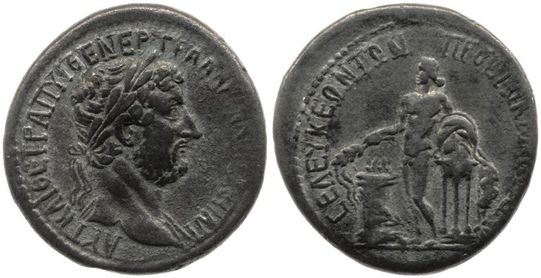
117-138 CE, silver tetradrachm, minted in Seleucia ad Calycadnum, British Museum

Slide 18
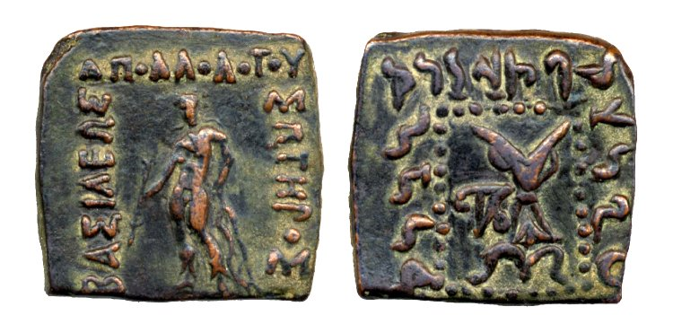
180-170 BCE, Greco-Bactrian (Afghanistan), British Museum
‘(Great) king Apollodotus the Saviour’ in Greek and Prakrit

Slide 19
Founding Delphi
Apollo founded the sanctuary either just before/after killing Python
  Another narrative of foundation connected to a serpentine monster
In some narratives he took over the site from Gaia or Themis
  Shows the power of the Olympian
  Also the longevity of the site

Slide 20
When he had said this, Phoebus Apollo laid out all the foundations throughout, wide and very long; and upon these the sons of Erginus, Trophonius and Agamedes, dear to the deathless gods, laid a footing of stone. And the countless tribes of men built the whole temple of wrought stones, to be sung of for ever.
But near by was a sweet flowing spring, and there with his strong bow the lord, the son of Zeus, killed the bloated, great she-dragon, a fierce monster wont to do great mischief to men upon earth, to men themselves and to their thin-shanked sheep; for she was a very bloody plague.
Homeric Hymn to Apollo 294-305

Slide 21
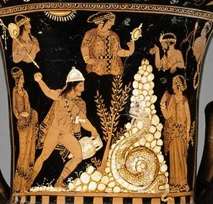
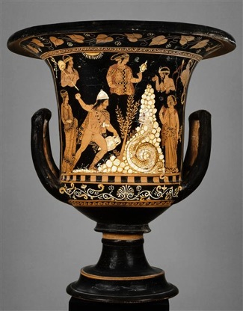
c. 340-330 BCE
Louvre

Slide 22
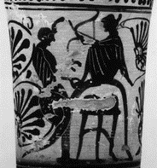
525-475 BCE
Attic
White ground lekythos
Louvre
Beazley 352170

Slide 23
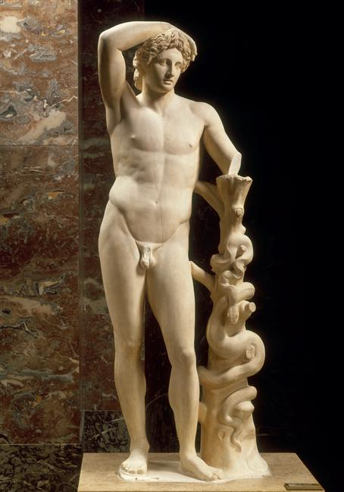
c. 300 BCE
Greek
Louvre

Slide 24
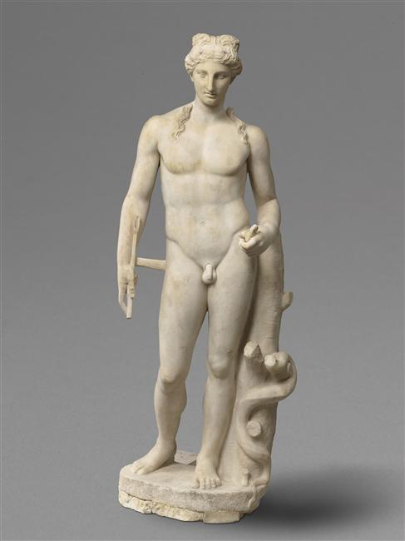
1st-2nd century CE
Roman
Louvre

Slide 25
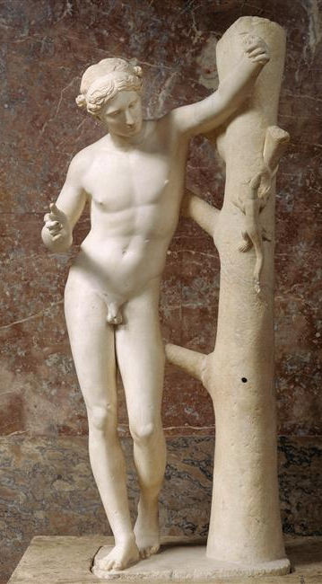
Apollo Saruoktonos
2nd century BCE
Marble copy of bronze original
  4th century BCE
  Attributed to Praxitiles
Louvre
Other copies at the Vatican and Liverpool Museums
Notes:
Mutiple copies – David in Ufizzi.

Slide 26
Pliny 36.4
Praxiteles, who excelled more particularly in marble, and thence acquired his chief celebrity, also executed some very beautiful works in brass … He also made the youthful Apollo, known as the "Sauroctonos," because he is aiming an arrow at a lizard which is stealing towards him.

Slide 27
Martial 14.172
Ad te reptanti, puer insidiose, lacertae
Parce: cupit digitis illa perire tuis.
The lizard which is crawling towards you, treacherous child,
Spare it. It is eager to perish by your hands.

Slide 28
An awful noise swelled up unspeakable as she writhed continually this way and that amid the wood: and so she left her life, breathing it forth in blood. Then Phoebus Apollo boasted over her:
“Now rot here upon the soil that feeds man' You at least shall live no more to be a fell bane to men who eat the fruit of the all-nourishing earth, and who will bring hither perfect hecatombs. Against cruel death neither Typhoeus shall avail you nor ill-famed Chimera, but here shall the Earth and shining Hyperion make you rot.”
Thus said Phoebus, exulting over her: and darkness covered her eyes. And the holy strength of Helios made her rot away there; wherefore the place is now called Pytho, and men call the lord Apollo by another name, Pythian; because on that spot the power of piercing Helios made the monster rot away.
Homeric Hymn to Apollo 360-375

Slide 29
The Fight for the Tripod
Herakles visited the oracle at Delphi, but she was unable to help him
In his rage he began destroying the temple, then decided to steal the tripod
Apollo saw this and there was a fight between them
Zeus intervened and returned the tripod to Apollo

Slide 30
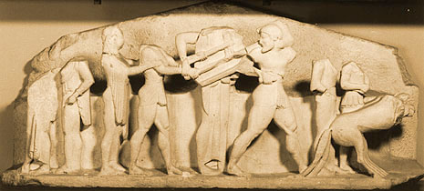
Cast of East Pediment of the Siphnian Treasury, Delphi,
c. 525 BCE, Beazley Archive

Slide 31
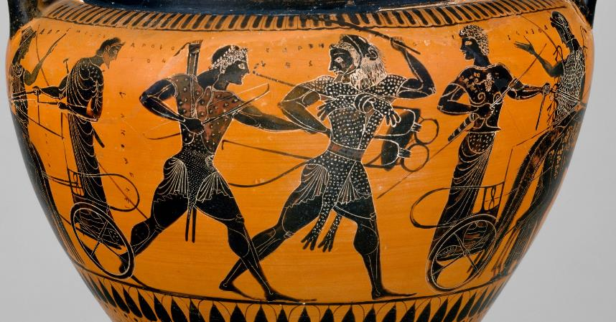
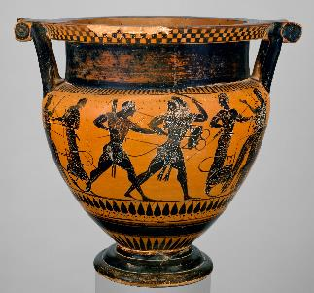
c. 520-510 BCE
Attic
Lykomedes Painter
Met Museum

Slide 32
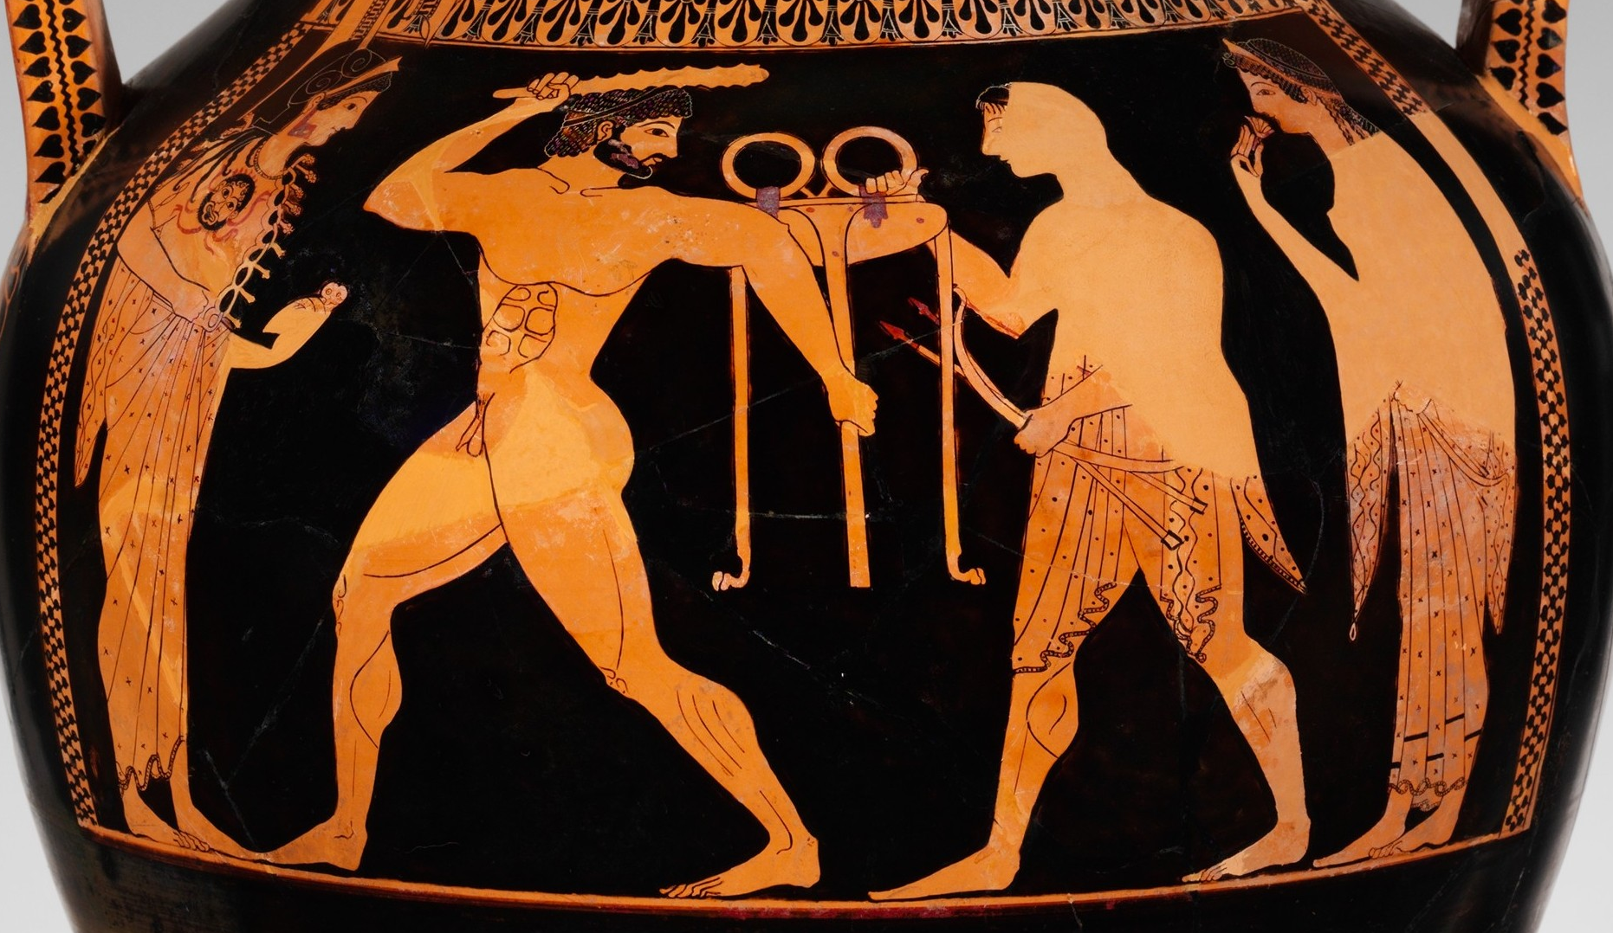

c. 530 BCE
Attic
Andokides Painter
Met Museum

Slide 33
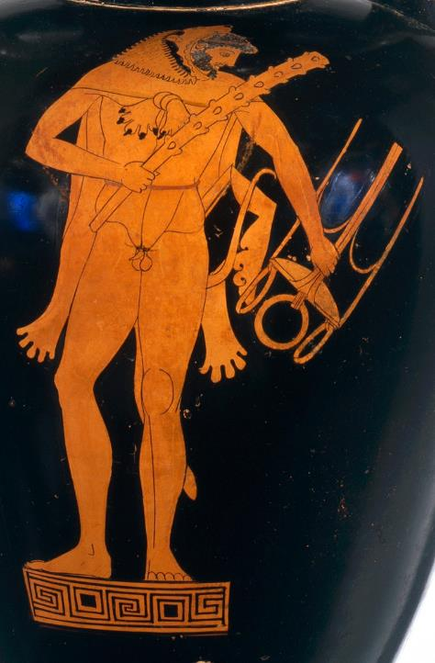
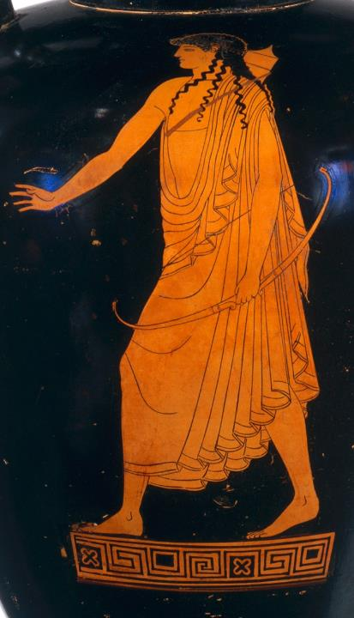
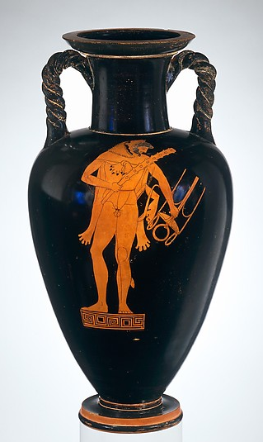
c. 490-480 BCE
Attic
Kleophrades Painter
Met Museum
Notes:
In the Archaic tradition, depictions of the struggle for the Delphic tripod emphasize the narrative: Herakles comes to Delphi to carry off the tripod, which is central to the sanctuary's prophetic activity; Apollo, the presiding deity, keeps firm hold of it. By contrast, the Kleophrades Painter emphasizes the protagonists rather than the action: Apollo moves purposefully, asserting himself simply by raising his right hand; Herakles has possession of the tripod, which he appears to defend with his club. The outcome is conveyed by the characterization of the figures.

Slide 34
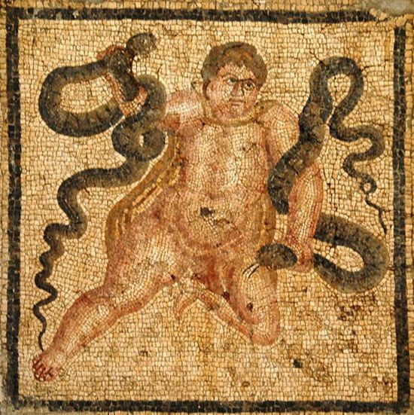
c. 100-200 CE
Roman Mosaic
Hatay Archaology Museum

Slide 35
when the son of Zeus suddenly came out of his mother's womb into the brilliant light, escaping her birth-pangs, with his twin brother, he did not escape the notice of gold-throned Hera when he was placed in his saffron swaddling-clothes. But the queen of the gods, stung in her heart, immediately sent serpents. The doors opened, and they crept into the spacious inner-chamber, eager to coil their swift jaws around the babies. But Heracles lifted his head straight up, and had his first experience of battle, seizing the two necks of the serpents in his two irresistible hands.
Pindar Nemian 1.35-45

Slide 36
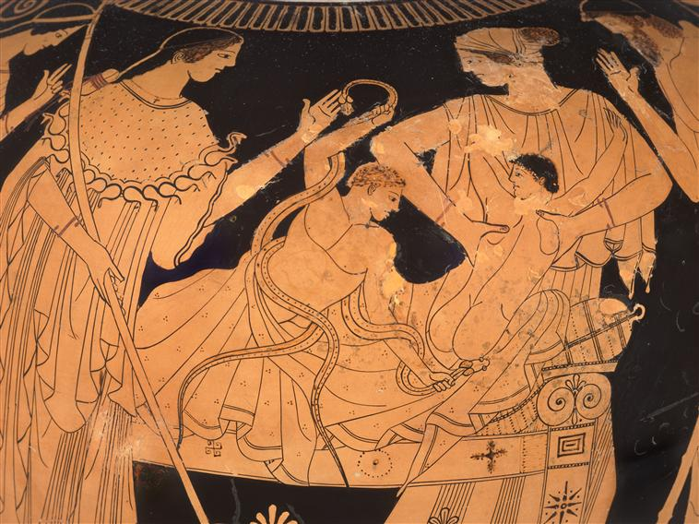
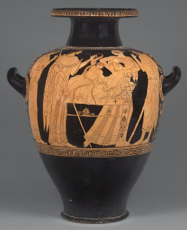
5th century BCE
Attic
Berlin Painter
c. 50x40cm

Slide 37
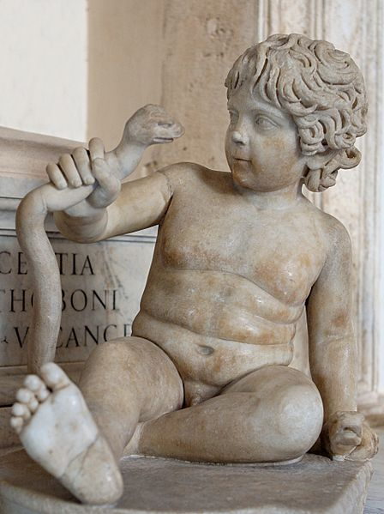
2nd century CE
Roman
Marble
Capitoline Museum

Slide 38
425-350 BCE, from Croton (Italy), silver. British Museum.

Slide 39
Apollo and Herakles
Similarities
  Archery
  Serpentine opponents
  Sons of Zeus
    Anger of Hera
  Monster killers/civilizing
  Twins (more prominent)
  Ambivalent depictions (violence/madness)
  Youthful depictions
Differences
  Madness/rage
  Masculine/feminine

Slide 40
Apollo
Due to religious sites, Apollo has very strong links to certain locations
  especially Delphi
Myths about the locations describe how they came to exist or highlight key features of the sites
These location are associated with the other attributes of the god
  Prophecy/music/poetry
  Healing/purification

