Slide 1

Module: Managing Enterprise
Module Code: BMSW4011
Assignment Title: Task 2 Presentation
Submission deadline: Tuesday 2nd December 2025
23:59PM 2025
Student Name: Ema Shahed
Student ID: 2421314

Slide 2
TASTE OF LUTON: ANGEL INVESTOR PITCH
Presented by Ema

Slide 3
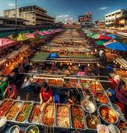
BUSINESS PROPOSITION OVERVIEW
Taste of Luton is a mobile multicultural street food truck offering a fusion of global cuisines including South Asian curries, Caribbean jerk chicken, Middle Eastern wraps, and British fusion meals.
The concept focuses on delivering premium-quality food at affordable prices using locally sourced, eco-friendly ingredients. The concept focuses on delivering premium-quality food at affordable prices using locally sourced, eco-friendly ingredients.
Operating across festivals, markets, and events in Luton, the business leverages flexibility to reach diverse audiences.
Its aim is to provide a memorable food experience that reflects the town’s cultural richness while contributing to sustainability and community engagement (Cai et al., 2023).

Slide 4
MISSION, AIM AND OBJECTIVES
Taste of Luton’s mission is to celebrate cultural diversity by providing affordable, high-quality street food that connects people through global flavours.
The business aims to establish itself as the most trusted multicultural street food brand in Luton.
Key SMART objectives include achieving monthly sales of £12,000 within the first year, attending at least three events monthly, building 1,500 loyal customers, and gaining 5,000 social media followers. Key SMART objectives include achieving monthly sales of £12,000 within the first year, attending at least three events monthly, building 1,500 loyal customers, and gaining 5,000 social media followers.
These measurable goals ensure sustainable growth and strengthen community engagement while building a strong, inclusive brand presence in the local market (Gavrila et al., 2021).

Slide 5

UNIQUE SELLING PROPOSITION (USP)
Taste of Luton’s uniqueness lies in its multicultural food offering under a single brand.
Unlike most competitors who focus on one cuisine, we deliver a variety of dishes from around the world, appealing to diverse tastes.
Our mobile food truck enhances accessibility and flexibility, while the use of eco-friendly packaging and locally sourced ingredients strengthens our sustainable identity.
Combining cultural representation, ethical sourcing, and affordability, Taste of Luton offers a one-of-a-kind dining experience that unites flavour, community, and environmental responsibility (Jeaheng et al., 2023).
Jeaheng et al., 2023

Slide 6
LEGAL STRUCTURE AND LOCATION
Taste of Luton will operate as a sole proprietorship, providing flexibility and full control over decisions.
This structure allows fast response to market changes and lower administrative costs (Kapoor et al., 2021).
The food truck will be based in central Luton, near the University of Bedfordshire, St. George’s Square, and other high-footfall areas.
This strategic location ensures exposure to students, employees, and shoppers from diverse backgrounds.
The chosen site offers excellent visibility and accessibility, maximizing both sales opportunities and brand awareness (Raihan, 2024).

Slide 7
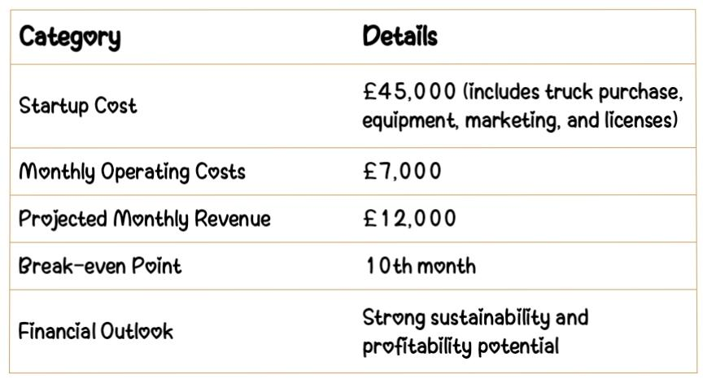
HUMAN RESOURCES AND FINANCIAL OVERVIEW
The initial team will include three members: a manager and head chef (the owner), an assistant chef, and a customer service representative.
Staff will be hired locally via job boards and university networks, promoting community employment (Rosário et al., 2021).
The total start up cost is estimated at £45,000, covering truck purchase, equipment, marketing, and licenses.
Monthly operating costs will average £7,000, with projected monthly revenue of £12,000.
The business is expected to break even by the tenth month, demonstrating strong financial sustainability and profitability potential.

Slide 8
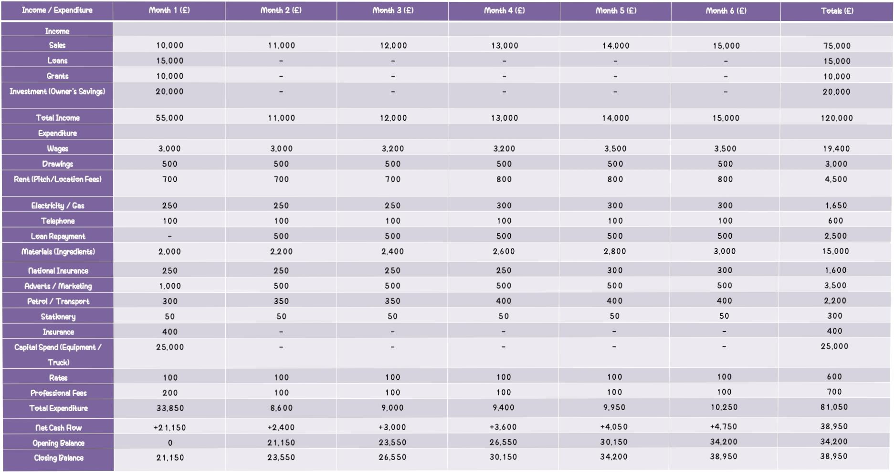
Table: Six-Month Cash Flow Forecast for Taste of Luton

Slide 9
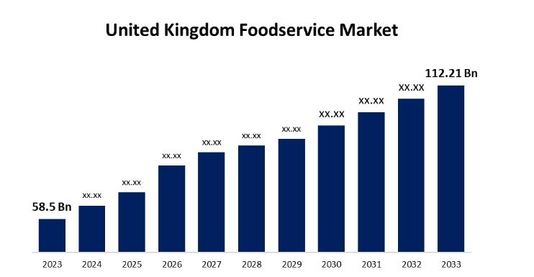
SWOT ANALYSIS
Taste of Luton’s strengths include cultural diversity, high-quality ingredients, and sustainability.
Weaknesses involve limited finances and dependence on outdoor conditions.
Opportunities arise from the expanding UK street food market valued at $169.42 billion (Statista, 2025), while food service market was at $58.5 billion USD in 2023 and potential event catering (Spherical insights, 2024).
However, threats such as rising ingredient costs and competition from established outlets must be managed through supplier partnerships and flexible pricing (Sheth, 2021).
This SWOT analysis highlights the brand’s strong community foundation and strategic resilience in a competitive environment (Sheth, 2021).

Slide 10
12-MONTH MARKETING STRATEGY
Taste of Luton’s 12-month marketing strategy integrates online and offline promotions.
Digital platforms like Instagram, TikTok, and Facebook will feature food videos, customer reviews, and live event updates to engage followers (Raihan, 2024).
Offline marketing includes flyers, collaborations with the University of Bedfordshire, and presence at community events.
Influencer partnerships will boost youth engagement, while consistent branding and storytelling will strengthen recognition.
The overall goal is to create awareness, build loyalty, and establish a positive reputation for quality and inclusivity (Stalmirska, 2023).

Slide 11

BRANDING AND VISUAL IDENTITY
Taste of Luton’s branding reflects multicultural vibrancy through bold colours, diverse imagery, and inclusive messaging.
The logo and slogan “One Town, Many Flavours, Enjoy it!” symbolize unity in diversity.
Promotional materials include colourful flyers, business cards, and sample social media posts showcasing international dishes.
TikTok ads and Instagram Reels highlight cooking visuals and customer feedback to attract young audiences.
A cohesive brand design ensures consistency across all touchpoints, strengthening brand recall and emotional connection with customers (Tacardon et al., 2024).

Slide 12
ANGEL INVESTOR PITCH
Taste of Luton seeks a £50,000 investment to expand its operations.
The funds will be allocated as follows: £20,000 for an additional food truck, £10,000 for marketing and branding, £10,000 for equipment upgrades, and £10,000 as working capital.
In return, the investor will receive a 15% equity share with an expected ROI within 24 months.
This investment will allow us to scale operations, increase visibility, and serve more customers at major events, festivals, and catering opportunities (Shah et al., 2022).

Slide 13
WHY INVEST IN TASTE OF LUTON
Investing in Taste of Luton offers financial and social rewards.
The business combines strong market demand with low overhead costs and high-profit margins.
Its focus on cultural diversity, sustainability, and community engagement differentiates it from competitors.
The scalable model allows easy expansion into event catering and additional locations.
As consumer interest in multicultural street food continues to rise, Taste of Luton provides an exciting, ethical, and high-potential investment opportunity (Tacardon et al., 2023).

Slide 14
REFERENCES
Cai, Y.J. and Choi, T.M., 2023. Omni-channel marketing strategy in the digital platform era. Journal of Business Research, 168, p.114197.
Gavrila, S.G. and de Lucas Ancillo, A., 2021. Spanish SMEs’ digitalization enablers: E-Receipt applications to the offline retail market. Technological Forecasting and Social Change, 162, p.120381. Gavrila, S.G. and de Lucas Ancillo, A., 2021. Spanish SMEs’ digitalization enablers: E-Receipt applications to the offline retail market. Technological Forecasting and Social Change, 162, p.120381.
Jeaheng, Y., Al-Ansi, A., Chua, B.L., Ngah, A.H., Ryu, H.B., Ariza-Montes, A. and Han, H., 2023. Influence of Thai street food quality, price, and involvement on traveler behavioral intention: exploring cultural difference (eastern versus western). Psychology Research and Behavior Management, pp.223-240.
Kapoor, R. and Kapoor, K., 2021. The transition from traditional to digital marketing: a study of the evolution of e-marketing in the Indian hotel industry. Worldwide Hospitality and Tourism Themes, 13(2), pp.199-213.
Raihan, A., 2024. A review of the potential opportunities and challenges of the digital economy for sustainability. Innovation and Green Development, 3(4), p.100174.
Rosário, A. and Raimundo, R., 2021. Consumer marketing strategy and E-commerce in the last decade: a literature review. Journal of theoretical and applied electronic commerce research, 16(7), pp.3003-3024. Rosário, A. and Raimundo, R., 2021. Consumer marketing strategy and E-commerce in the last decade: a literature review. Journal of theoretical and applied electronic commerce research, 16(7), pp.3003-3024
Shah, A.M., Yan, X. and Qayyum, A., 2022. Adoption of mobile food ordering apps for O2O food delivery services during the COVID-19 outbreak. British Food Journal, 124(11), pp.3368-3395.
Sheth, J., 2021. New areas of research in marketing strategy, consumer behavior, and marketing analytics: the future is bright. Journal of Marketing Theory and Practice, 29(1), pp.3-12.
Spherical Insights. (2024). United Kingdom Foodservice Market Size, Outlook Forecasts To 2033. Spherical Insights. https://www.sphericalinsights.com/reports/united-kingdom-foodservice-market
Stalmirska, A.M., 2023. Cultural globalisation and food in urban destination marketing. Tourism Geographies, 25(1), pp.158-176.
Statista. 2025. Food – United Kingdom | Statista Market Forecast. Statista. https://www.statista.com/outlook/cmo/food/united-
Tacardon, E.R., Ong, A.K.S. And Gumasing, M.J.J., 2023. The Perception of Food Quality and Food Value among the Purchasing Intentions of Street Foods in the Capital of the Philippines. Sustainability, 15(16), p.12549.

