Slide 1
Main presentation sent via email

Slide 2
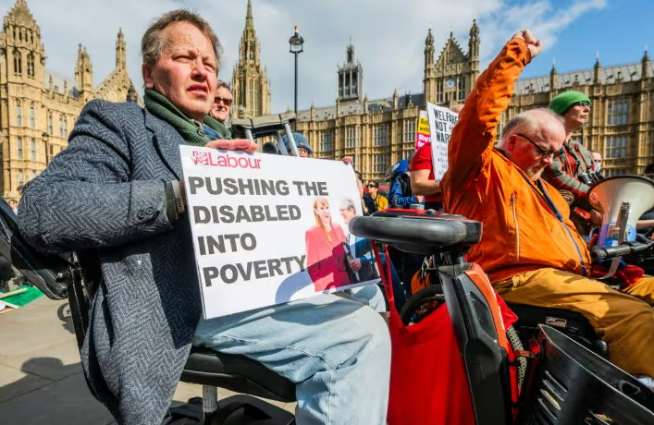

Nikola - Do they create help and resilience or don’t allow individuals to thrive in the workforce
The following evidence explores whether the UK welfare system creates help and resilience for individuals, or whether it limits their ability to thrive in the workforce.​
​Do they create help and resilience in UK: ​
Just over two fifths (46%) of people claiming Universal Credit are either behind on bills and credit commitmentsor are finding it a constant struggle to keep up with them (trussell, 2024).​
The charity estimates that 1.6 million people claiming Universal Credit have needed to use a food bank in the last 12 months (Trussell, 2024).​
A recent Institute for Fiscal Studies report indicates that, in the long term, a single disabled adult receiving the daily living component of Personal Independence Payment will be £2,826 per year worse off under Universal Credit, once transitional protections expire (Ray-Chaudhuri and Waters, 2024). ​
The risk shift in pensions: auto-enrolment has expanded workplace pensions, but the participation rate for those earning under £10,000 a year is half that for those on median earnings (44% versus 87%), while only 17%are saving enough for retirement. Just over 1 in 10 private sector employees are now enrolled in a Defined Benefit pension, offering a guaranteed retirement income, compared to just under 4 in 10 in the late 1990s(Cooke, 2023).
Campaigners protesting against disability benefit cuts outside parliament last month. Photograph: Guy Bell/Rex/Shutterstock

Slide 3
However, while this is negative side to UK welfare system the government has recognized the issue within the country, so government has created the Pathways to Work: Reforming Benefits and Support to Get Britain Working in 2025 which outlines a planned changes to UK welfare system that are specifically designed to help individuals become more resilient and thrive in the workforce (The Department of Work and Pensions, 2025).
Are they don’t allow individuals to thrive in the workforce:​
By bringing these workers into means-testing, their incentives are substantially weakened: under the legacy system, they would just pay tax, giving them a typical METR of 28%; but under the UC system, they also see their UC withdrawn, giving them a typical METR of 60% (Ray-Chaudhuri and Waters, 2024). ​
The extent of precarious work: over a fifth (21%) of UK workers, or 6.6 million people, are in temporary work, are low-income self-employed, or face volatile pay and hours, including zero hours contracts. Unemployment benefit replaces just 12% of average earnings and statutory sick pay just 16%. Around 2.2 million people are economically inactive but would like to work now or in the future (Cooke, 2023). ​

