Slide 2
The performance and control of international logistics functions and resilience

Slide 3
Companies are experiencing an ever diverse and changing environment - arising pressure from global competition, rapid technological change, shorter product lifecycles, increasing consumer expectations, and etc.
Adapting to these challenges increased supply chain complexity and resulted in more instability and unpredictability
Supply Chain (SC) disruptions refer to unplanned and unanticipated events that hamper the normal flow of goods and materials within a supply chain.
https://hal.archives-ouvertes.fr/hal-01320641/document

Slide 4
As a consequence, SC disruptions expose firms within the supply chain to operational and financial risks. SC resilience is usually defined as the capacity of a supply chain system to adapt to disruptions (Christopher and Peck, 2004, Ponomarov and Holcomb, 2009).
Hendricks and Singhal (2005) report that even minor disruptions might cause enormous long term negative impacts on financial performance.
Recent example shows in supply disruption to Toyota’s car production caused by the Japanese earthquake 2011 which has contributed to the company missing profits forecasts by £620 million (Supply Management Magazine).
Another well-known example seen in 2000, the shut-down of Philips’s microchips factory caused by a fire accident led to at least $400 million potential revenues to Ericsson, while Nokia managed to this disruption effect by alternative suppliers (Latour, 2001).

Slide 5
To protect against disruptions, various risk mitigation strategies have been proposed in the literature involving inventory redundancy (Groenevelt et al., 1992, Arreola-Risa and DeCroix, 1998).
Source/process flexibility (Tomlin, 2006,Simchi-Levi et al., 2013, Snyder and Shen, 2006), network design or facility location problems (FLP) (Snyder and Daskin, 2005, Cui et al., 2010), or enhancing contracts with external stakeholders such as buying insurance with unreliable suppliers (Gümüs et al., 2012).
Previous studies have clearly proven the effectiveness and efficiency of these strategies previous studies have clearly proven the effectiveness and efficiency of these strategies.
However, most of them are based on traditional hierarchical SC networks, where the performance is limited by dedicated assets and budget constraints.
Currently, a logistics network is defined by and dedicated to a company or a group of collaborating companies, so current logistics services are a hierarchical set of diverse independent heterogeneous logistics networks.
The storage and distribution schemes of product flows are usually fixed once the network has been defined.
Even though full flexibility may exist within a company, logistics operations are always restricted within their own network.

Slide 6
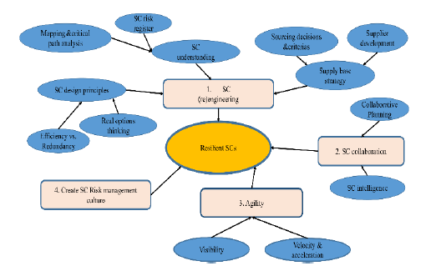
Figure 1. Supply Chain Resilience principles by Christopher
and Peck (2004)

Slide 7
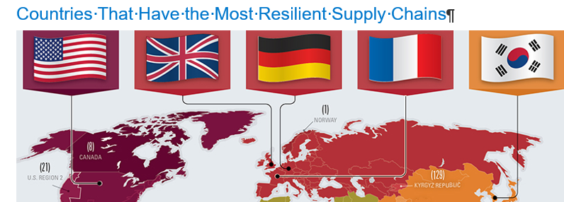

Slide 8
The concept of resilience arose from a fusion of disciplinary concepts and ideas in material science to describe the capacity of a material to bounce back to its original shape after any deformation (Sheffi, 2005).
Though the term resilience is used in a wide range of fields, the concept of resilience across them is closely related with the capability and ability of an element to return to a stable state after a disruption (Bhamra et al.2011).

Slide 9
SC Re-engineering studies concepts such as density, locations, complexity, and node criticality as the main characteristics that need to be considered in network design to build resilient SCs (Snyder and Daskin, 2005, Craighead et al., 2007, Kim et al., 2015).
Snyder and Daskin (2005) aim to optimize facility locations confronted to random failures. Craighead et al. (2007) examines the impacts of network characteristics of nodes to resilience. Density is defined as the geographical spacing of nodes within a supply chain.

Slide 10
Where in the world is your company potentially vulnerable?
The 2015 FM Global Resilience Index is the first data-driven tool to rank the supply chain resilience of 130 countries and territories around the world to help executives prioritize where they should focus their risk management and investment efforts.
The index aggregates nine drivers of resilience into three factors - economic, risk quality and the supply chain itself.
With this tool, business decision-makers will be able to generate powerful insights about risk and opportunities in the supply chain as important elements to guide their operating strategy in four areas:
Selecting suppliers based on the supply chain risk/resilience of the countries in which they are located
Deciding where to locate facilities
Evaluating the resilience of the countries hosting existing facilities
Assessing the supply chain resilience of countries where customers’ facilities are based

Slide 11
This year’s annual index rankings capture a fascinating mix of change and stability.
Norway, ranked 1, and Switzerland, ranked 2, hold the top places in the index. Norway achieves this with consistently high scores across the three core factors of resilience: economic, risk quality and the supply chain itself. Norway’s high score for risk quality depends strongly on minimal natural hazard exposure.
Switzerland scores highly on economic and supply chain factors (where the country leads). In particular, Switzerland scores best in the world for an extensive and efficient infrastructure.
Qatar, ranked 7, and Finland, ranked 9, are new to the top 10 this year.
Qatar benefits from macroeconomic stability, efficient goods and labuor markets, and a high degree of security. The country owes its jump in position to a considerable improvement in commitment to fire risk management in the region.
Finland’s strengths spring from its innovative capabilities which are the fruit of high public and private investment in research and development, strong links between academe and private sector companies, and an excellent record in education and training.
Most countries ranking in the bottom 10 score poorly on economic factors. Venezuela, ranked 130, placing it last in the 2015 index, is the victim of a challenging mix of an unstable macroeconomic environment, high inflation and public debt, and malfunctioning markets

Slide 12
With the help of the composite ranks and scores for each country, as well as the underlying scores for the nine drivers of supply chain resilience, business decision-makers can map their own current or planned operations and supply chains.
They can make more informed choices on how to manage their supply chain risk by weighing political factors and levels of corruption against natural hazard exposure and the quality of fire safety regulations.
The FM Global Resilience Index and The 2015 FM Global Resilience Index Annual Report helps determine exposures as well as clarify decisions about levels of supply chain redundancy.
By balancing supply chain needs with supply chain risk on an enterprise-wide, global level, companies in any industry can ensure that their business is resilient enough to withstand the inevitable threats to their supply chain and, by extension, enhance their competitive advantage in the marketplace.

Slide 13
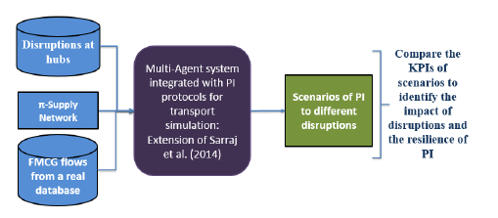
Complexity is defined as the total number of nodes and material flows in a given SC. Node criticality is defined as the importance of node within a SC.
They find that network characteristics of a supply chain fortify the severity of disruption while mitigation capabilities (waring and proactively/reactively respond to disruptions) reduce the severity of disruption.
Figure 2. Methodology depiction
Performance evaluation of interconnected logistics
networks confronted to hub disruptions
Yang, Pan, Ballot (2016)

Slide 14
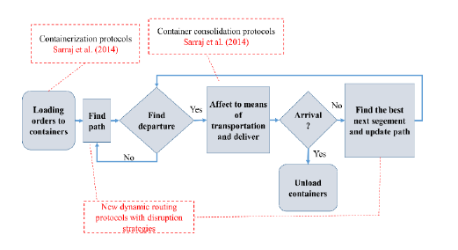

Slide 15
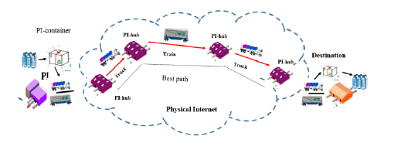

Slide 16
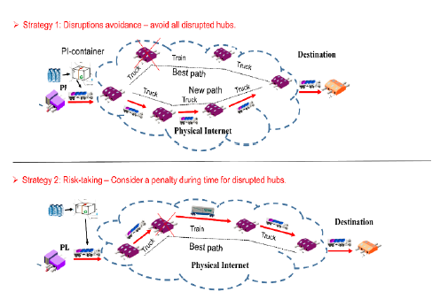

Slide 17
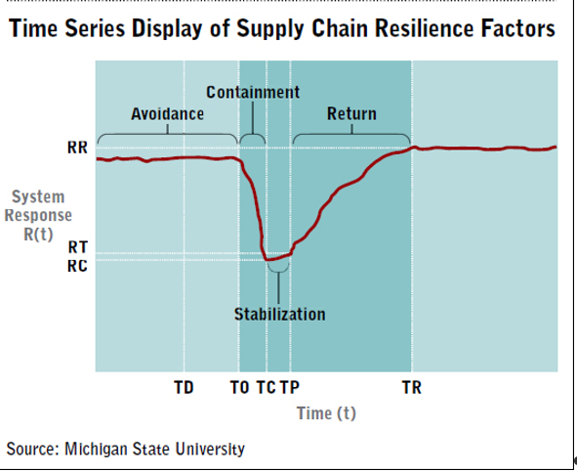
Figure 3

Slide 18
In this illustration, we can identify the four stages of resilience, which are avoidance, containment, stabilisation, and return.
Figure 3 also defines the sequence of events, or time series signature, in a disruption as well as the typical system response for a typical disruption.
Those would include inventory levels, cash flow, and asset availability to name just a few.
Two variables are central to understanding this illustration, T and R. T denotes the time at which a specific event occurs while R denotes the relative impact of the event as measured in terms of dollars, units lost, change in fill rate, or some other metric that is important to a firm’s performance. Taken together, time (T) and response (R) are important because they define inflection points in the time series signature where a change in state can be observed.

Slide 19
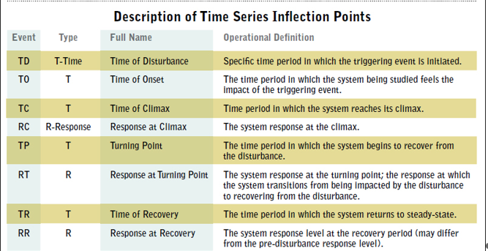
The differences between the variance events listed in Figure 3 identify traits of interest to management.
For example, TO-TD, or the gap between the moment at which the disruption took place (TD) and the moment that that disruption began to affect the firm (TO), tells management how long it will take for the firm’s performance to be impacted; this time interval also identifies the maximum amount of early warning that the firm can count on to begin taking action to minimize the negative effects of the disruption.

Slide 20
Four key pillars of Resilient Supply Chain:
visibility,
flexibility,
collaboration and
control.
In fact, the key attributes of Resilient Supply Chain could easily become a foundation for any supply chain. All four pillars, supported by
processes,
human resources and
technology,
constitute the Resilient Supply Chain concept.
file:///C:/Users/Windows/AppData/Local/Microsoft/Windows/INetCache/IE/0H50T2L7/5930-Article%20Text-18290-1-10-20171201.pdf

Slide 21
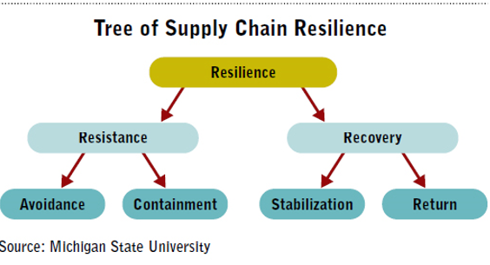
Once recovery is complete, firms often reflect upon their experience to document appropriate lessons and identify system refinements to reduce future risks. This completes a supply chain resilience cycle of: Avoidance ➝ Containment ➝ Stabilization ➝ Return ➝ Review ➝ Avoidance
https://www.supplychain247.com/search/results/search&category=papers&keywords=Resilience/

Slide 22
Bukowski (2012) presents RSC as a supply chain management strategy aimed to reduce risks within the entire supply chain and the enterprise itself.
He -adjusted supply chain design, creating alternative ways, supply chains reduction, taking dependability into account when designing supply chains, increasing inventory and pace of goods transfer in the supply chains, generating spare capacities in the process.
Lean concepts implementation, relations management with the suppliers, processes standardization and unification and visibility understood as information availability for all supply chain participants.
Bukowski points out there is a threat when implementing Resilient concept to reduce the existing supply chain efficiency where the processes are stable and predictable.

Slide 23
Logistics performance index: Overall (1=low to 5=high) - Country Ranking
Definition: Logistics Performance Index overall score reflects perceptions of a country's logistics based on efficiency of customs clearance process, quality of trade- and transport-related infrastructure, ease of arranging competitively priced shipments, quality of logistics services, ability to track and trace consignments, and frequency with which shipments reach the consignee within the scheduled time.
The index ranges from 1 to 5, with a higher score representing better performance. Data are from Logistics Performance Index surveys conducted by the World Bank in partnership with academic and international institutions and private companies and individuals engaged in international logistics.
2009 round of surveys covered more than 5,000 country assessments by nearly 1,000 international freight forwarders. Respondents evaluate eight markets on six core dimensions on a scale from 1 (worst) to 5 (best).
The markets are chosen based on the most important export and import markets of the respondent's country, random selection, and, for landlocked countries, neighbouring countries that connect them with international markets. Scores for the six areas are averaged across all respondents and aggregated to a single score using principal components analysis. Details of the survey methodology and index construction methodology are in Arvis and others' Connecting to Compete 2010: Trade Logistics in the Global Economy (2010).
Source: World Bank and Turku School of Economics, Logistic Performance Index Surveys. Data are available online at : http://www.worldbank.org/lpi . Summary results are published in Arvis and others' Connecting to Compete: Trade Logistics in the Global Economy,

Slide 24
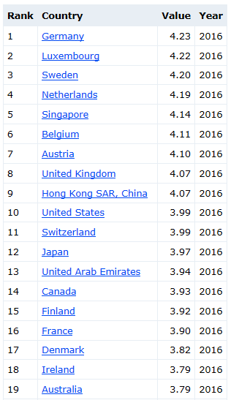
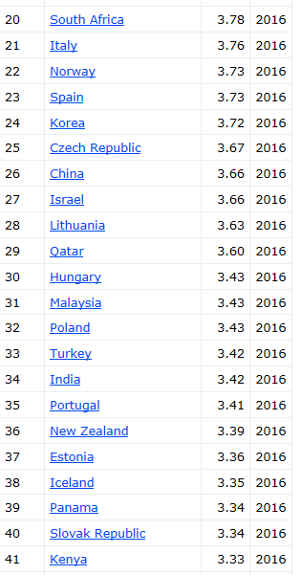
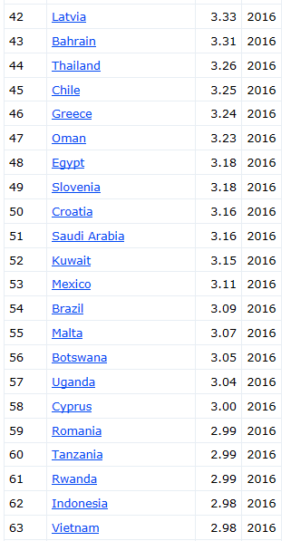
https://www.indexmundi.com/facts/indicators/LP.LPI.OVRL.XQ/rankin gs

Slide 25
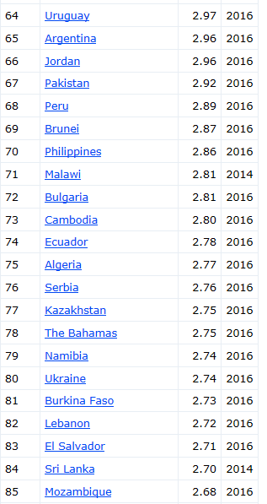
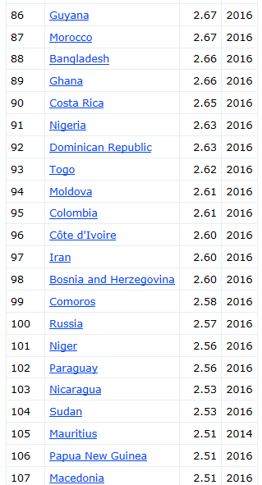
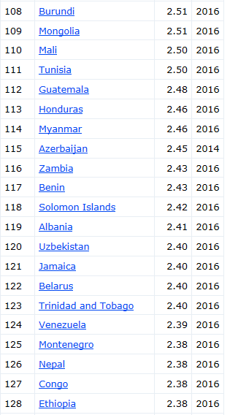

Slide 26
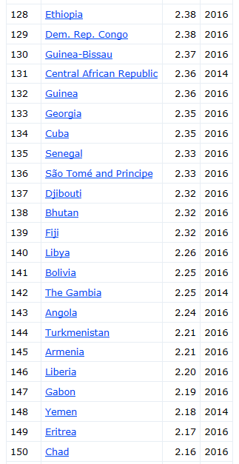
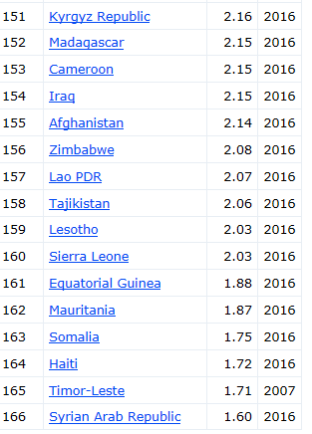
More rankings: Africa | Asia | Central America & the Caribbean | Europe | Middle East | North America | Oceania | South America | World |

Slide 27
Green Supply Chain Management (GrSCM), a pro-ecological logistics management concept.
According to Srivastava (2007) the increased significance of GrSCM directly stems from the deteriorating environment condition reflected in lower supply of raw materials, excessive waste and increased pollution levels.
The GrSCM is a natural consequence of the evolutionary change in manufacturing companies which replaced a reactive approach to environment management based on developed programs with a more pro-
Reduce,
Re-use,
Rework,
Refurbish,
Reclaim,
Recycle,
Remanufacture.
Green Supply Management concept is in fact a combination of environment management and supply chain management.
The scope of GrSCM definition is -friendly) has been assigned both to purchasing and integrated supply chains which forward the goods from the suppliers via manufacturers to the final customers

Slide 28
(Zhu & Sarkis, 2004,. Srivastava (2007) defined Green Supply Chain Management as an integrated environmental thinking within the framework of supply chain management which includes product design, search and selection of materials and raw materials for the given product, manufacturing and delivery to the final customer, pro-active approach to exploited product Reverse Logistics.

Slide 29
Bukowski is one of the Polish authors who covers the Total Logistics Management (TLM) issues and his findings are worth mentioning.
He maintains (Bukowski, 2014) the essence of Total Logistics Management concept should be based on a combination of three dominant concepts in Logistics Management, namely Lean, Agile and Resilient
Bukowski justifies his approach by formulating the main strategic and operational goals in supply chain and they are the rational risk management and supplies continuity in his opinion, with such goals defined, the issues of safety and security, dependability, survivability and resilience needs to be taken into special consideration.

Slide 30
The assumptions of the TLM concept first need to be embedded in Logistics Management and Supply Chain Management concepts either in the view of the enterprise’s strategic/operational functions or it’s functional/process categories.
If we take a closer look at the TLM concept proposed by Bukowski we can clearly distinguish internally and externally integrated operational approach to logistics characterised in functional/process categories for the whole company.
Obviously, strategic decisions on adopting Lean, Agile, Leagile or Resilient concepts are crucial for the company, however, they concern only company logistic functions and they should not enforce other organisation processes subordination to logistics.
Purely operational and slightly process approach has been adopted by the Global Logistics Excellence authors

Slide 31
Strategic choices are limited to key supply chain elements, regarded as one of the organisation management aspects a more functional approach.
In both cases the organisation searches for solutions optimising their activities with respect to 7Rs (right product, client, price, place, amount, quality (condition), logistic activities).
Logistics does not become a superior element of the business model creation but is one of the functional areas which undergoes management processes et al., 2016).

Slide 32
Total Logistics Management underlying assumptions. Bielecki and Szymonik (2015) formulated 6, Total Logistics principles.
They have been slightly modified and amended and are presented below:
Logistic quality guarantees full customer satisfaction and continuous logistic quality improvement and supply chain optimization should become a routine.
The pursuit of logistic partnership is based on professionalism and trust.
The safety and security assurance for people and goods and information flows
The pursuit of “one” click activities based on flow processes automation and computerisation.
Sustainable logistics development ensures an appropriate organisations impact on its environment.
Total Product Management based on product logistic efficiency is the foundation to secure effective and efficient goods and information flow.

Slide 33
Operating Objectives
In terms of logistical system design and administration, each firm must simultaneously achieve at least six different operational objectives.
These operational objectives, which are the primary determinants of logistical performance, include rapid response, minimum variance, minimum inventory, movement consolidation, quality, and life-cycle support.

Slide 34
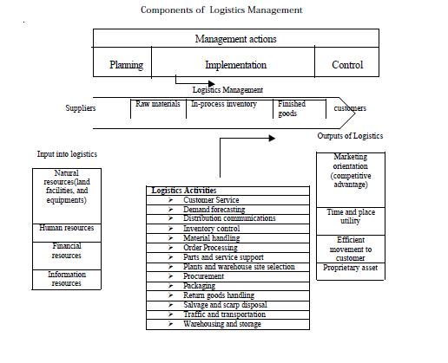
http://164.100.133.129:81/econtent/Uploads/International_Logistics_Management.pdf

Slide 35
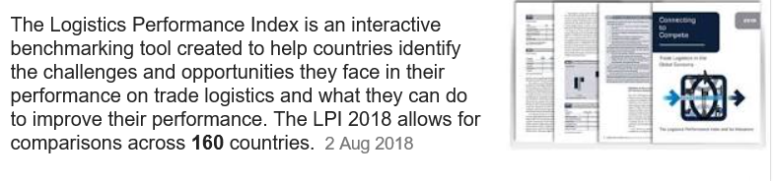
https://www.google.com/search?biw=1093&bih=452&ei=iWnLW5KuIeODgAb25rCgAg&q=international+logistics+performance+index&oq=international++logistics+performance&gs_l=psy -

Slide 36
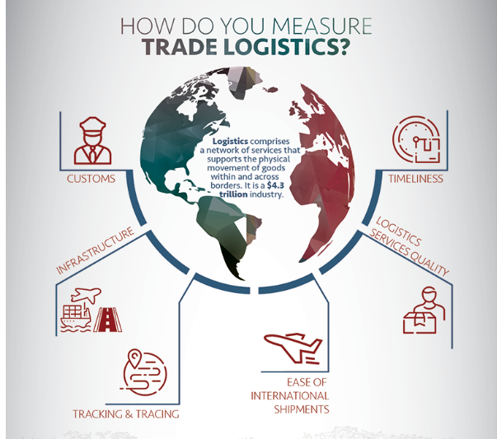

Slide 37
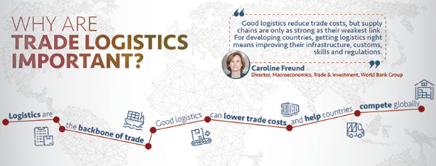

Slide 38
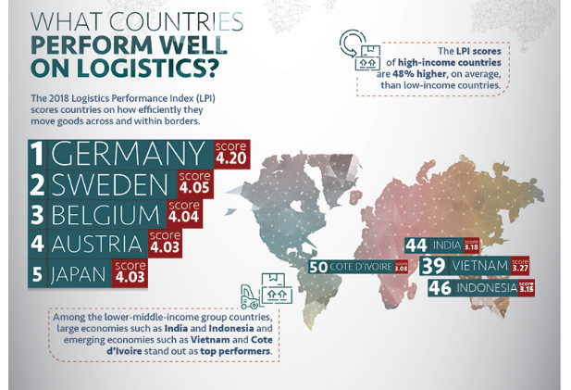

Slide 39
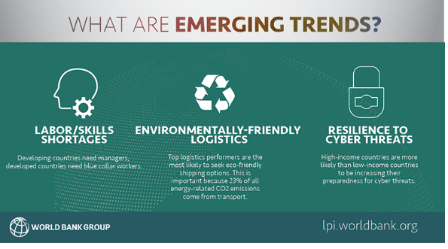
https://lpi.worldbank.org/international/global

Slide 40
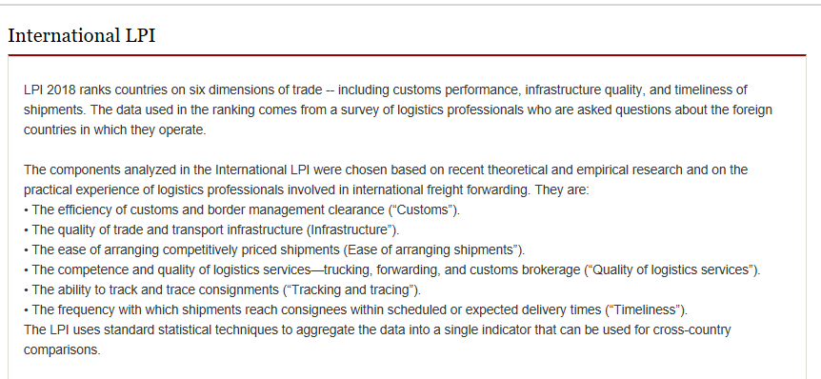
https://lpi.worldbank.org/international

Slide 41
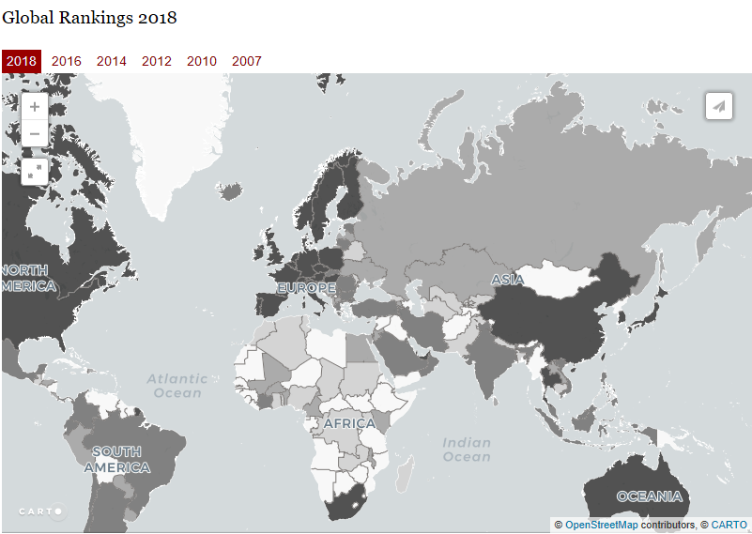

Slide 42
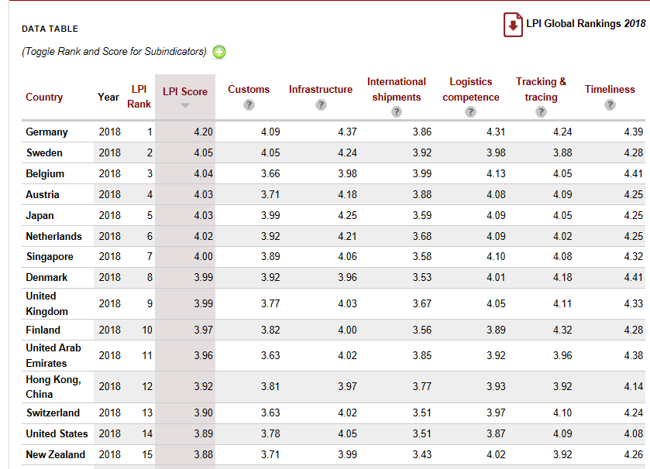

Slide 43
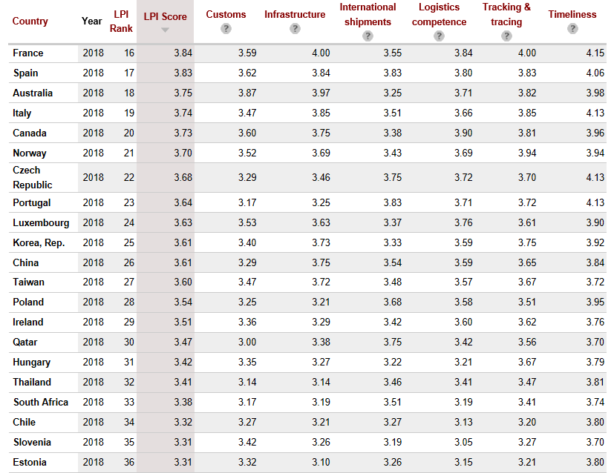

Slide 44
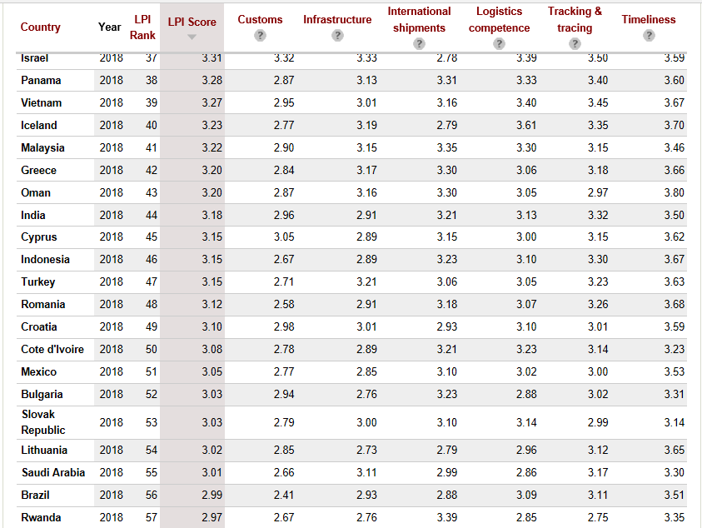

Slide 45
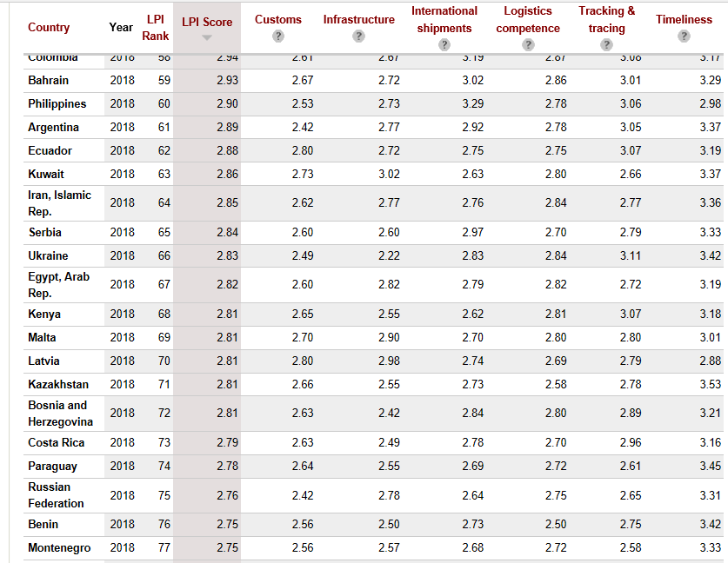

Slide 46
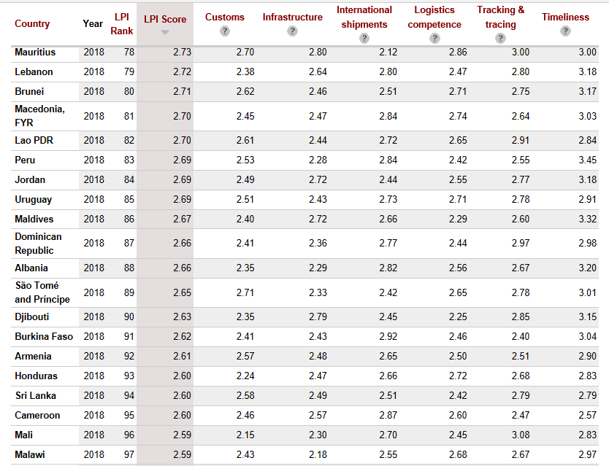

Slide 47
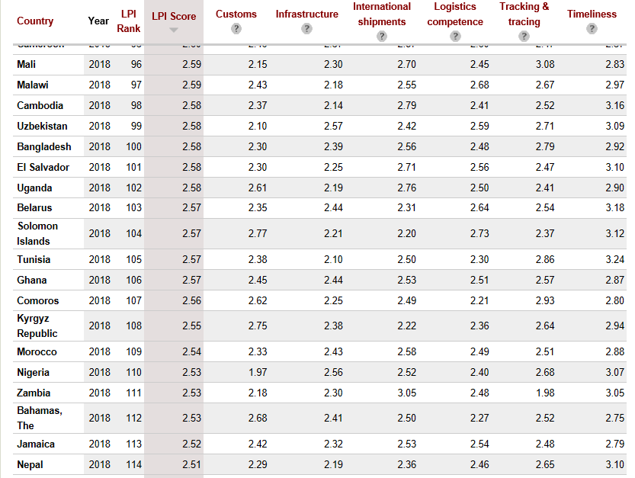

Slide 48
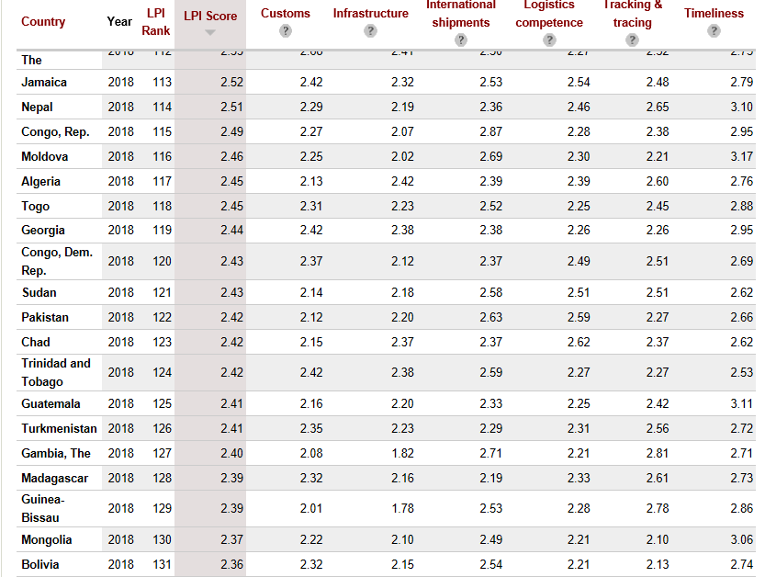

Slide 49
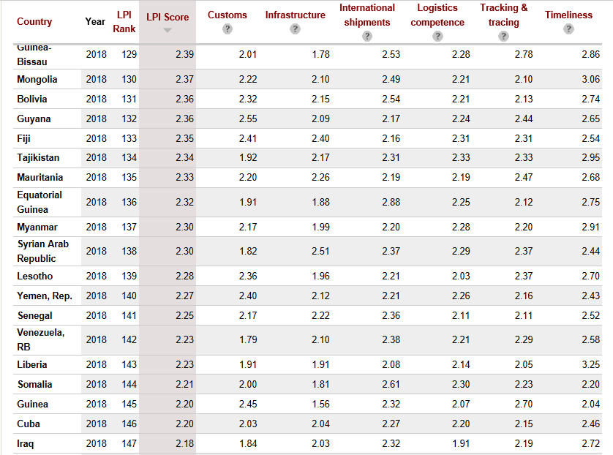

Slide 50
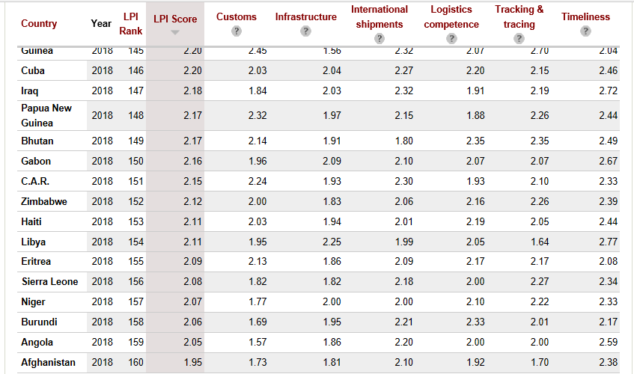

Slide 51
Development Relevance: The LPI measures on-the-ground trade logistics performance, helping national leaders, key policymakers, and private sector traders understand the challenges they and their trading partners face in reducing logistical barriers to international commerce.
As the backbone of international trade, logistics encompasses freight transportation, warehousing, border clearance, payment systems, and many other functions.
These functions are performed mostly by private service providers for private traders and owners of goods, but logistics is also important for the public policies of national governments and regional and international organizations.
Because global supply chains are so varied and complex, the efficiency of logistics depends on government services, investments, and policies. Building infrastructure, developing a regulatory regime for transport services, and designing and implementing efficient customs clearance procedures are all areas where governments play an important role.
The improvements in global logistics over the past two decades have been driven by innovation and a great increase in global trade.
While policies and investments that enable good logistics practices help modernise the best-performing countries, logistics still lags in many developing countries. Indeed, the "logistics gap" evident in the first two editions of this report remains. The tremendous importance of logistics performance for economic growth, diversification, and poverty reduction has long been widely recognised. National governments can facilitate trade through investments in both "hard" and "soft" infrastructure. Countries have improved their logistics performance by implementing strategic and sustained interventions, mobilizing actors across traditional sector silos, and involving the private sector. Logistics is also increasingly important for sustainability. A focus on the environmental impacts of logistics practices was recently included in the LPI.

Slide 52
Limitations and Exceptions: The Logistics Performance Index is an interactive benchmarking tool created to help countries identify the challenges and opportunities they face in their performance on trade logistics and what they can do to improve their performance.
Feedback from operators is supplemented with quantitative data on the performance of key components of the logistics chain in the country of work. Thus, the LPI consists of both qualitative and quantitative measures.
In addition, despite being the most comprehensive data source for country logistics and trade facilitation, the LPI has two important limitations.
First, the experience of international freight forwarders might not represent the broader logistics environment in poor countries, which often rely on traditional operators.
And the international and traditional operators might differ in their interactions with government agencies - and in their service levels.
Second, for landlocked countries and small-island states, the LPI might reflect access problems outside the country assessed, such as transit difficulties.
The low rating of a landlocked country might not adequately reflect its trade facilitation efforts, which depend on the workings of complex international transit systems.
Landlocked countries cannot eliminate transit inefficiencies with domestic reforms.

Slide 53
Statistical Concept and Methodology: The indicator presents data from Logistics Performance Surveys conducted by the World Bank in partnership with academic and international institutions and private companies and individuals engaged in international logistics.
The Logistics Performance Index (LPI) uses a structured online survey of logistics professionals at multinational freight forwarders and at the main express carriers. The 2012 LPI data are based on the 2011 survey, which was administered to nearly 1,000 respondents at international logistics companies in 143 countries (domestic performance indicators).
The international LPI covers 155 countries. The LPI assesses both large companies and small and medium enterprises. Most of the responses are from small and medium enterprises, with large companies (those with 250 employees or more) accounting for roughly 18 percent of responses.
The respondents include groups of professionals who are directly involved in day-today operations, from company headquarters and from country offices such as senior executives, area or country managers, and department managers. Many of the respondents are at corporate or regional headquarters or at country branch offices. The rest are at local branch offices or independent firms.
The majority of respondents are involved in providing most logistics services as their main line of work such as warehousing and distribution, customer-tailored logistics solutions, courier services, bulk or break bulk cargo transport, and less-than-full container, full-container, or full-trailer load transport

Slide 54
Each survey respondent rates eight overseas markets on six core components of logistics performance (the efficiency of customs and border management clearance, the quality of trade and transport infrastructure, the ease of arranging competitively priced shipments, the competence and quality of logistics services, the ability to track and trace consignments, and the frequency shipments reach consignees within scheduled or expected delivery times).
The components are rated on a scale (lowest score to highest score) from 1 to 5.
The eight countries are chosen based on the most important export and import markets of the country where the respondent is located, on random selection, and - for landlocked countries - on neighbouring countries that form part of the land bridge connecting them with international markets.
The method used to select the group of countries rated by each respondent varies by the characteristics of the country where the respondent is located.
If respondents did not provide information for all six components, interpolation is used to fill in missing values. The missing values are replaced with the country mean response for each question, adjusted by the respondent's average deviation from the country mean in the answered questions.

Slide 55
The LPI is constructed from the six indicators using principal component analysis (PCA), a standard statistical technique used to reduce the dimensionality of a dataset. In the LPI, the inputs for PCA are country scores on questions 10-15, averaged across all respondents providing data on a given overseas market.
Scores are normalised by subtracting the sample mean and dividing by the standard deviation before conducting PCA.
The output from PCA is a single indicator - the LPI - that is a weighted average of those scores.
The weights are chosen to maximize the percentage of variation in the LPI's original six indicators. To construct the international LPI, normalized scores for each of the six original indicators are multiplied by their component loadings and then summed.
The component loadings represent the weight given to each original indicator in constructing the international LPI.
Since the loadings are similar for all six, the international LPI is close to a simple average of the indicators. To account for the sampling error created by the LPI's survey-based dataset, LPI scores are presented with approximate 80 percent confidence intervals.
https://www.indexmundi.com/facts/indicators/LP.LPI.OVRL.XQ/rankings

Slide 56
The Logistics Performance Index (LPI) is an interactive benchmarking tool created by the World Bank to help countries identify the challenges and opportunities they face in their performance on trade logistics and what they can do to improve their performance.
It is the weighted average of the country scores on six key dimensions: efficiency of the clearance process (i.e., speed, simplicity and predictability of formalities) by border control agencies, including Customs; quality of trade and transport related infrastructure (e.g., ports, railroads, roads, information technology); ease of arranging competitively priced shipments; competence and quality of logistics services (e.g., transport operators, customs brokers); ability to track and trace consignments; timeliness of shipments in reaching destination within the scheduled or expected delivery time. This measure indicates the relative ease and efficiency with which products can be moved into and inside a country. Germany and Singapore are the most efficient and highest ranked LPI countries.

Slide 57
The Logistics Performance Index is reported by the World Bank in every two years.
The LPI is based on a worldwide survey of stakeholders on the ground providing feedback on the logistics "friendliness" of the countries in which they operate and those with which they trade.
They combine in-depth knowledge of the countries in which they operate with informed qualitative assessments of other countries where they trade and have experience of global logistics environment.
===2018 Logistics Performance Index=== World Bank has recently come out with the Logistics Performance Index 2018 ( released every two years).
Germany again leads the table as #1 with a LPI score of 4.20. Followed by Sweden, Belgium, Austria and Japan in that order of top 5 Nations.
The LPI scores of high income countries are 48% higher than lower income countries.
Logistics is a $4.3 trillion Industry globally. It is the backbone of trade and good logistics can reduce trade cost and make countries compete globally.
Getting logistics right, means improving infrastructure, skills, customs and regulations, policies and governance at the right proportion

Slide 58
Understanding what comprises the World Bank, Logistics performance Index : The logistics performance (LPI) is the weighted average of the country scores on the six key dimensions:
Efficiency of the clearance process (i.e; speed, simplicity and predictability of formalities) by border control agencies, including customs.
2) Quality of trade and transport related infrastructure (e.g., ports, railroads, roads, information technology);
3) Ease of arranging competitively priced shipments;
4) Competence and quality of logistics services (e.g., transport operators, customs brokers);
5) Ability to track and trace consignments;
6) Timeliness of shipments in reaching destination within the scheduled or expected delivery time.
India after having shown significant improvement in the 2016 Rankings have moved down from the 35th Rank to the 44th Rank in the 2018 edition. Ihttps://lpi.worldbank.org/international/global/2018 https://www.valueshipr.com/logistics-performance-index-2018-not-well-india-slipping-league-table/

Slide 59
Performance Indicator or Key Performance Indicator (KPI) is a type of performance measurement. KPIs evaluate the success of an organization or of a particular activity (such as projects, programs, products and other initiatives) in which it engages.
Often success is simply the repeated, periodic achievement of some levels of operational goal (e.g. zero defects, 10/10 customer satisfaction, etc.), and sometimes success is defined in terms of making progress toward strategic goals.
Accordingly, choosing the right KPIs relies upon a good understanding of what is important to the organization.
What is deemed important often depends on the department measuring the performance – e.g. the KPIs useful to finance will differ from the KPIs assigned to sales.
Since there is a need to understand well what is important, various techniques to assess the present state of the business, and its key activities, are associated with the selection of performance indicators.
These assessments often lead to the identification of potential improvements, so performance indicators are routinely associated with 'performance improvement' initiatives.
A very common way to choose KPIs is to apply a management framework such as the balanced scorecard.

Slide 60
Categorisation of indicators
Key performance indicators define a set of values against which to measure. These raw sets of values, which can be fed to systems that aggregate the data, are called indicators. There are two categories of measurements for KPIs.
Quantitative facts without distortion from personal feelings, prejudices, or interpretations presented with a specific value - objective- preferably numeric measured against a standard.
Qualitative values based on or influenced by personal feelings, tastes, or opinions and presented as any numeric or textual value that represents an interpretation of these elements.
An 'indicator' can only measure what 'has' happened, in the past tense, so the only type of measurement is descriptive or lagging.
Any KPI that attempts to measure something in a future state as predictive, diagnostic or prescriptive is no longer an 'indicator' it is a 'prognosticator' - at this point its analytics (possibly based on a KPI).

Slide 61
Points of measurement
Performance focuses on measuring a particular element of an activity.
An activity can have four elements: input, output, control, and mechanism.
At a minimum, an activity is required to have at least an input and an output.
Something goes into the activity as an input; the activity transforms the input by making a change to its state; and the activity produces an output.
An activity can also have enabling mechanisms that are typically separated into human and system mechanisms.
It can also be constrained in some way by a control. Lastly, its actions can have a temporal construct of time.
Input indicates the inputs required of an activity to produce an output.
Output captures the outcome or results of an activity or group of activities.
Activity indicates the transformation produced by an activity (i.e., some form of work).
Mechanism is something that enables an activity to work (a performer), either human or system.
Control is an object that controls the activity's production through compliance.
Time indicates a temporal element of the activity.

Slide 62
Identifying indicators of organisation
Performance indicators differ from business drivers and aims (or goals).
A school might consider the failure rate of its students as a key performance indicator which might help the school understand its position in the educational community, whereas a business might consider the percentage of income from returning customers as a potential KPI.
The key stages in identifying KPIs are:
Having a pre-defined business process (BP).
Having requirements for the BPs.
Having a quantitative/qualitative measurement of the results and comparison with set goals.
Investigating variances and tweaking processes or resources to achieve short-term goals.
Key performance indicators (KPIs) are ways to periodically assess the performances of organizations, business units, and their division, departments and employees. Accordingly, KPIs are most commonly defined in a way that is understandable, meaningful, and measurable. They are rarely defined in such a way such that their fulfilment would be hampered by factors seen as non-controllable by the organizations or individuals responsible. Such KPIs are usually ignored by organisations.
KPIs should follow the SMART criteria. This means the measure has a Specific purpose for the business, it is Measurable to really get a value of the KPI, the defined norms have to be Achievable, the improvement of a KPI has to be Relevant to the success of the organization, and finally it must be Time phased, which means the value or outcomes are shown for a predefined and relevant period.
In order to be evaluated, KPIs are linked to target values, so that the value of the measure can be assessed as meeting expectations or not.

Slide 63
Supply chain management
Businesses can utilize KPIs to establish and monitor progress toward a variety of goals, including lean manufacturing objectives, minority business enterprise and diversity spending, environmental "green" initiatives, cost avoidance programs and low-cost country sourcing targets.
Any business, regardless of size, can better manage supplier performance with the help of KPIs robust capabilities, which include:
Automated entry and approval functions
On-demand, real-time scorecard measures
Rework on procured inventory
Single data repository to eliminate inefficiencies and maintain consistency
Advanced workflow approval process to ensure consistent procedures
Flexible data-input modes and real-time graphical performance displays
Customized cost savings documentation
Simplified setup procedures to eliminate dependence upon IT resources
Main SCM KPIs will detail the following processes:
Sales forecasts
Inventory
Procurement and suppliers
Warehousing
Transportation

Slide 64
Supply chain management
Businesses can utilize KPIs to establish and monitor progress toward a variety of goals, including lean manufacturing objectives, minority business enterprise and diversity spending, environmental "green" initiatives, cost avoidance programs and low-cost country sourcing targets.
Any business, regardless of size, can better manage supplier performance with the help of KPIs robust capabilities, which include:
Automated entry and approval functions
On-demand, real-time scorecard measures
Rework on procured inventory
Single data repository to eliminate inefficiencies and maintain consistency
Advanced workflow approval process to ensure consistent procedures
Flexible data-input modes and real-time graphical performance displays
Customized cost savings documentation
Simplified setup procedures to eliminate dependence upon IT resources
Main SCM KPIs will detail the following processes:
Sales forecasts
Inventory
Procurement and suppliers
Warehousing
Transportation
Reverse logistics
Suppliers can implement KPIs to gain an advantage over the competition. Suppliers have instant access to a user-friendly portal for submitting standardized cost savings templates. Suppliers and their customers exchange vital supply chain performance data while gaining visibility to the exact status of cost improvement projects and cost savings documentation.

Slide 65
Problems
In practice, overseeing key performance indicators can prove expensive or difficult for organisations. Some indicators such as staff morale may be impossible to quantify.
As such, dubious KPIs can be adopted that can be used as a rough guide rather than a precise benchmark.
Key performance indicators can also lead to perverse incentives and unintended consequences as a result of employees working to the specific measurements at the expense of the actual quality or value of their work.
Sometimes the collecting of statistics can become a substitute for a better understanding of the problems so the use of dubious KPIs can result in progress in aims and measured effectiveness becoming different.
For example, US soldiers during the Vietnam War were shown to be effective in kill ratios and high body counts, but this was misleading when used to measure aims as it did not show the lack of progress towards the US goal of increasing South Vietnamese government control of its territory]
Another example would be to measure the productivity of a software development team in terms of lines of source code written. This approach can easily result in large amounts of dubious code being added, thereby inflating the line count but adding little of value in terms of systemic improvement.
A similar problem arises when a footballer kicks a ball uselessly in a match in order to build up his statistics.

Slide 66
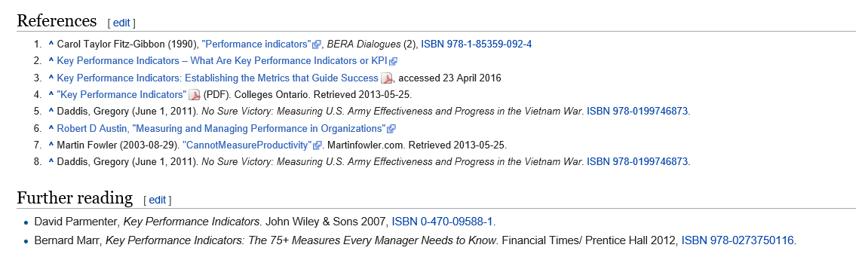
https://en.wikipedia.org/wiki/Performance_indicator

Slide 67
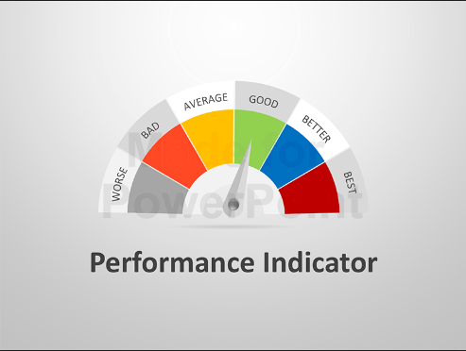
Any Questions

