Slide 1
My Jewelry
Marketing plan – new horizon
Prepared by Chan pak yip jeffery, CHAN SHUK YAN and
ho choi hei lizbeth
Assignment 2 of Hkbm7012 marketing managment
June 2020

Slide 2
Title and Content Layout with List
Company General Information
Review of the market and what we are doing.
Competitors’ analysis
Traditional Advert vs Digital Advert
New marketing Plan
  Segmentation
  Targeting
  Positioning
  Marketing Mix – 4 “P”
  Milestones and measurement

Slide 3
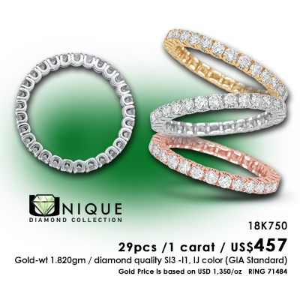

Kwong’s Art Jewellery
Company Profile
Milestones:
Jewellery Manufacturer & Wholesaler.
Founded in 1983.
Focus on Export Jewellery Worldwide Business.
In 1994, opened its first retail outlet in Hong Kong which is known as “My Jewelry”.
Mission:
Dedicated to bringing complete satisfaction to customers by delivering best quality jewelry and service.
https://www.kwongsart.com/

Slide 4

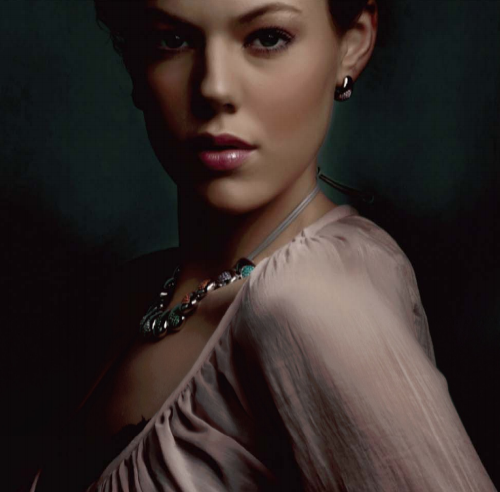
Brand Information
Founded in 1994.
Aim to provide better services “style-at-affordable-cost Jewelry”
Products focus on Simple and Classic Design.
Cost on raw materials & production.
Shop allocated over HK Island, Kowloon and New Territories.
VIP members 100,000.-
https://www.myjewelryeshop.com/pages/about-us

Slide 5
Current Segmentation & Marketing Mix
Segmentation : | Age Gender
Target Market | Young Female
Brand Positioning | Common Brand Medium Price
Market Mix (4P) : | Product - Design Jewelry Price – Medium Price Promotion – Shops & Online Place – Shopping mall

Slide 6
P
E
S
T
Political Environment
GBA (Greater Bay Area)
CEPA
Government Funding
EMF
BUD
ReTAAS
4. TDC (Trade developing Council)
Economic Environment
Covid-19
Gold price
Low demand on Jewellery products
Working Capital &Cash Flow
Tariff - Trade War
Social Environment
Branding
Digital marketing
Online purchase
E-Commerce
Compensatory Consumption
Technology
1. I.O.T.
(Internet of
Thing)
RFID
ERP
A.I.
Digital marketing
CNC production
3D design rendering

Slide 7





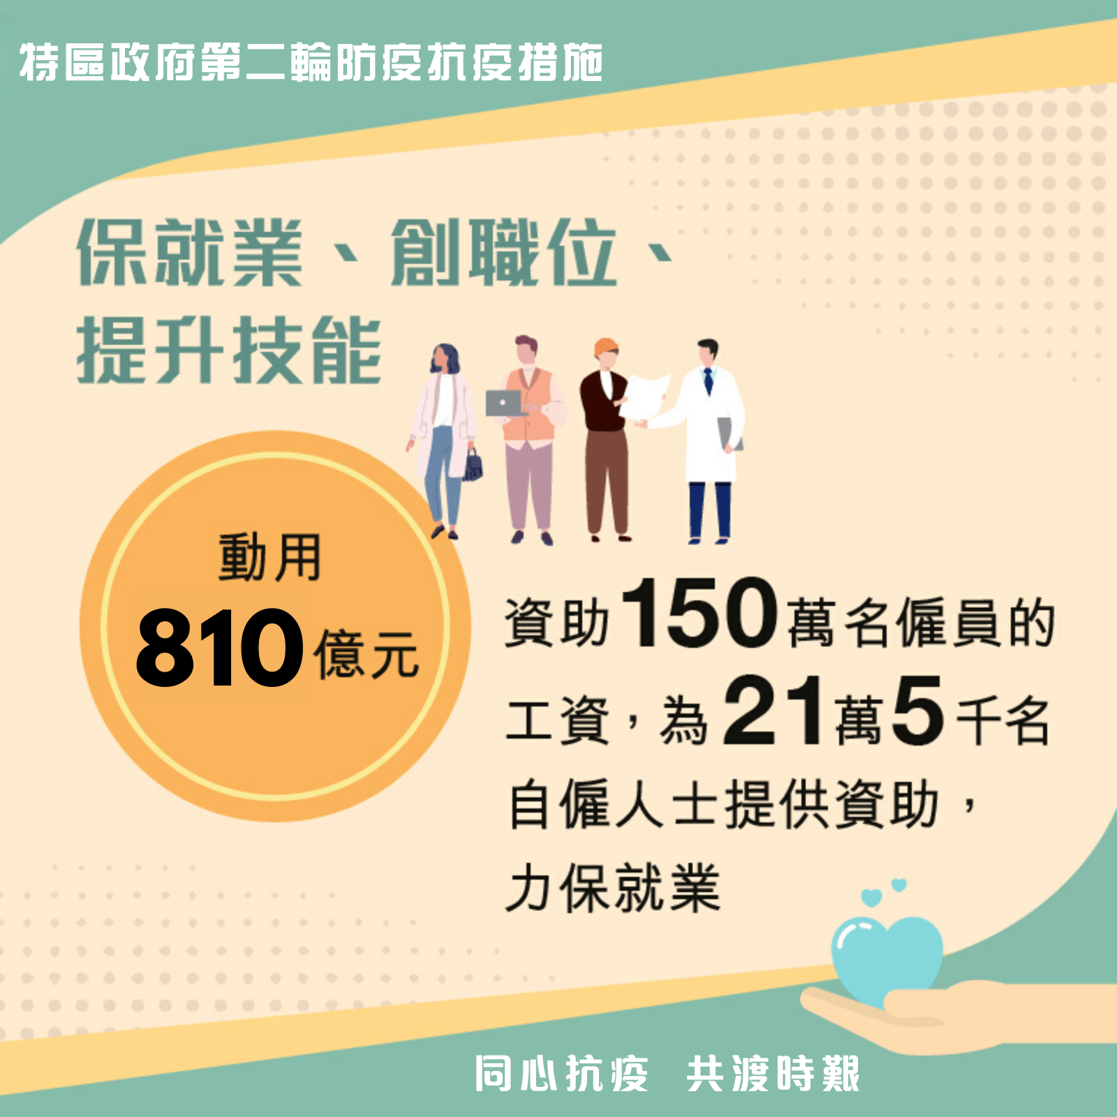
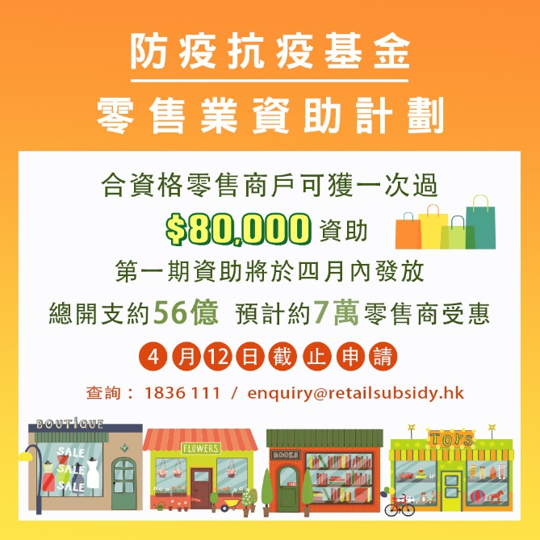
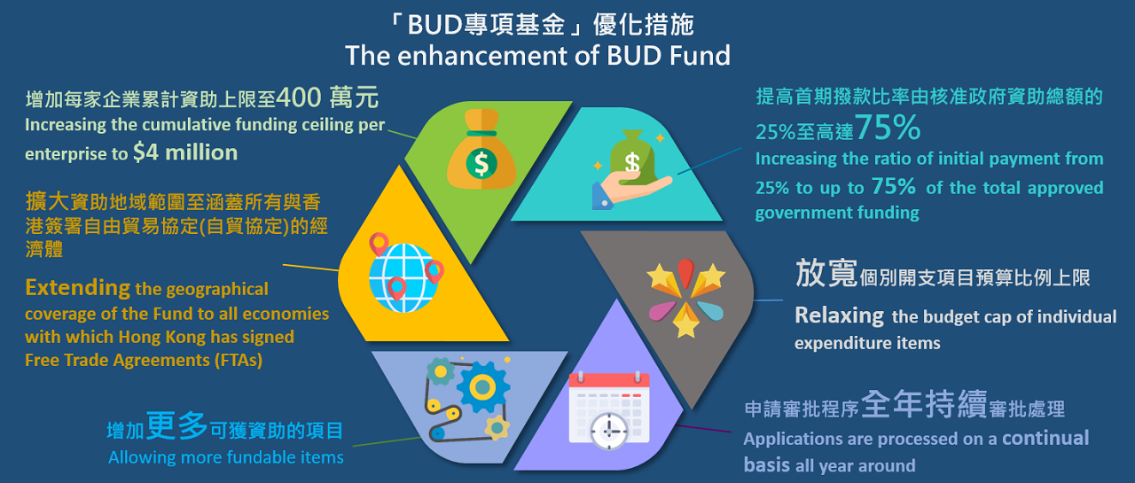
Government Funding $$$
  TVP – Technology
    D-BIZ - Distance Business Programme (遙距營商計劃)
Anti-epidemic Fund (防疫抗疫基金)
RETAAS – Retail Technology Adoption Assistance Scheme
SME Funding
    ESS - Employment Support Scheme (「保就業」計劃)
    Retail Sector Subsidy Scheme (零售業資助計劃)
  BUD – Branding, Upgrading & Domestic Sales

Slide 8
Competitive Analysis

Slide 9
Chow Tai Fook
Branch Networking Jewelry Store in Hong Kong
With about 80-100 branch stores in Hong Kong
Target Customers : Mature Women, Age between 30-60
The Market Mix
  Product Offer : Common Luxury Jewelry
  Pricing : About $2000-$100,000
  Promotion : Traditional Advertising Ads and Posters
  Place : Location with crowd allocate

Slide 10
TSL
High End Jewelry
Brach Networking and Online Store
Target Customer : Workforce Lady / Mature women (Age 20-50)
Market Mix Strategy
  Product Offer : Luxury Design Jewelry
  Pricing : About $2000-$100,000
  Promotion : Online Promotion and Traditional Advertising
  Place : High End Shopping Location

Slide 11
Comparison of Brand
 | Chow Tai Fook | TSL | My Jewelry
Segmentation | 1. Age 2. Class of Income | Class of Income Age | Age Gender
Target Market | Mature Average Income | Mature Middle Class Income | Young Female
Brand Positioning | Common Brand, Average Price | High Brand, Medium Price | Common Brand, Medium Price
Market Mix (4P)
Product | Wide Range of Jewelry | High End Design Jewelry | Design Jewelry
Price | Wide Price Range | High Price | Medium Price
Promotion | 1. Shops 2. Online Store | Shops Online Selling Platform | Shops Online Store
Place | Diverse Districts of Hong Kong | Place with High Crowd | Crowd District and several place

Slide 12
Comparison of Revenue
 | Chow Tai Fook | TSL | My Jewelry
Revenue (Million HKD) | 24,229 (million HKD) #1 | 4,065 (million HKD) #2 | 1000 (million HKD)
#1. Chow Tai Fook Annual Report 2018/19 (Chow Tai Fook Jewellery Group,2019) #2. TSL 2018/19 Annual Report (TSL,2019)

Slide 13
Comparison of Number of Shops
 | Chow Tai Fook | TSL | My Jewelry
No Of Shops [Local Stores In Hong Kong] | 80 #3 | 29 #4 | 10 #5
#3. Retail Network (Chow Tai Fook,2020) #4. Boutique Finder (TSL,2020) #5. Shop Location (My Jewelry,2020)

Slide 14
Comparison of Selling Platform
Brand | Local Stores | Media Platform |  |  |  | Online Platform
 |  | Facebook | WeChat | Instagram | YouTube
Chow Tai Fook | 80 | Yes | Yes | Yes | Yes | Online Purchase Store
TSL | 29 | Yes | Yes | Yes | Yes | HKTV Mall Tmall JD TaoBao
My Jewelry | 10 | Yes | Yes | Yes | Yes | Online Purchase Store

Slide 15
My Jewelry
Current Marketing Solution

Slide 16

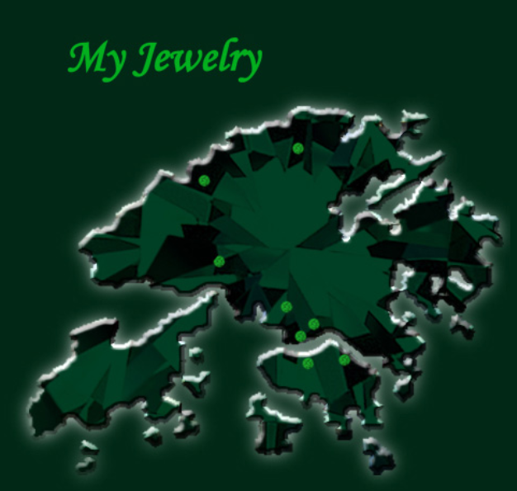
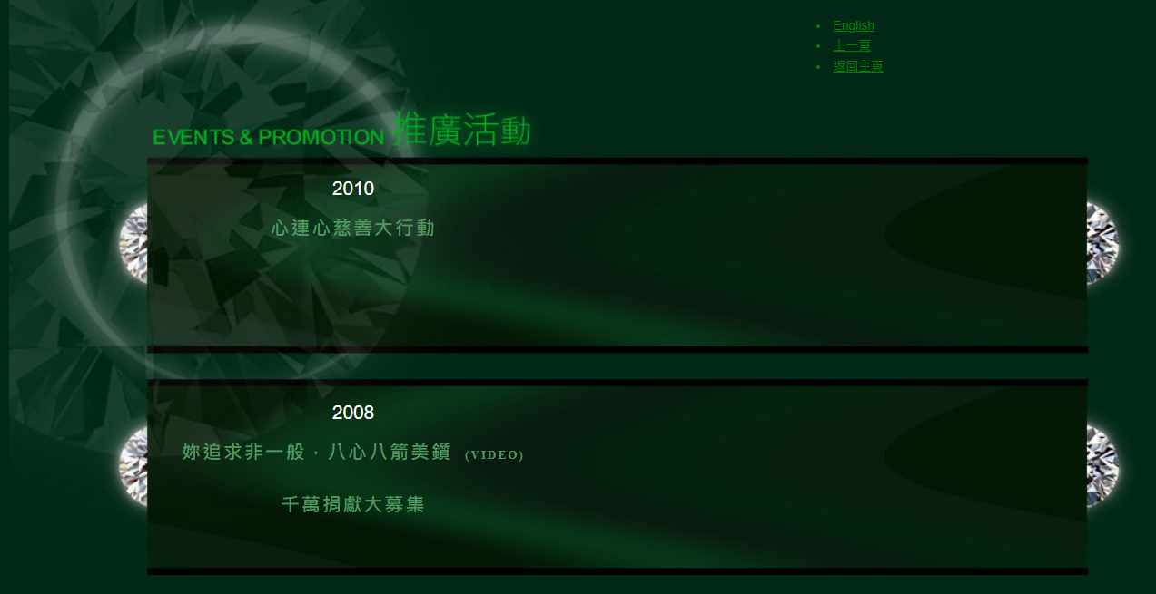
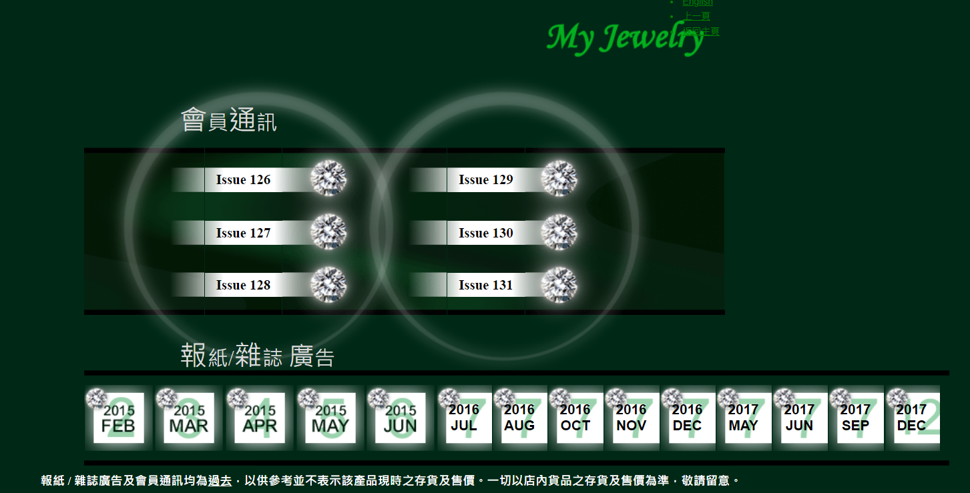
Current Marketing Solution
Product driven advertising on all social media including Facebook, Instagram, WeChat, Youtube & etc.
Physical shops for walk-in customer – no poster
Advertisement on newspaper and magazine have been stopped since May 2017
My Jewelry is not active in pursuing Advertising for the time being
They are primally doing promotion in its own website.
Source: https://www.myjewelry.com.hk/2MJWebProfile/Promo.asp

Slide 17
Analysis of STP

Slide 18
The new 4 Ps
Product
Reputable quality
Affordable price
Fashionable design for young peoples
Limited Edition
Fit to purpose packaging (e.g. proposal, birthday & any other events)
Guarantee for return on ay defect within 7 days
Warranty to repair within 2 years of purchase
Express Delivery Program
Place
10 Comfortable shops located in HK Island, KLN & N.T.
Own Website Online Purchase Platform
Other Popular Online Platform e.g.
  HKTV mail
  Big Big Channel
  Tmall
  JD
  TaoBao
The 4 P is a set of controllable variables that the company can use to influence the buyers responses(Singh, 2012).
Target Customers
Promotion
Lifestyle and story mode
Online Advert on FB, WeChat, Instagram, YouTube, Linkedin & etc.
Price
Young below HK$5,000
Middle Class : HK$10,000 to HK$20,000
Working Woman : HK$10,000 to HK$30,000

Slide 19
New Segmentation & Marketing Mix
SEGMENTATION
New target customers
Gender
Age Group / Purchasing Power
Young Couples/ Male / Female
From 25 to 40 from new working group to middle class

Slide 20
New Target Customer
Age Range between 20 – 40
  Design item from $5,000 to $10,000 HKD
  Target young audience with buying power
Middle Class
  The Design Jewelry with Luxury items like Diamonds
  Target on Middle Class
Women in Workforce
  Women with ability to purchase accessories

Slide 21
Expect Customer Age Distribution

Slide 22
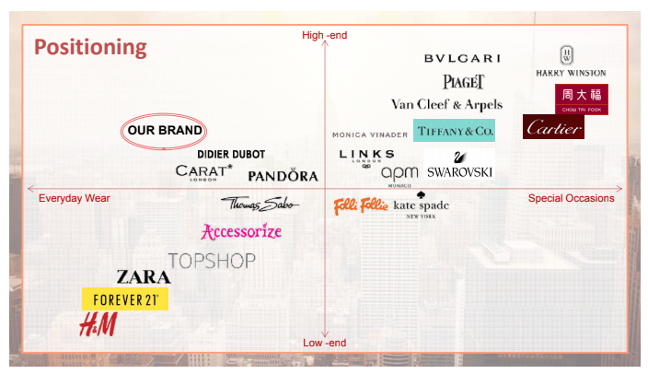
New Brand Positioning
OUR BRAND

Slide 23
New Marketing mix
Product Offer : Design Jewelry
Pricing : Range from $2000-$90000
Promotion : Everyday wearing Luxury
Place : Branch Stores and Website

Slide 24
New Marketing Plan

Slide 25
Planning of Social Media Cooperation Platform
Strategy | Online Platform | Expect Effect
1. Social Media Platform Advertising | Facebook, Instagram, Youtube, Yahoo, Linkedin | Online Advertising for more Target Audiences
2. Special Sales Events | Company Online Purchasing Platform | Online Holiday Season Boost of Sales
3. Advance Online Sales Platform | Company Online Purchasing Platform | Advance Develop Online Purchasing Stores to boost Sales
4. Develop Online Business Client Group | Professional Group Purchasing | Develop Source of Client Network

Slide 26
Promotion Mix Perspective
 | Action Plan | Expectation Effect
Advertising | Online Media Advertising e.g. Facebook | Purchase Prime Time of Customer Awareness
Personal Selling | Develop Online Client Group Personal Selling to Business Client | Effective but Costly
Public Relation | Develop New Online Website and Media Platform | Building Positive Image
Sales Promotion | Product Package Sales Offer | Short Term Boost Sales Target

Slide 27
Planning of Social Media Cooperation Platform
Online Platform
Reason of Choice of Social Media Cooperation
Amazon : Global Platform For Online Purchasing
Zalora : Office Lady Target Group
TaoBao : Mainland Dominant Online Purchasing Store
HKTV Mall : Hong Kong Biggest Online Purchase Store
Linkedin : Professional Group

Slide 28
Time Schedule of Action Planning
Duty | Person in Charge | Schedule (Finish date)
Confirm launching Online Platform shop in Zalora, Lane Crawford, Shein | Lizbeth Ho | 19 Nov 2020
Model selection Confirm Online shop layout | Gloria Chan | 17 Sep 2020 26 Sep 2020
Contract & Payment: - Review and confirm Online Platform contract terms - Prepare payment for Online Platform | Jeffery Chan | 2 Sep 2020 10 Sep 2020
Products: - Product selection - Prepare products for photo shooting - Draft product specifications - Product stock ready at warehouse Packaging: - Packaging ready | Gloria Chan, Jeffery Chan | 13 Aug 2020 12 Sep 2020 12 Sep 2020 7 Nov 2020 7 Nov 2020
Customer Services: - Prepare Q&A for customer service Logistic: - Confirm logistic arrangement -Shop layout, photo shooting and graphic design: | Lizbeth Ho | 26 Sep 2020 26 Sep 2020 26 Sep 2020

Slide 29
Reference
TSL (2019) Annual Report, Available at https://doc.irasia.com/listco/hk/tsesuiluen/annual/ar215560-e00417_annualreport2018_19.pdf (Accessed 10 June 2020)
Chow Tai Fook (2019) Annual Report, Available at https://www1.hkexnews.hk/listedco/listconews/sehk/2019/0614/ltn20190614020_c.pdf (Access Date 10 June 2020)
Four Steps to Client Segmentation. 2017. Wealth Management, .
R, K.B. and GUPTA, D., 2018. Essentials of Marketing Management in LIS. Library Philosophy and Practice, , pp. 1.
Singh, M. (2012). Marketing mix of 4P'S for competitive advantage. IOSR Journal of Business and Management, 3(6), 40-45.
VERMA, Y. and SINGH, M.R.P., 2017. MARKETING MIX, CUSTOMER SATISFACTION AND LOYALTY: AN EMPIRICAL STUDY OF TELECOM SECTOR IN BHUTAN. Indian Journal of Commerce and Management Studies, 8(2), pp. 121-129.
Londhe, B. R. (2014). Marketing mix for next generation marketing. Procedia Economics and Finance, 11(1964), 335-40.

