Slide 1
Marketing
LCBB4014
Week 4 – Session 2

Slide 2
Objectives of the session
  The product life cycle
    Introduction
    Growth
    Maturity
    Decline
  Marketing and economy
    Consumerism
  Marketing and technology
  Digital and social media marketing

Slide 3
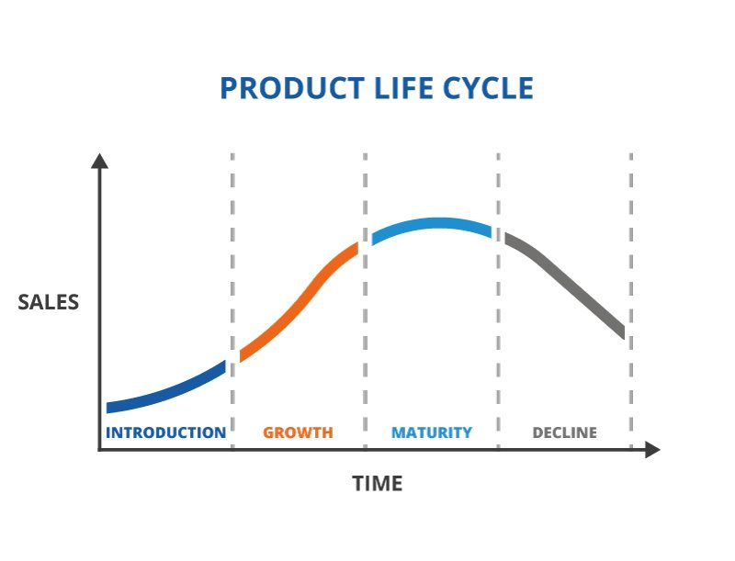
The product life cycle

Slide 4
Introduction
The introduction stage is when a new product is introduced to the market.
In this stage, sales are typically low because customers are unaware and unfamiliar with the product.
Organisations often incur significant costs in research, development, and marketing to create awareness and gain market acceptance.

Slide 5
Growth
In the growth stage, sales start to increase at a rapid rate.
Customers become more aware of the product, and positive word-of-mouth and reviews often drive further adoption.
Competitors may enter the market during this stage, leading to increased competition.
Organisations focus on expanding their market share, improving the product, and building brand loyalty.

Slide 6
Maturity
During the maturity stage, sales growth stabilizes.
The market becomes saturated, and competition is intense.
Organisations may offer product variations, engage in price wars, or invest in marketing to maintain market share.
Profits tend to level off as the product reaches its peak in terms of market penetration.

Slide 7
Decline
In the decline stage, sales start to decline as the product reaches market saturation, and customer preferences may shift to newer or more innovative alternatives.
Organisations may reduce production, discontinue the product, or focus on loyal customer segments. It becomes increasingly challenging to sustain profitability.
Organisations can shift into producing a new and innovative products which will go through the product life cycle again.

Slide 8
Supply and demand (1 of 2)
Demand and supply are fundamental concepts in economics that play a significant role in marketing.
These concepts are essential for businesses to understand as they influence pricing, production, and overall market dynamics.

Slide 9
Supply and demand (2 of 2)
Supply represents the quantity of a product or service that producers are willing and able to offer to the market at different prices during a specific period.
Demand refers to the quantity of a product or service that consumers are willing and able to purchase at various prices during a specific period.

Slide 10
Marketing and economy
Marketing activities is influenced by economic factors in a multiple ways:
In economic recession, when demand falls, customer buying behavior shifts to essentials and pay more attention to their spendings.
When inflation rises faster than wage inflation, the demand for luxury goods may fall.
In times of prosperity of the economy of a nation, prices becomes less of a factor, demand increases, particularly in purchases of luxuries.

Slide 11
Marketing and government (1 of 2)
Since 1980, the UK have changed the marketing environment. The state in involved in marketing in a number of ways:
  The government attempt to regulate the marketing activities of private firms. Most of these measures are aimed at regulating free competition and protecting individual consumers and the environment.
  The government have devised technical standards to which products should comply to ensure minimum standards quality, and to protect both the consumer and the environment against potentially dangerous products and components.

Slide 12
Marketing and government (2 of 2)
  The government set prices and promotional policies control industries can be used to direct public expenditure and consumption
  Advertising is often used to the behavior of individuals, as in the case of health information and education.

Slide 13
Consumerism
Consumerism refers to the cultural and economic ideology that encourages the acquisition of goods and services in continuously increasing amounts.
It is characterized by customer’s pursuit of material possessions and consumption as a means of achieving happiness, status, or fulfillment.
Consumerism is closely associated with modern industrialised societies where mass production and mass marketing have made a wide array of goods and services readily available to consumers.

Slide 14
Marketing and technology (1 of 5)
Marketing and technology are closely intertwined in today's business landscape.
Technology has transformed the way marketing is conducted, providing new tools, platforms, and strategies that enable businesses to reach and engage with their target audiences more effectively.
Here are several ways in which marketing and technology intersect:
  Digital Advertising and Social Media
  Data Analytics and Customer Insights
  Marketing Automation
  E-commerce and Mobile Marketing

Slide 15
Digital Advertising and Social Media
(2 of 5)
Organisation’s digital advertising rely heavily on technology and nowadays on social media such as Instagram, Facebook, Twitter, and Snapchat.
They use algorithms to target specific demographics and track user behaviour for precise ad targeting.

Slide 16
Data Analytics and Customer Insights
(3 of 5)
Technology has enabled businesses to collect, analyse, and interpret vast amounts of data.
Marketers use data analytics tools to gain valuable insights into customer behaviour, preferences, and trends.
This data-driven approach helps in making informed marketing decisions, personalising campaigns, and improving ROI.

Slide 17
Marketing Automation (4 of 5)
Marketing automation platforms leverage technology to streamline and automate repetitive marketing tasks, such as email marketing, lead nurturing, and customer segmentation.
This not only saves time but also ensures that messages are delivered at the right time to the right audience.

Slide 18
E-commerce and Mobile Marketing
(5 of 5)
The rise of e-commerce platforms and mobile apps has transformed the way businesses sell products and interact with customers.
Mobile marketing, mobile payment options, and in-app advertising have become essential for reaching on-the-go consumers.

Slide 19
Activity 1
Individually, identify the various types of promotion used by a store with which you are familiar.
Which promotion you think is more effective. And why?
Be prepared to discuss your answers

Slide 20
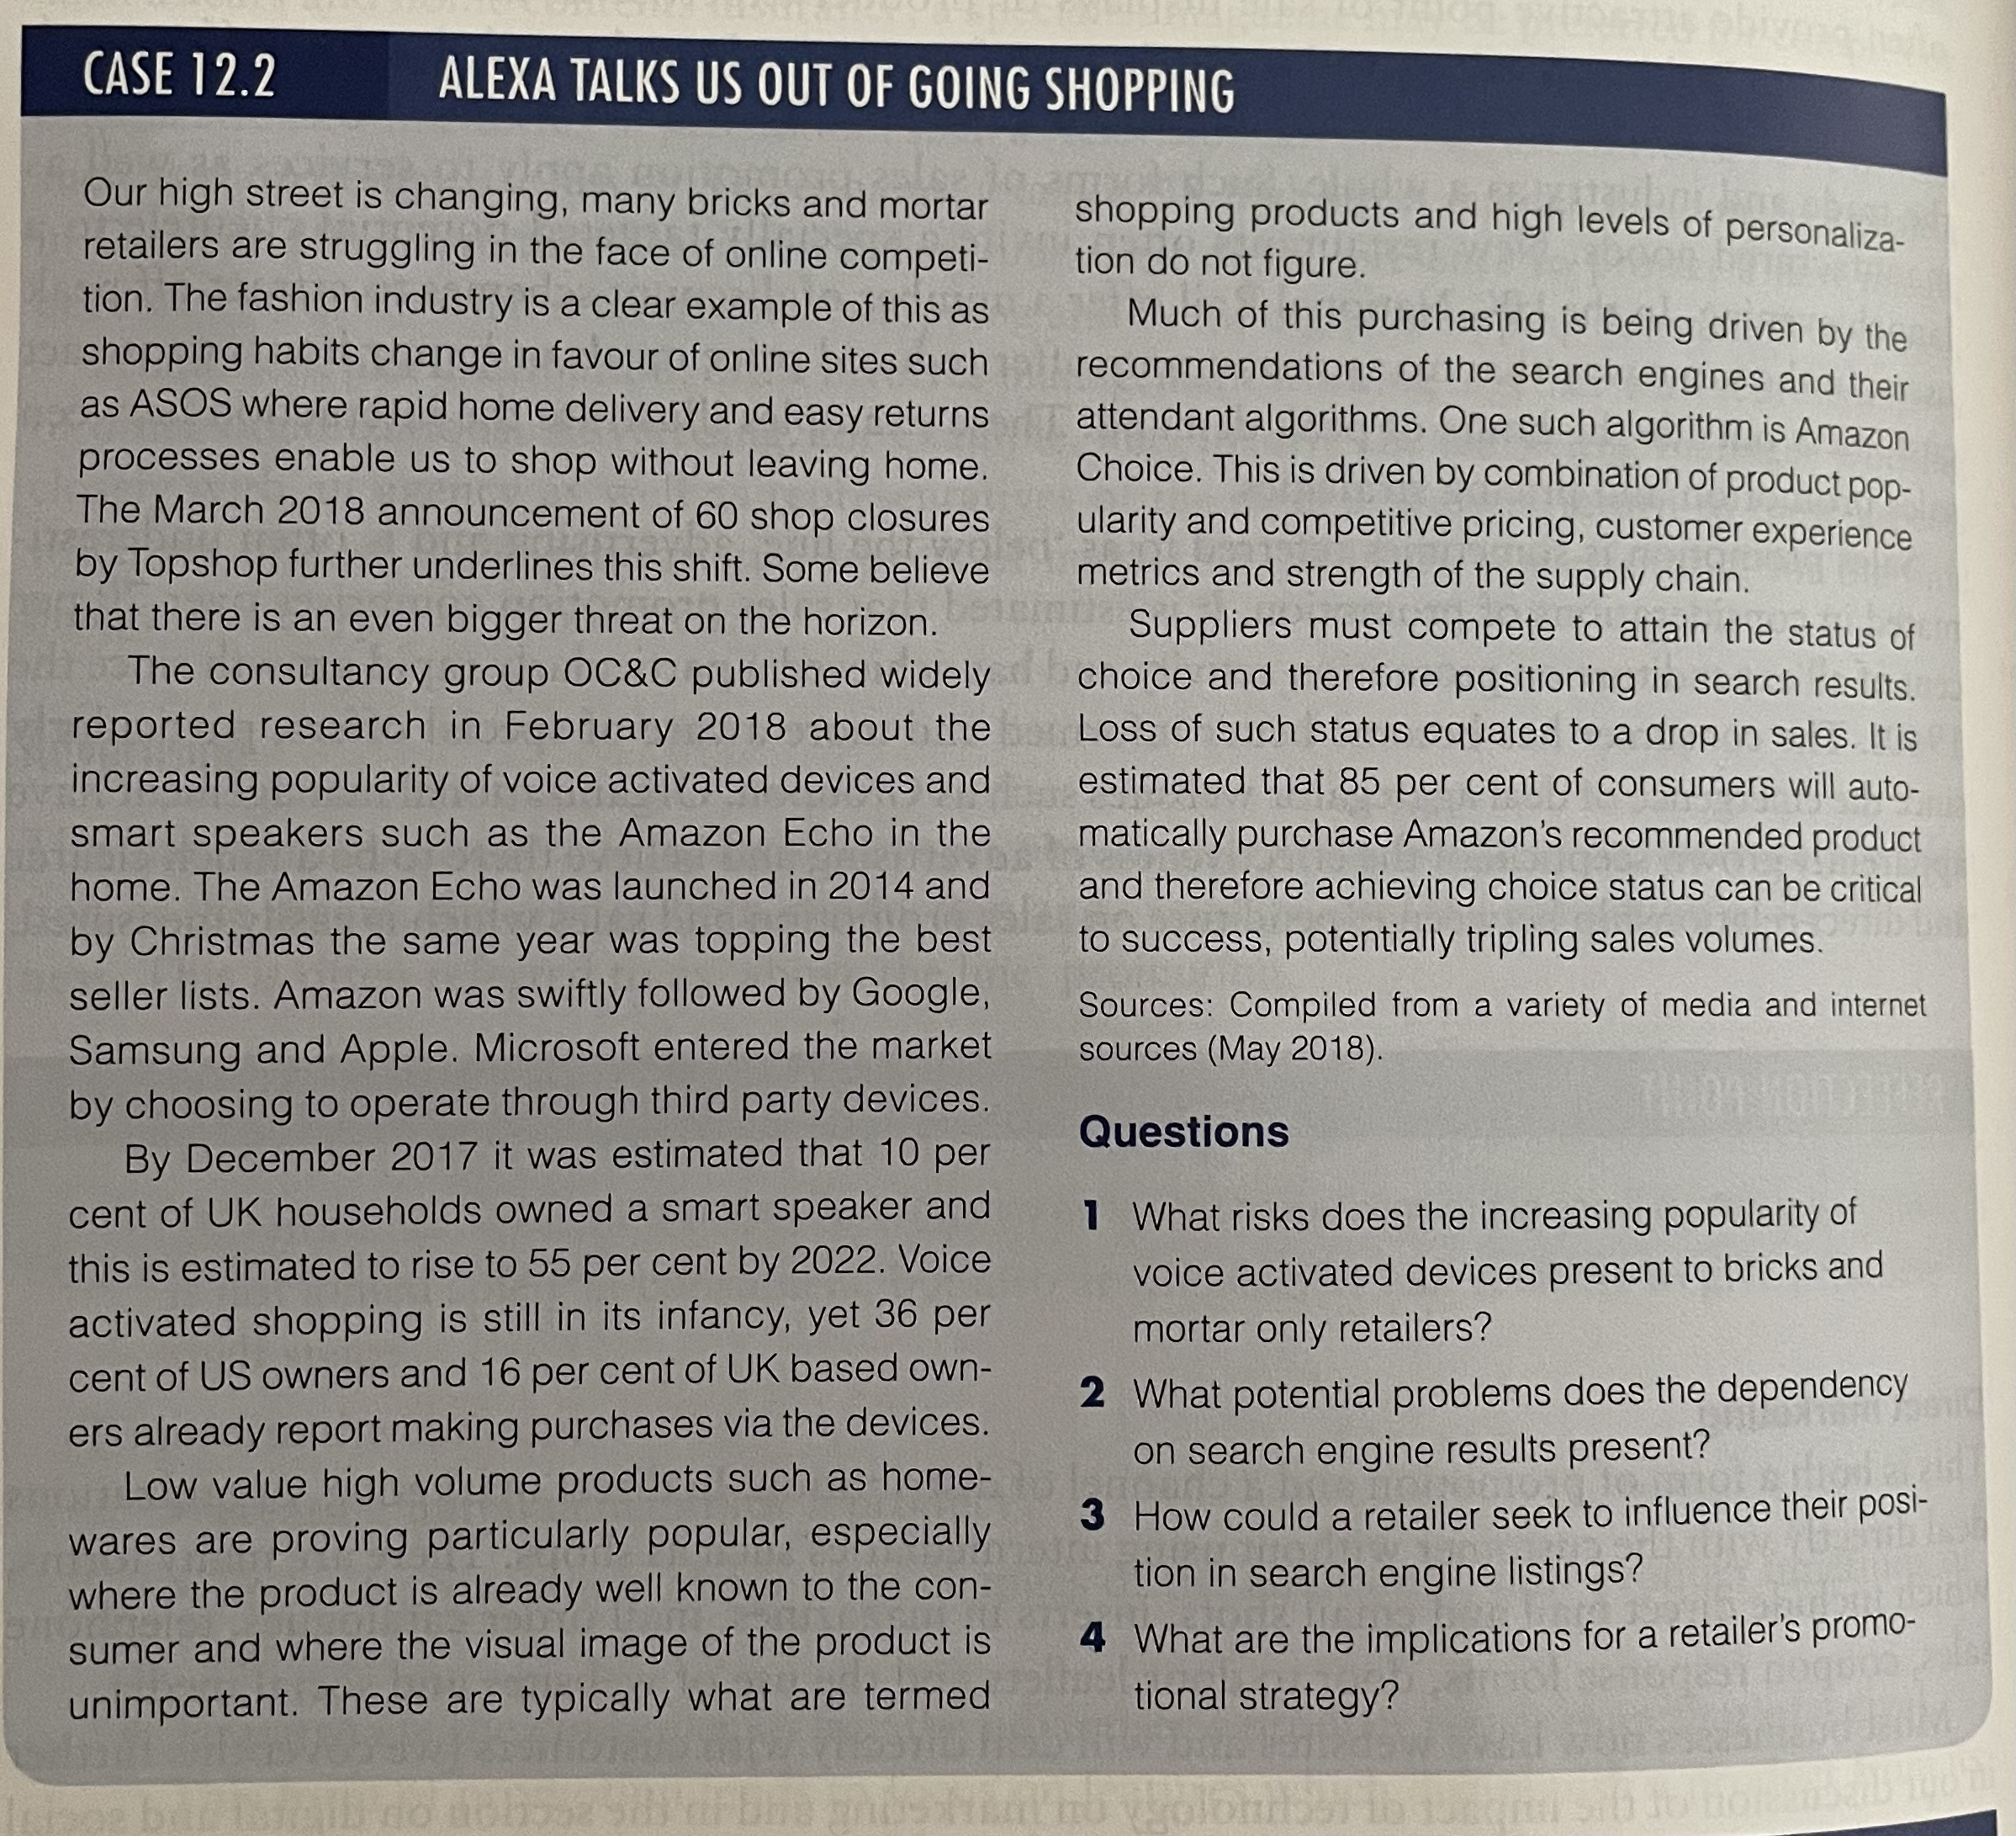
Activity 2
Read the case study and answer the questions.

Slide 21
References
Capon, C. (2009) Understanding the business environment: inside and outside the organisation. Third edition. Harlow, England: Prentice Hall/Financial Times.
Needle, D. Burns, J. (2015) Business in context : an introduction to business and its environment. Seventh edition. Andover: Cengage Learning.

