Slide 1
How can the NHS staff shortage be reduced?
Student: Frida Izabella Tac (2118358)
Problem Solving And Decision Making
BMSW4004
Lecturer: Nicholas Worthington

Slide 2

NHS-the employer
As the largest employer in Europe, the National Health Service (NHS) employs over 1.3 million people worldwide
Regardless of interests, skills, or qualifications, NHS offers over of different 300 careers.
There are however issues with staff shortage within the company. If the problems will not be solved in the near future, the good results and reputation of the NHS might be endangered.
(NHS Jobs - Working in the NHS, 2022)

Slide 3
What issues is the NHS facing?
1 in 8 nursing positions are vacant
The number of university applicants for nursing is in decline
1 in 10 social worker positions are vacant
Brexit might have negatively affected the number of foreign healthcare professionals joining the NHS
1 in 11 care worker vacancies are not fulfilled
UK adult care providers, such as Proper Care, are facing the exact same issues with staff shortage affecting the quality of the services delivered

Slide 4

PESTLE ANALYSIS-DESCRIPTION
Francis Aguilar created PESTLE in 1967 as an analytical tool for studying "micro-environments and macro-environments" and developing "strategic thinking.“
In PESTLE, P stands for Political, E stands for Economic, S stands for Social, T stands for Technological, L stands for Legal, and E stands for Environmental. Using PESTLE, views of the environment are obtained from different angles, giving a bird's eye view of the whole issue.
(Akman, 2020)

Slide 5
PESTLE analysis
POLITICAL | ECONOMIC | SOCIAL | TECHNOLOGICAL | LEGAL | ENVIROMENTAL
BREXIT | ECONIMIC DECLINE | AGING POPULATION | NEW MACHINERY –HARD TO KEEP ON WITH | LITIGATION | COVID-19
GOVERNMENT REGULATIONS | BUGET CUTS | STRIKES |  | VISAS REQUIRMENT | STAFF SHORTAGE (INTERESINGLY)
(Brexit and what it means for nursing and midwifery - The Nursing and Midwifery Council, 2022)
(Dalingwater, 2019)
(Readers’ poll: do NHS staff deserve a pay rise of more than 3 per cent?, 2021)
(Yau et al., 2020)

Slide 6
FISHBONE DIAGRAM -DESCRIPTION
Fishbone diagram analysis helps to uncover all the symptoms of any problem by assessing the causes and sub-causes of that particular problem. Therefore, it is also called "cause-effect analysis".
Fishbone diagrams have six classic categories that categorize any business process problems based on their causes. The factors to consider are people, equipment, materials, environment, management, and process.
(Bose, 2012)

Slide 7
FISHBONE DIAGRAM
METHOD
PEOPLE
Long recruitment process
Small number of trainee placements
Absenteeism
Shortage of healthcare professionals
Mental health
Staff shortage
New machinery
Maintenance
COVID-19
EQUIPMENT
ENVIRONMENT
(Reducing the delay between job offer and start date, 2022)
(Frequently Asked Questions (FAQs) about the GMTS, 2020)
(Roberts et al., 2021)

Slide 8
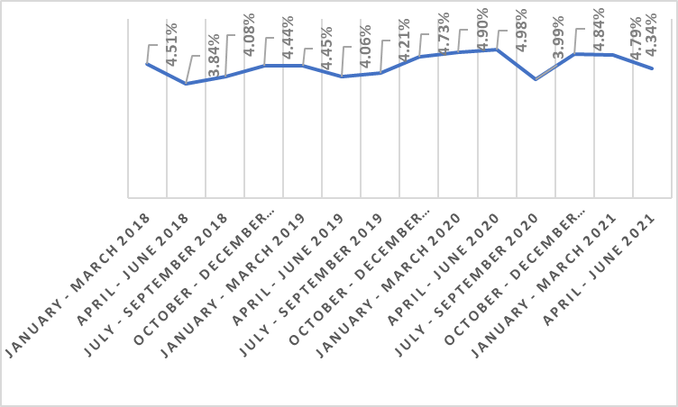
NHS ABSENTEEISM JAN 2018- JUNE 2021
(nhs.uk/ data-and-information)

Slide 9


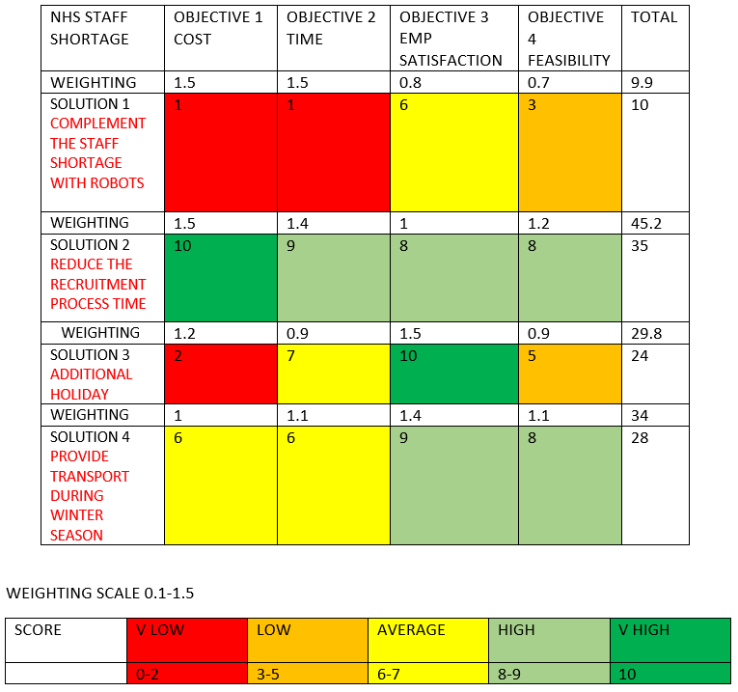


Solutions proposition. Part I.
MATRIX DECISION MAKING

Slide 10
Solutions proposition. Part II.
PMI MODEL
SOLUTIONS | PLUS | MINUS | INTERESTING
COMPLEMENT THE STAFF SHORTAGE WITH ROBOTS | ROBOTS ARE RELIABLE ROBOTS WILL NOT MAKE MISTAKES ROBOTS WILL NOT TAKE MATERNITY LEAVE, HOLIDAY OR PAYMENT | ROBOTS ARE EXPENSIVE THEIR MAINTANACE IS EXPENSIVE CAN BE REPROGRAMMED TO DO HARM IT WILL TAKE TIME(TECHNOLOGY IS NOT THIS ADVANCED YET) | ROBOTS CAN BE ADDED TO HELP THE NHS EMPLOYEES WITH THEIR TASKS, AS ASSISTANTS
REDUCE THE RECRUITMENT PROCESS TIME | WILL DECREASE THE NUMBER OF PEOPLE THAT GIVE UP THE JOB BEFORE STARTING IT WILL MAKE THE PROCESS LESS INTIMIDATING | MORE PEOPLE WILL NEED TO BE HIRED TO HELP WITH THE RECRUIMENT PROCESS | THERE COULD BE INTRODUCED A PAID TRIAL PEROD
ADDITIONAL HOLIDAY | BETTER WORK-LIFE BALANCE MIGHT HELP WITH MENTAL ISSUES | WILL INCREASE THE AMOUT OF WORK CAN BE EXPENSIVE | GIVING UNPAID EXTRA HOLIDAY DURING THE SUMMER (WHEN THE ABSENTEEISM IS LOW)
PROVIDE TRANSPORT DURING WINTER SEASON | WILL REDUCE ABSEENTEISM | MIGHT BE EXPENSIVE | PROVIDE TRANSPORT DURING WINTER SEASON UPON REQUEST

Slide 11
Final solutions
Give unpaid extra holiday during the summer (when the absenteeism is low)
1
Provide transport during winter season upon request
2
Reduce the recruitment process time
3

Slide 12
KEY PERFORMANCE INDICATOR
(KPI)
SOLUTIONS | YEAR | PERCENTAGE OF EMPLOYEE ABSENCE Current mean=4.65
1. Offer unpaid extra holiday during the summer | I | 4.30
 | II | 4.10
 | III | 3.90
2. Provide transport during winter season upon request | I | 4.10(mean during summer)
 | II | 4.10
 | III | 4.10
3.Reduce the recruitment process’ time | I | 3.70
 | II | 3.40
 | III | 3.10

Slide 13
Reference list
Nmc.org.uk. 2022. Brexit and what it means for nursing and midwifery - The Nursing and Midwifery Council. [online] Available at: <https://www.nmc.org.uk/registration/what-brexit-means-for-nursing-and-midwifery/> [Accessed 1 July 2022].
Dalingwater, L., 2019. NHS staffing shortages and the Brexit effect. Observatoire de la société britannique, (24), pp.67-86.
Thetimes.co.uk. 2021. Readers’ poll: do NHS staff deserve a pay rise of more than 3 per cent?. [online] Available at: <https://www.thetimes.co.uk/article/readers-poll-do-nhs-staff-deserve-a-pay-rise-of-more-than-3-per-cent-b8rh6hw0l> [Accessed 1 July 2022].
Yau, C.W.H., Leigh, B., Liberati, E., Punch, D., Dixon-Woods, M. and Draycott, T., 2020. Clinical negligence costs: taking action to safeguard NHS sustainability. BMJ, 368.
NHS Employers. 2022. Reducing the delay between job offer and start date. [online] Available at: <https://www.nhsemployers.org/articles/reducing-delay-between-job-offer-and-start-date> [Accessed 2 July 2022].
2020. Frequently Asked Questions (FAQs) about the GMTS. [ebook] NHS graduates, Appendix 2. Available at: <https://www.iow.nhs.uk/Downloads/Education%20Centre/Leadership/081419_GMTS_March2020_Appendix2_FAQs_V0.1_TC.pdf> [Accessed 2 July 2022].
Roberts, N.J., McAloney-Kocaman, K., Lippiett, K., Ray, E., Welch, L. and Kelly, C., 2021. Levels of resilience, anxiety and depression in nurses working in respiratory clinical areas during the COVID pandemic. Respiratory medicine, 176, p.106219.

Slide 14


Jobs.nhs.uk. 2022. NHS Jobs - Working in the NHS. [online] Available at: <https://www.jobs.nhs.uk/about_nhs.html#:~:text=The%20NHS%20%2D%20a%20rewarding%20place,GP%20practice%20or%20practice%20nurse> [Accessed 6 July 2022].
Akman, M.K., 2020. Defence Management and PESTLE analysis. Ante Portas-Security Studies, 1(14), pp.93-102.
Bose, T.K., 2012. Application of fishbone analysis for evaluating supply chain and business process-a case study on the St James Hospital. International Journal of Managing Value and Supply Chains (IJMVSC), 3(2), pp.17-24.

Slide 15
THANK YOU FOR THE ATTENTION!

