Slide 1
The Innovation Journey
Nada Ahmed
Founder and CEO Agile Leadership
January 2022

Slide 2
What happens when you don’t adapt?
Notes:
In a disruptive era, the only viable strategy is to adapt and that is especially true today. With change seeming to accelerate with each passing year, every organization must transform itself. Those who are unable to change often find that they are unable to compete and soon disappear altogether.

Slide 3
Innovation is essential for growth
Innovation: The creation of new products and services that deliver value to customers, in a manner that is supported by a sustainable and profitable business model.
Notes:
You have to catch the wave at the right time
You need to be thinking of new products and services- online marketing, cloud computing, electric cards

Slide 4
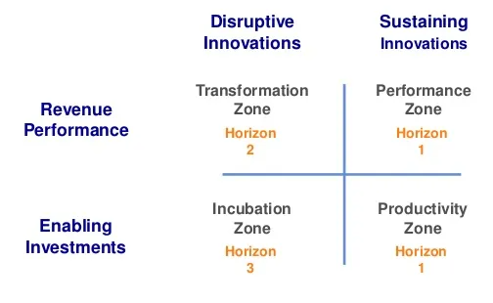
Zone to Win Framework
You have to catch the wave at the right time
Most companies focus on the present and don’t create room for creating the future
Notes:
Geoffrey Moore
Performance zone is about making the numbers
Productivity- services to the company- efficiencies and improvements, finance legal marketing
Incubation find the next wave, venture
Transformation can be dormant until the time is right

Slide 5
Zone to Win Framework
Incubating or scaling new products or business opportunities must be segregated from sustaining innovation- making improvement to existing entities
Financial commitments from the more established part of the business must be separate from the enabling investments
Incubation: NEW line of business not adjacent to existing business
Notes:
Geoffrey Moore
Disruptive innovation — incubating or scaling new products or business opportunities — must be segregated from sustaining innovation — making improvements to existing entities.
And, revenue performance — financial commitments from the more established parts of the business — must be separated from enabling investments — funding and resourcing new product and business opportunities.
You have to be a growth company today

Slide 6
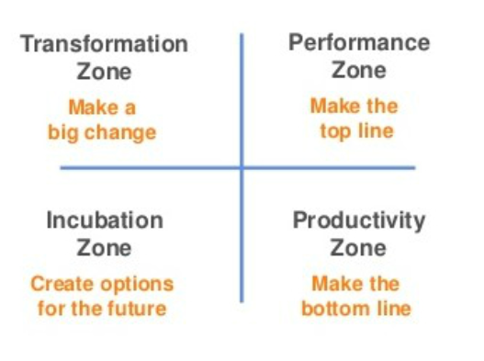
Established Enterprise Advantage
Ability to redirect professional services organization to prioritize projects that impact transformation zone
Intertial momentum of the installed customer base
Ecosystem of partners
Notes:
Disruptive innovation — incubating or scaling new products or business opportunities — must be segregated from sustaining innovation — making improvements to existing entities.
And, revenue performance — financial commitments from the more established parts of the business — must be separated from enabling investments — funding and resourcing new product and business opportunities.
You have to be a growth company today

Slide 7
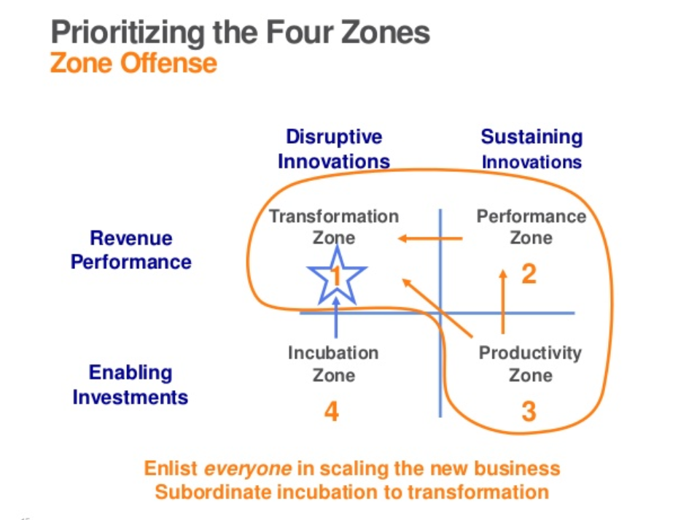
Prioritizing is the key
When it comes to making a big bet on the next big thing, pick one.
Difficult to scale 2 or more new franchises while at the same time be expected to make the numbers on the established lines of business

Slide 8
What disruptive forces are impacting us today?

Slide 9




Three different games to play
Infrastructure model
Efficiency
Operating model
Effectiveness
Business model
Competitive advantage
Notes:
Infrasture: How they access products or services . Digital marketing Adapt personal, equipment- technical operations, redefine price and performance
Operate: project management, more global- airlines need to have mobile offerings - agents and call centers play a diminishing role
Business model: a software or tech cuts of a major step for customers. - like Amazon with the book store still hour based, project based income

Slide 10
Innovation Myth or fact?
No established enterprise can be expected to change its core business model
Notes:
Moore says they should try to catch the wave in another adjacent market
Netflix – from discs by post to kings of streaming

Slide 11
How do you prevent the next wave from catching you?
CORE
NEW Business
Modernize your existing operating model as best as you can, incorporating enough of the next gen tech to blunt the impact of the disruptor
Create a portfolio of next generation opportunities to accelerate your own progress towards catching some other wave of disruption emerging in some other category

Slide 12
Transformation does not happen bottom up
Myth or Fact
Notes:
Change never happens all at once and can’t simply be willed into existence. It can only happen when people truly internalize and embrace it. The best way to do that is to empower those who already believe in change to bring in those around them

Slide 13
Transformation happens in all directions
Starts with leaders first
Identify the enthusiasts
EMPOWER

Slide 14
Transformation Myth or fact?
Company wide communication campaign is a key strategy
Notes:
Big kick of meetings and campaigns don’t work- garners more critics than supporters- you are trying to convince instead of empower
YOU have to communicate differently- its not that others have to change,

Slide 15
Communicate Differently
Intimate interventions
Use narratives
Notes:
Big campaigns mobilize the opposition, who will try to undermine the effort — either actively or passively — before you have the chance to gain momentum. Before you know it, your initiative loses steam and change dies with it.

Slide 16
Innovation pitfall
Leaders often get stuck in the details of how do we do it. How do we innovate? How do we transform?
Notes:
If you can get super clear on the why and the what- the how will be revealed to you

Slide 17
2 Key Questions
What are we transforming to?
Why are we transforming?
Notes:
Give an example of a company who was very clear on what they were transforming to
E.g. Satya NAdella and is cloud transformation
Microsoft was stagnant for almost a decade, while apple was taking the market share in iPhone.
Satya soon realized he need to let go of sunk costs of the past decisions, and predict the next wave and go for it.
Ask the audience and what was the next wave satya nadella caught on to? That Microsoft caught on to? In which it beat apple

Slide 18
Case Study: Microsoft
Old strategy | New Strategy
Consumer facing | Enterprise facing
PC Centric | Cloud focused
Proprietary phone hardware and operating system | subscription products with regularly recurring revenue.
Know it all | Learn it all
Microsoft, a company at the center of the technology world for decades, watched the future pass it by.
Notes:
Give an example of a company who was very clear on what they were transforming to
E.g. Satya NAdella and is crowd transformation
Microsoft was stagnant for almost a decade, while apple was taking the market share in iPhone.
Satya soon realized he need to let go of sunk costs of the past decisions, and predict the next wave and go for it.
Ask the audience and what was the next wave satya nadella caught on to? That Microsoft caught on to? In which it beat apple

Slide 19
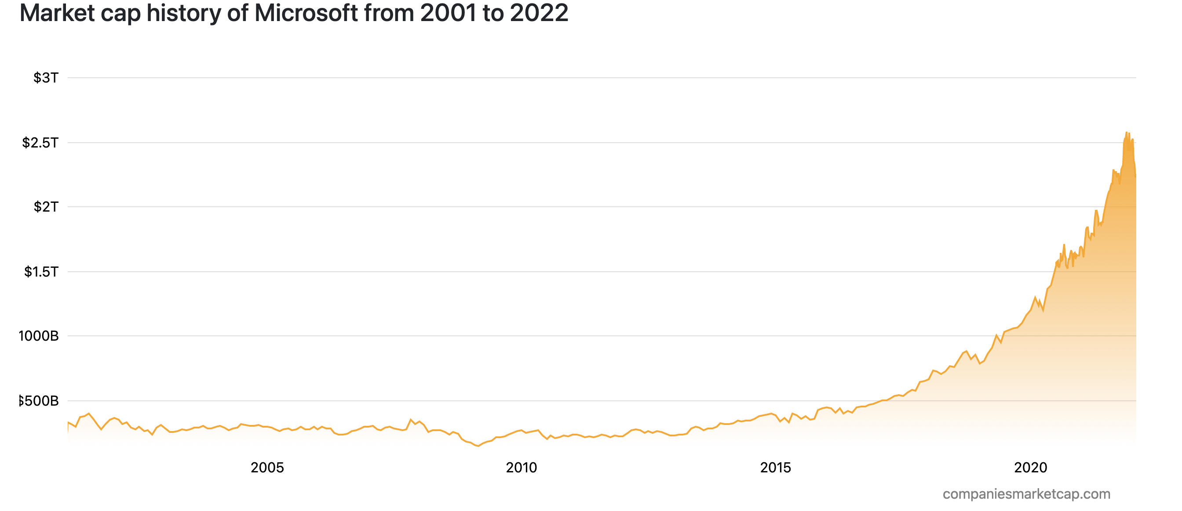
Case Study: Microsoft
Microsoft, a company at the center of the technology world for decades, watched the future pass it by.
Notes:
Give an example of a company who was very clear on what they were transforming to
E.g. Satya NAdella and is crowd transformation
Microsoft was stagnant for almost a decade, while apple was taking the market share in iPhone.
Satya soon realized he need to let go of sunk costs of the past decisions, and predict the next wave and go for it.
Ask the audience and what was the next wave satya nadella caught on to? That Microsoft caught on to? In which it beat apple

Slide 20
Why the how is not important
Part of being agile is not being fixed on the how. If you focus on the how to early you may go in the completely wrong direction
Instead have an interactive, experimental approach for the how
Leave the how to the teams
Notes:
10 min Miro exercise on these 2 questions

Slide 21
Strategy for the 2020s
Notes:
10 min Miro exercise on these 2 questions

Slide 22
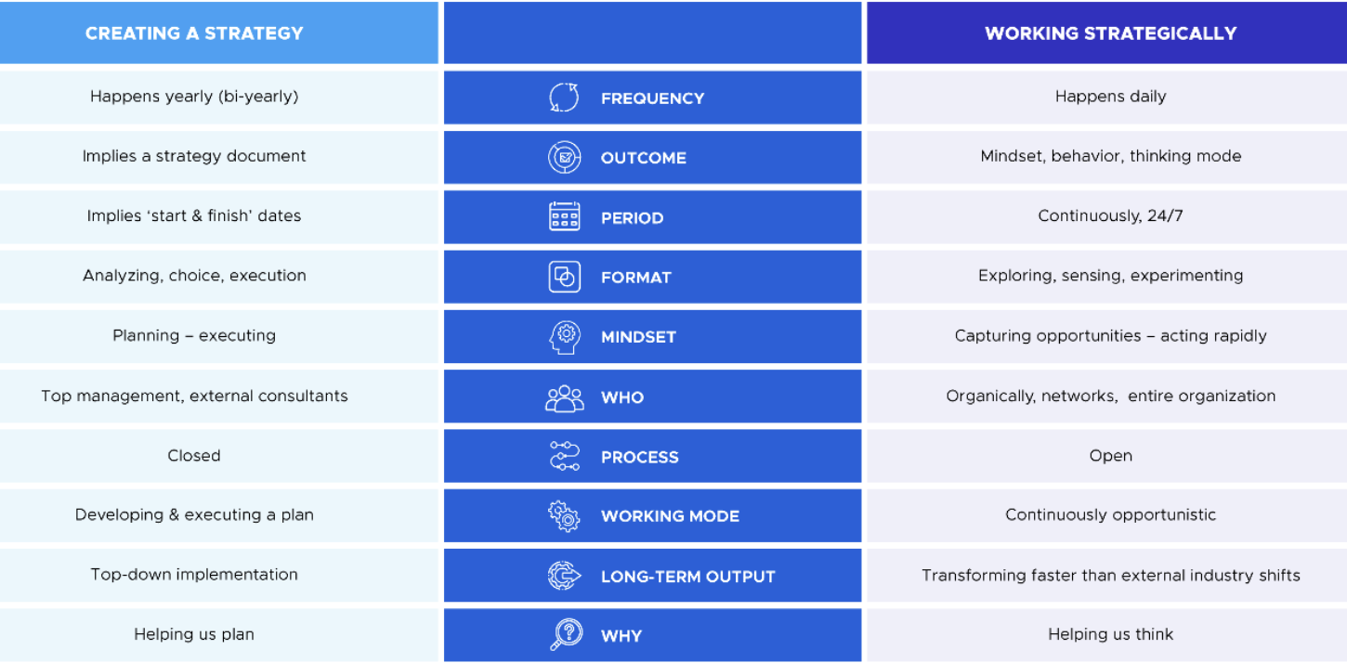
Innovative companies don’t create strategies- they work strategically
  Creating a Strategy
Working strategically
  Once a year, or every 5 years
  Is a document
  Analyzing, choice and execution
  Happens daily
  In mindset, behavior and thinking mode
  Sensing, exploring, experimenting

Slide 23


Leadership is the biggest barrier to Transformation
You need the right leaders on board
A leader’s role is less to plan and direct but to empower and inspire
Mindset and values matter
Notes:
Biggest barrier to transformation leadership
There is no one quick fix cookie cutter recipe for successful transformation. It all has to be catered towards your individual company goals.
Every transformation is different. That is why our job as leaders is to empower and build that transformation capacity with the teams-
Diverse skill set is needed- diversity
The answer doesn’t lie in any specific strategy or initiative, but in how people are able to internalize the need for change and transfer ideas through social bonds. A leader’s role is not to plan and direct action, but to inspire and empower belief.

Slide 24


Leadership for the post-industrial era
Notes:
Industrial era leadership
Reflect on if our leadership style has changed?
What are leadership skills we need going forward

Slide 25




Agile Manifesto
Individuals and interactions over processes and tools
Working software over comprehensive documentation
Customer collaboration over contract negotiation
Responding to change over following a plan

Slide 26
Agile Leadership
Individuals and interactions over processes and tools
Working software over comprehensive documentation
Customer collaboration over contract negotiation
Responding to change over following a plan
People over process
Meaningful, value-adding work
Collaboration over competition
Build resilience

Slide 27


Slide 28

Notes:
Performance metrics

Slide 29


Slide 30
Illusion of Control

Slide 31

Think differently about productivity and prioritization

Slide 32
Leading a Successful Transformation

Slide 33
You can contact me at nada@nadahmed.com
Add me on LinkedIn
On Instagram @agile_leadership
Website
www.nadahmed.com

Slide 34


