Slide 1
Life in the Eastern Desert of Egypt
Unit 4 – The Erythra Thalassa
CLAH7014

Slide 2
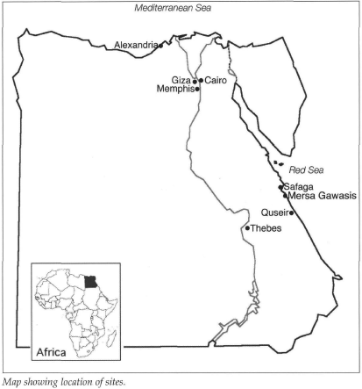
Pharaonic Activity
Crossing the ED and sailing down the Red Sea to reach “Punt”.
Punt a nebulous locations – East Africa above the Bab el-Mandeb? Southern Arabian Peninsula?
Earliest recorded expedition sent out by Sahura (2458-2446 BC);
  Periodic ones sent out under different Pharaohs, e.g. Mentuhotep III (2004-1992 BC); Hatshepsut (1508-1458 BC.
Remains from the site of Mersa Gawasis.

Slide 3
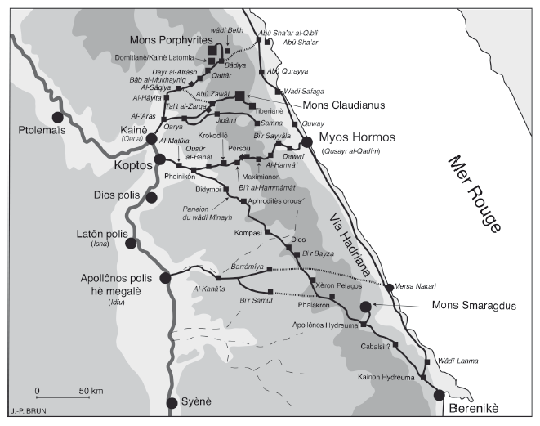
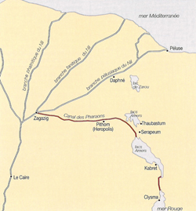
Ptolemaic Establishment of Ports
Ports
  Arsinoe; Philoteras; Nechesia; Berenike Trogoditika; Myos Hormos
Canal to Suez (re)excavated by Ptolemy II Philadelphos.
Tracks leading from Edfu and from Koptos.

Slide 4
Evidence for Exchange
Evidence from Delos relating to incense and ivory trade.
Sacred animal necropolis at north Saqqara.
  Papio hamadryas anubis (Olive Baboons)
  Cercopithecus (African green monkeys)
Loan agreement relating to the Spice-Bearing (Ἀρωματόφορος) land.
“Sphinxes, dogheads and cepi are sent to Alexandria from the country of the Trogodytes and from Ethiopia. Sphinxes resemble the animals as depicted in pictures… they are mischievous and so receptive of systematic training that their gracefulness in everything causes amazement…” - Agatharchides 74a = Photius, Cod. 250.73, p.455b.

Slide 5
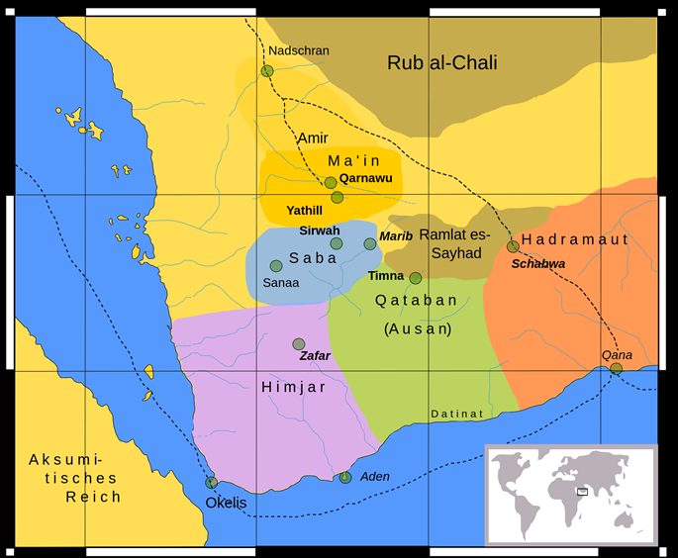
Egypto-Arabian Contact
P. Cairo Zen. 59536 – “Minaean frankincense”.
Zayd‘il bin Zayd - Memphis - importer of myrrh and calamus.
Sabaean merchants – Larimnum - Agatharchides 5.103a + b.
Qana’ (Kane of the PME) – Koan amphorae.
Khor Rori (Moscha Limen of the PME) imitations of the Athenian tetradrachmae (head/owl series).
Bust of Athena found at Jabal al-Lawdh (c.3rd -2nd century BC).

Slide 6
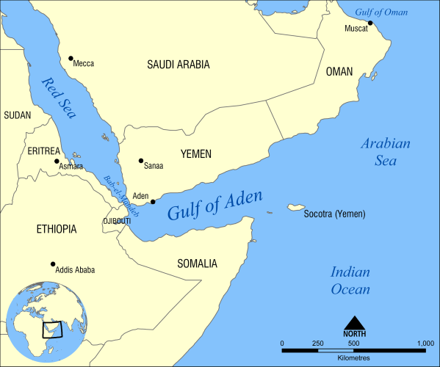
Nodes
“…Fortune Islands… In these islands one can see riding at anchor merchant vessels from neighbouring countries. Most of those encountered there are from the port Alexander built on the Indus River. Not a few, however, come from Persia and Carmania and the whole nearby region.” Agatharkhides 5.105a = Photius, Cod. 250.103, 459b.
“Eudaimon Arabia [prosperous Arabia], a full-fledged city in earlier days, was called Eudaimon when, since vessels from India did not go on to Egypt and those from Egypt did not dare sail to the places further on but came only this far, it used to receive cargoes from both…” – PME 26.

Slide 7
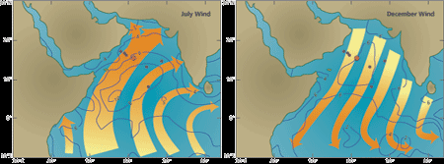
Discovery of the Monsoon?
Eudoxus of Cyzicus - Strabo Geog. 2.3.4-5.
Hippalos - PME 57; Pliny NH 6.26.100, 104-05.
Conspiracy of silence by Arab merchants?
“The whole coastal route just described, from Kane and Eudaimon Arabia, men formerly used to sail over in small vessels, following the curves of the bay. The ship captain Hippalos, by plotting the location of the ports of trade and the configuration of the sea, was the first to discover the route over open water.” – PME 57.

Slide 8
Roman Annexation
Roman” period began with Octavian’s (i.e. Augustus, who receives this title in 27 BC) annexation of Egypt in 30 BC.
Participation by a range of ethic groups with the Roman Empire – Graeco-Egyptians, Italians, Palymrenes, etc. – along various other international merchants (Indian, Arabians, Persians, etc.)
Muziris Papyrus (P. Vindob G 40822) - Verso mentions a consignment of ivory, cloth(?) and nard weighing 3.5 tons – other goods possible including pepper and malabathron – total cargo about 9.3 million sestertii (equivalent) on value.

Slide 9
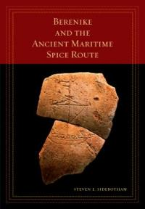

Ship Construction
The square-rigged merchant in the Mediterranean - capacity from 75 to several hundred tons (at extreme end 1000 tons).
Shell of planks held together by thousands of closely-set mortise-and-tenon joints, and sets of frames that were inserted afterwards
Dimensions of harbour at Berenike - 19-22 m wide and up to 60-61 m in length.
Brail-rings, a deadeye, various sheaves from rigging-blocks, and several fragments of sailcloth - S/S (Egyptian) and Z/Z (Indian) material.
O. Krok. 41 – wagon with shipbuilding wood.
Koptos Tariff - tolls paid by shipbuilders’ servants and artisans – also on components such as masts and yardarms.

Slide 10
Goods Traded
Imports
Exports
Spices and aromatics – pepper (esp. black), cassia, frankincense, nard.
Textiles – silks, Seric skins, cotton cloth.
Precious gems – beryl, opal.
Woods – teak, ebony.
Animals (exotic pets and food)
Slaves
Heavy/bulky items – non-precious metals, e.g. copper.
Crafted goods – bronze-wares, glass, reworked imports (silk!).
Foodstuffs and drink – wine, olive oil, maybe garum?
Mediterranean red coral.
Gold and silver crafted wares.
Peridot (chrysolithon / topazos)
Gold and silver craft wares and coins.

Slide 11
Foreign Merchants at the Red Sea Ports
Arabians at Myos Hormos and Berenike:
  Dedications by merchants from Eudaimon Arabia (Aden) in 1st c AD.
  South Arabian graffiti, and writing on sherds.
  South Arabian utilitarian wares (e.g. calcite beehive vessel)
Indians at Myos Hormos and Berenike
  Rice (kernels and chaff) found at Berenike
  Utilitarian and domestic wares – personal baggage?
  Arikamedu style cooking ware (Myos Hormos)
  Cooking pots (Wheeler Type 24), casseroles dishes (Wheeler Type 25), flanged casseroles and lids (Wheeler Type 28-29) – southeast Indian in origin (Berenike)
Indian scripts and symbols found in Eastern Desert (e.g. svastikas)
Names of Indians – Kanan and Cātan – Brahmi script (Myos Hormos) – Brahmi script (Berenike); Halaka, Vinhudala [=Visnudatta], and Nakada [=Nagadatta?] – ostrakon list good (oil, meat, wine) – Prakrit southwest, south central India (Myos Hormos).

