Slide 2
Today’s Agenda
9:30 “Introducing” culture
10:45 Break
11:00 Connecting: structure, strategy & environment
12:30 Lunch
1:15 AI and the business
3:00 Assignment overview

Slide 3
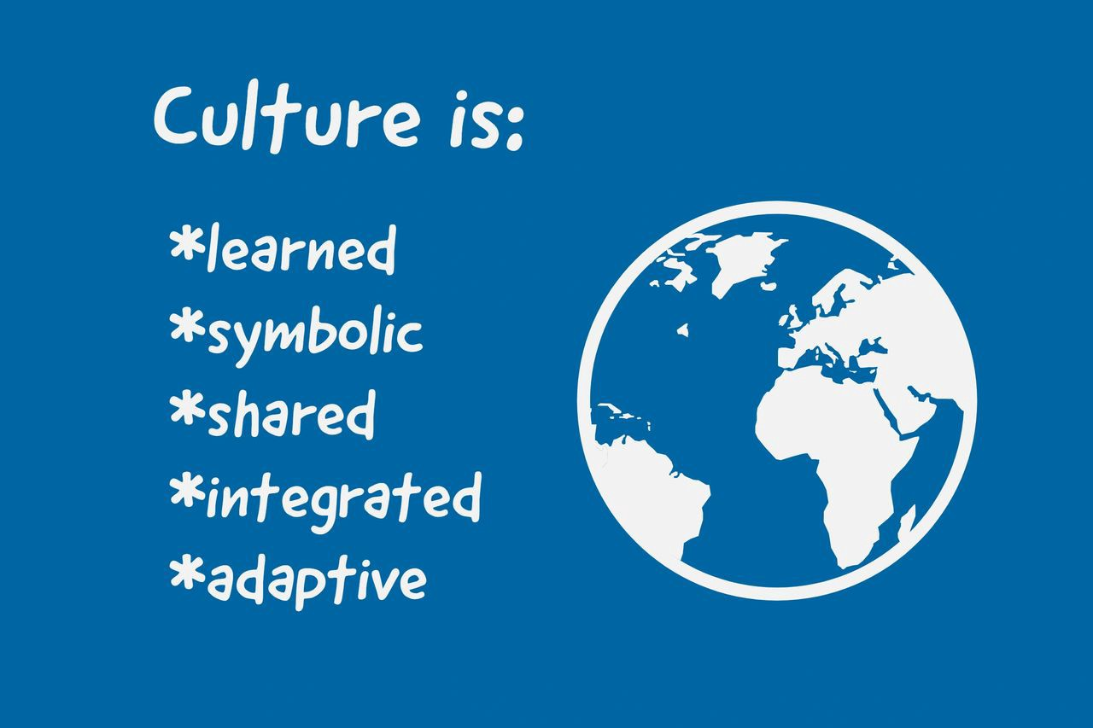
Let’s talk about culture

Slide 4
Let’s talk about culture
How we do things around here…
when no-one is looking
Processes:
What is…Noticed? Rewarded? Explicit/implicit?
Behaviours

Slide 5
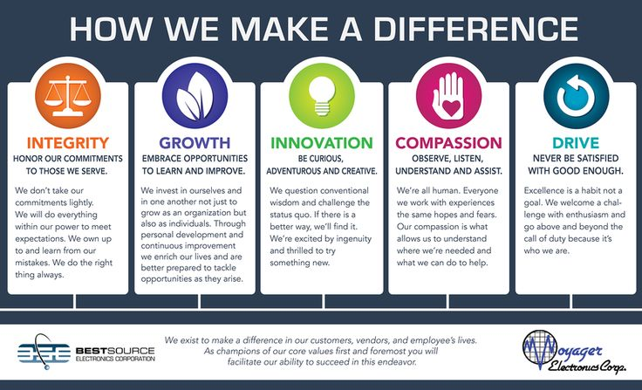
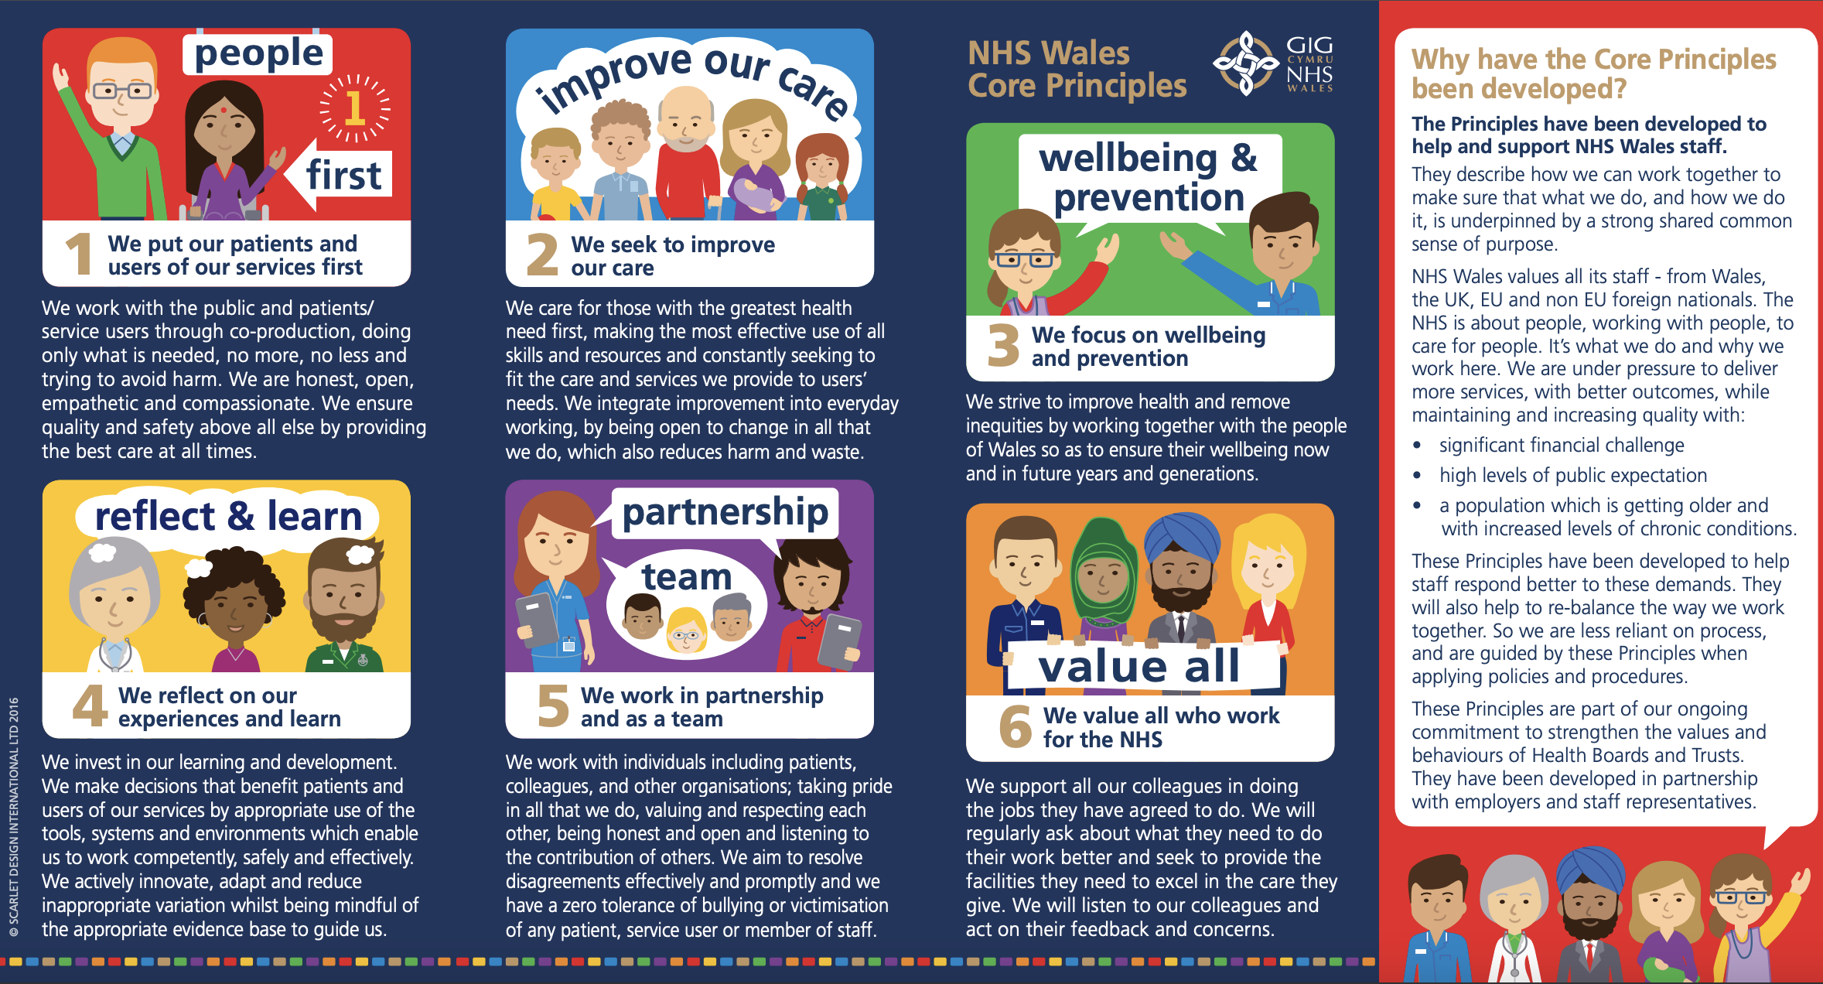
Let’s discuss culture…
Does having organisational values help develop a positive culture?
Why? How? What?

Slide 6
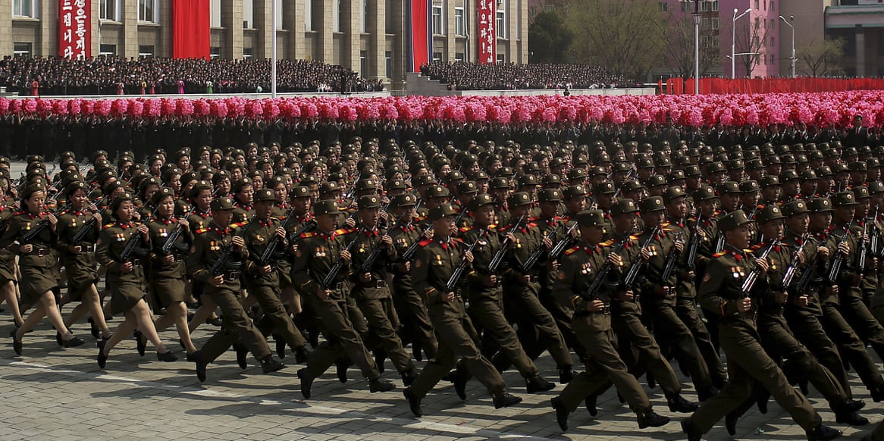

Understanding individual differences…
How most work is designed
Our normal energy flow normally (any given day, week, year)
10
9
8
7
6
5
4
3
2
1
0
10
9
8
7
6
5
4
3
2
1
0
Energy/Wellness
Energy/Wellness
Time
Time
What do you notice about your energy & wellness? Highs? Lows?
What can I/we do so that you move up from where you are?
How can I help you to have as much energy/wellness at work as possible?
Notes:
How you can use this:
This is meant to be a simple way of thinking about our work and how we can give and get the best from ourselves. We can use it by ourselves, with our team/ colleagues and/or with our manager. By thinking about what/who/when affects our wellness and energy, we should be able to have more choices about what we do and how we do it at work.
There are many things that impact on our energy and wellness at work which include:
Self: our own body rhythms; our underlying wellness; our broader lives; our self-perceptions
Others: the relationships and interactions we have (especially our manager and other leaders)
Situation: what/how we are required/being asked to do; the cultures around us
Recognising, understanding and accepting these and then having honest conversations with others should provide us with more choice about how we can be our best as much as possible. The more we are at our best, the better it is for ourselves, others in lives and the people we serve through our work.

Slide 7



What is the impact of sharing power & focusing on learning?
Outcomes achieved:
Profits, efficiency, creativity, awareness, impact
Growth & achieving potential: individuals, organisations &
communities
Participation & ownership: increased by “if you decide you own it”

Slide 8




How do we share power?
Difference/
diversity: recognise, understand & genuinely value
Avoid: giving answers, interrupting, self curiosity questions
Listen:
To hear and understand and give space
Ask questions: to help everyone achieve outcomes

Slide 9
Successful organisations...
Genuinely value differences to include everyone and
balance power so that people decide why, what, how, when as much as possible
…within the loosest possible parameters!
Where is your organisation?
Too Tight
Too Loose

Slide 10
Learning Outcome 1
Understand the connections between organisational structure, strategy and the business operating environment

Slide 11
Models of Organisational Structure
Bureaucracy
Divisionalisation
Matrix organisations
Networks
Virtual organisations
Strategic Alliances
(Kew and Stredwick, 2016)
Notes:
Bureaucracy – specialisation, hierarchical structure, little flexibility, rules. Civil Service.
Divisionalisation – similar to above, but some decision making devolved to business areas. Eg Multi-nationals, with countries as divisions.
Matrix organisations – when organisations run short projects. Manager will report to his functional manager, plus project manager.
Networks – similar to matrix, but more informal. Networks/connections between different parts of the organisation. Unilever encourages lateral relationships between managers in different divisions.
Virtual organisations – physical assets are replaced by computer networks. eg Dell only build a computer when have firm customer order (sending a monitor direct from Sony)
Strategic alliances – medium to long term cooperative relationships between firms. Joint ventures. Temporary. Eg Intel and Hewlett-Packard collaborating on a new processor.

Slide 12
Organisational Structure
A quote by Mintzberg (known as a writer and theorist supporting emergent strategy):
… structure follows strategy as the left foot follows the right in walking… structure and strategy both support the organisation. None takes precedence; each always precedes the other, and follows it, except when they move together, as the organisation jumps to a new position. Strategy formation is in an integrated system, not an arbitrary sequence (Mintzberg, 1990).
At the time of developing an organisational strategy (and also later as part of a strategic review), an important discussion should take place regarding how the organisation should be structured, seeking an ‘optimum’ structure to achieve the strategic goals as efficiently and effectively as possible. The structure of the organisation in turn impacts significantly upon all other aspects of the strategy, including the people-related (HR) parts that enable the strategy to be formed and managed over time. In terms of company structure, this will have an impact on how work is carried out, how teams and individuals work together, the structure of power and relationships within the organisation, and ultimately how company strategy is achieved.
(Taylor and Woodhams, 2022)
Notes:
This quote reflects that strategy and structure are interconnected. During times of a strategic change, it may often be the structure that needs to adapt to the strategic goals (although not always, as we’ll explore below). This could involve adding new departments, hiring new groups of talent, moving towards a matrix structure for greater agility in delivering projects, or removing functions that are no longer adding value to the organisation and its strategy. An example would be the structural changes underway in many organisations that run customer contact centres; with increasing technological advances, many are introducing AI-driven chatbots to answer customer queries online, with the aim of reducing the number of calls going into a call centre (and therefore the number of people needed to answer them).

Slide 13
Types of Structure
Some examples of organisational structure can overlap with each other. For example, the strategy may start with a functional-hierarchical organisation, and then later as the business grows, a strategic review may indicate the organisation changes and becomes a divisional-hierarchical organisation. To explain this further, a traditional and commonly seen approach is to form a hierarchy with a leader at the top, then layers of management below reflecting a subdivision of labour through the organisation, with each layer line managing the layer below. If branches of the hierarchy are focused to achieve specific business functions (specialised activities the business needs to achieve to reach the strategic goal), such as sales, marketing, operations, manufacturing, IT, finance and HR functions, this is a functional-hierarchical structure. The advantage of this structure is that employees and managers have clearly defined specialist roles and responsibilities that relate to achieving functional goals which in turn move the organisation towards achieving the strategic goal. In this scenario, the organisation has one of each function (e.g. one finance function) focused upon the organisation as a whole.
However, a drawback of this approach is that the business is slow to adapt and change, because knowledge is retained within each function (the knowledge is siloed) and new ways of working that require cross-functional knowledge and change can result in resistance, making change slower and more costly to achieve. It is much harder for a good idea at the ‘bottom’ of the hierarchy to be heard and considered by the executives at the top, and similarly strategic changes and innovations that the executives require take longer to be communicated, understood and enacted.

Slide 14
Types of Structure
Often in larger organisations, such as a multinational corporation (MNC), or as an organisation grows and expands to new countries or with new products and services, the business restructures to create divisional-hierarchical structures. In this case, each division is typically focused upon delivering a particular product or service or focused on a particular geography. As a result, each division will have its own business functions, e.g. each division has an HR function, an IT function etc, with each division focused on its own area of specialism. The headquarters of the organisation will then also have similar functions whose role is to provide direction to the divisions to establish organisational standards, ethical policies and the like, as well as collect information back from the divisions and consolidate this into the overall strategic plan, measuring how well the organisation as a whole is meeting its strategic KPIs.
Another way in which organisational structures can overlap is in the formation of a matrix organisational structure. In this case two (or more) organisational structures overlap and employees report to two (or more) managers – for example, a functional or divisional manager (part of the hierarchical structure), and a project manager in relation to a specific project goal.
Advantages of a matrix organisation are that multiple skill sets work together so the organisation operates to maximum efficiency, with employees carrying out both their functional/divisional role and also their project role with clear project objectives, greater autonomy and free-flowing information. Matrix organisations can be very motivating and provide positive environments where employees develop new skills. However, when managed poorly, a matrix can result in confusion, management conflict and a lack of clarity regarding priorities and organisational goals.
Notes:
The divisional structure has the opposite benefits and disadvantages of the functional structure. It facilitates coordination in units to achieve on-time completion, budget targets, and development and introduction of new products to market, while addressing the specific concerns of each unit. It provides clear responsibility for all activities related to a product, but with duplication of functions and costs. Sometimes this is helpful, say when the organization has a unit in Spain and another in China, very different markets, and a marketing strategy is needed for a new product. Marketing experts in both places can incorporate the appropriate cultural perspectives into their region’s marketing campaign. However, the organization’s marketing function employees in two places may represent an increased cost, in doing basically the same task in two different countries.
Robbins, Stephen, and Timothy Judge. Organizational Behavior, EBook, Global Edition, Pearson Education, Limited, 2016. ProQuest Ebook Central, http://ebookcentral.proquest.com/lib/trinity/detail.action?docID=5185702.
Created from trinity on 2024-10-04 15:49:06.
The matrix structure combines the functional and product structures, and we find it in advertising agencies, aerospace firms, R&D laboratories, construction companies, hospitals, government agencies, universities, management consulting firms, and entertainment companies. 24 Companies that use matrix-like structures include ABB, Boeing, BMW, IBM, and P&G. The most obvious structural characteristic of the matrix is that it breaks the unity-of-command concept. Employees in the matrix have two bosses: their functional department managers and their product managers.
Robbins, Stephen, and Timothy Judge. Organizational Behavior, EBook, Global Edition, Pearson Education, Limited, 2016. ProQuest Ebook Central, http://ebookcentral.proquest.com/lib/trinity/detail.action?docID=5185702.
Created from trinity on 2024-10-04 15:49:58.

Slide 15
HR Implications of Structure
In perhaps a more tangible way than organisational strategy, organisational structure is definitely a matter for HR attention. One of the areas of specialist knowledge on the CIPD Profession Map (CIPD, 2022b) is Organisation Development and Design, which they describe like this:
OD&D considers both the ‘hard’ elements of an organisation – structures, frameworks, systems, policies and metrics (‘organisation design’) – and the ‘soft’ elements of an organisation – its culture, capability, values, behaviours, and relationships (‘organisation development’). It requires a deep understanding of all these elements as part of a wider integrated ecosystem.
Organisation structure is relevant to HR in several different ways:

Slide 16
Organisational Strategy
What do we mean by Strategy?
‘..no single definition of strategy exists, and often in businesses different terms can be used to refer to it…
You may notice an underlying theme, namely that strategy centres around an organisation’s goals and how these will be achieved, in the context of its external environment. You may have noticed the word ‘corporate’ and ‘firm’ within these definitions, but strategy is by no means exclusive to large or private sector organisations.
Charities, governments, public service organisations, SMEs, start-ups and many other types of organisation can and do have a strategy, and it is fairly critical that they do. Developing and implementing a strategy is one of the key actions that an organisation can take in order to adapt to the opportunities and challenges that they face. ‘
(Taylor and Woodhams, 2022)
Notes:
Rather extreme examples of companies that failed to adjust their strategy in the face of external change include Blockbuster Video, who did not see the impact the internet would have on movie watching and failed to pivot their business online (unlike Netflix), and also Nokia, who had the global share of the mobile phone marketplace and remained tied to their own technology platform that was difficult to change, rather than take advantage of the internet and create a new more user-friendly phone, like Apple’s iPhone.

Slide 17
Planned Versus Emergent Strategy
Planned Strategy
Is not fixed – must be reviewed
Can be difficult in VUCA environment
Emergent Strategy
Decisions as events arise
Mintzberg ‘ emerges over time as intentions collide with and accommodate a changing reality’
Must take into account external factors etc- PESTLE/SWOT/Five Forces
Little or no planning
Fasth (2016)

Slide 18
Three Core Areas of Strategy:
To better understand these two approaches it is helpful to identify three core areas of strategy: strategic analysis, strategy development and strategy implementation (Lynch, 2003). It is important to keep in mind these approaches are not used in an identical way in all organisations. The process of creating strategy is fluid and can vary quite significantly, with the areas below being representative of general stages that are typically represented:

Slide 19
Step one: Strategy Analysis
The leadership or executive team (but sometimes other individuals or groups) consider the organisation’s overall mission and/or purpose and stated objectives, both current and future. They do so in the context of the wider context that the organisation operates in, including the economic environment, its customers, competitor activity and market trends, and also take into account internal resources such as finance, people (especially ‘talent’ required for mission-critical roles), and organisational capabilities and capacity.
Strategic analysis involves discussion (sometimes including external experts) and ideally analysis of a wide range of data from both inside and outside the organisation, often resulting in statistical projections (educated, informed predictions) into the future. Those forming the strategy need the ability to think strategically, to remain analytical and critical, and should also record reasons why things have been discounted (excluded) from the strategy, as well as drawing attention to possible flaws in the strategy, potential risks and biases (e.g. cognitive biases such as assuming obvious decisions are the best or tending to make familiar choices).
Strategic thinking requires the executive team to be agile, prepared to challenge and be challenged on the strategic plan, and open to changing the strategy, if necessary, in a new, modified direction.

Slide 20
Step two: Strategic Development
It is typically the leadership team (such as an organisation’s executive team) that leads strategy development, supported by different business functions including HR. Different strategic options are identified and evaluated in order to reach a conclusion about which strategy to follow. Strategy development uses various methods, including informed discussion, analysis of data and the application of strategic models or frameworks to assist strategy formulation and review. Business literature provides many examples of strategic models that have evolved over time, many of which are still used today.
Here we will briefly discuss a few common strategic tools and models, although others do exist. Choosing what models to use is part of the strategic discussion and is specific to each business; keep in mind that few organisations would just choose one model and form strategy on the basis of what it revealed – there are many different inputs into the process.

Slide 21
SWOT Analysis
This is a simple framework looking into the business at a moment in time to identify the Strengths, Weaknesses, Opportunities and Threats for the business. A criticism of SWOT analyses is that they fail to address uncertainty or dependency and are rather simplistic. However, they do provide a starting point from which to use other frameworks. Focusing on quality (in the form of a priority list of well-researched and well-argued points) over quantity can help to carry out a robust SWOT analysis.
Pest(le) Analysis
In contrast to a SWOT analysis, this is a predominantly outward-looking framework considering wider external factors in relation to the business – Political, Economic, Social and Technological, and sometimes including Legal and Environmental. Similar to SWOT, PESTLE fails to address uncertainty. To consider the factors here requires detailed analysis and understanding of complex external situations that may be in different locations for a business; however, variability is not reflected in the framework. This is exacerbated by dynamic factors mentioned elsewhere in this book, including ongoing and increasing globalisation and pace of technological change and advance.
Porter’s Five Forces Model (1980)
This is also an outward-looking framework focused on competition in relation to the business, useful for gauging competition and identifying areas where the business should focus efforts in order to reduce the threat from each of the five competitive forces. This model also provides a useful framework when dealing with suppliers and buyers, and understanding the power dynamic. The outcomes of analysis using these strategic models, along with earlier analysis, reveal important factors and considerations in generating various strategy options, and evaluating these in order to select and shape a final strategy.
One criticism of planned strategy is that it develops strategy on the basis of simplified and often incorrect assumptions about the external environment, leading to a weak and ineffective strategy. For example, in a fast-changing external environment with many dynamic factors in play, it can be very challenging to predict a competitor’s performance in the short-to-medium term, to choose objectives that do not need to change or flex, or to anticipate large-scale disruptions such as conflicts, global health crises or future transformative technologies (Lynch, 2003).
Keep in mind that developing strategy is a hugely complex area, and the outcome can vary widely depending on many factors, such as the size of the organisation and the sector in which it operates. A strategy may revolve around new products that will be launched and corresponding KPIs, but could also address much broader organisational goals which can have a bigger impact on its structure, operations, finances and people. For example:

Slide 22
Step three: Strategy Implementation
Strategy implementation obviously depends very much on the strategy itself and what it sets out to achieve, and can involve a fairly broad range of activities. An organisational strategy is likely to include some clearly defined organisational outcomes. Examples could include any combination of the following, although many others could also apply:
a specific number of people employed or trained up to have new skills;
opening of a specific new business site;
going live with new technology;
product development milestones;
hitting a sales revenue and/or profit figure (which may enable further new steps to be started);
attaining a specified number of new customers;
achieving a specific repeat sales revenue figure through customer retention activities;
launching on the stock market with an Initial Public Offering (IPO);
making acquisition(s) of a particular business;
opening up in a new country.
An organisational strategy can take many forms, and the level of formality with which it is expressed can vary across organisations. For example, it could be a formal document with clearly defined metrics or key performance indicators assigned to strategic outcomes, or a single overarching strategic goal stemming from the vision of the founder of a start-up which different areas of the business set out to meet.

Slide 23
Business Plan and Strategy Implementation
Once the strategy is formed, it is used as a framework to develop a detailed business management plan which outlines how it will be implemented. This is often developed by the leaders of different business functions, who develop the plan for their own area of the business. These plans can guide the work of teams and managers, and tend to include operational detail, budgets and (more detailed) sub-goals reflecting the specific activities for each part of the business. All of these day-to-day activities ultimately roll up to enable the business to reach its strategic goal. Business managers track progress against the business plan, which is adjusted to reflect monthly, quarterly and annual actual progress and this is rolled up to the executive level who make sure that the business continues towards its strategic goal, providing a framework against which the organisation can measure strategic performance.
In planned strategy, development is completed before implementation takes place; after various options have been evaluated and a final strategy identified, an implementation plan is developed and then enacted. In emergent strategy, strategy development and implementation are not two clearly differentiated phases.

Slide 24
Project and Strategy Implementation
Project definition.
Project Scope
Risk analysis and management
Project management and control
Project closure
Stakeholder management.
Resources and budget
The extent of projects within an organisation, and the skill and experience of managers in dealing with these, may also depend on the organisation’s structure.
Taylor and Woodhams (2022)
Notes:
The Project Management Institute’s Body of Knowledge Guide® (PMBOK® Guide, 2021) describes a project as ‘a temporary endeavour undertaken to create a unique project, service or result’. This means that a project is a unique venture that aims to achieve clearly defined goals including those around cost and schedule (Pinto, 2019). Projects are one of the principal ways that change can be brought about within organisations, and in addition to translating organisational strategy into functional strategies and business plans, are one of the main tools that an organisation has to enact its strategy. A collection of projects aimed at achieving a broader goal can also be referred to as a programme; for example ‘digital transformation’, which typically involves more than one technological change, may come under this category.

Slide 25
The role of HR in Organisational Strategy
The CIPD Profession Map highlights the importance of core areas of knowledge that would enable and enhance HR practitioners’ ability to contribute to strategy, particularly business acumen and evidence-based practice, which respectively represent understanding the organisation and its commercial context, and understanding data analytics and its use in creating insight and measuring value (CIPD, 2022b).
In terms of strategy implementation, the role of HR can vary quite significantly and can be direct or indirect.
Direct
The HR function may have a direct contribution to make at an organisational level, such as hiring people for a new division or project, developing and deploying training relating to organisational change, or leading on an organisational restructure (which could include redundancies). In many organisations, HR would also be involved in communicating about the strategy, particularly where this involves change that will impact employees in some way. HR may plan and manage communications directly, or else provide advice to another team responsible for this.
Indirect
More indirectly, HR must also contribute by ensuring that as a function, it fully understands the strategy and its implications for different areas of the business. How this happens will depend to a large degree on the structure and role of the HR function. For example, where an HR function is structured to include HR Business Partners, whose role it is to support functions with their specific people goals, and the people aspects of achieving strategy, this process would be much smoother and more effective than where the HR function is seen as purely operational, and structured as such.
Notes:
HR may therefore be involved in providing data and metrics about critical areas of people practices which could impact the strategy, such as turnover rates, the availability of ‘ready now’ talent, the availability of mission-critical skills within the organisation, and more. They may also need to provide HR-related insights about the external environment which may impact the organisation’s mission and goals and/or the strategy it goes on to develop. For example, a ‘Resourcing and talent planning’ survey by the CIPD (CIPD, 2021a) identified that the number of companies with initiatives to retain employees is reducing and that large numbers of sectors are experiencing high staff turnover (loss of employees) alongside greater difficulty, time and cost in attracting new employees. Such research would inform strategic plans to ensure HR and the wider organisation view employee retention as a strategic activity.

Slide 26
Analysing the External Environment
To inform strategy
To remain competitive
To ensure sustainable organisational performance
Our responsibility to understand the external world
Tools – PESTLE, SWOT, Porter’s 5 Forces
Notes:
CIPD viewpoint – if just look at internal factors, HR will miss the potential risks and future opportunities.

Slide 27
Video - PESTLE
CIPD’s video on what PESTLE stands for:
https://youtu.be/GFVKKTwkANY

Slide 28
W
Weaknesses (internal factor)
O
Opportunities (external factor)
T
Threats (external factor)
S
Strengths (internal factor)
Notes:
A SWOT analysis is a planning tool used to understand the Strengths, Weaknesses, Opportunities, and Threats involved in a project or in a business. It involves stating the objective of the business or project and identifying the internal and external factors that are either supportive or unfavourable to achieving that objective. SWOT is often used as part of a strategic or business planning process, but can be useful in understanding an organisation or situation and decision-making for all sorts of situations.
Strengths: positive tangible and intangible attributes, internal to an organisation and within the organisation’s control
Weaknesses: internal factors within an organisation’s control that detract from the organisation’s ability to attain the desired goal. Which areas might the organisation improve?
Opportunities: external attractive factors that represent the reason for an organisation to exist and develop. What opportunities exist in the environment, which will propel the organisation? Identify them by their ‘time frames’.
Threats: external factors beyond the organisation’s control which could place the organisation mission or operation at risk. The organisation may benefit by having contingency plans to address them if they should occur. Classify them by their severity and probability of occurrence.

Slide 29
Internal Factors that affect Organisations and HR
Organisation
Social
Communication
Culture
Layout
Technology
Power
Conflict
Financial
Notes:
Social components – structure, rules and systems, co-ordinating mechanisms and networks
Communication – affects how it functions. Email – fast. Grapevine.
Culture – the way we do things around here, management style.
Three levels - artefacts, values, assumptions (Schein, 1997, cited in Kew and Stredwick, 2016)
Artefacts – architecture, interior design, dress code.
Values – norms, beliefs and values.
Assumptions – basic assumptions underpinning the organisation’s values. Example – the seven principles of public life (selflessness, integrity, objectivity, accountability, openness, honesty, leadership).
Layout – location, layout of workspaces and equipment, landscaping, internal décor. All have implications for the behaviour of stakeholders
Technological Innovation – materials and processes used in transforming organisational inputs into outputs, as well as the skills, knowledge and human resources incorporated in this process
Power, conflict and control – sources of power, mitigate conflict and retain control over resources
Financial Health – eg relying on funding, order to order etc.

Slide 30
Examples of Effect on HR
Example 1 – A social trend is the ageing population. Possible HR implications for the NHS – need to train staff in elderly patient care; increase number of staff in certain wards; offer flexible working opportunities to encourage older workers into the workforce/retain them.
Example 2 - The Tipping Act 2023 (Legal factor) From the 1 October 2024 any industry and employer that handles tips is accountable. While the obvious areas of hospitality, hotels, taxis and service work are prime for the change, the wording of the Act allows for both tips and service charges to be entailed. Therefore, if you are an employer that bills mandatory or discretionary service charges to customers – of which the customer believes that all or part of this charge is being distributed to staff – you may be accountable. (CIPD, 2024)
Notes:
The pandemic:
P – Government : The decision by the UK to leave the EU has left the pound weaker and an uncertainty with future trade restrictions in Europe continues.
E- interest rates
S – wellbeing,
T – home-working, Shopping: How do we strike a balance by introducing AI to make shopping convenient and accessible to consumers but retain a human connection and in person shopping?
L – new employment laws- Concerns over family-friendly legislation implications, as most of it was brought in by the EU
E – Environmental restrictions imposed by in-country governments
Other issues:
#Black Lives Matter
#Metoo campaign
Competition
Austerity measures (if public sector)

Slide 31
Technology - The Fourth Industrial Revolution
2 views – pessimistic/optimistic
Likely – a time lag between jobs going and jobs being created
Good source: World Economic Forum:
The Fourth Industrial Revolution: what it means and how to respond | World Economic Forum (weforum.org)

Slide 32
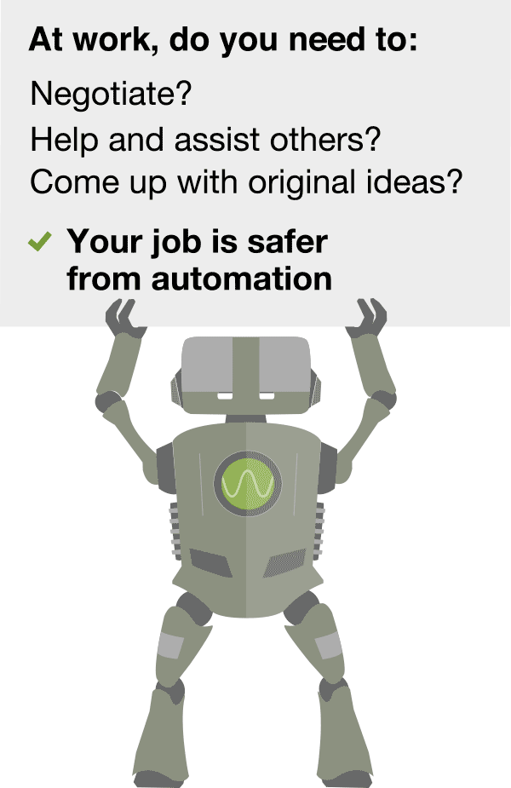

What makes a job susceptible to Automation?
https://willrobotstakemyjob.com/
Notes:
What makes a job susceptible to automation?
Certain aspects of a job are simpler to automate than others.
Social workers, nurses, therapists and psychologists are among the least likely occupations to be taken over as assisting and caring for others, which involves empathy, is a crucial part of the job.
Roles requiring employees to think on their feet and come up with creative and original ideas, for example artists, designers or engineers, hold a significant advantage in the face of automation.
Additionally, occupations involving tasks that require a high degree of social intelligence and negotiating skills, like managerial positions, are considerably less at risk from machines according to the study.
In contrast, while certain sales jobs like telemarketers and bank clerks may involve interactive tasks they do not necessarily need a high degree of social intelligence, leaving them exposed to automation.
As more advanced industrial robots gain improved senses and the ability to make more coordinated finger and hand movements to manipulate and assemble objects, they will be able to perform a wider range of increasingly complex manual tasks.
However, manipulation in unstructured environments — like the tasks that must be performed by a house cleaner — are still beyond the scope of automation for the foreseeable future.
Sophisticated algorithms are challenging a number of office and administrative support roles, particularly in legal and financial services.
Machines are already beginning to take on a number of tasks carried out by legal professionals by scanning thousands of documents to assist in pre-trial research.
(BBC, 2015)

Slide 33
AI in the workplace
‘..AI and other technologies can change how people work in six ways. With each type of impact comes different considerations for your organisation. In the media, discussions normally focus on whether these technologies will replace people’s jobs or augment people’s capabilities. But technology can also create new jobs, intensify the pace of work, transfer tasks to other people, or enable work to be carried out remotely (telepresence)’
(Mohdzaini, 2024)

Slide 34
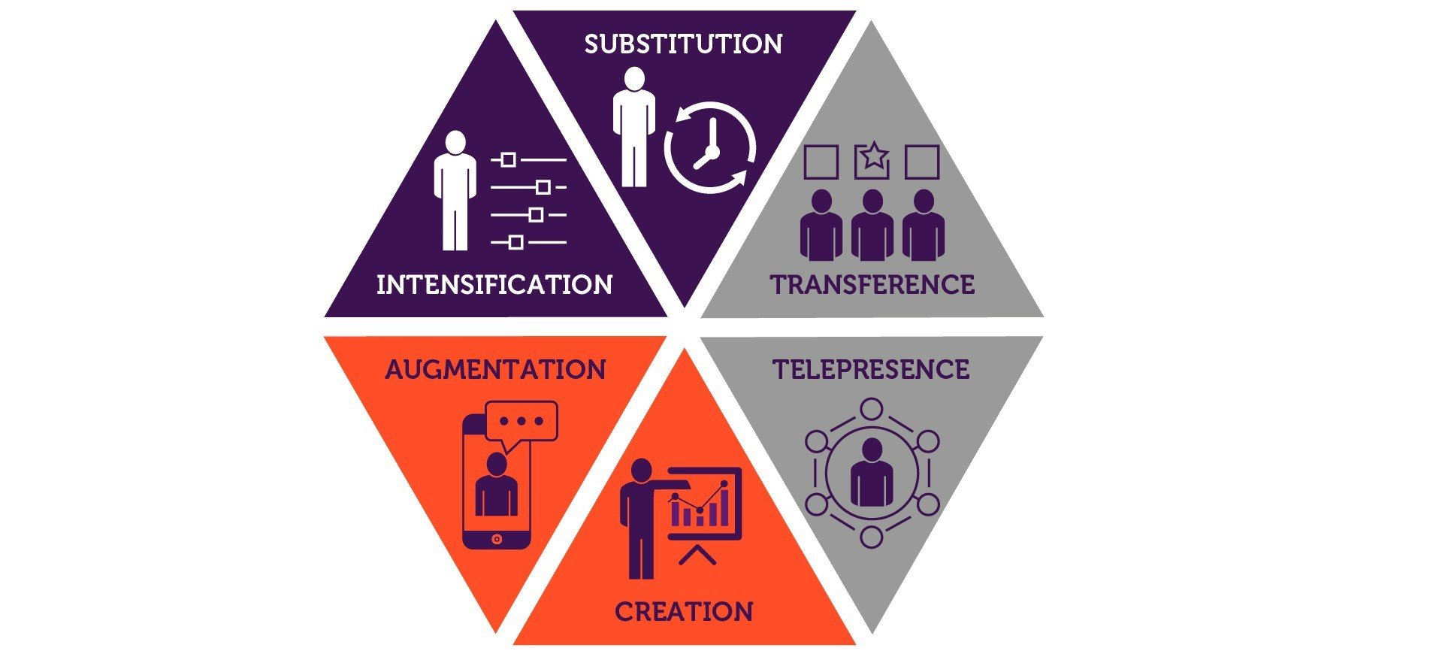
‘..According to Professor Stuart Russell, technology can help improve productivity for a particular task and result in impacts such as job creation. But further improvements in productivity can eventually lead to those jobs being eliminated (substitution).’ (Mohdzaini, 2024)

Slide 35
AI in HR
HR functions should consider the use of AI in three broad areas:
how it can reshape HR or people strategy
how it creates a new paradigm for HR teams
how it can impact every stage of the employee lifecycle.
(CIPD, 2023)
Notes:
AI presents the greatest opportunity to raise productivity for employees who use technology. This creates a raft of considerations for people strategy outcomes.
AI use becomes a new factor to consider alongside other fast-emerging people trends such as positive psychology and psychological safety, risk of burnout, EDI, future skills, good work, four-day week, hybrid working, and others.
HR strategy needs to consider the impact of AI on all of these elements. It also needs to consider who benefits from productivity gains – does it mean organisations do even more work, or could it create the opportunity for much more flexibility in work, for example, a four-day week.

Slide 36
AI and the employee life cycle
Attraction
Each element of attraction could be enhanced with generative AI, including:
Finding routes to candidates, such as identifying the most effective job boards for specific roles, or the events and approaches that can broaden attraction.
Where social media is used to promote employer brand, generative AI can help shape a content strategy and individual post content.
Transforming detailed role profiles into candidate-centric job adverts. They can improve inclusive language, brand consistency and clarity.

Slide 37
Can AI improve employee feedback?
Workplace experiment Tong et al (2021) cited in Mohdzaini (2022)
4 Teams
2 – AI feedback- 1 out of 2 told it was Human
2- Human feedback – 1 out of 2 told it was AI
What do you think was the outcome?
Why does this matter?

Slide 38

Questions…

Slide 39
References
CIPD (2024) UK Employment law round-up: September 2024. Available at: https://www.cipd.org/uk/views-and-insights/thoughtleadership/insight/employment-law-changes-september-2024/#:~:text=September%202024%20has%20been%20a%20busy%20month%20for%20employment%20law (Accessed: September 2024)
CIPD (2023) Preparing your organisation for AI use. Available at: https://www.cipd.org/uk/knowledge/guides/preparing-organisation-ai-use/ (Accessed: September 2024)
Fasth, J. (2016) Mintzbery on strategy. Available at: https://youtu.be/_vpvU5fIyOA?si=TuMasfokHXrywi-G (Accessed: August 2024)
Mohdzaini,, H. (2022) Can AI feedback improve employee performance?. Available at: https://www.cipd.org/uk/knowledge/bitesize-research/ai-feedback-employee-performance/ (Accessed: September 2024)
Mohdzaini, H. (2024) Technology, AI and the future of work. Available at: https://www.cipd.org/uk/knowledge/factsheets/emerging-future-work-factsheet/ (Accessed: September 2024)
Robbins, S.P. (2012) Organizational behavior / Stephen P. Robbins, Timothy A. Judge. Harlow : Pearson,.
Taylor, S. and Woodhams, C. (eds). (2022) Studying human resource management. 3rd ed. London: CIPD Kogan Page.

