Slide 1

Module Name: Managing Business Information
Module code: LCLM 5004
Assignment Title: Group Presentation on Different Information Systems
Assignment Number: Component 1
Students Name & ID:
Khaled Alsaman 2329747
Mohammad Jawad Naheem 2332327
Mohammed Shahnawaz Afzal 2424009

Slide 2
Table of Contents
Introduction………………………………………………....…………………………………………3
Introducing Different Information Systems………………………………………………………….4-5
Analysing and Comparing Systems………………………………………………………………….6-7
Ethical Considerations……………………………………………………………………………….8-9
Real-World Case Studies…………………………………………………………………………..10-11
Conclusion…………………………………………………………………………………………….12
References…………………………………………………………………………………………….13

Slide 3
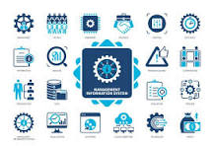
Introduction
This presentation will evaluate different information systems and their effectiveness for organisations.
It will clearly analyse and compare some information systems, along with some other ethical considerations.
The presentation will elaborate on clear real-world examples of some businesses using these systems.
(IBM , 2026)
Notes:
Modern organisations operate in a data-heavy environment where using traditional systems can mitigate efficiency. This presentation will elaborate on the critical role and importance of information systems and also provide an overview of different types of systems and their impact. The discussion will continue by comparing and analysing Transaction Processing Systems, Management Information Systems and Decision Support Systems. It will highlight some ethical considerations related factors and also evaluate present examples of organisations using the information systems.

Slide 4
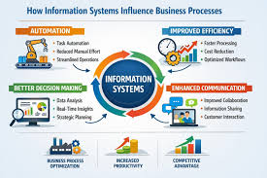
Introducing Different Information Systems
Evaluating Role and Importance of Information Systems
Information systems are highly effective in nature and allow companies to mitigate human errors, foster speed of daily work and reduce operational costs.
Instead of using the outdated working approach, the management of an organisation becomes able to access real-time data with the help of integrated systems.
Using information systems supports organisations to leverage technological efficiency and differentiate themselves from competitors.
(Werner, 2026)
Notes:
Speaker Notes
Information Systems act as a digital backbone of a modern organisation and help to improve its market efficiency. The primary role of these information systems is to make changes in unstructured data and improve it to help an organisation stay ahead of the competition.
For modern managers, the use of information systems is a very important thing which helps to improve their efficiency and foster organisational performance.
Efficiency
Information Systems are highly effective in nature and allow organisations to foster market efficiency (IBM , 2026). Mainly, these systems help companies to reduce dependency on manual, time-consuming work and automate the majority of their processes. Also, this higher automation support reduces stress for employees, and they become able to focus on innovative working approaches.
Decision Making
Information systems help to provide quick information support related to any sudden market shifts or any other changes (Pearlson et al., 2024). These factors foster efficiency of managers within an organisation and make them more effective to respond quickly to any sudden market challenge.
Competitive Advantage
Information systems are highly effective for modern organisations as they reduce operational costs, mitigate time consumption and support providing a superior customer experience. Proper use of these systems helps an organisation to dominate the market.

Slide 5

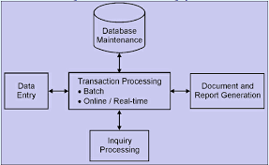
Contd….
Overview of Different Types and Their Impact
Modern organisations currently deploy many specialised information systems in business to generate massive market benefits and reduce competition.
One of the major information systems is the Transaction Processing System, and it supports businesses to handle daily tasks and routine transactions.
Decision Support Systems are highly advanced tools which help managers to mitigate any non-routine or complex issues.
(Schneider, 2026)
Notes:
Transaction Processing Systems
Transaction Processing Systems, or TPS, support a business to maintain a smooth operation of its daily tasks. As an example, TPS supports organisations to process payroll, track inventory levels and record customer sales.
Decision Support Systems
DSS is highly effective for predicting the impact of sudden market changes on future profits (Tonle et al., 2024) It helps leaders to navigate future market complexities on an early basis.

Slide 6
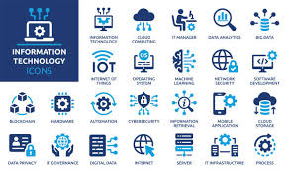
Analysing and Comparing Systems
Businesses are currently focusing on using different kinds of information systems to generate higher business success.
These systems also support organisations to increase efficiency and reduce competition from rivals.
Three major systems which are used today by businesses are Transaction Processing Systems, Management Information Systems and Decision Support Systems.
(IBM , 2026)
Notes:
Information systems play a essential role to make operations of an organisation smoother. Also, use of diversified information systems foster performance of an organisation and improve efficiency.

Slide 7
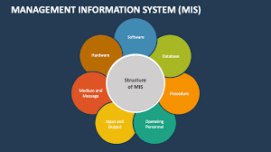
Contd….
TPS is a highly effective system which increases operational efficiency by tracking daily routines, while it is unable to perform complex data analysis.
MIS uses data from TPS to process reports and increase efficiency for middle management decision-making, although it has a lack of flexibility.
DSS uses analytical models and supports businesses to identify the impact of any future market shifts, although these systems are highly expensive, which makes their integration difficult.
(Ebsco, 2025)
Notes:
Transaction Processing Systems
Transaction Processing Systems support managers to analyse and track daily tasks, sales receipts, payroll and inventory updates (Schneider, 2026). It is beneficial for speeding up customer service, reducing human error and boosting efficiency. However, TPS fails to analyse complex data and is unable to provide long-term strategic plan-related support to managers.
Management Information Systems
Management Information Systems takes the raw data of TPS to provide a structured report. Using it is highly beneficial for organisations to reduce dependency on middle management and provide a clear report on sales and budgets (Ebsco, 2025). However, it sometimes lacks the ability to produce standard reports and is unable to solve non-routine business issues.
Decision Support Systems
Decision Support Systems are mainly used by senior managers to solve complex and challenging problems. It is beneficial to predict the impact of price changes on profit and other market shifts (Cook, 2026). The major limitation of it is that integrating these systems takes a lot of time and is highly expensive.

Slide 8
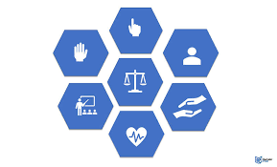
Ethical Considerations
Discussing data privacy, security, and ethical concerns
Concerns related to Employee Monitoring: Consistent monitoring or tracking using information systems threatens workplace morale and violates fundamental privacy boundaries.
Data Security and Privacy: Consumer trust is compromised due to Unauthorised access and breaches, violating the regulatory aspects of GDPR.
AI-driven Algorithmic Bias: Being trained on unrepresentative data can cause potential risks in perpetuating historical inequalities underpinned by machine learning systems.
(Daniels, 2024)
Notes:
Ethical Considerations
Discussing data privacy, security, and ethical concerns
Modernisation of a particular business and its infrastructure requires addressing the ethical dimensions associated with information systems. Considering data privacy, enforcing robust security for safeguarding information is crucial in this aspect. Potential data breaches often incur significant financial penalties, besides hindering consumer trust under strict frameworks like GDPR (Forbes , 2025). It is pertinent that strategic integration of internal monitoring systems for measuring employee metrics often leads to loss of morale and increased psychological stress across the organisational workforce. Moreover, implementing artificial intelligence-driven algorithms for streamlining operational decisions imposes significant risks associated with algorithmic bias (Werner, 2026).

Slide 9
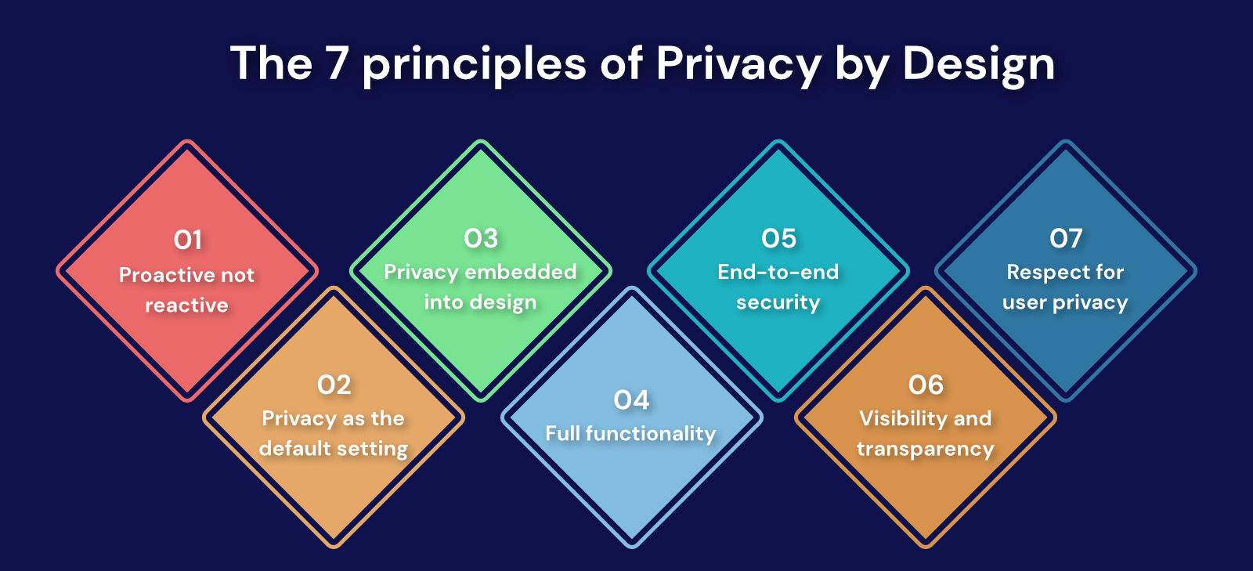
Contd….
Suggesting strategies to mitigate risks
Privacy by Design: Businesses must integrate end-to-end encryption, multi-factor authentication, and data minimisation protocols in their structure.
Governance of Ethical AI implementation: Featuring continuous auditing in the business processes helps to detect algorithmic bias while ensuring transparency.
Boosting Corporate Trust: Developing robust employee monitoring policies in addition to enforcing workforce digital literacy training helps in boosting workforce morale.
(Werner, 2026)
Notes:
Suggesting strategies to mitigate risks
Safeguarding operations demands the development of proactive mitigation strategies to combat the socio-technical threats. Enterprises must incorporate a Privacy by Design framework that can help them to ensure appropriate encryption of data, besides featuring multi-factor authentication across the systematic procedures (Daniels, 2024). Further, the business also needs to enforce ethical governance by developing a dedicated committee in this regard. This helps them to effectively mitigate algorithmic biases by ensuring consistent audits of the automated models developed for decision-making. This specifically contributes to boosting fairness and transparency in operations. Additionally, to effectively navigate the existing frictions underpinned by robust employee monitoring necessitate the business management must maintain complete transparency regarding data collection.

Slide 10
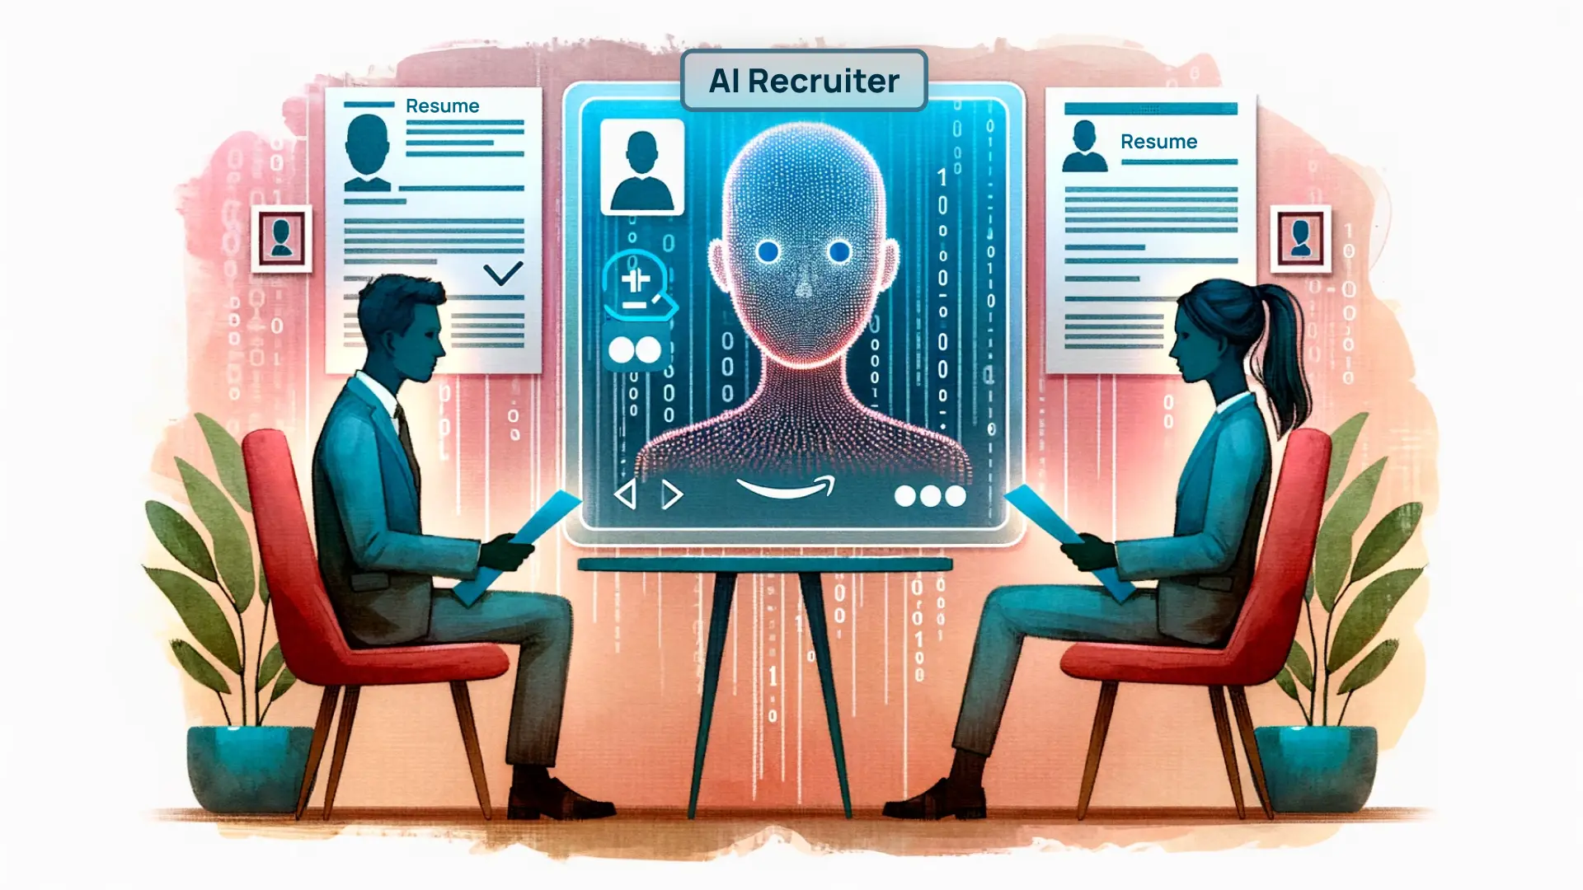
Real-World Case Studies
Presenting Examples of Companies
Addressing Corporate Breach: The potential systemic flaws existing across vendor access management controls are exposed by a severe POS system breach.
Amazon AI Recruitment: Gender discrimination in hiring is automated by machine learning models.
Pivot Solutions for operations: Deployment of isolated network infrastructures, in addition to featuring multi-factor authentication and human-in-the-loop validation, helps in remediation.
(Gervais, 2026)
Notes:
Real-World Case Studies
Assessing real-world examples helps to gain practical insights into the potential areas of failure that need to be avoided while aiming for business modernisation in the current market landscape. Considering the instance of the Target Corporation data breach, it was evident that hackers potentially exploited the existing vulnerabilities in the credentials of third-party HVAC vendors. This helped them seamlessly gain access to the central point of sale systems. Evaluating the instance demonstrates that a major catastrophic failure existed in the organisation’s access control and network segmentation. Further, the case of an experimental AI recruitment tool at Amazon demonstrates the way it incurred penalties for resumes containing the word "women’s ". The reason was that it had been trained on a decade of tech industry resumes dominated by male individuals (Tarasiuk, 2025).

Slide 11

Contd….
Assessing the impact on business performance
Optimising business Performance: Seamless operational efficiency and data-based decision-making can be driven by integrating strategic information systems.
Aligning the Socio-Technical elements: Effectively balancing advanced digital algorithms with robust ethical frameworks ensures Long-term organisational success.
Effective Risk Management: business strategies need to be embedded in the core pillars such as cybersecurity, data privacy, and bias mitigation.
(Tarasiuk, 2025)
Notes:
Assessing the impact on business performance
The influence of moves beyond the fundamental and common technical upgrades in the contemporary context. Effective deployment of the platforms helps organisations to streamline their workflows while eradicating data silos. Seamless implementation of optimised information system algorithms also contributes to maintaining a distinct competitive advantage in the contemporary business landscape. However, as per the real-world case study evaluations, effective management of technology is not possible in a vacuum. The organisational potential mainly lies in their adopted socio-technical strategies incorporating advanced digital systems. These systems must be mainly focused on explicitly backing robust ethical guardrails, regulations of data protection and human equity. Risk mitigation must be prioritised as the primary concern and not as an afterthought. Effective modernisation and business optimisation can be mainly streamlined through embedding cybersecurity, algorithmic auditing, and transparent governance into digital infrastructure. This also contributes to boosting business resilience while increasing trust for seamless future growth (Gervais, 2026).

Slide 12
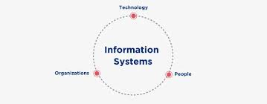
Conclusion
Diversified types of Information Systems, their overview, and role have been evaluated in this presentation.
It has also highlighted a clear analysis and comparison of TPS, DSS and MIS systems.
Furthermore, data privacy and security-related factors, along with examples of real-world businesses using these systems, have been elaborated.
(Cook, 2026)
Notes:
This presentation has highlighted that integration of information systems is highly required by modern organisations to foster business success. It has evaluated the main importance and role of diversified information systems, their impact and a critical overview. The presentation has also highlighted TPS, MIS, and DSS systems and provided a clear analysis of these. Security, ethical concerns, data privacy, AI decision-making, employee monitoring and bias-related factors have also been highlighted. It has also illustrated the ways to mitigate risks and ensure responsible use of these systems. Ultimately, examples of different companies, such as Amazon and Target Corporation, have also been discussed to identify the use of these systems by these companies, along with their challenges and solutions.

Slide 13
References
Cook, J., (2026). The Secret Decision-Making System Behind The World’s Top Entrepreneurs. [Online] Available at: https://www.forbes.com/sites/jodiecook/2026/03/25/the-secret-decision-making-system-behind-the-worlds-top-entrepreneurs/ [Accessed 5 June 2026].
Daniels, J., (2024). Privacy By Design: Integrating Privacy Into Product Development. [Online] Available at: https://www.forbes.com/councils/forbesbusinesscouncil/2024/09/12/privacy-by-design-integrating-privacy-into-product-development/ [Accessed 5 June 2026].
Ebsco, (2025). Management information system. [Online] Available at: https://www.ebsco.com/research-starters/information-technology/management-information-system [Accessed 5 June 2026].
Forbes , (2025). How To Modernize Legacy Apps: Key Steps And Considerations. [Online] Available at: https://www.forbes.com/councils/forbestechcouncil/2025/07/29/how-to-modernize-legacy-apps-key-steps-and-considerations/ [Accessed 5 June 2026].
Gervais, S., (2026). Cybersecurity’s Shift From Protection To Governance. [Online] Available at: https://www.forbes.com/councils/forbesbusinesscouncil/2026/05/15/cybersecuritys-shift-from-protection-to-governance/ [Accessed 5 June 2026].
IBM , (2026). Information Management Systems. [Online] Available at: https://www.ibm.com/history/information-management-system [Accessed 5 June 2026].
Pearlson, K.E., Saunders, C.S. and Galletta, D.F., (2024). Managing and using information systems: A strategic approach. John Wiley & Sons.
Schneider, J., (2026). What is a transaction processing system (TPS)?. [Online] Available at: https://www.ibm.com/think/topics/transaction-processing-system [Accessed 5 June 2026].
Tarasiuk, S., (2025). AI Bias In Hiring Is An HR Problem, Not A Tech Issue. [Online] Available at: https://www.forbes.com/councils/forbeshumanresourcescouncil/2025/07/15/ai-bias-in-hiring-is-an-hr-problem-not-a-tech-issue/ [Accessed 5 June 2026].
Tonle, F.B., Niassy, S., Ndadji, M.M., Tchendji, M.T., Nzeukou, A., Mudereri, B.T., Senagi, K. and Tonnang, H.E., (2024). A road map for developing novel decision support system (DSS) for disseminating integrated pest management (IPM) technologies. Computers and Electronics in Agriculture, 217, p.108526.
Werner, J., (2026). Legacy Migration To New AI-Native Worlds. [Online] Available at: https://www.forbes.com/sites/johnwerner/2026/04/23/legacy-migration-to-new-ai-native-worlds/ [Accessed 5 June 2026].
Notes:
Cook, J., (2026). The Secret Decision-Making System Behind The World’s Top Entrepreneurs. [Online] Available at: https://www.forbes.com/sites/jodiecook/2026/03/25/the-secret-decision-making-system-behind-the-worlds-top-entrepreneurs/ [Accessed 5 June 2026].
Daniels, J., (2024). Privacy By Design: Integrating Privacy Into Product Development. [Online] Available at: https://www.forbes.com/councils/forbesbusinesscouncil/2024/09/12/privacy-by-design-integrating-privacy-into-product-development/ [Accessed 5 June 2026].
Ebsco, (2025). Management information system. [Online] Available at: https://www.ebsco.com/research-starters/information-technology/management-information-system [Accessed 5 June 2026].
Forbes , (2025). How To Modernize Legacy Apps: Key Steps And Considerations. [Online] Available at: https://www.forbes.com/councils/forbestechcouncil/2025/07/29/how-to-modernize-legacy-apps-key-steps-and-considerations/ [Accessed 5 June 2026].
Gervais, S., (2026). Cybersecurity’s Shift From Protection To Governance. [Online] Available at: https://www.forbes.com/councils/forbesbusinesscouncil/2026/05/15/cybersecuritys-shift-from-protection-to-governance/ [Accessed 5 June 2026].
IBM , (2026). Information Management Systems. [Online] Available at: https://www.ibm.com/history/information-management-system [Accessed 5 June 2026].
Pearlson, K.E., Saunders, C.S. and Galletta, D.F., (2024). Managing and using information systems: A strategic approach. John Wiley & Sons.
Schneider, J., (2026). What is a transaction processing system (TPS)?. [Online] Available at: https://www.ibm.com/think/topics/transaction-processing-system [Accessed 5 June 2026].
Tarasiuk, S., (2025). AI Bias In Hiring Is An HR Problem, Not A Tech Issue. [Online] Available at: https://www.forbes.com/councils/forbeshumanresourcescouncil/2025/07/15/ai-bias-in-hiring-is-an-hr-problem-not-a-tech-issue/ [Accessed 5 June 2026].
Tonle, F.B., Niassy, S., Ndadji, M.M., Tchendji, M.T., Nzeukou, A., Mudereri, B.T., Senagi, K. and Tonnang, H.E., (2024). A road map for developing novel decision support system (DSS) for disseminating integrated pest management (IPM) technologies. Computers and Electronics in Agriculture, 217, p.108526.
Werner, J., (2026). Legacy Migration To New AI-Native Worlds. [Online] Available at: https://www.forbes.com/sites/johnwerner/2026/04/23/legacy-migration-to-new-ai-native-worlds/ [Accessed 5 June 2026].

