Slide 1
Strategic Management
BMSK6004 – Online Session One

Slide 2


Agenda
Introduction to the module
Module Aims and Objectives
The Assignment
Perception of strategy
So, what is strategy?
Why strategy?
Research & report

Slide 3

LEARNING OUTCOMES
Upon the successful completion of this module, the student should be able to demonstrate the ability to:
Critically appraise an organisation’s strategic direction
Critically analyse the components of an organisation’s internal and external environments
Critically evaluate stakeholder expectations
Formulate and verify new strategies for sustainable growth

Slide 4
Module Task Assessment
TASK
Common Assessment Criteria
Depth of critical analysis of your chosen organisation’s internal and external environment
Conduct a stakeholder analysis and an evaluation of stakeholder expectations
Application of a range of relevant academic theories/models
Provide a critical appraisal of your chosen organisation’s current strategic direction
Depth and clarity of the proposed new strategy
Engagement with Literature Skills. (30)
Knowledge and Understanding Skills (25)
Cognitive and Intellectual Skills (25)
Practical Application Skills (10)
Transferable Skills for Life and Professional Practice (10)
Notes:
Stress the assessment criteria are applied to how you complete the tasks.
The marks are weighted this way for a purpose – reading and research begets knowledge and understanding, which enables us to use our minds and intellects to develop arguments and draw conclusions, whilst checking out our reasoning by looking at real life workplace examples….and appropriate case studies, in order to write a compelling, professional report that is well structured, and fully referenced, so as to inform the reader of the strength of our sources, the logic of our reasoning, and the insights we have developed.

Slide 5

Your Thoughts on the Assignment
Q & A – Discussion
Depth of critical analysis of your chosen organisation’s internal and external environment
Conduct a stakeholder analysis and an evaluation of stakeholder expectations
Application of a range of relevant academic theories/models
Provide a critical appraisal of your chosen organisation’s current strategic direction
Depth and clarity of the proposed new strategy

Slide 6

1. Depth of critical analysis of your chosen organisation’s internal and external environment
Critical analysis - supported & referenced research
    Detailed (depth) Macro & Micro Environmental analysis
Select an organisation - where you can satisfy the need for supported and referenced research (it might not be your own)
Give a brief explanation - about your chosen organisation and why you chose it. (500 words max)

Slide 7

2. Conduct a stakeholder analysis and an evaluation of stakeholder expectations.
A detailed stakeholder analysis
  Map stakeholders and analyse them by their Power and Interest
  Who are they? Groups and individuals? What specifically are their expectations?
  What actions will you need to take?

Slide 8
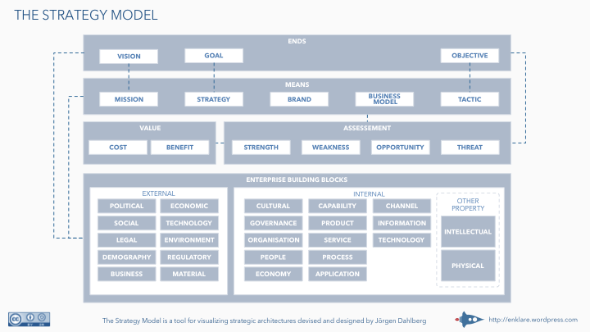
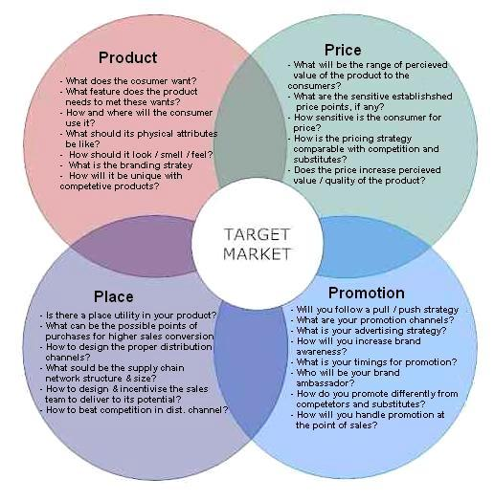
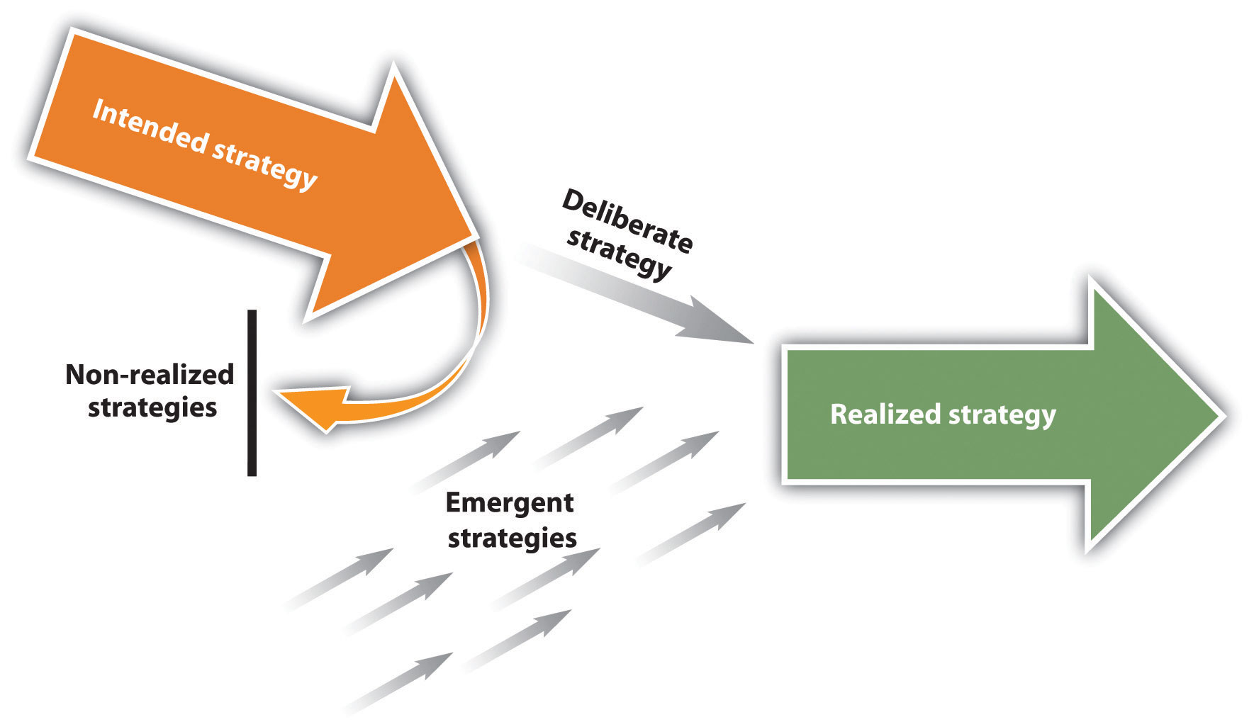
3. Application of a range of relevant academic theories/models.
Select at least two models or theories
    Select ones which are the most appropriate for your selected organisation, ensuring that their selection over the other models or theories is briefly explained
Apply both models and/or theories to your chosen organisation
  Use, wherever possible, your research to illuminate your application

Slide 9

4. Provide a critical appraisal of your chosen organisation’s current strategic direction
Critically appraise to what degree is, or is not, your chosen Organisation's current strategic direction followed or achieved and why?
Strategic Direction is about:
  Vision (the why)
  Mission (the how)
  Satisfying stakeholders expectations and goals

Slide 10

5. Depth and clarity of the proposed new strategy.
Propose a clear new strategy based on your detailed research findings and analysis undertaken in assessment 1-4
Have a ‘voice’, and present your proposal clearly, logically and written in a way that would convince a board of directors to consider changing/amending the organisation’s strategic plan

Slide 11

The final, but vital, considerations..
Reading and research are at the core of this assignment – research for your environmental analysis, research into stakeholders, and research into the concepts and models relating to strategy.
Make sure that your citation/referencing, report structure, syntax, grammar and punctuation are up to standard – check the Skills for the Workplace Outreach Homepage, if you are in doubt. Always proof-read your work…and get someone else to proof-read it too.
Submission date: 11:59pm, Sunday, 29th November 2020

Slide 12

What is Strategy?
Please think about, and then write down, a definition….in plain English!
In the context of organisations
In the context of ‘your’ organisation
2 mins to prepare for a group discussion

Slide 13

Why Strategy?
So, you have a view of ‘what’ strategy is, please think about why having a strategy is important (or not), and what should you take into account when devising a strategy?
5 mins to prepare for feedback for discussion

Slide 14
For the next session
Research your own/chosen organisation, and identify their current strategy.
  Make use of the online Databases – MarketLine and NewsBank
  Make use of journal articles in the online library
  Search the quality newspapers in the online library (Financial Times, Sunday Times, Observer, Times, etc.)
  Internet sources (use the CRAAP test)
  Ask your tutor for advice, if you have any difficulties with using the library. There is advice available on the SfWP Outreach Homepage on Moodle
  Write up your findings ready for discussion at a follow-up session….this exercise should take about 2 to 4 hours to complete

Slide 15

Summary
Take 5 minutes to reflect upon this session – what have you learnt?
Any key areas you want to research further?
What can help you with your assignment?
What can help you in your career?
Engage with your tutors on the topics

