Slide 1


Food and Beverage Operation
BMIH4002
MENU ENGINEERING
Student Name: Antonia Lupas
Student ID: 2210502
Lecturer Name: Rohan Dubrey

Slide 2
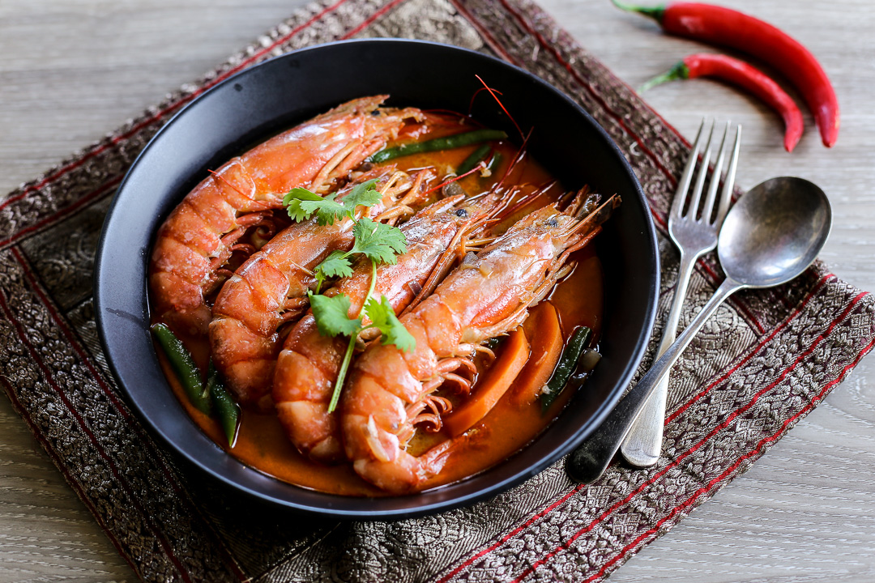
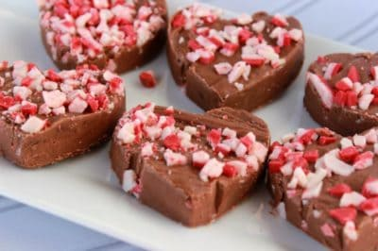
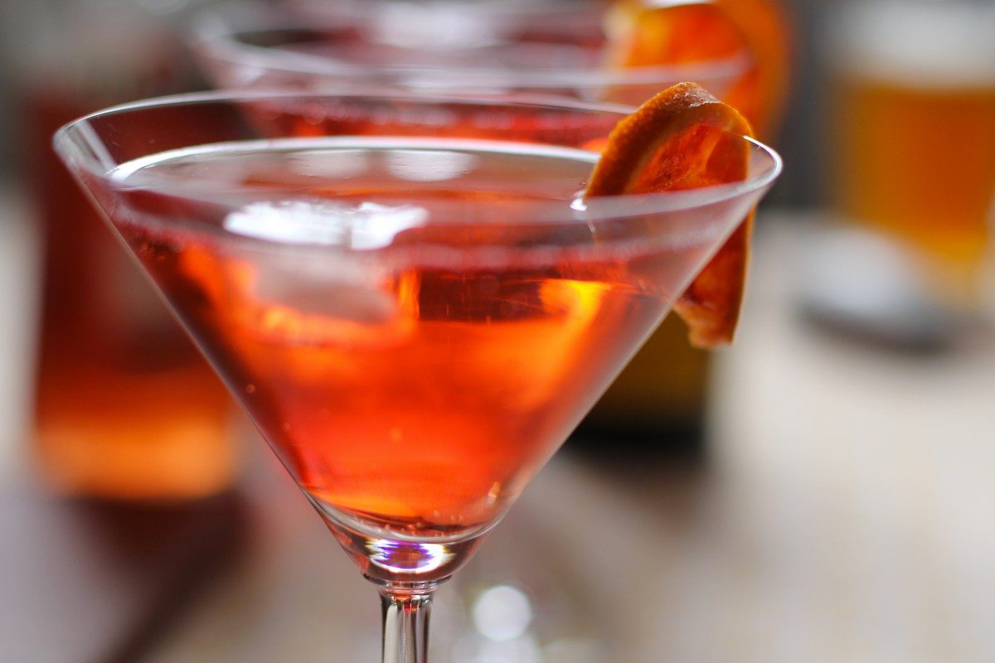

Hotel Trinity Valentine’s Day Menu
Starter
Thai mussels & prawns (ve)…………………………………….……...……£10
Tomato & mozzarella salad with tomato dressing (v)……………£13
Bang cauliflower (v)………………………………………………….………£6
Potted crab (ve)…………………………………………………...….………£12
Thai mussels & prawns………………………………….……………....…. £15
Courgetti carpaccio (v)…………………………………………...…………. £10
Swedish meatballs (ve)…………………….………………….….……….…£17
Steak (ve)……………………………………………………...……….……. £20
Main Course
Truffle chicken & potato gratin (ve)…………………………………………£10
Pomegranate salmon (ve)……………………………………….……………£15
Salmon encroute (ve)…………………………………………………………£15
Creamy baked gnocchi with squash & spinach (v)………………….………£10
Next level paella (v)………………………………………………….………£15
Simple herbed chicken with garlic sauce (ve)………………………………. £10
Lamb chops with chilly & Ligurian broad bean pesto (ve)……………….…£18
Dessert
White chocolate mousse…………………….………………….……..…......…. £6
Petit baked Alaska……………………………………………………..….......... £5
Butterscotch Pudding Parfait with Gingersnap Crumble…………..…£8
Sticky Toffee Pudding…………………………………..….….…….…………£14
S'mores Linzer Cookies…………..………………………...………..…...……. £12
Custard tart…………………………………………………………..…………. £6
Coconut ice……………………………………….……………………….….… £4
Crumble tart……………………………………………………………….……. £7
Beverages
Beer………………………………………………………………….……£10
Orange juice………………………………….………………………...…. £8
Wine…………………………………………………………………….... £10
Mulled Wine………………………………….……………….…….…... £10
Sparkling Water…………………………….….……….….…….….……...£5
Scotch……………………………………………………………….………£8
Gin and tonic……………………………………………….……….………£6
Champagne……….…………………………….….………….…………… £26
Rules and Regulations
All food items served at the party have been prepared and stored in accordance with food safety regulations.
Proper hand washing and sanitizing procedures have been followed by all kitchen staff.
All food has been kept at the appropriate temperature to prevent the growth of bacteria.
Any leftovers will be stored properly and discarded if they have been left at room temperature for too long.
The venue or caterer is committed to ensuring the health and safety of all guests and will take immediate
action if any issues arise.
Location and Availability
The Hotel Trinity is in the heart of London. The Valentine’s day menu will be available on 14 February 2023.

Slide 3



Hotel Trinity Valentine’s Day Menu
Deals Offers and Discounts
Deal 1 in £150
Wine
White chocolate mousse
Cherries Jubilee
Steak
Truffle chicken & potato gratin
Creamy baked gnocchi with squash & spinach
Deal 2 in £200
Tomato & mozzarella salad with tomato dressing
Swedish meatballs
Next level paella
Lamb chops with chilly & Ligurian broad bean pesto
Petit baked Alaska
Bee & Gin & Tonic
Operations Hours
Working hours (10:00 am to 12:00 pm O’clock).
Time availability
The Valentine’s day menu will be available on 14 February.
Seasonality of Ingredient
The offered dishes' seasonality of ingredients includes chestnuts, spices, and citrus fruits.
Entertainment
Dance performance
Live music
Children's fun activities, i.e., games
Valentine’s day gifts distributions
Allergens Statement
Customers with nutritional restrictions must be cautious. Our food may have come into touch with or contain allergies that are routinely encountered during processing. The allergens responsible for allergy responses include milk, wheat, soy, fish, peanuts, tree, eggs, nuts, and shellfish. Although we make efforts to avoid hazards and carefully prepare allergen-containing meals, we feel you should be informed of the potential of cross-contamination. Several uncontrolled variables or manufacturers may modify the formulas of the items we serve without our awareness.
Special Symbol- (Vegetarian, v)

Slide 4

References
Filimonau, V. and Krivcova, M., 2017. Restaurant menu design and more responsible consumer food choice: An exploratory study of managerial perceptions. Journal of cleaner production, 143, pp.516-527.
Lanicci, J.M., 2016. A Multi-Scale Analysis of the Atmospheric Conditions Associated with the Daytona Beach Tornado of Valentine’s Day 2006. Electronic Journal of Severe Storms Meteorology (EJSSM), 11(5).
Miller, B., MacAvoy, S. and Ballard, J. (2019). 85 Best Dinner Ideas for the Most Festive Holiday Menu. [online] Good Housekeeping. Available at: https://www.goodhousekeeping.com/holidays/valentine’s ideas/g29073023/easy-valentine’s-dinner-ideas/ [Accessed 17 Nov. 2022].
Nagi (2021). Christmas Recipes and Menus. [online] RecipeTin Eats. Available at: https://www.recipetineats.com/christmas-recipes/ [Accessed 17 Nov. 2022].
Ozdemir, B. and Caliskan, O., 2015. Menu design: A review of the literature. Journal of Foodservice Business Research, 18(3), pp.189-206.
BBC GoodFood (2022). Valentine’s Say Day Recipes. [online]. Available at: https://www.bbcgoodfood.com/recipes/collection/valentines-day-recipes [Accessed 3 Feb.2023].
Bermondsey Larder(2022). Menu - Sample. [online]. Available at: https://www.bermondseylarder.com [Accessed 17 Feb.2023].
Freepic (2023). Valentine’s Day Images. [online]. Available at:https://www.freepik.com/free-photos-vectors/valentine-heart [Accessed 17 Feb.2023].

