Slide 1
(re)
HPAR6001
camera obscura – the image and motion as record
visual methodologies: resistivity, magnatometry, GPR, survey, photography, sketch, plan, video
human vs mechanical representations
style, order and codification - maps, conventions, scale, colour, type, matrix
2.5D space / CAD / GIS
the interactive record

Slide 2

https://www.youtube.com/watch?v=TFejIkYDH9Q
Archaeology at work
English Heritage
Time: 58:55

Slide 3
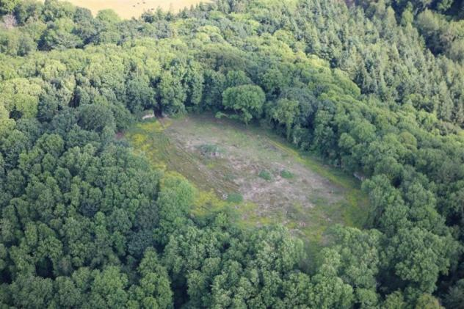
https://www.youtube.com/watch?v=gia1B97H61U&index=8&list=PLiw5X7jx1CEOvrUjNjtreeu03EVGpXQth
LLANGYBI CASTLE / CASTELL TREGRUG : Monmouthshire
Time Team (Series 17 – Episode 08) Tregruk 2010
Time: 47:50

Slide 4
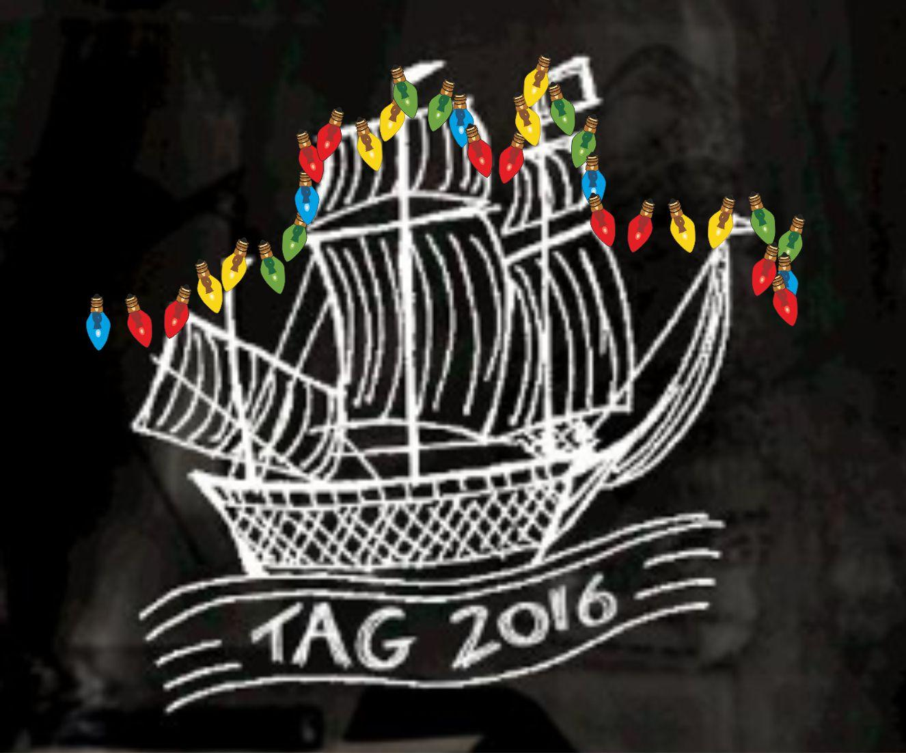

Doug's Archaeology
Investigating the Profession and Research
Doug Rocks-Macqueen
https://dougsarchaeology.wordpress.com/2017/05/24/sightations-cafe/
TAG 2016 Southampton
Plastic Earth
How can we give a voice to the archaeological record?
https://youtu.be/Ruj9X0xpLU4
https://www.youtube.com/watch?v=uo-MdQP-NLY
Eloise Govier
University of Wales Trinity Saint David
Time: 6:20
Hannah Sackett
Bath SPA University
Time: 10.55

Slide 5
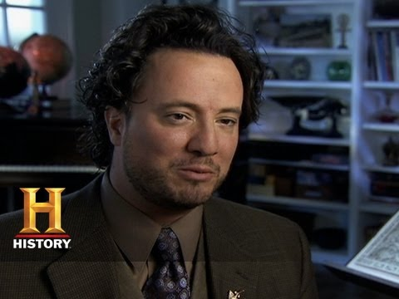
https://www.youtube.com/watch?v=VqGT2n4rnxo
Giorgio Tsoukalos
Ancient Aliens: Mysteries of Ancient Construction
Time: 3:23

