Slide 1
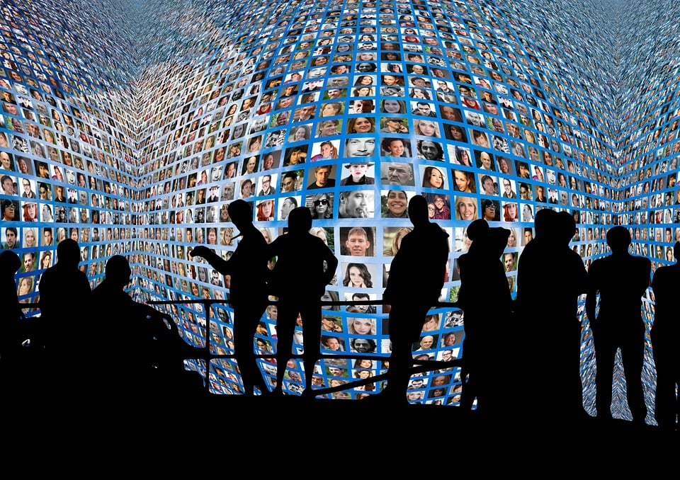
Types of Media & Their Roles
Several types of media including; newspapers, social media platforms, television
What roles do each of them play in public perception?
Agenda Framework
Framing Theory

Slide 2
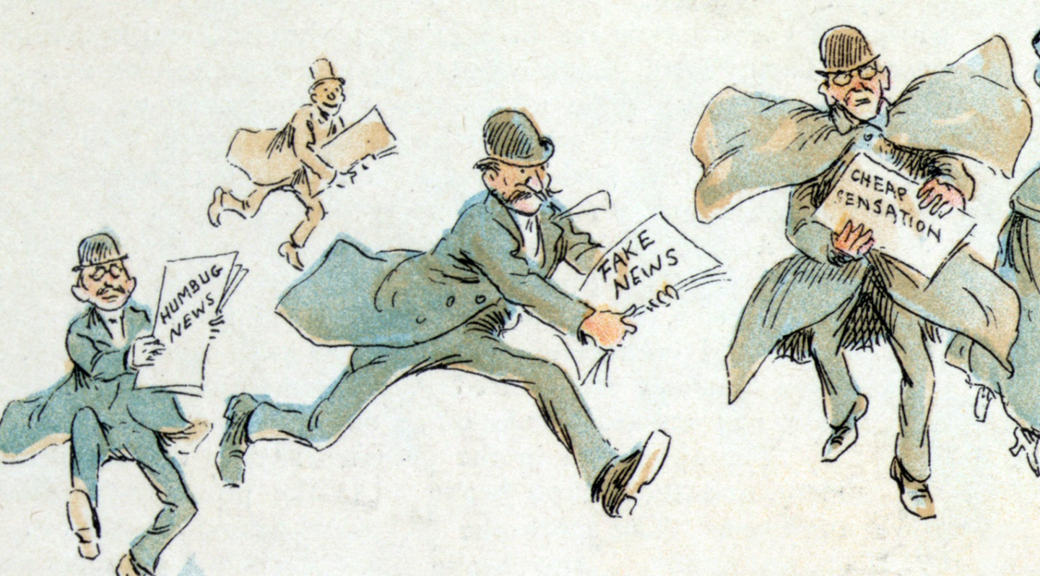
Accuracy in the Media: is there bias?
Importance of accurate information being published by the media
Circumstances where bias has been proven
Consequences of inaccurate and biased information
BLM Movement & Brexit Referendum

Slide 3
Alvarado, M. (2024) UNESCO report confirms quality of journalism essential for democracy, accountability and civic engagement. Available at: https://latamjournalismreview.org/articles/unesco-quality-journalism-democracy-accountability-civic-engagement/#:~:text=Research%20suggests%20that%20high%2Dquality,and%20low%2Dquality%20information%20environments. (Accessed: 15 January 2025)
Bogart, L. (1984) 'Public’s Use and Perception of Newspapers’. Public Opinion Quarterly, 48(4), pp. 709-719.
Bu, Y., Melatos, A. (2023) ‘Discerning media bias within a network of political allies and opponents: Disruption by partisans’ , Physica A. Available at: https://www.sciencedirect.com/journal/physica-a-statistical-mechanics-and-its-applications (Accessed: 16 January 2025)
Davison, W. (2024) Mass Media and Social Media. Available at: https://www.britannica.com/topic/public-opinion/Mass-media-and-social-media
Firmstone, J. (2024) United Kingdom - Media Landscapes. Available at: https://medialandscapes.org/country/united-kingdom/media/print#:~:text=Print%20newspapers%20are%20read%20by,and%20monthly%20(30.8%20million). (Accessed: 12 January 2025)

Slide 4
Goyanes, M., Canedo, A. (2024) Media Influence on Opinion Change and Democracy. Switzerland: Springer Nature Switzerland.
Liao, C. (2023) 'Exploring the Influence of Public Perception of Mass Media Usage and Attitudes towards Mass Media News on Altruistic Behaviour', Behavioural Sciences, 13(8), pp. 621-650. Available at: https://pmc.ncbi.nlm.nih.gov/articles/PMC10451722/#sec5-behavsci-13-00621
McCombs, M.E., Shaw, D.L. (1972) “The Agenda-Setting Function of Mass Media.” The Public Opinion Quarterly, 36(2), pp. 176–87. Available at: http://www.jstor.org/stable/274778 (Accessed 15 January 2025)
Ofcom. (2024) News consumption in the UK: 2024. Available at: https://www.ofcom.org.uk/siteassets/resources/documents/research-and-data/tv-radio-and-on-demand-research/tv-research/news/news-consumption-2024/news-consumption-in-the-uk-2024-report.pdf?v=379621 (Accessed: 13 January 2025)
Ona Ethics. (2024) Accuracy. Available at: https://ethics.journalists.org/topics/accuracy/ (Accessed: 15 January 2025)
Shoemaker, P., Reese, S. (1996) Meditating the Message: Theories of Influence on Mass Media Content. New York: Longman Publishers USA
Yossi, D. (2022) ‘Public opinion, media and activism: the differentiating role of media use and perceptions of public opinion and political behaviour’, Social Movement Studies, 21(3), pp. 334-354.

