Slide 1
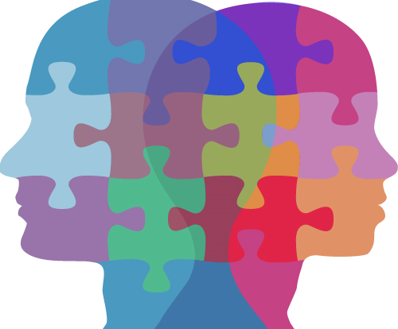
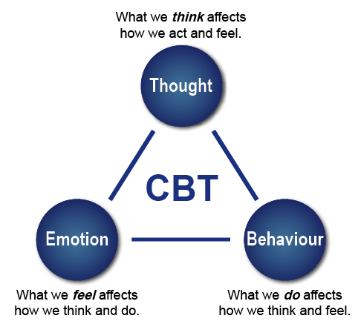
Compare and Contrast Two Therapeutic Interventions and Consider the Impact of Each, in Relationship to Working With Psychological Distress
Production loss every week | 5.6 hours
Impaired daily functioning | 80%
Loss of work due to absenteeism | 50%
Short term disability days (Monthly period) | 1.5-3.2 days
How effective is CBT treatment within an individual experiencing Bi-polar?
Case success story
Loo, J., Samad, F., Sidi, H., & Thambu, M. (2016)
Method
A 45 year old male was diagnosed with bi-polar II after going downhill with a third occurrence of depressive episodes. A study was combined to establish whether his bi-polar that was resistant to ECT may be successfully treated with CBT.
Results
While being diagnosed he was given a full course of ECT. The ECT failed and he was then given cognitive behaviour therapy and achieved a fully functional recovery.
BI-POLAR
Advantages of CBT
Proven it does work for some people with success stories and case studies conducted
Helps people think and feel different by controlling their thoughts
Helpful if medication hasn’t worked
Quick results
Bipolar disorder as defined by Mind () is a mental health problem that mainly affects your mood. It is also known as manic depression. There is no single cause for bipolar but… They suggest that if a person suffers with bipolar 2, they are likely to have times where they experience depressive episodes (feeling low). Even though antidepressants are effective within bipolar treatment the side effects involve the change of mood swings.
Disadvantages of CBT
Doesn’t work for everyone
Long waiting list if done through NHS
Have to proceed extra work between the session- homework
What can we use to help treat Bi-polar?
We can use many different treatments to treat bi-polar, including medication, different therapies, lifestyle advice and family interventions.
Case study
Method
Conducted within the British healthcare system to compare two groups of individuals. Group 1- People diagnosed with bipolar disorder receiving an average of 14 hours of recovery focused CBT plus medication and group 2- sufferers of bipolar disorder with just the treatment of medication and support from doctors, mental health workers and psychiatrist with no CBT.
Results
Participants that received CBT along with medication showed a greater level of recovery which continued for up to 12 months after therapy had concluded whereas the participants not receiving CBT showed less of a recovery.
Psyweb.com. (2018).
What is CBT?
CBT is based on the concept that thoughts, feelings, physical sensations and actions are connected and negative thoughts and feelings can trap a person in a malicious cycle. This treatment helps a person break down problems in their life in a more positive way of thinking.
Conclusion
In conclusion, CBT is an effective treatment for bipolar. As shown in the case study CBT is more effective than ECT. As with any therapy there comes disadvantages and advantages, although this does depend on the person receiving the treatment and what works best for them. But with support from the success stories shown there is clear evidence to show the efficiency of CBT. To support this therapy further there is little to no harm done while conducting it compared to other treatments such as medication and ECT.

Slide 2
References
Loo, J., Samad, F., Sidi , H., & Thambu, M. (2016). When electroconvulsive therapy fails: cognitive– behavioral therapy in treatment-resistant bipolar depression. A case report. Psychiatry and Psychotherapy, 67-69. doi:10.12740/APP/63754
Psyweb.com. (2018). CBT Effective with Bipolar Symptoms: New Study. [online] Available at: http://www.psyweb.com/lifestyle/bipolar/cbt-effective-with-bipolar-symptoms-new-study [Accessed 1 Mar. 2018].
Psychology Today. (2018). Cognitive-Behavioral Therapy: Proven Effectiveness. [online] Available at: https://www.psychologytoday.com/blog/anxiety-files/201111/cognitive-behavioral-therapy-proven-effectiveness [Accessed 1 Mar. 2018].
Mind.org.uk. (2018). Cognitive behavioural therapy (CBT) | Mind, the mental health charity - help for mental health problems. [online] Available at: https://www.mind.org.uk/information-support/drugs-and-treatments/cognitive-behavioural-therapy-cbt/#.WpAFY6jFKUk [Accessed 1 Mar. 2018].

