Slide 1
Computer Networks and Internet
By: Dr. Redhwan Al-amri

Slide 2
Objectives
Upon completion of this Chapter, you should be able to:
Define computer networks and the Internet.
Describe Network Architecture
Discuss the Network Hardware

Slide 3
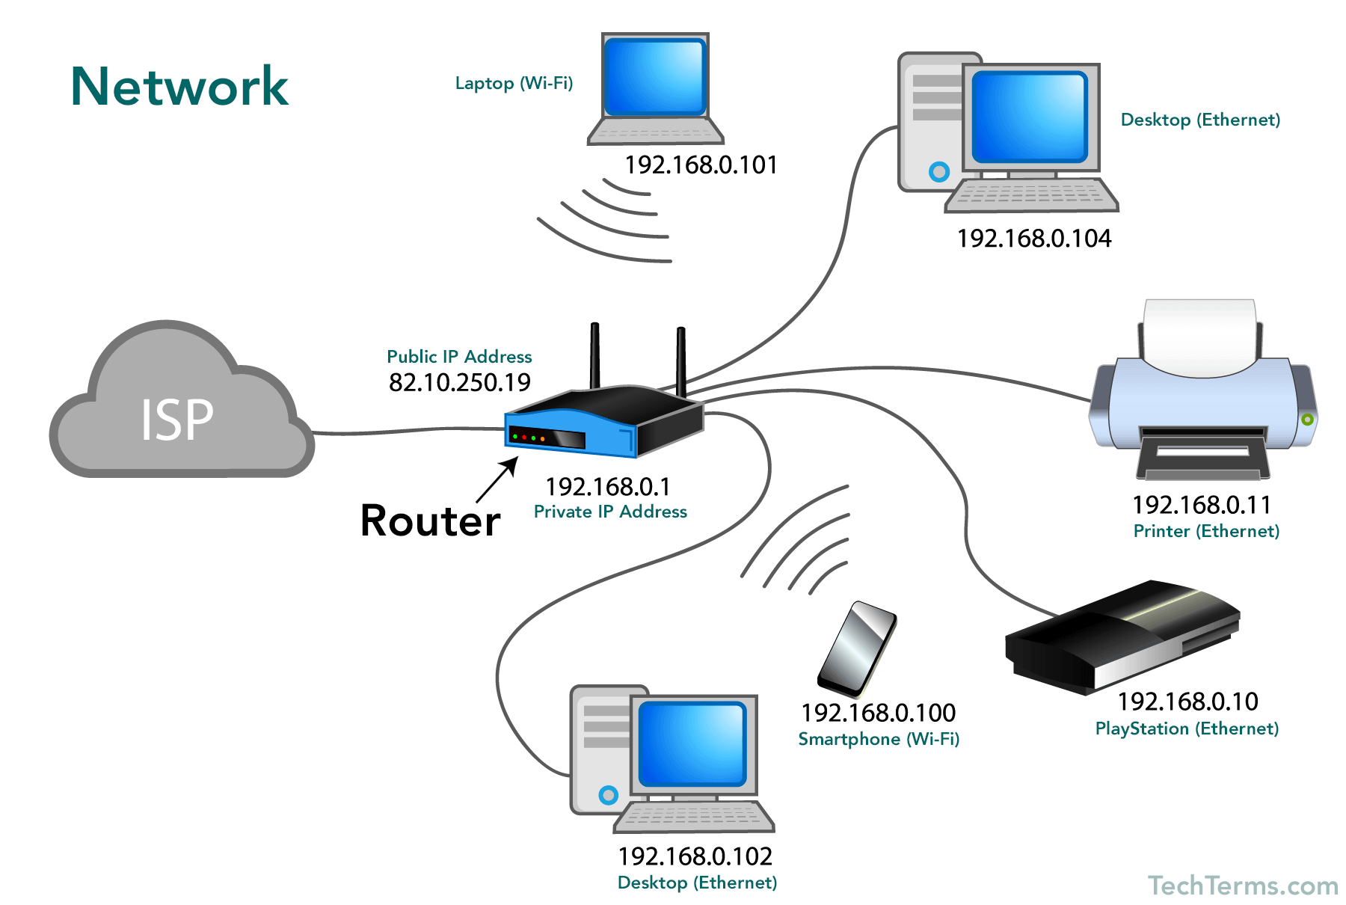
Definition
What is a Network?

Slide 4
Definition
Network is a collection of computers and devices connected together via communication devices and transmission media

Slide 5
Advantages of the Network
  Facilitating communication
    Communication via email , messaging chat
  Sharing hardware
    Sharing of common devices such as printers , servers in one environment
  Sharing data and information
    Electronic data interchange(EDI) – standards in business to define how data is transmitted via any communication method

Slide 6
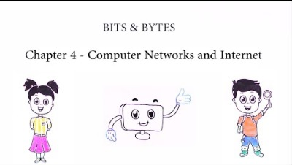
Overview of Computer Networks and Internet

Slide 7
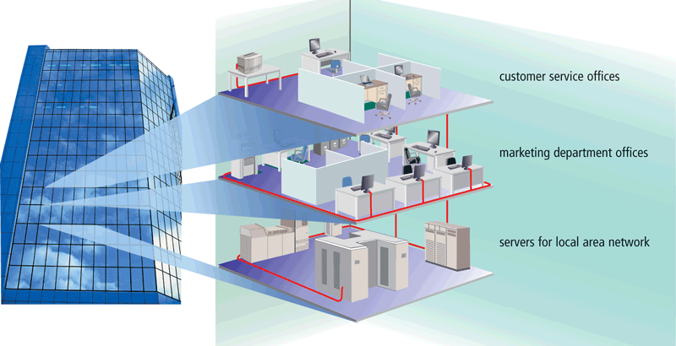
Local area network (LAN)
LAN is a network that connects computers and devices in a limited geographical area such as a home , office, etc.

Slide 8
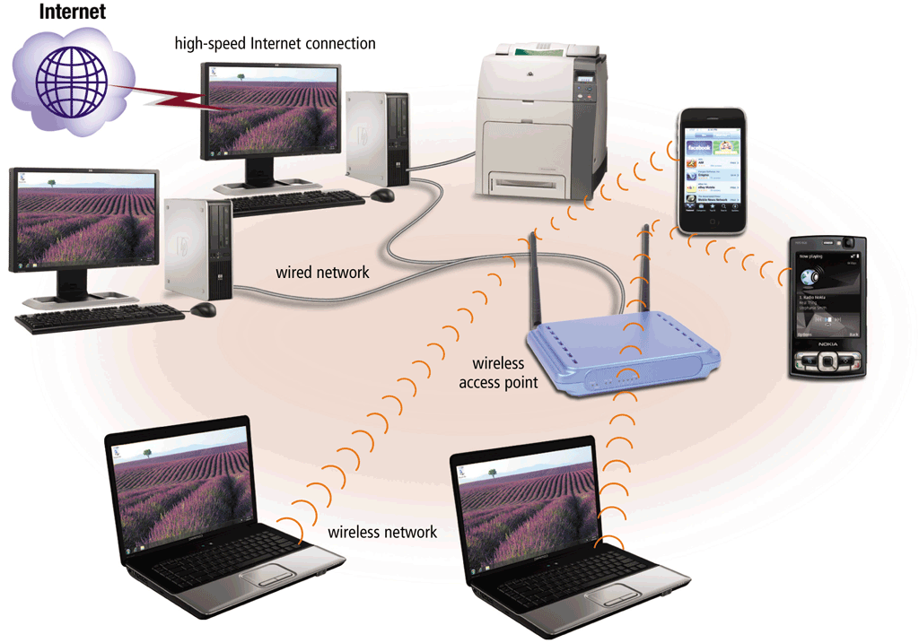
A wireless local-area network (WLAN)
WLAN
  Is a LAN that uses no physical wires and the computers using this type of network must have the wireless capability

Slide 9
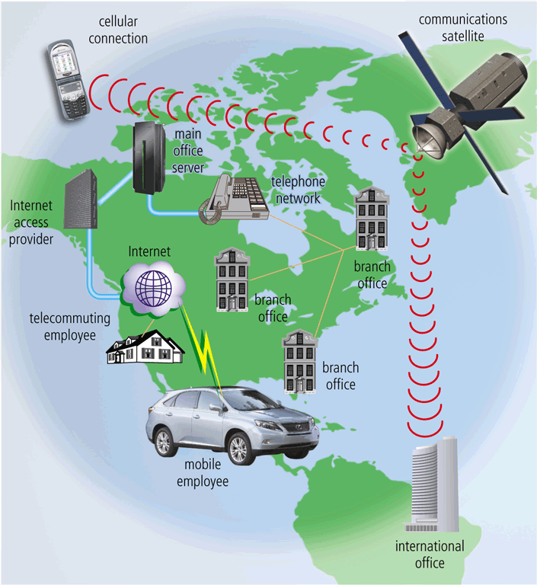
Metropolitan Area Network & Wide Area Network (MAN & WAN)
MAN
A metropolitan area network is a high-speed network that connects local area networks in a metropolitan area such as a city or town. Typically includes more than one LAN.
WAN
A wide area network is a network that covers large geographic areas such as countries using a communication channel.

Slide 10
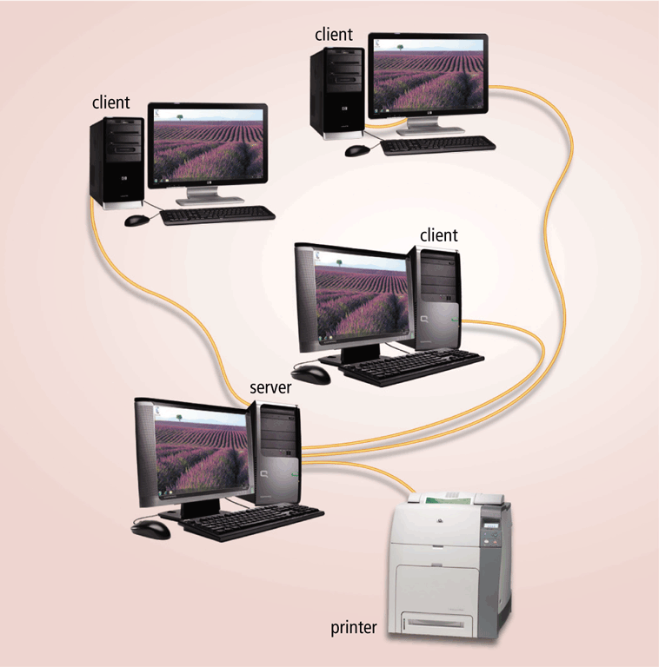
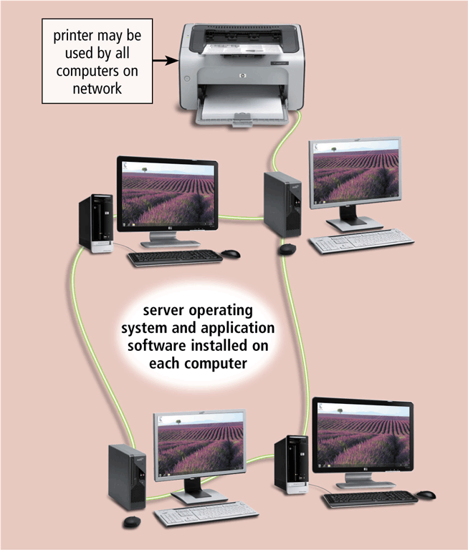
Network architectures
2 categories of network architectures:
  Client/server
  Peer to peer
Client/server network
Peer-to-peer network

Slide 11
Client/Server
One or more server act as a server an other computers request services from the server
Server is commonly called as the host
Client is the computer or devices which request and receive the service
Dedicated server – specific task that can be placed with other dedicated servers to perform multiple operations
  Email server
  Print server
  Internet server
  Database server
Client/server network

Slide 12
Peer to Peer
Simple and inexpensive and connects fewer than 10 computers
Each computer is called a peer and has equal responsibility and capabilities to
  Share data
  Share hardware
Ideal for small business and home users
Peer-to-peer network

Slide 13
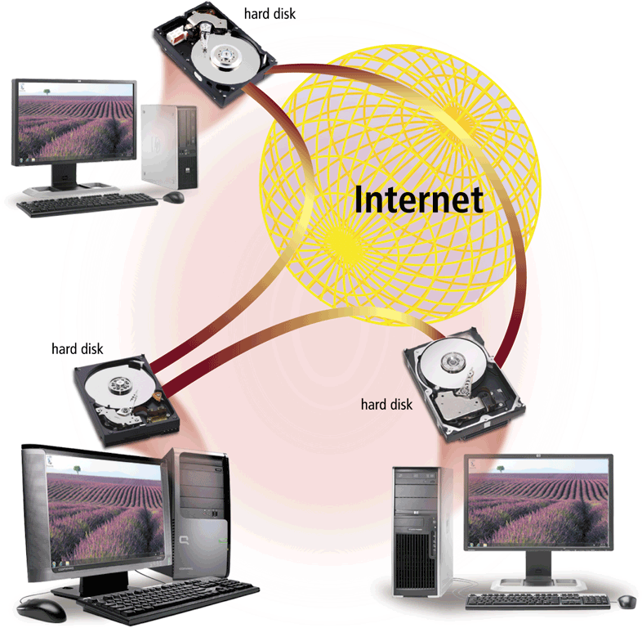
Internet Peer to Peer
Internet Peer to Peer ( P2P) describes an internet network in which users access each other’s hard disks and exchange files directly on the internet
Is also known as file sharing network
Internet copies files from individual
the hard disk on this network
Example
  Bit torrent, Kazaa

Slide 14
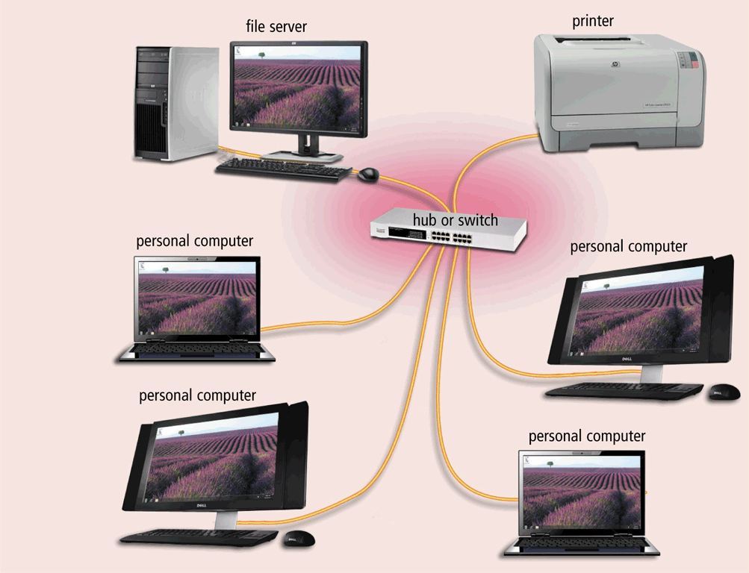
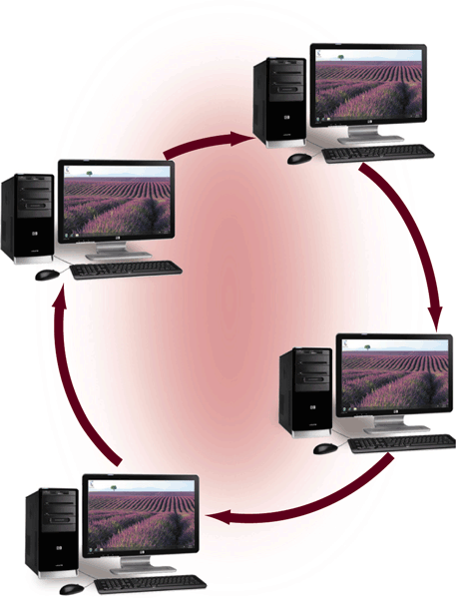
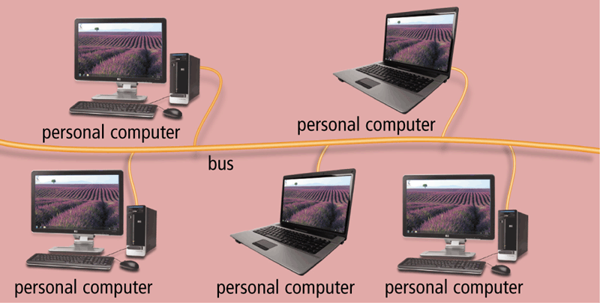
Network Topologies
Layout of computers and devices in a communication network
Star network
Bus network
Ring network

Slide 15
Star Topology
All computers and devices on the network connect to a central device forming a star
Types of devices forming a central communication point
  Hub - To connect a network of personal computers together
  Switch - Allow connections to multiple devices, manage ports, manage VLAN (Virtual LAN) security settings
All data are transferred to another node using these devices
Advantages
  Nodes can be easily removed or added.
  If one node fails, other nodes can operate
  normally.

Slide 16
Bus Topology
Consist of a single central cable to all computers and devices
The bus is the physical central cable that connects and transmits data, information and instruction in both directions
When sending device transmits data, the receiving address is included to ensure it’s received by the proper devices
Advantages
  Easy to install
  The device can be attached and detached from the bus without disrupting the rest
  Failure of one device does not affect the other device

Slide 17
Ring Topology
Cable forms a closed loop with all computers and devices arranged along the ring
Data transmitted will travel from device to device on the entire ring in a single direction until it reaches its destination
If one device fails the entire network fails

Slide 18
Intranet & Extranet
Intranet: Internal network that uses the internet technologies within the internal network
  Sharing electronic media
  Manuals
  Employee directory
Extranet: Allows suppliers or customers to access part of its intranet
  Tracking shipment
  Print bills

Slide 19
Network Communication Standards
Developed by ANSI (American National Standards Institute) and IEEE(Institute of Electrical and Electronics Engineers)
Network standard: defines guidelines that specify the way computers access
  Medium to which they are attached
  Type of medium
  Speed of medium
A standard that outlines the characteristics of how two network devices communicate is called a protocol
Protocol may define
  Data format
  Coding schemes
  Error handling
  Sequencing techniques

Slide 20
Network Communication Standards
Ethernet is a network standard that specifies no computer controls when data can be transmitted
The token ring standard specifies that computers and devices on the network share or pass a special signal (token)
TCP/IP is a network standard that defines how messages are routed from one end of a network to another

Slide 21
Ethernet
Specifies how devices connect to the Internet
Network standard that specifies no central computer or device on the network (nodes) should control when data can be transmitted
Each node attempts to transmit data when it determines network is available to receive communication
If two computers on an Ethernet network attempts to send data at the same time, a collision will occur

Slide 22
Token Ring
Specifies that computers and devices on a network share or pass a signal called a token in a preset order
A token is a series of bits which functions like a ticket
A device with a token can transmit data over the network
Only one token exists per network
Only a host that holds a token can send data, and tokens are released when receipt of the data is confirmed.

Slide 23
TCP/IP
Transmission Control Protocol/Internet Protocol
Specifies a protocol that defines how messages (data) are routed from one end to another end and ensures data arrives correctly
TCP/IP describes rules for dividing the messages into small pieces called packets
Each packet has a receiving address, error checking bit, sequencing pattern, and regulating flow
The technique of breaking message into small packets and sending packets along the best route is called: packet switching
All host on the Internet follows these rules

Slide 24
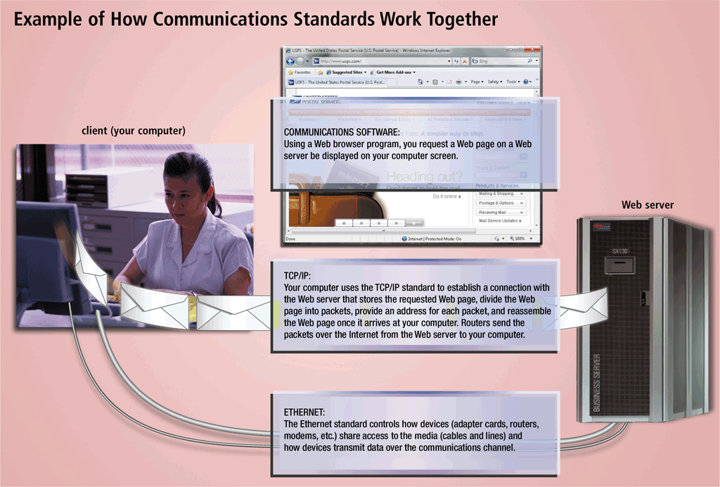
Communication Standards

Slide 25
Network Communication Devices
Communications Device
  any type of hardware capable of transmitting data, instructions, and information between a sending device and a receiving device

Slide 26
Network Cards
Network Interface Card (NIC) is a communication device that enables a computer or device that does not have built-in networking capability
Network card coordinates the transmission and receipt of data, instructions and information to and from a computer or device

Slide 27
Hubs
Hubs are devices used to link several computers together.
They repeat any signal that comes in on one port and copies it to the other ports (a process that is also called broadcasting).
There are two types of hubs: active and passive.
Passive hubs simply connect all ports together electrically and are usually not powered.
Active hubs use electronics to amplify and clean up the signal before it is broadcast to the other ports.

Slide 28
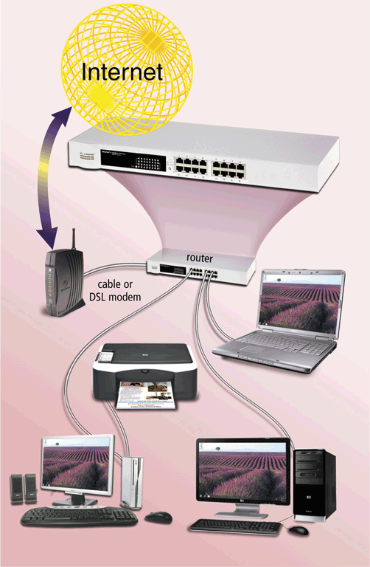
Router
Routers are highly intelligent devices that connect multiple network types and determine the best path for sending data.
To prevent unauthorized access, routers are commonly inbuilt with a hardware firewall.
Routers also provide wireless communication

Slide 29
Switches
A network switch is a computer networking device that connects network segments.
Network switches are capable of inspecting data packets as they are received, determining the source and destination device of that packet, and forwarding it appropriately.
By delivering each message only to the connected device it was intended for, a network switch conserves network bandwidth and offers generally better performance than a hub.
A vital difference between a hub and a switch is that all the nodes connected to a hub share the bandwidth among themselves, while a device connected to a switch port has the full bandwidth all to itself.

Slide 30
Summary
A network is a collection of computers and devices connected together via communication devices and transmission media
Advantages of network
  Facilitating communication
  Sharing hardware
  Sharing data and information
Network Communication Devices
  Network Cards
  Hubs
  Router
  Switches

Slide 31

Test Your Understanding!

