Slide 1

Embedded Counselling Practices
Helen Williams
P147366
Notes:
HELLO

Slide 2
Aims
Reflect on my use of embedded counselling skills within the module;
include implications and recommendations for the use of embedded counselling practices within the health and social care sector.

Slide 3
Meaning of embedded counselling
Human services such as nurses, teachers etc, respond to an individual who is experiencing emotional distress by using counselling skills to listen to the individual's concerns and worries.
(Mcleod, 2007)
Any person in a professional or supportive role with face to face contact where the role could incorporate a counselling dimension.
(McLeod and McLeod, 2011)
Notes:
McLeod, J., (2007) Counselling skill . Maidenhead: Open University Press.
McLeod, J. and McLeod, J. (2011)
Counselling skills: a practical guide for Counsellors and helping professionals. Maidenhead, Berkshire: McGrawHill/Open University Press.
Approached in this way, the use of the label ‘embedded counsellor’ invites us to re-engage with the radical values that prompted the origins of counselling in ways that are relevant to current life.
(Bond, 2008) Confidentiality and Record Keeping in Counselling and Psychotherapy

Slide 4
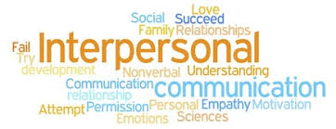
Experience
Notes:
Information about InfoNation
First point of contact
Sign post to other services or organisations
Provide advice and support
Run workshops
Continually on course to improve my personal development

Slide 5
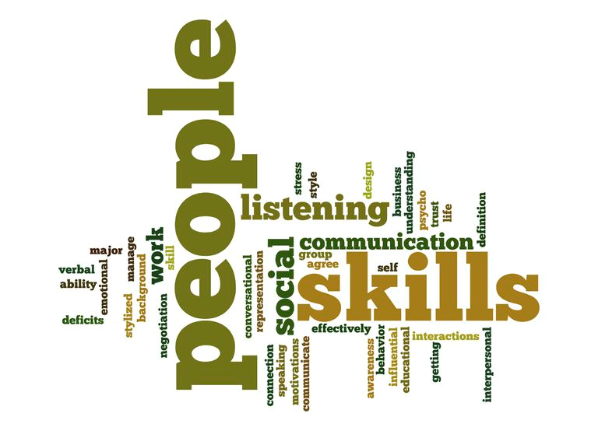
Notes:
Red Tie Rabbit (2015) What are Interpersonal Skills? (Assessed: 1st May 2018) http://www.redtierabbit.com/what-are-interpersonal-skills/
Interpersonal skills are the skills you use when both communicating with individuals and groups. Interpersonal skills are essentially our social skills and we’ve all been developing them since we were babies. Those with good interpersonal skills tend to be better in social situations and also tend to thrive in their professional careers. It’s worth noting the importance of interpersonal skills increase as you climb the ladder.
When we think about communication, we think of the following:
– The words we use when we speak to others.
– Our tone of voice when we speak to others.
– Our body language when speaking to others.
Counselling skills are more about the counselling skills when a person is distress
Egan, G. (2010) The Skilled Helper: A Problem-Management and Opportunity - Development Approach to Helping. 10th Edn. Belmont: Brooks/Cole, Cengage Learning.

Slide 6
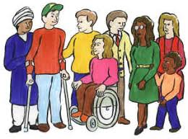
Embedded counselling
The clients
CEPEDA & DAVENPORT (2006)
Notes:
CEPEDA, L M. & DAVENPORT, D S. (2006) PERSON-CENTERED THERAPY AND SOLUTION-FOCUSED BRIEF THERAPY: AN INTEGRATION OF PRESENT AND FUTURE AWARENESS. Psychotherapy: Theory, Research, Practice, Training 2006, Vol. 43, No. 1, 1–12
The proposed approach may not be appropriate for all clients and circumstances. For example, the client who comes from a cultural understanding of therapy as brief and action oriented, along with the notion of “doctor knows best,” may become frustrated with the PC approach of Phase I and perceive the therapist as “leading one step from behind.” Clients may enter therapy with a clear idea of “homework” or task between sessions, and may have well-deﬁned problems and concerns that are in need of immediate and concrete answers. These clients might not want to spend time exploring their inner self, strengthening their self-concept, or deepening their awareness of emotions, but may want just quick solutions to their problems.
Download Free Clip Art (2018) clip art group of people cartoon people clip art free clipart clipartbold 2 (Assessed: 5th May 2018) https://download-free-clip.art/clip-art-group-of-people/clip-art-group-of-people-cartoon-people-clip-art-free-clipart-clipartbold-2/

Slide 7

Solution Focused
Notes:
Swansea University (2018) BSc (Hons) Adult Nursing, Swansea. (Assessed: 1th May 2018) http://www.swansea.ac.uk/undergraduate/courses/human-and-health-sciences/bschonsadultnursingswansea/
Swansea University (2018) BSc (Hons) Mental Health Nursing. (Assessed: 1th May 2018) http://www.swansea.ac.uk/undergraduate/courses/human-and-health-sciences/bschonsmentalhealthnursing/
Solution-focused conversations: a new therapeutic strategy in well child health nursing telephone consultations
Polaschek, Linda ; Polaschek, Nick
Journal of Advanced Nursing, Jul 2007, Vol.59(2), p.111
Solution-focused group therapy
Nickerson, Peter
Social Work, Jan 1995, Vol.40(1), pp.132-3
The Effectiveness of Solution-Focused Therapy With Children in a School Setting
Franklin, Cynthia ; Biever, Joan ; Moore, Kelly ; Clemons, David ; Scamardo, Monica
Research on Social Work Practice, 2001, Vol.11(4), pp.411-434
A thematic analysis of the experience of UK mental health nurses who have trained in Solution Focused Brief Therapy.
Detail Only Available
Academic Journal
(English) ; Abstract available. By: Smith S; Macduff C, Journal Of Psychiatric And Mental Health Nursing [J Psychiatr Ment Health Nurs], ISSN: 1365-2850, 2017 Mar; Vol. 24 (2-3), pp. 105-113; Publisher: Blackwell Scientific Publications; PMID: 28124407
Solution-focused approach therapy for mental health nursing students.
Detail Only Available
Academic Journal
(English) ; Abstract available. By: Evans N; Evans AM, British Journal Of Nursing (Mark Allen Publishing) [Br J Nurs], ISSN: 0966-0461, 2013 Nov 28-Dec 11; Vol. 22 (21), pp. 1222-4, 1226; Publisher: MA Healthcare; PMID: 24280922
Solution-focused approach therapy for mental health nursing students.
Detail Only Available
Academic Journal
(English) ; Abstract available. By: Evans N; Evans AM, British Journal Of Nursing (Mark Allen Publishing) [Br J Nurs], ISSN: 0966-0461, 2013 Nov 28-Dec 11; Vol. 22 (21), pp. 1222-4, 1226; Publisher: MA Healthcare; PMID: 24280922
The ongoing movement from institutional care to community-orientated care has gradually spread around the developed world. This shift in the philosophy of care has resulted in a reduction in the length of inpatient admissions and contributed to a decline in the number of inpatient beds. This literature review seeks to establish the suitability and relevance of solution-focused brief therapy (SFBT) to mental health nursing practice, with particular emphasis being given to acute inpatient settings. Databases searched for published material in English between 1980 and 2006 were: Cumulative Index of Nursing and Allied Health Literature; MEDLINE; Applied Social Sciences Index and Abstracts; Sociological abstracts; and social service abstracts. Search terms included: SFBT and solution-focused approaches. Only nine papers from the original 203 citations met the inclusion criteria and were thus reviewed. These papers indicated that SFBT constitutes an appropriate set of techniques for use in mental health nursing particularly where staff have relatively brief contact with patients. Preliminary data suggest that SFBT is congruent with the philosophical underpinning of contemporary mental health nursing. However, its clinical utility and effectiveness is not well established and methodologically rigorous studies are urgently needed to determine the appropriateness and effectiveness of such approach to nursing practice.
Fig 2 (2015) Solution-Focused Talk (Assessed: 4th May 2018) http://www.hanhconsulting.com/our-program/sftalk/

Slide 8

Implications
Lack of research
Recognition of the use of embedded counselling skills
Support for practitioners
Unclear boundaries
Notes:
Tim Bond (2015)
McLeod, J. (2008) Outside the therapy room. Therapy today. 19 (4), (2008, May), pp. 14 -18.
McLeod, J, & McLeod, J 2015, 'Research on embedded counselling: An emerging topic of potential importance for the future of counselling psychology', Counselling Psychology Quarterly, 28, 1, pp. 27-43
Nursing standard (2018) Analysis, Under pressure: A day in the life of a front-line nurse (Assessed: 2nd May 2018) https://rcni.com/nursing-standard/newsroom/analysis/under-pressure-a-day-life-of-a-front-line-nurse-79246

Slide 9

recommendations
Appropriate supervision
Work balance
Identify boundaries
Training

Slide 10
References
CEPEDA, L M. and DAVENPORT, D S. (2006) PERSON-CENTERED THERAPY AND SOLUTION-FOCUSED BRIEF THERAPY: AN INTEGRATION OF PRESENT AND FUTURE AWARENESS, Psychotherapy: Theory, Research, Practice, Training, 43 (1),(2006), pp.1–12.
Egan, G. (2010) The Skilled Helper: A Problem-Management and Opportunity - Development Approach to Helping. 10th Edn. Belmont: Brooks/Cole, Cengage Learning.
Evans, N. (2011) Solution-focused approach therapy for mental health nursing students. British Journal of Nursing, 22 (21),(December 201), pp.1222-4, 1226.
Fig 1. (2018) clip art group of people cartoon people clip art free clipart clipartbold 2 (Assessed: 5th May 2018) https://download-free-clip.art/clip-art-group-of-people/clip-art-group-of-people-cartoon-people-clip-art-free-clipart-clipartbold-2/
Fig 2 (2015) Solution-Focused Talk (Assessed: 4th May 2018) http://www.hanhconsulting.com/our-program/sftalk/
Franklin, C., Biever, J., Moore, K., Clemons, D. and Scamardo, M. (2001) The Effectiveness of Solution-Focused Therapy with Children in a School Setting. Research on Social Work Practice, 11(4), (2001), pp.411-434.
McLeod, J. and McLeod, J. (2015), 'Research on embedded counselling: An emerging topic of potential importance for the future of counselling psychology', Counselling Psychology Quarterly, 28(1), (2015), pp. 27-43.
McLeod, J. (2008) Outside the therapy room. Therapy today. 19 (4), (2008, May), pp. 14 -18.

Slide 11
McLeod, J. and McLeod, J. (2011) Counselling skills: a practical guide for Counsellors and helping professionals. Maidenhead, Berkshire: McGrawHill/Open University Press.
McLeod, J. (2007) Counselling skill, Maidenhead: Open University Press.
Nickerson, P. (1995) Solution-focused group therapy. Social Work, 40(1), (January 1995) pp.132-3.
Nursing standard (2018) Analysis, Under pressure: A day in the life of a front-line nurse (Assessed: 2nd May 2018) https://rcni.com/nursing-standard/newsroom/analysis/under-pressure-a-day-life-of-a-front-line-nurse-79246
Polaschek, L. & Polaschek, N. (2007) Solution-focused conversations: a new therapeutic strategy in well child health nursing telephone consultations. Journal of Advanced Nursing, 59 (2), (Jul 2007), p.111.
Red Tie Rabbit (2015) What are Interpersonal Skills? (Assessed: 1st May 2018) http://www.redtierabbit.com/what-are-interpersonal-skills/
Smith, S. & Macduff, C. (2017) A thematic analysis of the experience of UK mental health nurses who have trained in Solution Focused Brief Therapy. Journal of Psychiatric and Mental Health Nursing; 24 (2-3), (March 2017), pp. 105-113.
Swansea University (2018) BSc (Hons) Adult Nursing, Swansea. (Assessed: 1th May 2018) http://www.swansea.ac.uk/undergraduate/courses/human-and-health-sciences/bschonsadultnursingswansea/ .
Swansea University (2018) BSc (Hons) Mental Health Nursing. (Assessed: 1th May 2018) http://www.swansea.ac.uk/undergraduate/courses/human-and-health-sciences/bschonsmentalhealthnursing/ McLeod, J. and McLeod, J. (2011) Counselling skills: a practical guide for Counsellors and helping professionals. Maidenhead, Berkshire: McGrawHill/Open University Press.
McLeod, J. (2007) Counselling skill, Maidenhead: Open University Press.
Nickerson, P. (1995) Solution-focused group therapy. Social Work, 40(1), (January 1995) pp.132-3.
Nursing standard (2018) Analysis, Under pressure: A day in the life of a front-line nurse (Assessed: 2nd May 2018) https://rcni.com/nursing-standard/newsroom/analysis/under-pressure-a-day-life-of-a-front-line-nurse-79246
Polaschek, L. & Polaschek, N. (2007) Solution-focused conversations: a new therapeutic strategy in well child health nursing telephone consultations. Journal of Advanced Nursing, 59 (2), (Jul 2007), p.111.
Red Tie Rabbit (2015) What are Interpersonal Skills? (Assessed: 1st May 2018) http://www.redtierabbit.com/what-are-interpersonal-skills/
Smith, S. & Macduff, C. (2017) A thematic analysis of the experience of UK mental health nurses who have trained in Solution Focused Brief Therapy. Journal of Psychiatric and Mental Health Nursing; 24 (2-3), (March 2017), pp. 105-113.
Swansea University (2018) BSc (Hons) Adult Nursing, Swansea. (Assessed: 1th May 2018) http://www.swansea.ac.uk/undergraduate/courses/human-and-health-sciences/bschonsadultnursingswansea/ .
Swansea University (2018) BSc (Hons) Mental Health Nursing. (Assessed: 1th May 2018) http://www.swansea.ac.uk/undergraduate/courses/human-and-health-sciences/bschonsmentalhealthnursing/

