Slide 1

The Grave of Empires
HPAR5012/HPAR6012
AL WILLIAMS-SPOONEr

Slide 2
Inspiration

Slide 3
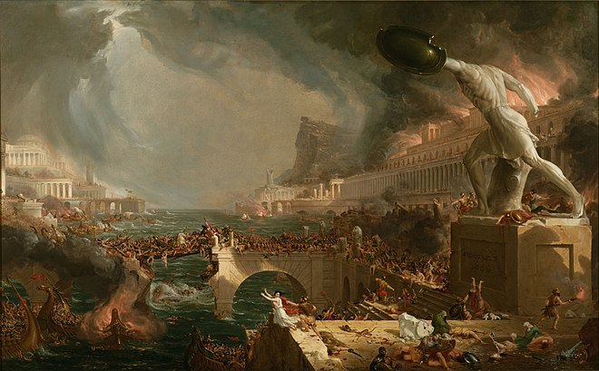
The Course of Empire: Destruction
Thomas Cole
Oil on canvas
33 ¼ x 63 ¼ in. (84.5 x 160.7 cm)
1836
The Met (2024)

Slide 4
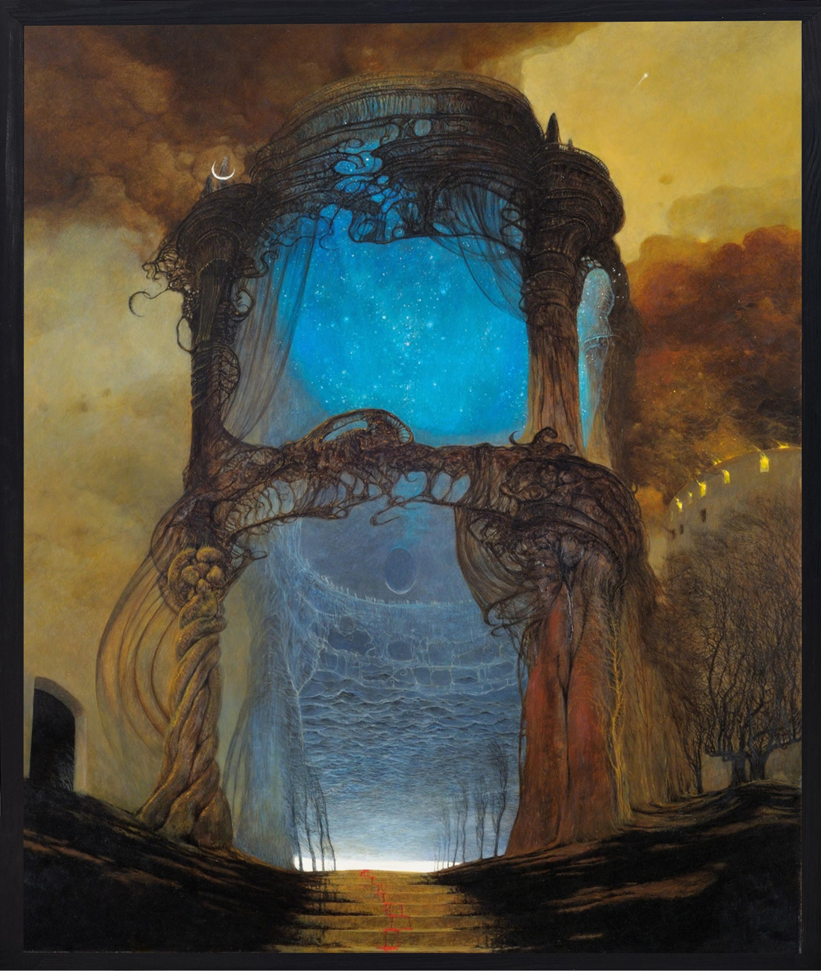
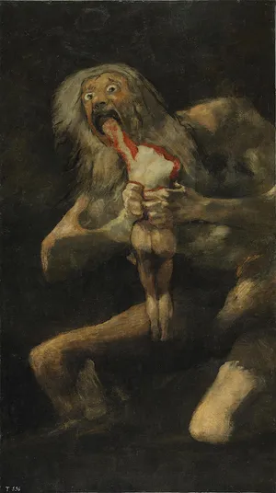
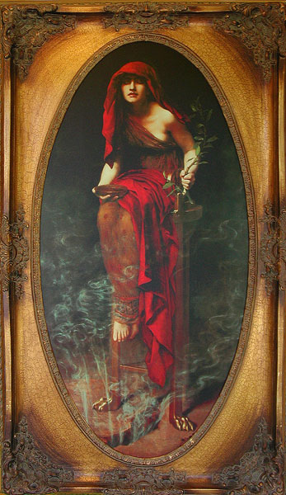
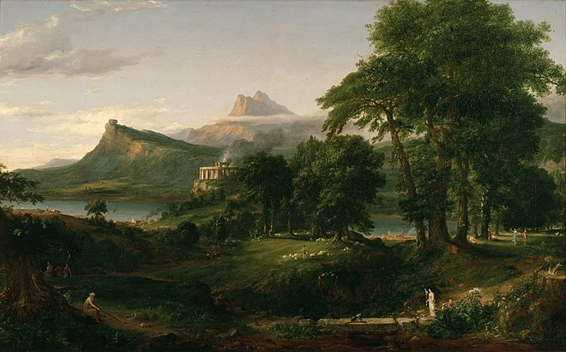
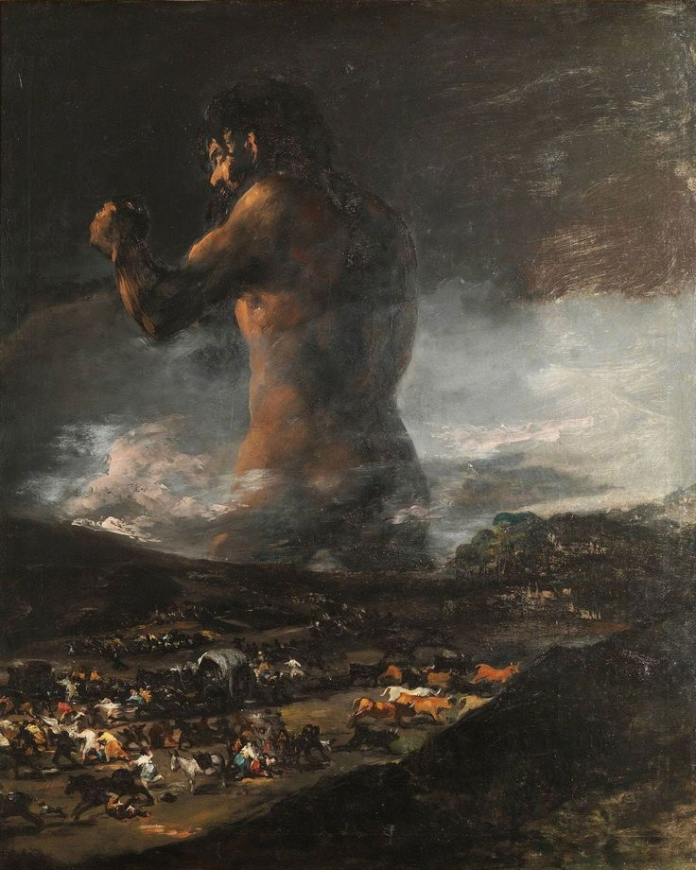
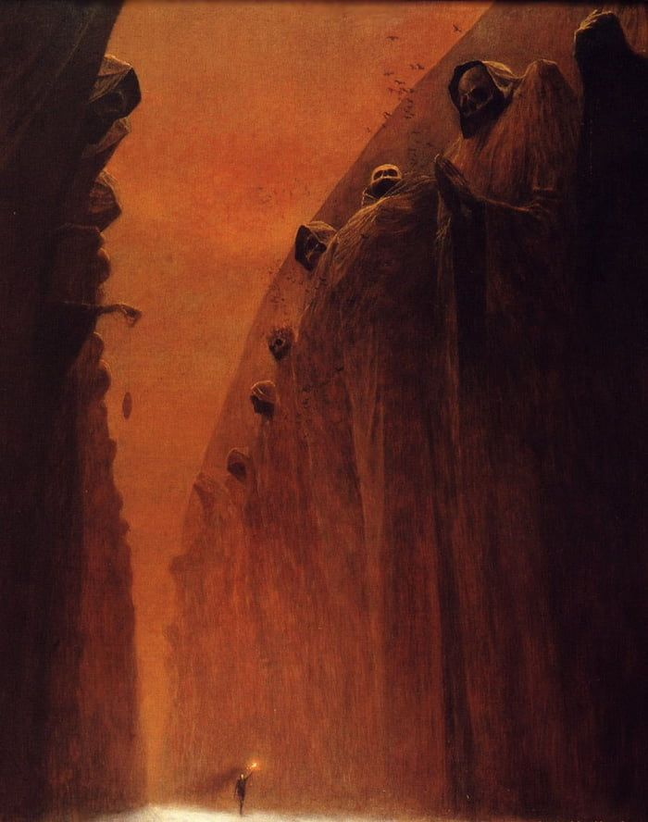
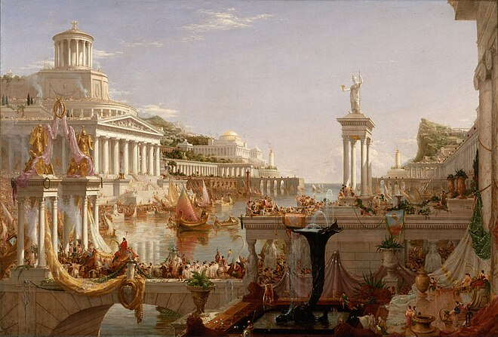

Slide 5
Focus Points

Slide 6
Key Points
Narrative
Media
Concept
Theme
Painting
Text
Music
Inspiration
Response
Idea
Artwork
Presence
Emotion
Symbology
Identity
Time
Grouping
Iconography
Reflection
Personal
Methodology
Association
Empire
Story
Graves
Destruction
Rome
Egypt
Death
Immortality
Tomb
Representation
Myths
Traditions
Culture
Colours
Sounds
Aesthetic
Imagination
Interpretation
Dramatic
Analysis
Visual
Stereotypes

Slide 7
Big Questions
What would an Empire's Grave look like?
What would be the iconography?
What symbols would be used?
Would it be extravagant or humble?
What aspects of the respective Empire would a grave represent?
What constitutes an Empire?
What constitutes a grave?
Why are certain mediums being used over others?
How is a no longer existing Empire turned into a narrative?
What are the inspirations?
Why focus on certain Empires over others?
Who is the intended audience?
Who would the grave be made by?

Slide 8
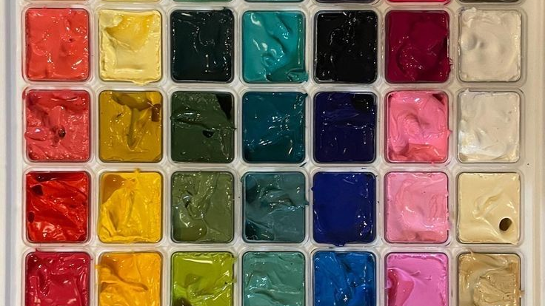
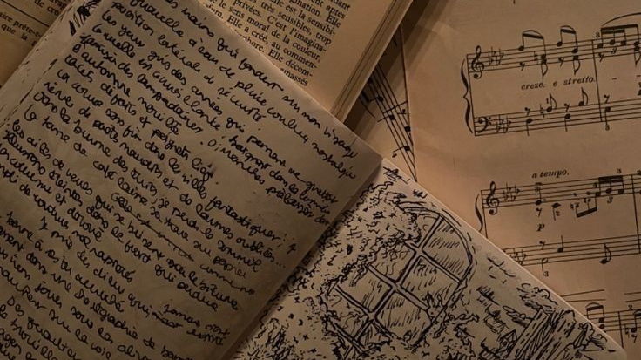
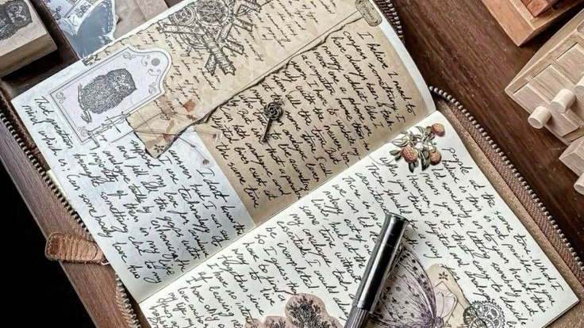

The Idea

Slide 9
The Idea
Explore the concept and narrative of an Empire's Grave
Experiment with brush markers, fine liners, acrylic paint, etc.
Research iconography and symbols associated with certain Empires
Fill a journal with concept art pieces, poetry, and possibly a whole written short story
Explore the concept of an Empire and Death and Presence
Create multiple pieces of artwork and text in a collection
Display the process of thought that goes into concept/theme exploration through mediums
Incorporate inspirations by personal interpretation
Explore concepts of culture and identity represented through death
Compare other artists' interpretations on the theme

Slide 10
Bibliography
Britannica (2024) Saturn Devouring His Son, Available at https://www.britannica.com/topic/Saturn-painting-by-Goya (Accessed: 12 December 2024)
Beksiński, Z. (1972), Untitled, Available at https://uk.pinterest.com/pin/589197563763702822/ (Accessed: 12 December 2024)
Beksiński, Z. (1978), AE78, Available at https://beksstore.com/product/zdzislaw-beksinski-painting-ae78/ (Accessed: 12 December 2024)
Goya, F., Julià, A. (1808) The Colossus, Available at https://uk.pinterest.com/pin/589197563763702945/ (Accessed: 12 Decmber 2024)
Illusions Gallery (2018) The Story Behind the Painting: "The Priestess of Delphi" by Hon. John Collier, Available at https://www.illusionsgallery.com/Story-Delphi.html (Accessed: 12 December 2024)
Pinterest (Unknown), Unknown, Available at https://uk.pinterest.com/pin/12384967721048091/ (Accessed: 14 December 2024)
Pinterest (Unknown), Unknown, Available at https://uk.pinterest.com/pin/67624431898712719/ (Accessed: 14 December 2024)
Pinterest (Unknown), Unknown, Available at https://uk.pinterest.com/pin/985231163808872/ (Accessed: 14 December 2024)
Pinterest (Unknown), Unknown, Available at https://uk.pinterest.com/pin/140806233387696/ (Accessed: 14 December 2024)
The Met (2024) The Course of Empire: Destruction, Available at https://www.metmuseum.org/art/collection/search/692371 (Accessed: 25 November 2024)
Wikepedia (2024) The Course of Empire (paintings), Available at https://en.wikipedia.org/wiki/The_Course_of_Empire_(paintings) (Accessed: 12 December 2024)

