Slide 1
21st Century Learning
The Outdoor Classroom

Slide 2
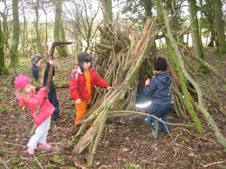
Task
Think of your most memorable play experience
Share it with the rest of the class
Notes:
Studies show that older generations will give an example of outdoor play whereas younger generations give examples of indoor play –why do you think this is?

Slide 3
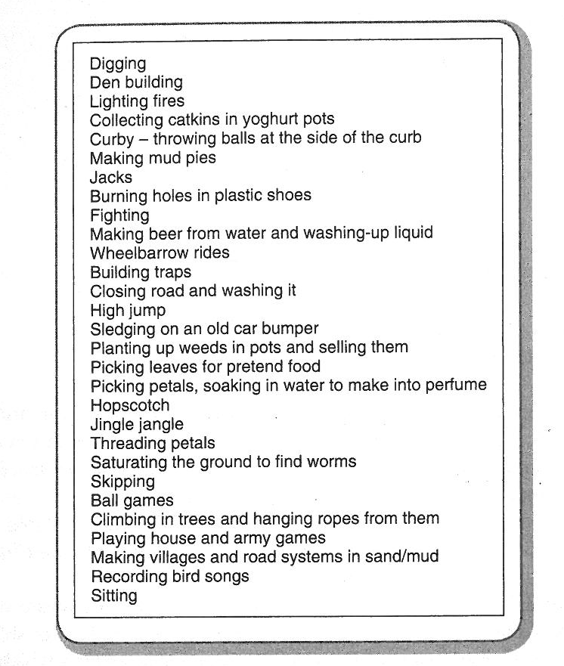
Bilton (2010)
Notes:
What skills are developed?

Slide 4
Children play and exist outside much less than they used to -why??

Slide 5
Why?
Worried about road safety
Worried about abductions
Car – more freedom for parents less for children
Organised activities – previously would have organised their own activities
Choose not to play outside because dangers suggested by adults make them nervous. Thomas & Thompson 2004 (in Bilton 2010)
Technology
‘Suburban garden pride’ Bilton 2010 p 13

Slide 6
Children play and exist outside much less than they used to
1985 – 21% 5 – 10 yr olds travelled to school alone. In 2005 this had fallen to 6% (Dept of Transport 2006)
1971, 80% of 7-8 yr olds went to school without adult. By 1990 – 9% (Hillman et al 1990)

Slide 7
Inquiry-Based Learning
http://www.youtube.com/watch?v=u84ZsS6niPc
Discuss:
Are there more opportunities for IBL indoors or outdoors?
Why?
Notes:
Video about Inquiry based learning

Slide 8
Perspectives of outdoor learning
Montessori
Frobel
Steiner
What did they believe?

Slide 9
Historical Perspectives of Outdoor Learning
Frobel (1782-1852)
Believed children needed to be close to nature
Self-led discovery and play
Considered that education was not always about formal learning
Montessori (1870- 1952)
Integrated both indoor and outdoor play
Children free to roam between the two environments
Steiner (1861 – 1925)
Made a connection between the child’s spirituality and their world
Encourages use of the outdoor environment and provided spaces that were as natural as possible
Believed children should be able to play without adult interference
Notes:
Frobel –
First to use term ‘kindergarten’ - translates to garden for children
In his nursery Frobel creates open spaces to play alongside calmer places for reflection and thought
Frobel's nursery encouraged independence and creativity through investigation and discovery.
Montessori –
Began working in Rome with disabled children (wanted to remove the overpowering gap that parents and teachers had on education).
Montessori believed in children learning life skills rather than play (play must be purposeful).
Children free to roam both inside and outside (this is done in practice today in lower FP)
Steiner
Provided natural areas – trees, a digging area, veg beds,
Similar ethos is now followed in forest schools
Adult as facilitator

Slide 10
The Outdoor Classroom
Sensory experiences readily available
More opportunities for creativity in the outdoor learning environment (Moyles, 2010)
More opportunities for exploratory learning (Davies et al 2010)
Outside learning is more inclusive – traveller and refugee children feel more at ease outdoors (Bilton, 2004)
Settings that provide periods of free access to outdoor learning environments report that in general children behave more co-operatively (DCSF, 2008)
Notes:
The outdoor classroom:
Sensory, exploratory environment which engages students in the learning process
Traveller and refugee children feel more at ease outdoors – why?
Practitioner observations have shown that children
commonly make at least five times as many utterances outdoors as they do inside Improves communication skills)
Movement between indoor and outdoor environments (Montessori)

Slide 11
Risk and Challenge
What is risk?
‘Any behaviour in which there is uncertainty about the outcomes. It involves a consideration of the benefits against the possible undesirable consequences of the behaviour as well as the probability of success or failure’
Little (2006)
In pairs
make a list of the characteristics of ‘risky’ activities outdoors
Notes:
Certain amount of risk is necessary - benefits out way consequences
Enhances problem solving skills
Physical development
Self esteem and confidence

Slide 12
‘risky’ characteristics
play involving height, motion and speed.
inverting the normal order of things – tipping, hanging, spinning, rolling,
joy in precariousness, unpredictability
playing ‘on the edge’ of capability- testing skill, speed, endurance etc.
deliberate thrill seeking
seeking out scary situations whether imagined or real eg going in a dark place
Simultaneous experience of joy & fear, in control and out of control, risk and mastery, play and reality
Notes:
Any activity that could potentially end in injury?
Health and Safety gone mad?
What does the amount of ‘risky’ activities prohibited in school depend on? - discuss
Teachers opinions
School policies
The general environment

Slide 13
What are the benefits of risk taking?
Positive learning dispositions
A mastery approach – an ‘I can do it’ attitude
Playing at the edge of capabilities – pushing out limits
Emotional well being and resilience
‘training for the unexpected’ (Spinka, Newberry and Bekoff 2004)
Links between movement and thought (Athey , Greenland 2007)
Notes:
Improves overall development
Enhances learning
Improves overall confidence
Encourages self expression
Link between movement and thoughts – enhances problem solving and thinking skills

Slide 14
Science and the Outdoor Classroom
Knowledge and understanding of the world
Examples of activities (activities often cross over into areas of learning:
Local environments/ where we live
Sorting/classification of objects (e.g leaves)
Organisms and their environment
Earth Science
Weather
Notes:
Some examples of science in the outdoor classroom – fit mostly in with knowledge and understanding of the world.
Not all focus on foundation phase – many activities can be carried out in ks2 and ks3 (in more complex way)

Slide 15
Creativity and the Outdoor Classroom
Creative development
Willow weaving
Mud Pie
Use of natural environment to create pictures
Den building
House building for mini-beasts
Notes:
Natural resources used – more readily available
Children will used the natural resources without being instructed to do so.
Different shapes, textures – manipulation of different materials

Slide 16
Learning outside the classroom
Secondary Schools and Further Education
Field trips
Placements
Work experience
Vocational qualifications
Residential visits
Barriers:
Health and Safety, Inclusion, Cost, Behaviour, Quality
Notes:
Report conducted by Ofsted – good practice is limited. Not as well embedded into the curriculum as KS1.
Some school/college courses lend themselves better to learning outdoors that others.
Barriers – H + S (lengthy risk assessments)
inclusion – is place accessible for all?
can school/college afford it? Is it fair to expect pupils to pay?
sometimes behaviour is worse on trips (excitability because it is out of the ordinary?)
Quality – will pupils learn from it?

Slide 17
Forest School and Inquiry based learning
Forest School Philosophy:
is to encourage and inspire individuals of any age through an innovative, long term, educational approach to outdoor play and learning in a woodland environment.
Three essential elements:
-Use of local woodland/wooded setting
-Qualified practitioner
-Regular visits to same woodland
Child led
Integrates all areas of learning
Notes:
Forest school – completely child led – children decide exactly what they are going to do in the outdoor environment and what resources they will use – promotes enquiry and creativity.
Not just for FP but can be used with young adults/adults with learning difficulties.

Slide 18
Outdoor learning video
https://www.youtube.com/watch?v=Jkiij9dJfcw
Make a note of the benefits of the outdoor classroom (be prepared to discuss these with the rest of the class)
What opportunities are there for creative and scientific inquiry?
Notes:
Forest schools

Slide 19
Task
In pairs:
Create a session plan for an outdoor learning lesson for one or more of the following:
Numeracy
Literacy
Music
Science
Art
Consider health and safety issues, resources needed, location etc

