Slide 1
ECGE4001R – Academic Study Skills

Slide 2
Task – Before we Start.
Getting to know your colleagues.
Interview the person sitting next to you
Ask 5 questions (in addition to the persons name).
Interviewee becomes the Interviewer
  5 DIFFERENT questions.
Present the answers

Slide 3
Introduction
The aim of this module is to introduce higher education academic skills and effective communication within the context of the students’ programme of study.
This module is a generic faculty module (which is why the module code differs from other modules in your programme of study).
However, important to note you will be taught this module in accordance to the skills needed for a Psychology and for your programme of study.
  Lecture material and content will be very similar across all University Psychology based programmes but will deviate from other programmes taught within the Faculty.

Slide 4
Aims of the Module
To introduce higher education academic skills and effective communication within the context of the students’ programme of study.

Slide 5
Learning Outcomes
Upon the successful completion of this module, the student should be able to demonstrate the ability to:
  • engage in, and recognise the importance of academic reading, writing, referencing and develop confidence in communication and presenting to different audiences and for different purposes;
  • explore different communication styles and systems;

Slide 6
Learning Outcomes Continued.
• develop digital competency and numeracy skills in line with the academic demands of the programme;
• organise their learning effectively and reflect upon their own progress and future development.

Slide 7
Indicative Content
The module will include:
the development of students’ reading skills and strategies appropriate to academic study. For example, critical and evaluative reading, effective use of electronic resources, primary and secondary resources;
the development of understanding the importance of referencing and referencing styles in relation to students’ programme of study; the importance of acknowledging the work of others and how to avoid plagiarism;

Slide 8
Indicative Content (Continued)
the development of understanding of communicating to a range of audiences, for a range of purposes and changing the environment to improve communication. The module will examine the need for effective communication systems and how these support and promote communication, participation and working;
exploration of verbal and presentation skills. Students will examine the use of individual and group presentations, PowerPoint presentations, poster presentations and peer reviews;

Slide 9
Indicative Content (Continued)
the development of a range of appropriate written communication, formats and structures; including academic demands such as note taking, essay planning and writing, summarising, layout, paraphrasing, assignments, reflective writing, report writing, letter writing and appropriate use of emails;
becoming familiar with and develop competency, skills and confidence in the use of digital literacy. For example students will use electronic and digital resources to facilitate and support personal research, communication and presentation of work

Slide 10
Indicative Content (Continued)
the development of appropriate management skills, for example time management and working to deadlines; the development of appropriate numeracy skills, for example awareness of data and statistics used in research;
exploration of how to stimulate and maintain a positive attitude to study and develop strategies for future success. For example, time management, effective and sufficient planning, motivation, working to deadlines, working as part of a group, personal development planning including target setting and reflexivity.

Slide 11
Assessment
Assessment Component 1 – 50%
  Portfolio of activities (1500 words)
    Friday 8th November @23.59 via the turnitin portal.
Assessment Component 2 – 50%
  Academic Presentation (10 minutes in total)
    Presentation - Monday 9th December and Friday 13th December
      Presentation slides submitted via turnitin @23.59 on Monday 9th December.

Slide 12
Assessment Component 1 – Portfolio of Activities (1,500 words) – 50%.
1. Paraphrase a section from a selected book chapter (500 words)
• All students will be provided with a chapter from a relevant book and will be required to paraphrase certain sections of it into their own words.
2. Summarise three selected journal articles into abstracts (400-500 words)
• All students will be provided with three short research journal paper and will be required to summarise the paper into an abstract, whilst ensuring they do not plagiarise the paper’s actual abstract.
3. Create a reference list (500 words)
• Students will be provided with a 20 item list comprised of the following: books, journal papers, webpages, government documents, conference proceedings, etc. They will only be provided with the author names, dates, and titles, and will be required to produce an accurate reference list of all the items in appropriate APA formatting.

Slide 13
Assessment Component 2: Academic Presentation (10 minutes) 50%
Title: Ten-minute (total) individual presentation on a topic of the student’s choice related to their own academic and/or professional skills development.
5 minute presentation + 5 minute question and answer session.

Slide 14
Recommend Reading
Classification | Reading List entry | Electronic*
Essential | Burns, T. & Sinfield, S. (2016) Essential study skills: the complete guide to success at university (4th ed). London: Sage. | ☐
Essential | Cottrell, S. (2013) The Study Skills Handbook (4th ed). Basingstoke: Palgrave MacMillan. | ☐
Essential | Godfrey, J. (2013) How to use your reading in your essays (2nd ed). Basingstoke: Palgrave MacMillan. | ☒
Essential | Harrison, M., Jakeman, V. and Paterson, K. (2012) Improve your grammar. Basingstoke: Palgrave MacMillan. | ☐
Essential | Judge, B. (2009) Critical Thinking Skills for Education Students. Exeter: Learning Matters. | ☐
Essential | Moore, S., Neville, C. and Murphy, M. (2010) The ultimate study skills handbook. Maidenhead: McGraw-Hill, Open University Press. | ☐
Essential | Pears, R. & Shields, G. (2017) Cite them right: the essential referencing guide. Basingstoke: Palgrave MacMillan. | ☒
Essential | Pears, R. & Shields, G. (2016) Cite them right: the essential referencing guide. Basingstoke: Palgrave MacMillan. | ☐
Further | Bedford, D. and Wilson, E. (2009). Study skills for part-time students. Harlow: Prentice Hall. | ☐
Further | Cottrell, S. (2010) Skills for Success: The Personal Development Planning Handbook (2nd ed.) Hampshire: Palgrave MacMillan. | ☐
Further | Pritchards, A. M. (2008) Studying and Learning at University: Vital Skills for Success in your Degree. London: Sage Publications. | ☒
Further | Savage, M. and Barnett, A. (2015) Digital Literacy for Primary Teachers. Northwich: Critical Publishing Limited. | ☒
Further | van Emden, J. & Becker, L. (2010) Presentation Skills for Students (2nd ed). Basingstoke: Palgrave Macmillan. | ☐
Further | http://www.skills4studycampus.com/palgrave/ | ☒

Slide 15
Module Content – Breakdown….
Lecture 1 – Introduction and Overview.
Lecture 2 – Digital Literacy
Lecture 3 – Referencing, Paraphrasing and Avoiding Plagiarism.
Lecture 4 – Reading Skills and Effective use of Resources.

Slide 16
Module Content - Breakdown
Lecture 5 – Academic Writing Skills.
Lecture 6 – Presentation and Communication Styles.
Lecture 7 – PowerPoint and Academic Posters.
Lecture 8 – Time Management Skills.
Lecture 9 – Numeracy Skills.
Lecture 10 – Assessed Presentations

Slide 17
What is meant by Academic Study Skills?
Task
In small groups, I would like you to discuss and consider what YOU think is meant by Academic Study Skills.
Conduct a mind map of the learning skills needed to study at HE.
  (10 minutes).
Discussion and Feedback.

Slide 18
What is meant by Academic Skills?
Cottrell (2013) – Study Skills involve a number of skills and subskills that you will use and require to assist you to achieve your potential in higher education study.
Gettinger and Seibert (2002, p 350)
“Academic competence is associated with the knowledge and application of effective study skills. Capable students at all grade levels may experience difficulty in school, not because they lack ability, but because they lack good study skills.”

Slide 19
Why the need for a study skills module?
This is a critical module for your academic and personal development.
Provides you with the skills needed to adapt to your academic studies.
Psychology.

Slide 20
Why the need for a study skills module?
Motivation and Maintenance.
Reflection
Transferable Skills
Personal Development Plan (PDP)
Continuing Professional Development (CPD)

Slide 21
What skills are needed.
Independent Study
Working with Others
Managing Anxieties
Research Skills
Writing Skills
Self Evaluation
And Many More
ITC / E-Learning Skills
Note Taking
Presentation Skills
Understanding Learning Styles
Time Management Skills

Slide 22
Why so many skills are needed…
The degree programme you are studying is a fascinating discipline that has been designed by lecturing staff with applied work in the field.
The variety of assessments that you will undertake are essential in order to achieve the benchmarks of the British Psychological Society.
Transferable skills that will prepare you for the world of work and / or further study beyond your degree.
  Essential in todays competitive career market.

Slide 23
Expectations of studying at degree level.
In addition to face-to-face learning, we'll expect you to cover a good deal of reading and private study.
This is likely to take up a lot of your remaining time.
Most students recommend treating the course like a full-time job, even if you don’t necessarily follow a 9–5 working pattern.
Therefore, whilst the contact time with lecturers might appear to be little there is an expectation that students will spend a lot of their remaining time in independent study.

Slide 24
University regulations.
In order to progress to the next Level of study, a student must pass 120 credits at their current level.
As an example, for you to progress onto Level 5 (Year 1) of your study you must pass 120 credits which have been set at the Level 4 (Year 1) level.
A pass mark is set at 40% (or more) for the module at Undergraduate level.
Each module is typically worth 20 credits, although the module lead / programme director will state if this is not the case.

Slide 25
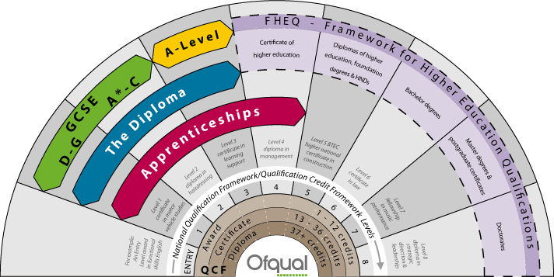
An overview qualification levels in England and Wales.

Slide 26
Therefore….
When lecturers talk about or two level 4 students, they are referring to students embarking on their first year of their degree.
Level 5 = Second year of their degree.
Level 6 = Final year of their degree.
Postgraduate students are referred to as level 7.

Slide 27
Types of Assessments you will undertake for your degree.
Essays
PowerPoint Presentations
Poster Presentations
Examinations
Multiple Choice Questions (MCQs)
Research Report Writing
Seen Examinations
Open Book Tests
Promotional Leaflets
Campaign Strategy
Briefing Report
Portfolios
Dissertation

Slide 28
Moodle
Moodle is a learning platform designed to provide educators, administrators and learners with a single robust, secure and integrated system to create personalised learning environments.
Open Source Virtual Learning Environment.
Will contain information that is vital for your learning, such as Lecture Material, Supplementary Reading, and other important information relating to your course.
It is strongly advisable that you log in to moodle frequently throughout the course.
https://moodle.uwtsd.ac.uk

Slide 29
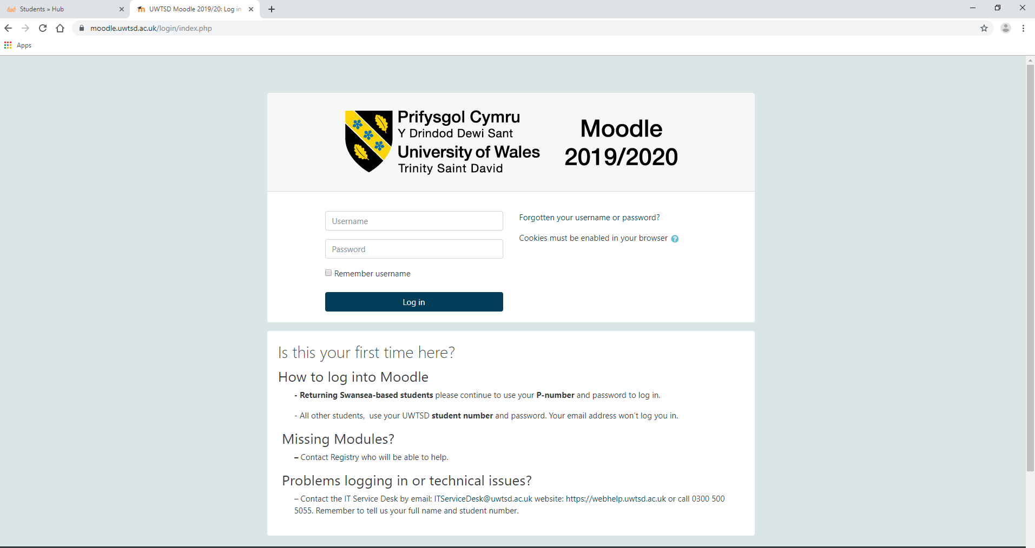
Moodle

Slide 30
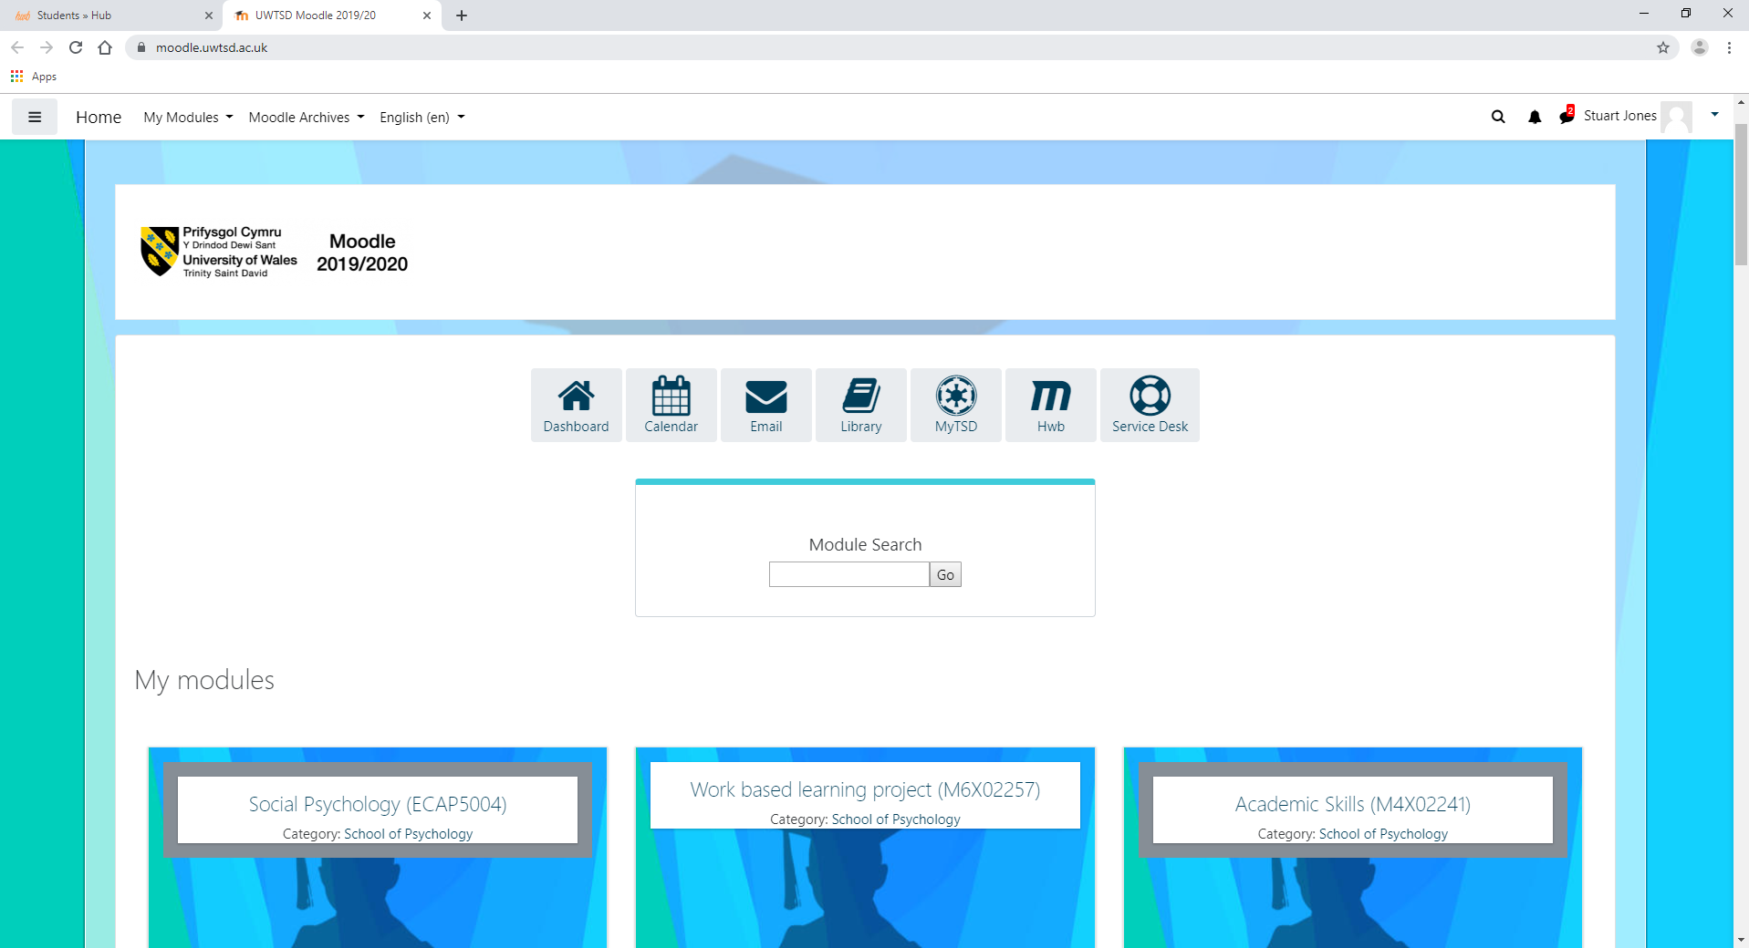
Moodle

Slide 31
Student Hwb
New for September 2019.
One stop shop for all the essential information that you will need at UWTSD.
Accessible via desktop of any University desktop computer OR via downloading The UWTSD Hwb app directly from your app store.
Manage your studies with all your course essentials.

Slide 32
Student Hwb
The Student HWB is a cloud based system which will provide UWTSD staff and students with a new, simple way of accessing key online services and information in one convenient location. The HWB portal will allow access to services such as Email, Moodle and Library while at the same time providing the latest information, forms, procedures, news and developments of the University.
The portal will provide just about everything you need to access in an easy to use format, you can access it on your computer, laptop, tablet or smartphone. The HWB is available on and off campus.

Slide 33
The HWB
The HWB Portal allows you to manage your university experience by providing a gateway to:
Moodle
Library Services
PC Availability
Office 365
IT Service Desk
University Email
Help and Advice
Student Forms
News and Events
Important Announcements
And Many More.

Slide 34
How to Access The HWB
Use the Shortcut provided on the desktop of University PCs
Follow the “Quick Links” on the University Website
Download the app from the App Store
Download the app from Google Play
Any issues relating to the hwb contact
  hwb@uwtsd.ac.uk
  0300 131 3030

Slide 35
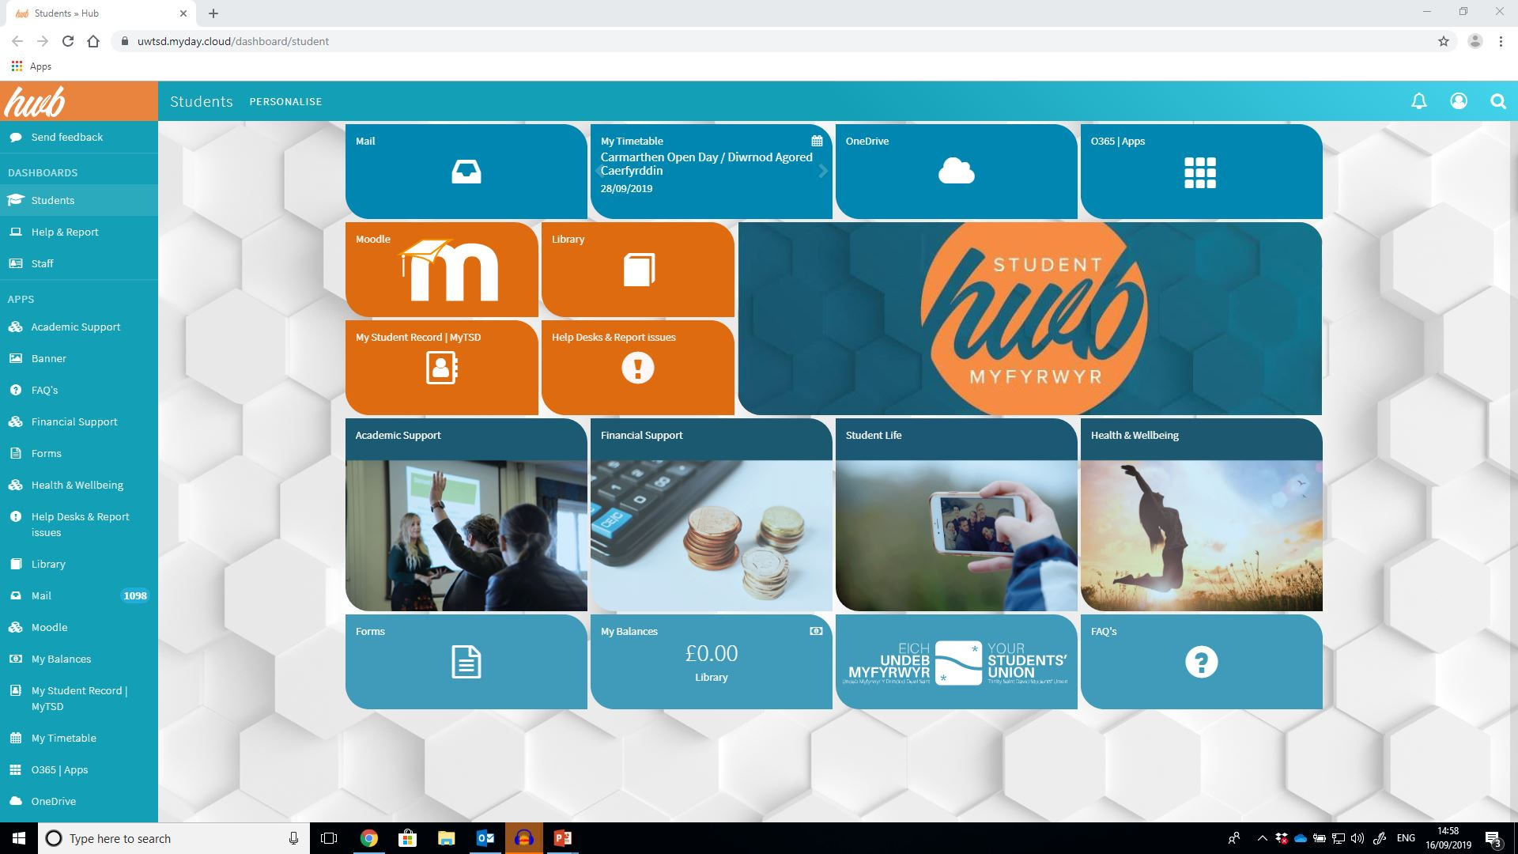

Slide 37
Task
For the rest of the session, familiarise yourself with both Moodle and The HWB.
Speak to the tutor (individually) if you have any issues or problems accessing these VLE portals.

