Slide 1

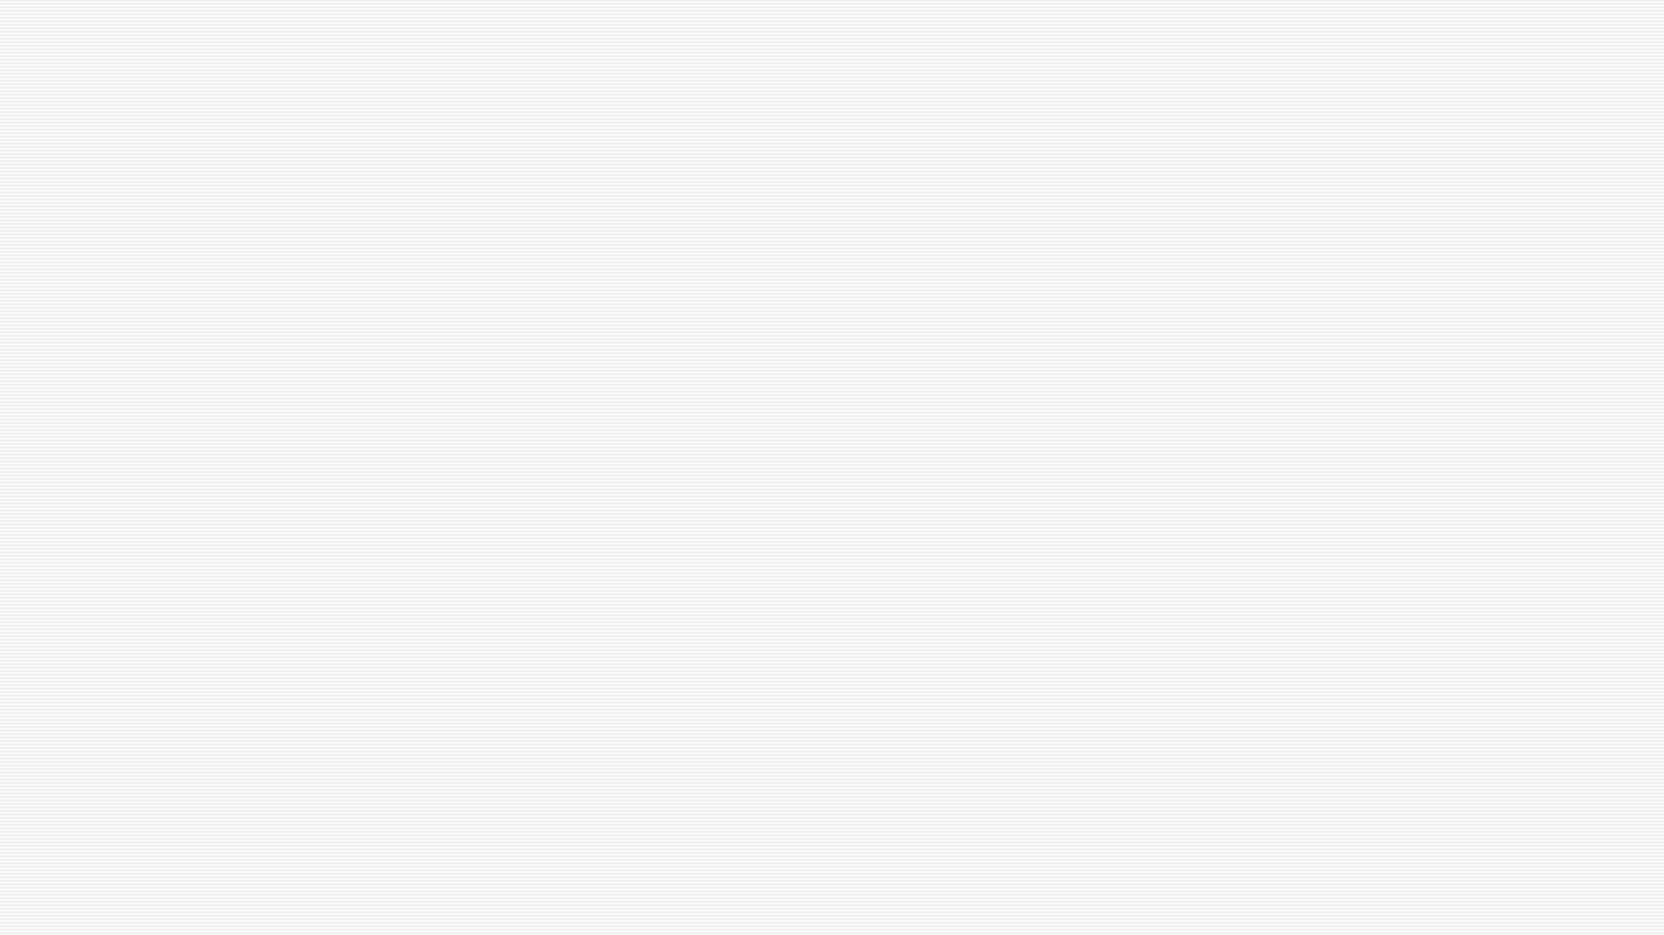

Business Plan group presentation
z
Group D
Lavinia Craiu-Student ID 2021272 L
Daniela Graur-Student ID 2022769
Daniela Cristina Onoleata- Student ID 2022553
Dumitru Boscanean- Student ID 2019593
Gohar Amin Hashmi- Student ID 2021997

Slide 2

GOHAR AMIN HASHMI
z

Slide 3
Executive Summary
◉ We are known by the name of AA Security Company.
◉ We provide all kind of security guards which are talented and professional with license .
◉ We do Hotels , Pubs , Sites , Concerts , Retail shops and others as well .
◉ Our proficiency and Loyalty is what we serve to our clients .

Slide 4
Company Profile
◉ Company is been launched on 2 October 2010 and it is now at this stage that in security market every single person who is in contact with security is known by AA Security Company .
◉ Its not only a company its like a family home with its employees all of the company employees are insured with company .

Slide 5
Products and Services
◉ Our main product in security industry is your believe that how professionally we do our work .
◉ We are honest with our promise of giving our best service as we can .
◉ In AA Security company we only hire people which have minimum 3 years experience and are well trained .

Slide 6

LAVINIA CRAIU
z

Slide 7
WHAT MY BUSINESS IS ?
MY TARGET AUDIENCE.
WHERE I WILL BE PLACING MY BUSINESS?
WHY MY BUSINESS WOULD BE SUCCESSFUL?

Slide 8
Local Factors
-Location
-Staff
-Customers and buying habits
-Equipament and other supplies
-Competitors
The main competitors would be:
-Aldo
-Clarks
-JD
-Foot Locker
-Geox

Slide 9
The name of business is “AA SECURITY”, I have chosen this name because is an easy-to-remember name, it is also a name that gets attention and helps customers to form an impression on what I want to sell. The ideea of my business is to sell a wide selection of shoes from sport shoes to smart shoes. I have chosen to sell shoes because they are always in demand and bought regardless of financial status. My business will focus on selling shoes for all ages an genders since eeveryone wears shoes, some people prefer sport shoes ,some prefer smart shoes ,and some of them do not mind, they only want to wear comfortable shoes, that’s why my business would be perfect for them.
I will be producing high-quality shoes for an accessible price so everyone can afford to buy.
My business will be different from other businesses because I can offer people the option of designing their own shoes
Before locating my business I will consider what other businesses are around and how they can impact on my business.

Slide 10
My business location will be in London because it is a quite populated city and I can get the chance of having more customers. I will be placing my business in places like shopping centres or other busy places , so I can make sure my business will be seen by the customers.
If my business gets successful I will be doing franchises (an authorization granted by a government or company to an individual or group enabling them to carry out specified commercial activities, for example acting as an agent for a company's products) and I will expand it thoughtout England, so the distance will not be a problem for my customers.
My business would be successful since the quality of my products is unique and the price affordable, and simply because it meets the demand of the customers.

Slide 11
Location plays an important role in the smooth running of my business. That’s why I would have to set my business in an easy to access place.
Saff - The success of my business also depends on the experience of the staff I employ, the way they know how to understand what a person wants and that is exactly what they had to offer. When I will be hiring my employees, I will be really careful to hire nice and friendly staff, experienced and always happy to help the customers choose the right shoes for them, so they will be satisfied.
My employees will be wearing decent uniforms, so that the customers won’t complain about it. They have to live local so they won’t have to travel too much to their workplace.

Slide 12
Costumers- The costumers are the heart of a good functioning business, I have to aim to maintain the costs down, so I can keep my customers and also to get loyal customers.
The front of my shop would be carefully organized, the most interesting samples will be placed in display cases, so that the customers would be attracted by its image.
All the shoes will be organized into categories: by age, size, gender, sports shoes and smart shoes to help the costumers find what they are looking for quicker.
According to statistics, 95% of buyers go through the store from left to right. Therefore, I will be locating the most interesting, beautiful and attractive models to the right of the entrance.
Equipament -The equipment for my business won’t be a lot. I will need shelves, podiums for shoes, mirrors, padded chairs, shoehorns.
Competitors- I have to make sure that I am not setting up my business near my competitors, so without competiton ,I can attract more customers as they do not have so many choices.

Slide 13
Costumers- The costumers are the heart of a good functioning business, I have to aim to maintain the costs down, so I can keep my customers and also to get loyal customers.
The front of my shop would be carefully organized, the most interesting samples will be placed in display cases, so that the costumers woulf be attracted by its image.
All the shoes will be organized into categories: by age, size, gender, sports shoes and smart shoes to help the costumers find what they are looking for quicker.
According to statistics, 95% of buyers go through the store from left to right. Therefore, I will be locating the most interesting, beautiful and attractive models to the right of the entrance.
Equipament -The equipment for my business won’t be a lot. I will need shelves, podiums for shoes, mirrors, padded chairs, shoehorns.
Competitors- I have to make sure that I am not setting up my business near my competitors, so without competiton ,I can attract more customers as they do not have so many choices.

Slide 14
DANIELA GRAUR
z

Slide 15

HOW LOCAL FACTORS AFFECT MY BUSINESS?
z

Slide 16
Location- If my business will be placed in low populated areas or far to people houses or their workplaces, they will not be interested on spending time and money traveling that far. This would affect my business since I will not have who to sell my products.
Competitors- We live in a extremely competitive atmosphere. It is really difficult to capture market interest and get customers, but when competitors are around you, this becomes more complicated.
If my business will be placed near my competitors , the risk of lose instead of making a profit will increase , since they are taking away potential customers and grab market-share
Staff- If the customers will not be satisfied by the quality of the services provided by my employees, I will not get good feedbacks from them and the image of my business will be affected.

Slide 17
Staff- If the customers will not be satisfied by the quality of the services provided by my employees, I will not get good feedbacks from them and the image of my business will be affected.
Buying habits- Some people prefer to spend money on things that they think are more important than shoes, that would affect my business since the demand for my products will decrease and the risk of failure will increase.
POLITICAL ISSUES
Brexit Even if my business is placed in UK, most of my resources come from other countries like Italy for example. Since free trade between EU and UK will no longer be established, the costs of my supplies will go up.

Slide 18
Political factors
Government changes in their rules and regulations could have an impact on my business.
Increase and decrease in tax. The government can increase taxes for my business
The political situation of the UK affects its economic setting. The economic environment affects the business performance.
Economic factors
Interest rates (the cost of borrowing money)
If the interest rates are high, I would find it difficult to borrow money to sustain my business growth.
Exchange rates (the value of an individual currency against other currencies)
If m business will buy goods from other countries with a different legal tender, such as US for example, I will have to convert my currency into their currency to make the payment. If the currency is weak I will have to pay out more money.
z

Slide 19
Inflation
Rising prices- If I will be rising the prices of my products, the customers may not be able to spend money on my products anymore and they will look for alternatives, and the risk of losing my customers will increase.
Changing prices- If the prices of my products will change constantly, then I would have to spend more money on creating new price tags.
Social factors (are things that affect peoples lifestyles)
Population growth rate,
social classes and their influence on the society,
average disposable income level,
wealth of people,
economic inequalities,
level of education,
access to education (free, paid).
z

Slide 20
Technological factors( technology trends)
Computer calculation speed/power
The ability of computers to create truly ‘random’ numbers
Engine efficiency
Internet connectivity
Wireless charging
Automation
Security in cryptography
Now days, people prefer to shop online as they find it an easier way to save time ,this could affect my business since there are lots of opportunities to find more goods and better prices than my business offers.

Slide 21
DANIELA CRISTINA ONOLEATA
z

Slide 22
Business environment Analysis:
Porter’s 5 forces
PESTLE analysis
SWOT analysis
Competitor Analysis
Competitor Profile
Competitor Intelligence Mapping
TABLE OF CONTENTS

Slide 23
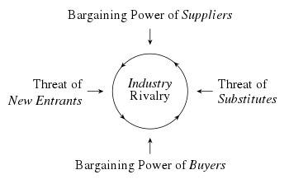
BUSINESS ENVIRONMENT: PORTER’S 5 FORCES ANALYSIS
Forces | Severity Level | Impact
Threats of new entrants | Low | New entrants enter the market with similar sized shoes
Threats of Substitute | Moderate | Shoes are not available in customized form
Rivalry among the businesses | High | Presence of reputed shoe brands offer highly aggressive competition
Bargaining Power of Suppliers | High | With the raise of nation’s economy, suppliers raise the price of the raw materials
Bargaining Power of Buyers | Low | Buyers are required to purchase the shoes as per the displayed price to them

Slide 24



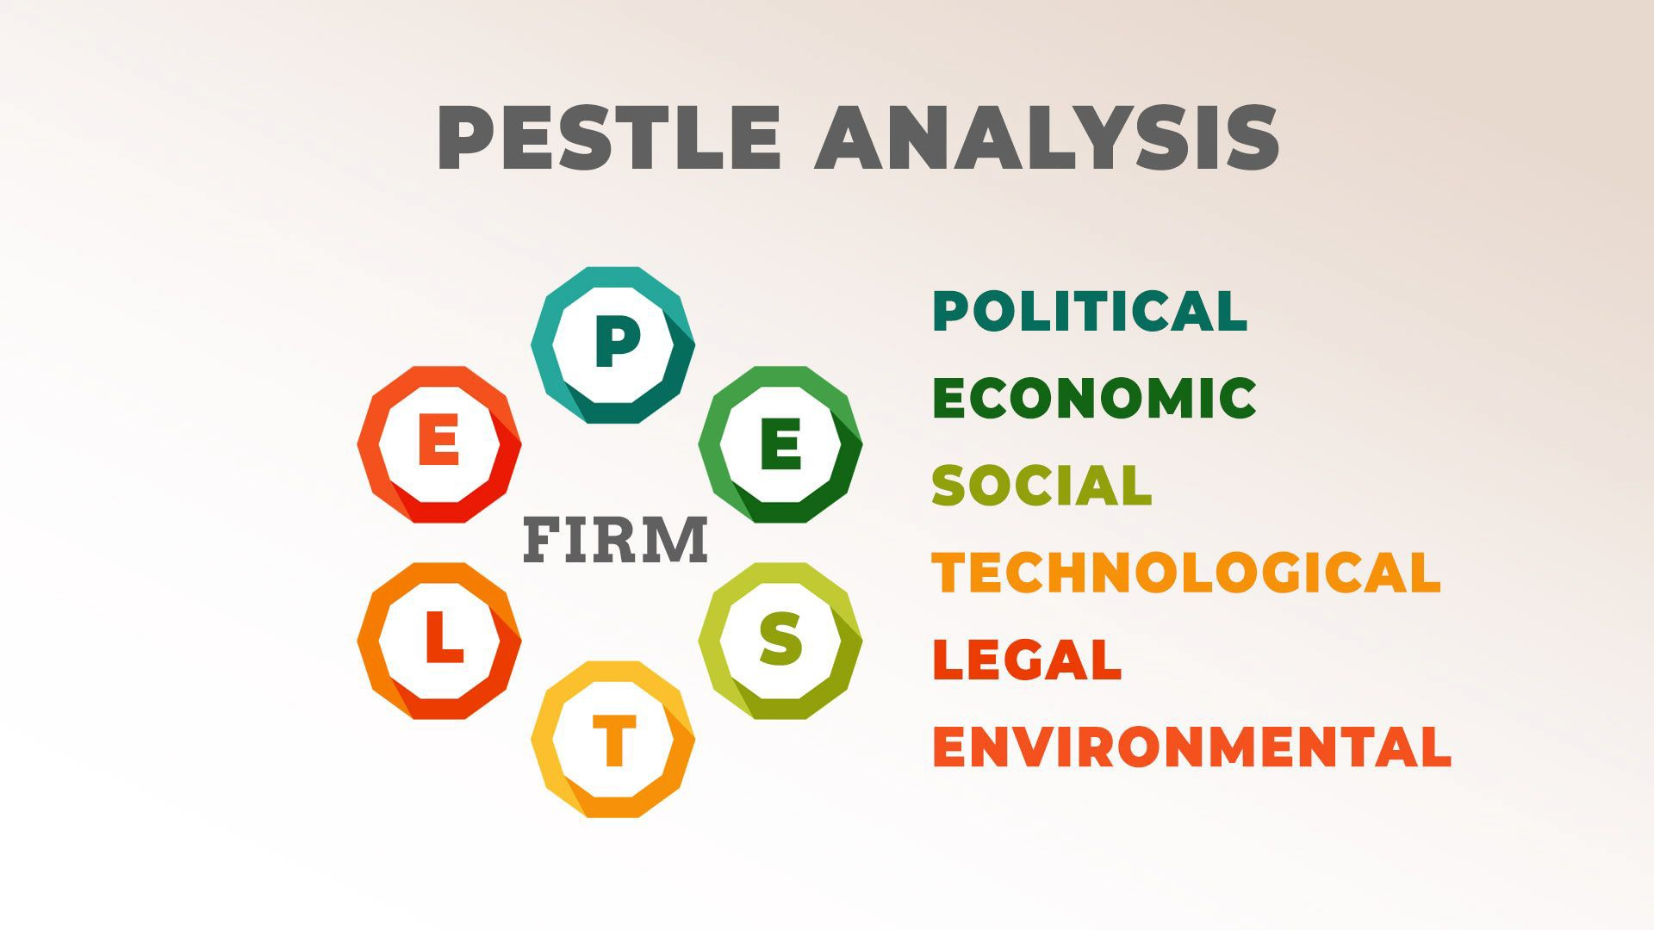
BUSINESS ENVIRONMENT: PESTLE ANALYSIS
Political Factors | Highly active and stable governing body Adaptable taxation policies
Economic Factors | Presence of high GDP growth rate Revenue of footwear industry in UK is 6.77 million US dollars
Social Factors | Presence of high literacy rate Market demand is low
Technological factors | Use of modern technologies like AI, CRM software can boost the business performance
Legal factors | Following equality act 2010 can help the business to avoid discriminatory factors
Environmental factors | Use of natural resources and focusing on low resource consumption level can boost the business revenue margin
Figure 2: Pestle analysis model
(Source: Kara, 2018)

Slide 25
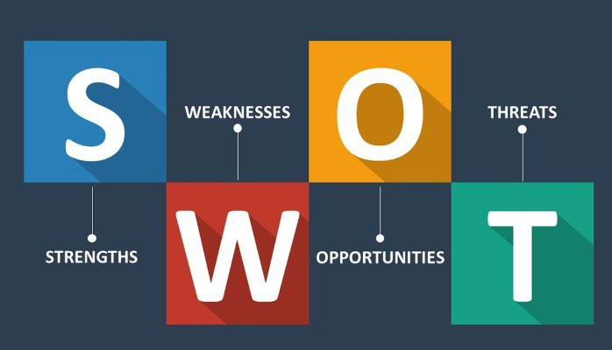
BUSINESS ENVIRONMENT: SWOT ANALYSIS
Strengths Customized size of shoes can attract the market audiences Promote social activities and also assesses multiple CSR activities | Weaknesses Low brand awareness High competition Inefficiency in using advanced technologies
Opportunities Multi-size customized shoes can attract the market audiences Use of modern technologies can increase the business productivity and efficiency margin | Threats Low brand awareness can disallow the business to engage the market audiences Providing shoes at base price can negate the profit margin of the business
Figure 3: SWOT analysis model
(Source: Namin et al. 2019)

Slide 26

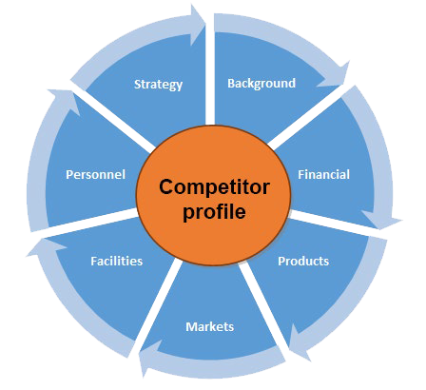
COMPETITOR ANALYSIS: COMPETITOR PROFILE
Key competitors: Loake, Barker and John Lobb
Financial competition: Brands offer shoes in low price
Product variation available in
market: Customized design shoes
Product Strategy to be considered: Multi-sized customized
shoes
Facilities to be considered:
providing superior quality footwear at base price
Figure 4: Competitor Profile (Source: Wen and Fu, 2016)

Slide 27
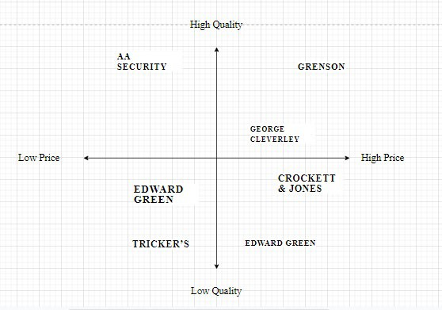
COMPETITOR INTELLIGENCE MAPPING

Slide 28
DUMITRU BOSCANEANU
z

Slide 29
Marketing Strategy
The main focus of the ‘Shoes Store' marketing strategy will be on location. The placement of the shoe store should be in a key location with a lot of foot traffic. Because rent is classified as general expenses, this location will come at a premium and will not be directly tied to the marketing budget.
Advertising is another type of marketing that will be discussed in greater detail later. The goal of the marketing effort is to raise store awareness among the target audience.
There are three basic strategies employed by Shoes Store. The first strategy is to appeal to all types of customers. Shoes Store aspires to educate and train a devoted customer base by creating a welcoming environment.
The second and most crucial tactic is to attract fashion addicts. These clients are well-versed in current trends and the products available in our stores. This particular set of clients plays an essential role in the store. Other clients find fashion addicts' knowledge and experience appealing and interesting.
The third technique is to create a sociable atmosphere for clients. Customers who would not typically consider shopping and chatting while sipping a cup of tea will be attracted by a social environment that provides entertainment. Customers who came to buy a pair of shoes will end up enjoying a cup of our delectable coffee or tea brands
once they arrive at Shoes Store.

Slide 30
Goals of Marketing
· Increase overall sales by 10% yearly during the first three years of operation.
• Diversify your service offerings to protect your company against revenue stream changes.
• Increase customer satisfaction.
• Maintain a team of enthused employees who are eager to share their knowledge of fashion with clients.
• Make the brand so well-known in the community that it becomes a household name.
z

Slide 31
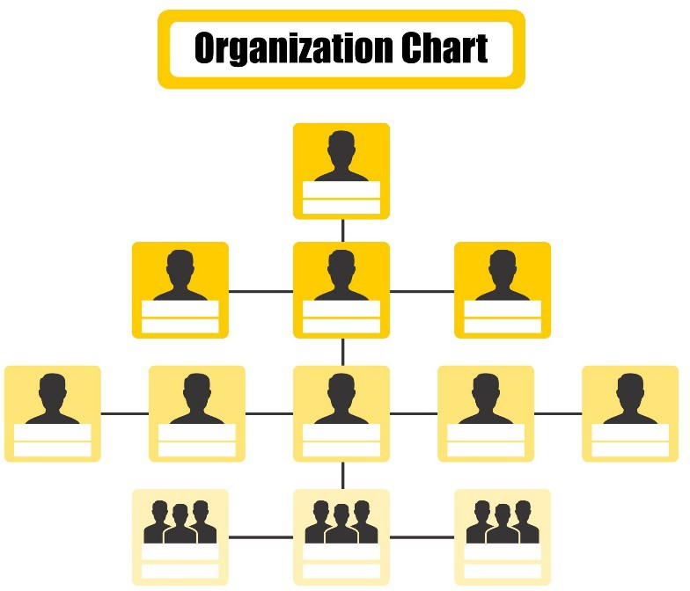
Organization Structure and Management
In the twenty-first century corporate climate, a well- designed organisational structure is a logical prerequisite for success. However, a well-designed management system that can serve as a firm foundation for running the organisation and maintaining advancements is insufficient. A management system must handle all contextual and cultural aspects that may affect a company's functioning in order to be effective.
z

Slide 32
◉ Our biggest achievement is we help our country at the time of Covid 19 when no one is willing to serve for our nation .
◉ We do collective work with Private and Govt. firms as per the requirements .
◉ Our companies complaint rate is 0% that’s why we are known by in Security Industry.

Slide 33
◉ By these services we are known by all in this industry .
◉ We provide services at Marriages , Construction sides , Clubs and pubs , Hotels , Receptions and all kind of retail and we also provide covers as well .
◉ Our specialty is we never step back .

Slide 34
References
BTEC first student book Pearson -2012
Ethical factors –M.twin 2019-available on - https://www.dictionary.com/browse/ethical
Insights in business technology, Alex Steven 2017- available on - https://www.axis.com/blog/secure-insights/tech-trends-2019/
Brexit impact on businesses 2018/05,i information available at- https://geeks.co.uk/2018/05/brexit-impact-uk-businesses-outsourcing-perspective/
PESTLE Analysis 2018, Information available on-
pestleanalysis.com/political-factors-affecting-business/
https://toughnickel.com/business/Business-Competition-The-Good-and-Bad-Effects- for-Businesses-Large-and-Small
https://www.reference.com/world-view/definition-social-trends-30f79ce0e0635afd
https://blog.constructaquote.com/main-risks-associated-running-business/

Slide 35
Gijsenberg, M.J. and Nijs, V.R., 2019. Advertising spending patterns and competitor
Goyal, A., 2020. A Critical Analysis of Porter’s 5 Forces Model Advantage. Goyal, A.(2021). A Critical Analysis of Porter’s, 5.
Kara, E., 2018. A contemporary approach for strategic management in tourism sector: pestel analysis on the city Muğla, Turkey. İşletme Araştırmaları Dergisi, 10(2), pp.598-608.
Namin, F.N., Askari, H.R., Ramesh, S., Hassani, S.M.M., Khanmohammadi, E. and Ebrahimi, H., 2019. Application of ANP network analysis process method in SWOT model. Civil Engineering Journal, 5(2), pp.458-465.
Statista, 2020. The 20 countries with the largest gross domestic product (GDP) in 2020. Available at: https://www.statista.com/statistics/268173/countries-with-the-largest-gross- domestic-product-gdp/ [Accessed on: 15th August 2021].
Wen, Z. and Fu, S., 2016. Turing instability for a competitor-competitor-mutualist model with nonlinear cross-diffusion effects. Chaos, Solitons & Fractals, 91, pp.379-385.

