Slide 1
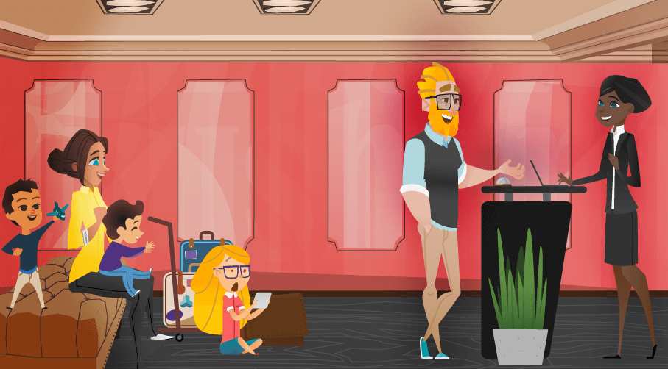
BMIH4003-Hospitality and Guest Services
Student Name: Mohammed Somru Miah
Hotel Brand: JW Marriott

Slide 2
INTRODUCTION
TARGETED MARKET OF JW MARRIOTT
NATURE, SCOPE AND ROLE OF THE GUEST SERVICES AND FACILITIES
TABLE OF CONTENTS
ROLE AND FUNCTION OF GUEST SERVICES
IMPORTANCE OF HOSPITALITY AND HOW HOTELS MEET/EXCEED GUEST EXPECTATIONS
CONCLUSION
REFERENCES

Slide 3
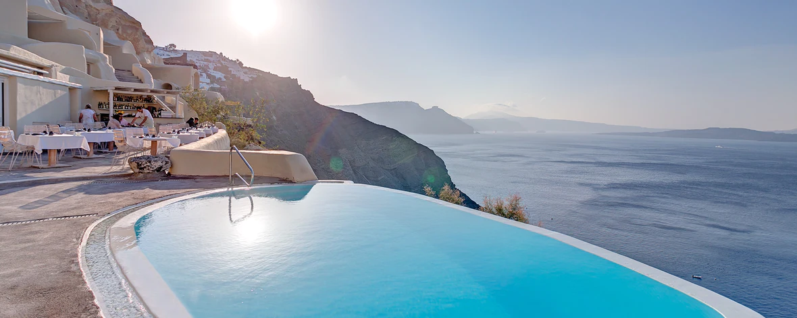

Marriott International owns the luxury hotel brand JW Marriott. In Washington, D.C., in 1984 the first JW Marriott hotel start operating , and the brand was called in honor of J.W. Marriott, the founder of the Marriott Corporation. Marriot International was established in 2017, headquarter situated in Bethesda, Maryland, USA . (Luxury Hotels & Resorts: Mindful Experiences, 2022)
Notes:
Marriott International owns the luxury hotel brand JW Marriott. In Washington, D.C., in 1984 the first JW Marriott hotel start operating , and the brand was called in honor of J.W. Marriott, the founder of the Marriott Corporation. Marriot International was established in 2017, headquarter situated in Bethesda, Maryland, USA (Luxury Hotels & Resorts: Mindful Experiences, 2022)

Slide 4
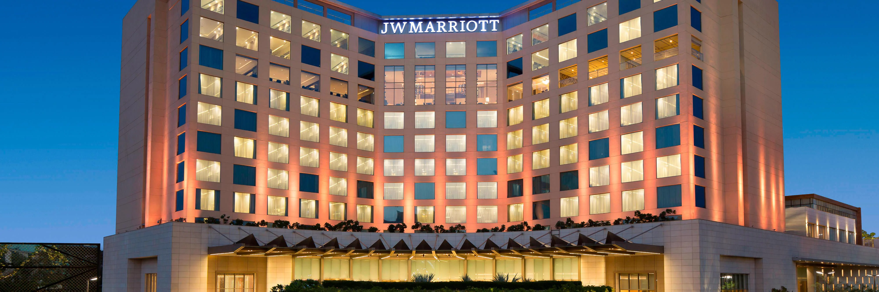
TARGET MARKET OF JW MARIOTT(Xaif, 2022)
As a luxury brand, Marriott International created the JW Marriot with the purpose of cuisine to guests looking for a peaceful and luxurious accommodation experience. (Garrido, 2012)
Notes:
As a luxury brand, Marriott International created the JW Marriot with the purpose of cuisine to guests looking for a peaceful and luxurious accommodation experience (Garrido, 2012)

Slide 5
NATURE, SCOPE AND ROLE OF THE GUEST SERVICES AND FACILITIES:
2
01
02
03
04
05
Generates an uncomplicated, individualized practice.
Decisions in Marriott's customer experience strategy are based on data.
Marriott gives guests full package travel experiences.
Marriott concerned about their workers.
Marriott maintains its focus on increasing customer loyalty.
Notes:
NATURE, SCOPE AND ROLE OF THE GUEST SERVICES AND FACILITIES:
1. Marriott generates an uncomplicated, individualized practice.
Customers' expectations are shifting, even in the hotel and hospitality sectors. Clients assume the same custom-made, prompt, and data-driven practice from each business. Marriott rises to the occasion.(Just a moment, 2022)
2. Decisions in Marriott's customer experience strategy are based on data.
Marriott recognizes the significance of knowing their clients. They also use data with care to improve the customer experience. Marriott learns from their customers through direct survey feedback. (Experience | Services & Facilities, 2021)
3. Marriott gives guests full package travel experiences.
Marriott Bonvoy, the company's new rewards program, demonstrates that the company maintenances about further service than just giving you a room for a days. They plan to offer a comprehensive tour experience.
4. Marriott concerned about their workers.
The success of Marriott exemplifies this. Marriott has many devoted employees as well as devoted customers. They put money into training and development to give them opportunities to grow with the company.
5. Marriott maintains its focus on increasing customer loyalty.

Slide 6
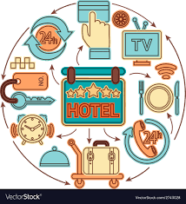
NATURE OF THE SERVICE:
BASIC
ADDITIONAL
BASIC which includes room service
which includes room service
Additional includes the following (Ruby and Vogelsberg, 2018):
Dry-cleaning, laundry, and repairing footwear and clothing;
Beauty saloons ;A pool, sauna, and bath; Playgrounds, gym, and pool; Gift and flower delivery;
Using a safety deposit box or luggage locker;
Renting of sporting goods and household appliances;
Service for guided tours;
Leasing a conference room or other space.
Notes:
Room service
Dry-cleaning, laundry, and repairing footwear and clothing;
Beauty saloons
A pool, sauna, and bath;
Playgrounds, gym, and pool;
Gift and flower delivery;
Using a safety deposit box or luggage locker;
Renting of sporting goods and household appliances;
Service for guided tours;
Leasing a conference room or other space.

Slide 7

ROLE AND FUNCTION OF GUEST SERVICES
Develop and promote hotel services and amenities to increase occupancy and profitability
Keep track of the supplies that are needed,
Create strategies for the guest service department's finances and operations
GUEST SERVICE
Handle guest complaints and provide service replacements or refunds if necessary.
Oversee all front office activities
Making sure that hotel amenities like the pool, spa, gym, and valet services are safe and secure
Notes:
Developing and promoting hotel services and amenities to increase occupancy and profitability
Creating strategies for the guest service department's finances and operations
Overseeing all front office activities
Handling guest complaints and provide service replacements or refunds if necessary (Ford and Sturman, 2019)
Keeping track of the supplies that are needed, and
Making sure that hotel amenities like the pool, spa, gym, and valet services are safe and secure

Slide 8

IMPORTANCE OF HOSPITALITY AND HOW HOTELS MEET/EXCEED GUEST EXPECTATIONS
The Latin word "hospes," that includes "visitors" and "strangers," is the basis of the term "hospitality," which includes "welcoming" or "offering a home and other services away from home." Hospitality encompasses all aspects of warmth, respect, and even safety; It encourages cultural understanding and appreciation. (Bagdan, 2019)
Notes:
The Latin word "hospes," that includes "visitors" and "strangers," is the basis of the term "hospitality," which provides for "welcoming" or "offering a home and other services away from home." Hospitality encompasses all aspects of warmth, respect, and even safety; It encourages cultural understanding and appreciation. (Bogdan, 2019)

Slide 9

BENEFITS OF BEING HOSPITABLE: (Solomon and Humler, 2019)
It makes interpersonal relationships better.
Enables one to view things from a new perspective
Stimulates reflection on what they has to offer
Strengthens the support network
It gives a chance to be an example to others
Demonstrates one's importance to others
Notes:
Benefits of being hospitable
It makes interpersonal relationships better.
Enables to view things from a new perspective
Stimulates reflection on what one has to offer
Strengthens the support network
It gives a chance to be an example to others
Demonstrates one's importance to others

Slide 10

MOST COMMON GUEST EXPECTATIONS
First and foremost, seeking an enjoyable and stress-free experience to share with their loved ones. (Arjona, 2019)
In order to enhance the guest experience, they suggested the following innovations as solutions:
An interactive map of the park
Notifications via an app for a mobile or tablet
An individual itinerary
The capacity to pay without cash
Confirm safety and cleanliness
Information about security measures
Even though so much of the guest experience is now digital, visitors still feel at ease when they can immediately locate helpful staff members when they have a problem.
Notes:
MOST COMMON GUEST EXPECTATIONS
First and foremost, seeking an enjoyable and stress-free experience to share with their loved ones (Arjona, 2019). To enhance the guest experience, they suggested the following innovations as solutions:
An interactive map of the park
Notifications via an app for a mobile or tablet
an individual itinerary
The capacity to pay without cash
Confirm safety and cleanliness
Information about security measures
Even though so much of the guest experience is now digital, visitors still feel at ease when they can immediately locate helpful staff members when they have a problem (Solomon and Humler, 2019).

Slide 11

MEET OR EXCEED THE EXPECTATIONS OF GUESTS
Appropriate, skilled staff, regulations, and policies can do so. The guidelines that can help improve the guest experience are listed below (Ford and Sturman, 2019):
1. Digital solutions for all guests
2. Always approach a situation with a proactive attitude and make the guest feel confident
3. Make the guests feel appreciated by practicing personalization
4. Be willing to assist
5. Request feedback on a regular basis.
Suggestions for getting feedback:
After a guest's visit, send them a warm, personalized email including a link to a customer survey or a Facebook review page so the guest can quickly click through. Keep the message short and simple. Try SMS messaging.
Notes:
Appropriate, skilled staff, regulations, and policies can do so. The guidelines that can help improve the guest experience are listed below
1. Digital solutions for all guests
2. Always approach a situation with a proactive attitude and make the guest feel confident
3. Make the guests feel appreciated by practicing personalization
4. Be willing to assist
5. Request feedback regularly.
Suggestions for getting feedback
After a guest's visit, send them a warm, personalized email including a link to a customer survey or a Facebook review page so the guest can quickly click through. Keep the message short and simple. Try SMS messaging.

Slide 12
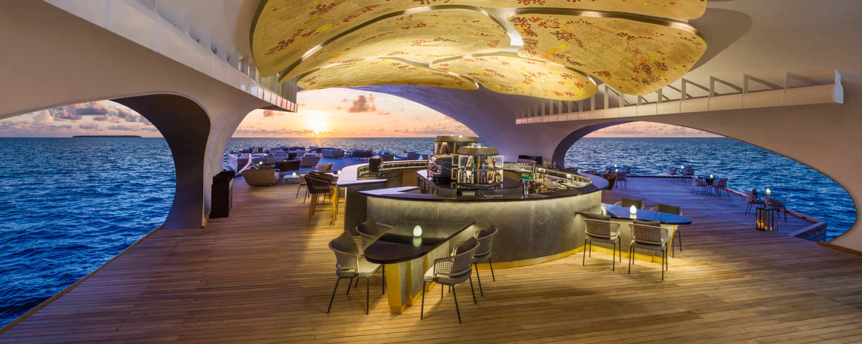
CONCLUSION
JW Marriott is frequently mentioned in the media and is one of the greatest recognized hotels in the flora and fauna. Marriott International has almost over 7,000 properties in 100 countries, Marriott International's link is also outstanding, which goes without saying.
Notes:
JW Marriott is frequently mentioned in the media and is one of the greatest recognized hotels in flora and fauna. Marriott International has almost over 7,000 properties in 100 countries, Marriott International's link is also outstanding, which goes without saying.

Slide 13
REFERENCES
Bagdan, P. (2019) Guest Service in the Hospitality Industry. 2nd edn. Kendall Hunt Publishing.
Arjona, M.F. (2019) Guest Service in the Hospitality Industry. Society Publishing.
Luxury Hotels & Resorts: Mindful Experiences (2022). Available at: https://jw-marriott.marriott.com/.
Garrido, R (2012), Hilton, Marriott and IHG Hotel brand market segments
Just a moment... (2022). Available at: https://in.indeed.com/cmp/Jw-Marriott/reviews?fjobtitle=Guest+Service+Agent.
Experience | Services & Facilities (2021). Available at: https://marriott-hotels.marriott.com/experience/.
Ford, R. and Sturman, M. (2019) Managing Hospitality Organizations: Achieving Excellence in the Guest Experience. 2nd edn. SAGE Publications, Inc.
Solomon, M. and Humler, H. (2019) The Heart of Hospitality: Great Hotel and Restaurant Leaders Share Their Secrets. Reprint. SelectBooks.
Ruby, P. and Vogelsberg, D. (2018) Creating Guests for Life: Lessons Learned and Rules to Follow for Improving Service. 1st edn. Joshua Tree Publishing.
Xaif (2022) Detailed marketing strategy of Marriott International - A Case Study, IIDE. Available at: https://iide.co/case-studies/marketing-strategy-marriott-international/ (Accessed: January 28, 2023).

Slide 14


