Slide 1
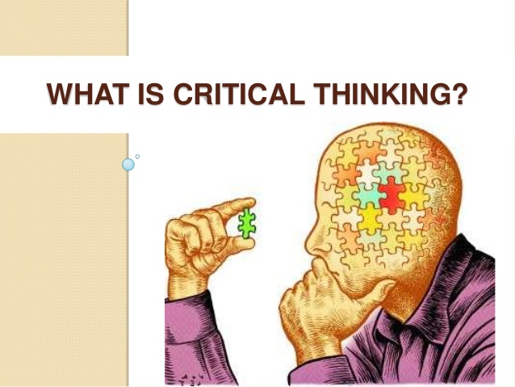
Introduction to Critical Thinking
According to Dr Baerjee, R. (2019)
“Critical thinking is a meta-skill”, it rules a persons thought and mind to present things that are rational and that it makes sense. Also people with critical thinking developed, can easily upgrade there own knowledge and easily engage in independence self-learning.
Why is it important:
A person with critical thinking can identify logical errors taking the points and view into account as well this helps the person to increase and improve his or her core skills.
According to Skills you need.com.(2019)
Critical thinking is to think about the scenario your are in and what can you do for the best possible outcome.
Critical thinkers are able to find the links between ideas, take all things into account and give a conclusion and identify the irrelevant and irrational points made in the argument. Also critical thinkers can fulfil things that are occupying there minds in the best possible way.
Four skills for Critical Thinking:
Reading
Planning
Organisation
Research
Research
What is Critical research paradigm?
According to Basnet, M.(2011)
The model for critical research is a rising research pattern in “educational research” which targets to increase “democracy, cultural, ethical and socially oriented believes and system.”
Reading
According to Division of Student Life(2019)
Always be prepared for assessments and revise, finishing your reading can also prove beneficial as your range of vocabulary can be extended which can help you get better results on your assessment also after classes try to read over your work once you are done to clearly remember what things you had learnt.
Planning
According to Hu, James. (2017) “Studies at university of California, Berkley”, You use critical thinking with modesty, awareness and eventuality, experiments, risk analysis, not always rely on the internet.
Conclusion
Anyone that has developed critical thinking has the ability to find the best possible outcome in most situations.
Reading in critical thinking is very important as every time you finish off reading then your vocabulary and complexity of the work that you are doing. Critical thinkers do not always rely on the things on the internet but by thinking about what has been given and take risks and do experiments by planning. Being a critical thinker also means that the whole organisation has to be heard in order to make a conclusion using all the points that had been made in the argument,
The paradigm is an upcoming “educational research” that targets multiple things.
Organisation
According to Middlebury College (2017)
Developing thinking skills you need to hear the whole organisations point of view on the topic you are talking about as well.
Bing.com image

Slide 2
Fleming, G. (2018) Thoughtco. Introduction to critical thinking
Available at: https://www.thoughtco.com/introduction-to-critical-thinking-1857079
(Accessed: 20/10/2019)
Dr Baerjee, R. (2019) bright hub Education.
Available at: https://www.brighthubeducation.com/teaching-methods-tips/97818-the-importance-of-critical-thinking/
(Accessed: 20/10/2019)
Division of Students life. Critical thinking, reading and note taking
Available at: https://www.deakin.edu.au/students/studying/study-support/academic-skills/reading-and-note-taking
(Accessed:21/10/2019)
Hu, J. (2017) Studied at university of California, Berkeley. How do you apply critical thinking to contingency planning?
Available at: https://www.quora.com/How-do-you-apply-critical-thinking-to-contingency-planning
(Accessed: 21/10/2019)
Middlebury College (2017) Critical Thinking skills and organization Essay
Available at: https://speedypaper.com/essays/101-critical-thinking-skills-organization-essay
(Accessed:21/10/2019)
Critical Thinking Skills.(2019)
Accessed at: https://www.skillsyouneed.com/learn/critical-thinking.html
(Accessed: 21/10/2019)
Basnat, M. (2011) what is critical research paradigm?
Available at: https://manju-basnet.blogspot.com/2011/05/what-is-critical-research-paradigm.html
(Accessed: (21/10/2019)
Bing.com image.Critical Thinking skills
Available at: https://image.slidesharecdn.com/criticalthinkingskills-130418140401-phpapp02/95/critical-thinking-skills-3-638.jpg?cb=1366294164
[image]
Basnat, M. (2011)
Available at : manju-basnet.blogspot.com/2011/05/what-is-critical-research-paradigm.html
(Accessed : 23/10/2019)
Jarche, H. (2010)
Available at: https://jarche.com/2010/03/critical-thinking-in-the-organization/
(Accessed: 23/10/2019)
Intra focus (2013)
Available at : https://www.intrafocus.com/2013/07/strategic-planning-7-critical-success-factors
(Accessed: 23/10/2019)
Doyle, A. (2019)
Available at: https://www.thebalancecareers.com/critical-thinking-definition-with-examples-2063745
(Accessed:23/10/2019)
The Skills We Need for (no date)
Available at: https://www.skillsyouneed.com/learn/critical-thinking.html
(Accessed:23/10/2019)

