Slide 1

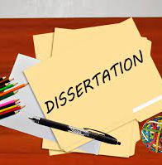

BMPL6008
Independent Project
Methodology Workshop
Mike Durke

Slide 2

Aims
Understand the term ‘Methodology’ & ‘Research methods’
List the 3 types of Data Collection
Describe the difference between ‘Quantitative & Qualitative data’, ‘Primary & Secondary data’, ‘Descriptive & Experimental Data’
List the different types of methods for data collection
List the 4 main methods of data analysis
How to structure your ‘methodology chapter’

Slide 3
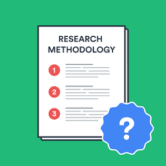
Methodology v Research methods
Methodology is:
‘ a set of systems, methods, procedures or rules that is used to conduct a structured research process for a dissertation’
‘the science of dealing with principles of procedure in research and study’
‘A system of ways of doing, teaching or studying something’
It explains what the exact activities and processes of your research is , through what methods you will be measuring the data and how you will interpret your results and outcome
Notes:
So lets begin by trying to define ‘methodology’ and ‘research methods’
Methodology is:
a set of systems, methods, procedures or rules that is used to conduct a structured research process for a dissertation’ or ( Dissertation-help.co.uk. 2022)
‘a system of ways of doing, teaching or studying something’ ( Cambridge English Dictionary online, 2022)
It explains what the exact activities and processes of your research is , through what methods you will be measuring the data and how you will interpret your results and outcome. ( dissertation.help.co.uk, 2022)
Research methods are:
‘ specific procedures for collecting and analysing data.
Integral part of research design ( Scribbr, 2022)

Slide 4
Methodology v Research methods
Research methods are:
‘ specific procedures for collecting and analysing data.
Integral part of research design’.
Notes:
So lets begin by trying to define ‘methodology’ and ‘research methods’
Methodology is:
a set of systems, methods, procedures or rules that is used to conduct a structured research process for a dissertation’ or ( Dissertation-help.co.uk. 2022)
‘a system of ways of doing, teaching or studying something’ ( Cambridge English Dictionary online, 2022)
It explains what the exact activities and processes of your research is , through what methods you will be measuring the data and how you will interpret your results and outcome. ( dissertation.help.co.uk, 2022)
Research methods are:
‘ specific procedures for collecting and analysing data.
Integral part of research design ( Scribbr, 2022)

Slide 5
Methodology and Methods
Methodology – overarching strategy and rationale of your research project – a study of the methods, theories and principles
Methods – specific tools and procedures data use to collect and analyse

Slide 6
Planning your research methods
Step 1 - Deciding on how you will collect data
Methods will depend on the data required to answer your research question:
Qualitative v quantitative data
Primary v secondary data
Descriptive v experimental
Notes:
Research methods are specific procedures for collecting and analysing data. Developing your research methods is an integral part of your research design. When considering your methods around how you will plan your research , two key areas to consider:
Firstly - Step 1 - Deciding on how you will collect data
Methods will depend on the data required to answer your research question:
Qualitative v quantitative data – will your data take the form of words or numbers?
Primary v secondary data – will you collect original data yourself or data that has already been collected by someone else?
Descriptive v experimental – will you take measurements of something as it is or will you undertake an experiment
(scribbr, 2022)

Slide 7
Planning your research methods
Step 2 – how will you analyse the data
Quantitative data – you can use statistical analysis methods to test relationships between variable
Qualitative data – you can use methods such as thematic analysis to interpret patterns and meanings in the data
Notes:
Secondly - Step 2 – how will you analyse the data
Quantitative data – you can use statistical analysis methods to test relationships between variable
Qualitative data – you can use methods such as thematic analysis to interpret patterns and meanings in the data
(scribbr, 2022)

Slide 8

Methods for collecting data
Qualitative v Quantitative data
Primary v Secondary data
Descriptive v experimental data
Data is the information you collect for the purpose of answering your research question
Influenced by the aims of your research
Notes:
Data is the information you collect for the purpose of answering your research question
Keep referring back to your research question to make sure that what you are doing/your chosen methods will lead you to that answer
The type of data you need depends on the aims of your research
It could be any of the following:
1. Qualitative v quantitative data
2. Primary v secondary data
3. Descriptive v experimental data

Slide 9
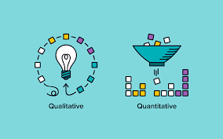
Qualitative v Quantitative data
Qualitative data – deals with words
Quantitative – deals with numbers
Notes:
Your choice of qualitative or quantitative data collection depends on the type of knowledge you want to develop
What do we mean by ‘QUALITATIVE’ and ‘QUANTITATIVE’
In its simplest form:
Questions about ideas, experiences and meanings or to study something that can’t be described numerically, collect – QUALITATIVE data
If you want to develop a more systematic/automatic understanding of a subject, or your research involves hypothesis testing, collect – QUANTITATIVE data
So what are the pros and cons of each data method – take 5 mins to discuss with your colleague

Slide 10
Qualitative v Quantitative
 | Pros | Cons
Qualitative | Flexible – you can often adjust your methods as you go to develop new knowledge Can be conducted with small number of participants | Can’t be analysed statistically or generalised to broader populations Difficult to standardise research
Quantitative | Can be used to systematically describe large collections of things Generates reproducible knowledge | May require statistical training to analyse data Requires larger number of participants/sample
Notes:
Here are some others ( source Scribbr, 2022 online)

Slide 11

Primary v Secondary data
Primary data – any new or original information that you collect for the purposes of answering your research question
Secondary data – information that has already been collected by other researchers
Notes:
Question: What is the difference between PRIMARY and SECONDARY data?
PRIMARY is any original or new information that you collect for the purpose of answering your research question ( e.g. surveys, observations, experiments)
SECONDARY is information that is already out there, which has been collected by other research that has been done ( previous studies, Govt stats etc)
So what are the pros/cons of each?

Slide 12
Primary v Secondary Data
 | Pros | Cons
Primary | Can be collected to answer your specific question You have control over the sample methods Up to date data | May be expensive/time consuming to collect Need to know data collection methods
Secondary | Easier and quicker to access Can collect data over a longer timescale and bigger geographical area | No control over how data was generated Requires extra processing to make sure it works for your analysis Could be too old
Notes:
Content taken from Scribbr , 2022

Slide 13
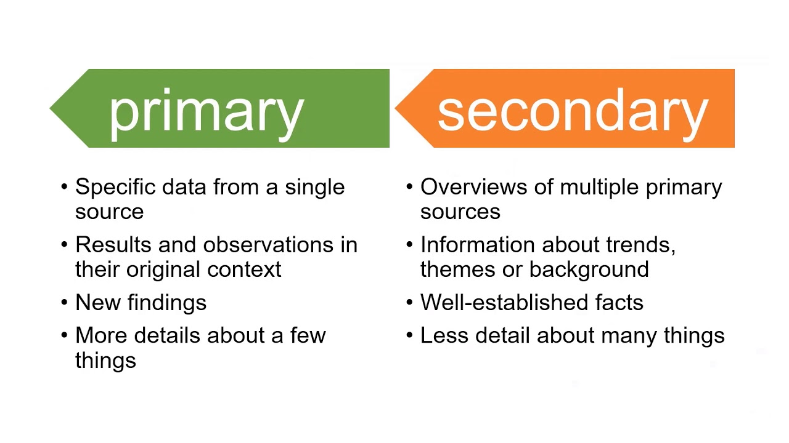
Notes:
Source: QUT Library , Youtube 2020

Slide 14

Descriptive v Experimental Data
Descriptive research – you collect data about your study subject without interviewing. Validity depends on sampling method.
Experimental research – you systematically intervene in a process and measure the outcome. Validity depends on experimental design.

Slide 15
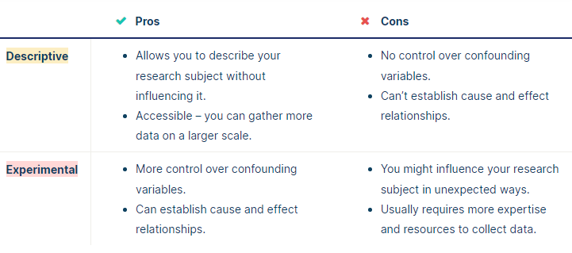
Descriptive v Experimental Data
Notes:
Source; Scribbr , online 2022

Slide 16
Research methods for collecting data
Research method | Primary or secondary? | Qualitative or quantitative? | When to use
Experiment | Primary | Quantitative | To test cause-and-effect relationships
Survey | Primary | Quantitative | To understand general characteristics of a population
Interview/focus group | Primary | Qualitative | To gain more in-depth understanding of a topic
Observation | Primary | Either | To understand how something occurs in its natural setting
Literature review | Secondary | Either | To situate your research in an existing body of work, or evaluate trends
Case study | Either | Either | To gain understanding of a specific group or context (often when you do not have resources for a large study

Slide 17

Methods for analysing data
Qualitative analysis methods – used to understand words, ideas and experiences.
  It relies upon the researcher’s judgement – reflect carefully on your choices and assumptions.
Quantitative analysis methods – uses numbers and statistics to understand frequencies, averages and connections
  As the data is collected and analysed statistically, the results are easily standardised and shared
Notes:
Your data analysis methods will depend on the type of data you collect and how you prepare it for analysis.
Qualitative analysis:
Data can be analysed both quantitatively and qualitatively. e,g survey responses could be analysed qualitatively by studying the meanings of responses or quantitatively by studying the frequency of responses to a question.
It relies upon the researchers judgements – so its good to reflect carefully on your choices and assumptions. It tends to be quite flexible.
Quantitative analysis:
Uses numbers and statistics to understand frequencies, averages in descriptive studies and correlations or cause and effect relationships in experiments

Slide 18
Methods for analysing data
Statistical analysis
Meta-analysis
Thematic analysis
Content analysis
Notes:
The 5 different methods for analysing data
How many have you heard of?
What do you think they mean?

Slide 19
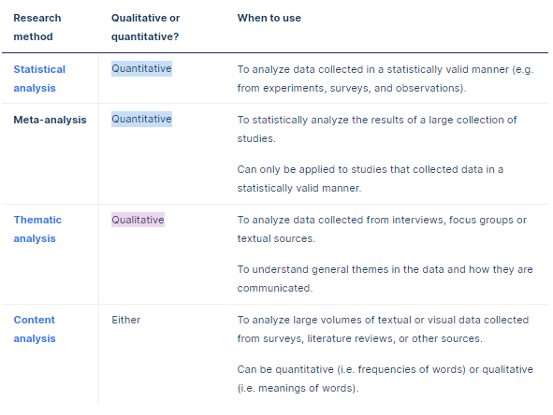
Methods for data analysis

Slide 20
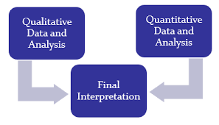
Mixed Methods Research
Mixed methods research is where you use both qualitative and quantitative data collection and analysis methods to answer your research question
Notes:
What about mixed methods approach to your research – what do you think that is ?

Slide 21
Writing your Methodology Chapter
All dissertation projects need to be clear on data collection
Include this chapter if undertaking – Primary/secondary/case study
It is the ….who, when, where, why…. of your research

Slide 22
What needs to be included
1.Introduction to the chapter
2. Research strategy
3. Data collection
4. Data Analysis
5. Limitations
Notes:
Lets look at what needs to be included in this chapter and how to structure it
5 areas to cover:
Introduction
Your research strategy
Data collection
Data analysis
Any limitations or problems that you encountered throughout your research

Slide 23


Introduction
Brief introduction to your subject area
Remind reader of your objectives
Explain why you are undertaking this research
  Reflection on literature review
  Gaps within the research
  New legislation
Notes:
Given the word count this subheading will not be very long
What do you think needs to be in your introduction?

Slide 24

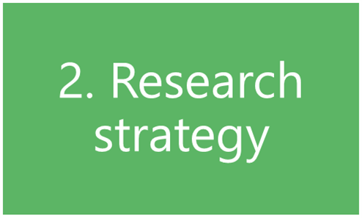
Research Strategy
What research methods have you used ( survey, questionnaire, case study etc)
Why did you choose that strategy/model?
How did you choose your sample (size/participants)?
NB – don’t spend too much time writing about research methods in general
Notes:
Considering the next sub heading of the chapter – what would you consider writing here?

Slide 25

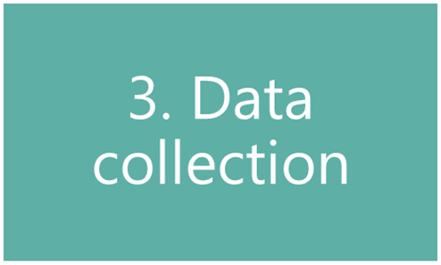
Data Collection
How will you analyse your findings?
  Quantitative = numbers
  Qualitative = focus on words
  Themes
NB – don’t talk about your findings yet!
Notes:
Next sub-heading – data collection – what do you think you need to write about here?

Slide 26

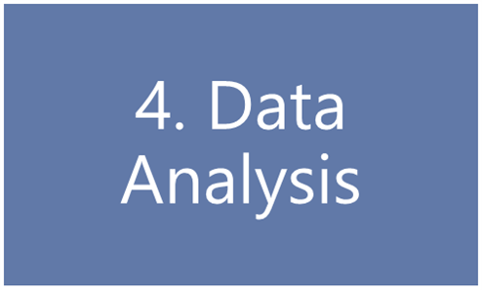
Data Analysis
How you prepared the data before analysis
Quantitative data:
  Any software used
  any statistical methods used
Qualitative data:
  Any coding or categorising of themes/ideas
Notes:
4th sub-heading – data analysis
What will you write here?

Slide 27

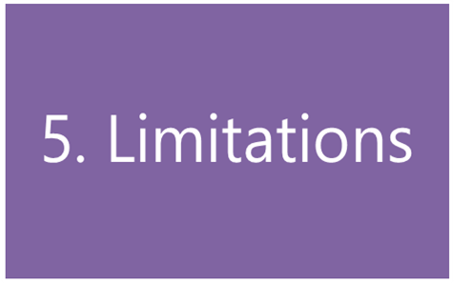
Limitations
Do you foresee any limitations or problems with undertaking your research?
Any limitations to your research strategy
  Access to participants
  Limited data collection
Notes:
Final sub-heading
What will you write here?
Remember that you are writing about limitations/problems in relation to your data gathering only – not general problems like time management
Questions to ask ( Biggam, 2015. p194)
What are the known criticisms of my chosen research strategy?
Is the approach to my data collection limited in any way? ( e.g. why use q’aires when interviews may give more meaningful info)
Is my sample population big enough – too big?
Is it valid? ( have I argued successfully that my methods are appropriate to achieving my objectives)
Is it free from bias and is it fair?
You must show how you have addressed any limitations that you highlight. Avoid just producing a list – not acceptable
Also – is time management a limitation?
Time limits is a common limitation expressed by students – especially when deadlines are fast approaching – these are more to do with a lackof time management and planning
Leave time for your empirical work and plan for any mishaps like people not available

Slide 28

Tips for writing a strong methodology
Don’t just describe – explain how and why you applied them and demonstrate how it was conducted
Focus on your objectives and research question- show why your methods suit your objectives. Keep relating your choices back to the purpose of your research
Cite relevant sources
Write for your audience – consider how much info you need to give. Clear – structured – argues your approach.
Don’t just list details and procedures
Discuss any difficulties you encountered and how you dealt with them – include how you minimised impact as a result or changed methods.
Notes:
And finally some tips for writing a strong methodology chapter:
Don’t just describe – explain how and why you applied them and demonstrate how it was conducted
Focus on your objectives and research question- show why your methods suit your objectives. Keep relating your choices back to the purpose of your research
Cite relevant sources
Write for your audience – consider how much info you need to give. Clear – structured – argues your approach.
Don’t just list details and procedures
Discuss any difficulties you encountered and how you dealt with them – include how you minimised impact as a result or changed methods.

Slide 29

Sources
Burnett, J. (2009) Doing Your Social Science Dissertation. London: SAGE Publications.
Denscombe, M. (2012) Research proposals a practical guide. Berkshire, McGraw Hill Open University Press.
Walliman, N. (2006) Social research methods. London: SAGE.
https://www.sagepub.com/sites/default/files/upm-binaries/18533_Chapter3.pdf
Notes:
Some useful sources for you – others will be added to Moodle over the next few weeks

Slide 30


