Slide 1





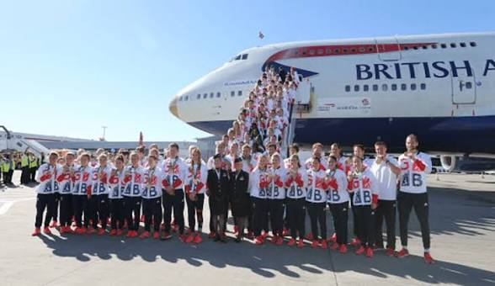

Module code: LCLM 5005
Programme: BA (Hons) Leadership and Management Skills for the Workplace
Module: Organisational Culture
Task 2
Title: Organisational Culture and Its Influence on British Airways
Student name: Andreea Mihaela rusu
NO: 2408444
Lecturer: Ibrahim Rufai

Slide 2

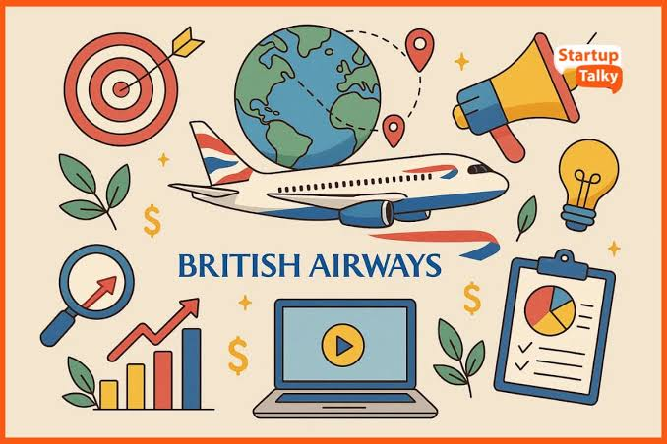
Aim of the Presentation
Introduction
What is Organisational Culture?
British Airways Overview
Applying Schein's Model
Hofstede & Handy
External Environment
Barrier or Enabler?
Recommendations
Conclusion
References

Slide 3
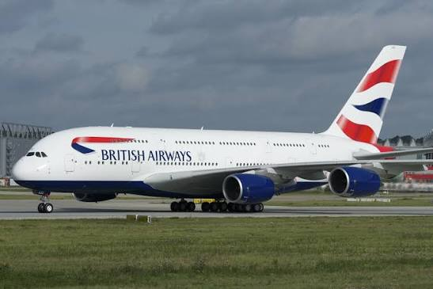
Introduction
Examine organisational culture at British Airways.
Analyse how culture influences structure and decision-making.
Apply organisational culture theories.
Assess whether culture is an enabler or barrier.
Provide recommendations to improve organisational performance.
Notes:
This presentation explores how organisational culture affects British Airways. It explains how culture shapes decision-making and organisational structure, applies key theories, evaluates its impact on organisational performance, and concludes with recommendations.

Slide 4

What is Organisational Culture?
Definition: "The shared values, beliefs and assumptions that influence how employees behave."
(Schein & Schein, 2021)
According to Mullins & Christy (2016)
Organisational culture influences:
Decision-making
Organisational structure
Employee motivation
Job satisfaction
Leadership
Organisational performance
Notes:
Organisational culture is often described as "the way things are done around here." It shapes employee behaviour and affects almost every aspect of an organisation.

Slide 5

British Airways Overview
About British Airways
UK's national airline
Part of International Airlines Group (IAG)
Culture Influences
Customer experience
Operates worldwide
Highly regulated industry
Focus on: -Safety, Customer service, Innovation, Sustainability.
Operational decision-making
Formal organisational structure
Notes:
British Airways operates in one of the world's most competitive industries. Because aviation is highly regulated, organisational culture strongly influences operational performance and customer service.

Slide 6
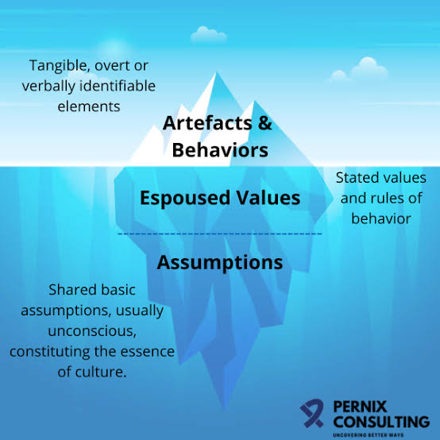
Applying Schein's Model
Three Levels of Culture
Artefacts Uniforms Aircraft branding Safety procedures Digital technology | Espoused Values Customer service Safety Teamwork Sustainability | Basic Assumptions Safety first Protecting brand reputation Operational excellence
Notes:
Schein explains culture at three levels. British Airways demonstrates visible symbols such as uniforms, promotes values like customer service, and is built upon strong assumptions regarding safety.

Slide 7
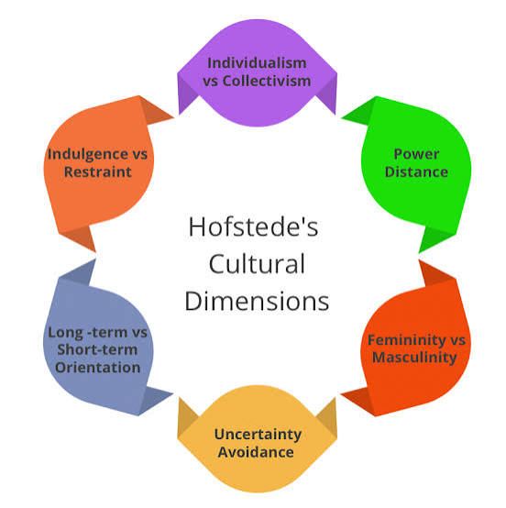
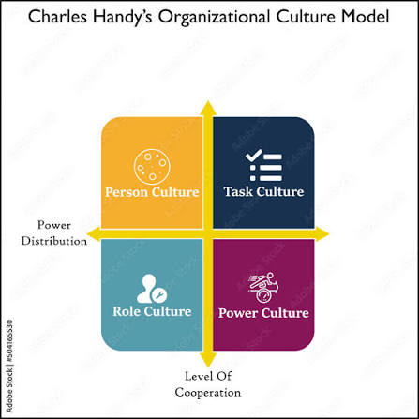
Hofstede & Handy
Hofstede's Cultural Dimensions
Moderate Power Distance
Individual accountability
High Uncertainty Avoidance
Handy's Cultural Types
Predominantly:
✔ Role Culture
Supported by:
✔ Task Culture
Notes:
British Airways has adapted its organisational culture to respond to major external pressures by investing in technology, sustainability and improved customer service.

Slide 8
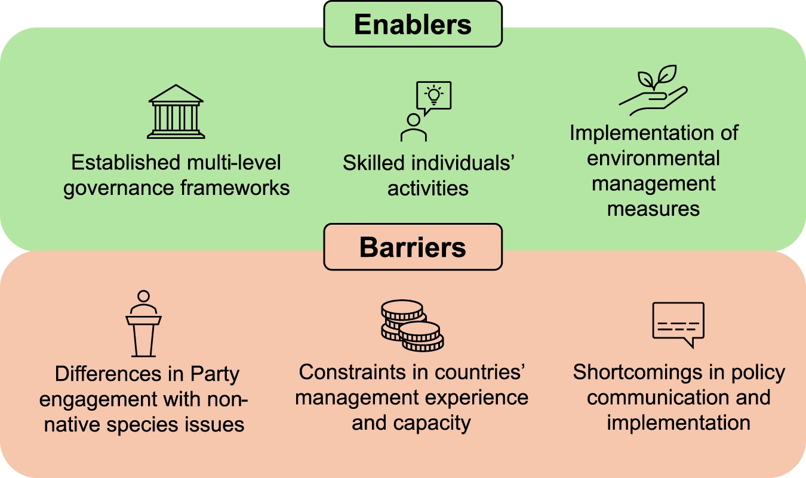
Barrier or Enabler?
Barriers
Resistance to change
Industrial disputes
Enablers
Innovation
Professionalism
Customer focus
Strong safety culture
Bureaucracy
Culture is more of an enabler than a barrier.
Notes:
Although organisational culture has occasionally created challenges through employee disputes and bureaucracy, overall it supports organisational success.

Slide 9
Recommendations
Improve Organisational Culture
Increase employee participation
Expected Benefits
Higher employee engagement
Develop transformational leadership
Strengthen communication
Reward innovation
Promote continuous learning
Better customer satisfaction
Greater organisational performance
Notes:
These recommendations are based on organisational behaviour theories and aim to strengthen organisational culture while improving long-term organisational performance.

Slide 10
Conclusion
"In conclusion, British Airways demonstrates how organisational culture can be a strategic asset. While its strong safety and customer-focused culture supports organisational performance, improving employee engagement and participative leadership will help the airline remain competitive in a rapidly changing global aviation industry. Thank you for listening !

Slide 11
References
Browaeys, M.-J. and Price, R. (2019). Understanding Cross-cultural Management. 4th ed. Pearson UK.
British Airways (2024). Annual Report and Accounts 2023. London: British Airways PLC.
Burnes, B. (2020). Managing Change. 7th ed. Harlow: Pearson Education Limited.
Clegg, S., Kornberger, M. and Pitsis, T. (2022). Managing and Organizations. 6th ed. London: Sage.
Grugulis, I. and Wilkinson, A. (2022). Managing Culture at Work. 4th ed. London: Sage.
Handy, C. (1999). Understanding Organizations. 4th ed. London: Penguin Books.
Hofstede, G., Hofstede, G.J. and Minkov, M. (2010). Cultures and Organizations: Software of the Mind. 3rd ed. New York: McGraw-Hill.
Holbeche, L. (2006). Understanding Change: theory, Implementation and Success. Oxford: Butterworth-Heinemann.
International Airlines Group (2024). Annual Report and Accounts 2023. London: International Airlines Group.
Johnson, G., Whittington, R., Scholes, K., Angwin, D. and Regnér, P. (2020) Exploring Strategy. 12th ed. Harlow: Pearson Education.
Mullins, L.J. and Christy, G. (2016). Management and Organisational Behaviour. 11th ed. Harlow: Pearson Education.
Northouse, P.G. (2022). Leadership: Theory and Practice. 9th ed. Thousand Oaks, CA: Sage.
Robbins, S.P. and Judge, T.A. (2023). Organizational Behaviour. 19th ed. Harlow: Pearson.
Schein, E.H. and Schein, P.A. (2021). Organizational Culture and Leadership. 6th ed. Hoboken, NJ: Wiley.
Senior, B., Swailes, S. and Carnall, C. (2020). Organisational Change. 6th ed. Harlow: Pearson.
Smith, P.B., Peterson, M.F. and Thomas, D.C. (2020). The Handbook of Cross-Cultural Management Research. 2nd ed. Thousand Oaks, CA: Sage.

Slide 12

Any Questions?

