Slide 1

“Current Health, Wellbeing and Sustainability Policies and Initiatives That Impact Citizens on a Global, National and Local Level”
Student Name | Sindatche Baldé
Student ID | 2233643
Module Name | Health, Wellbeing and Sustainable Development
Module Code | BMHP6030
Lecturer Name | Shepherd Ziko

Slide 2



Key Concepts - Overview
Health, wellbeing and sustainable development are interconnected priorities shaping policy.
Health is more than the absence of disease; it includes physical, mental and social well-being.
Wellbeing emphasizes the holistic and multi-dimensional quality of life. (Dahlgren and Whitehead, 2021)
Sustainable development asks that present needs be met without compromising future generations.
These concepts guide modern health systems and policy frameworks (Whitmee et al., 2024).
Notes:
The present slide preconditions the situation: health, wellbeing and sustainable development are not independent issues but support each other. Health is contextually defined as a comprehensive concept, physical, mental and social and wellbeing expands that to quality of life. Sustainable development gives us the moral and practical boundaries that we should not cross to ensure that what we have today does not compromise the future generations. Collectively these ideas underpin the idea of integrated policy and practice as is presented throughout this presentation. The provided definitions serve to clarify the importance of integration to policy, service design and population outcomes.

Slide 3
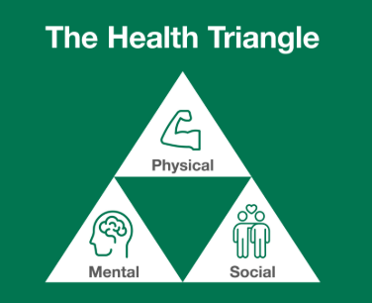

Health - Core Dimensions
Physical health: prevention, treatment and service access (Macassa, 2021).
Mental health: promotion and early intervention as central pillars (Lakioti et al., 2025).
Social health: community, relationships and social determinants influence outcomes.
Health equity: removing barriers to services and social determinants.
Notes:
About health as a policy issue, it would be beneficial to divide it into physical, mental and social realms. There is physical care; prevention and clinical services; mental health services and needs promotion and early interventions; social health acknowledges that relationships, housing and income determine outcomes. Notably, equity reduces in all three: the disparity in access to services or resources leads to expected health disparities. Such a framing of health leads to the kind of investments that governments make in terms of immunisation and other chronic disease management to mental health promotion and social policy interventions that lessen disparities.

Slide 4
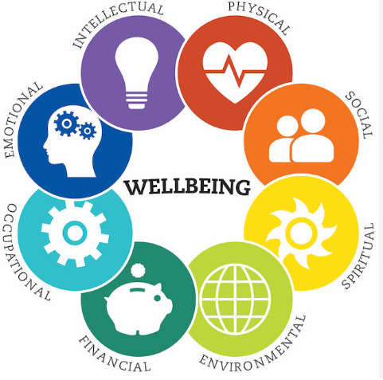


Wellbeing
Wellbeing integrates physical, mental, emotional and social functioning (Dahlgren & Whitehead, 2021).
Emphasises prevention, resilience and quality-of-life measures.
Community and environment (green space, air quality) are critical wellbeing determinants (Whitmee et al., 2024).
Measurement requires both subjective (self-report) and objective (health, environment) indicators.
Notes:
Wellbeing extends beyond clinical measures to embrace the appearance and functionality of people in their everyday activities. It would mean facilitating resilience and healthy lifestyles and environments, such as safe green areas or clean air, and clinical care. The wellbeing measurement is more challenging than counting hospital admissions: it requires both subjective (the way people assess their life quality) and objective (the prevalence of diseases or air pollution) measures. Combining both data forms aids the services to focus on interventions that actually enhance life opportunities and not just treatment of sickness.

Slide 5
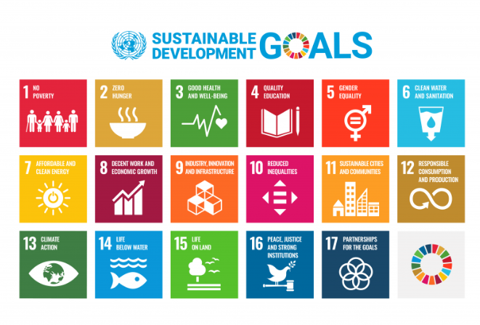
Sustainable Development: Why It Matters for Health
Sustainable development links economic, social and environmental goals.
Protects determinants of health: clean air, safe water, food security and shelter (Filho et al., 2023).
Climate change threatens health gains through pollution, food insecurity and extreme weather (Menton et al., 2020).
Policy must align health and environmental targets to secure long-term wellbeing.
Notes:
Sustainable development does not add to health but forms its basis. The population health is based on clean air, safe water, and resilient food systems which are endangered by climate change and other environmental damages. When the health policy is not taking notice of environmental boundaries, the benefits can be overturned in the short term by the negative consequences in the long term. This is why contemporary policies focus on the low-carbon, climate-resilient health system and intersectoral policies that safeguard the health circumstances. When sustainability is incorporated in health planning, the policy is stronger, fairer and more prospective.

Slide 6

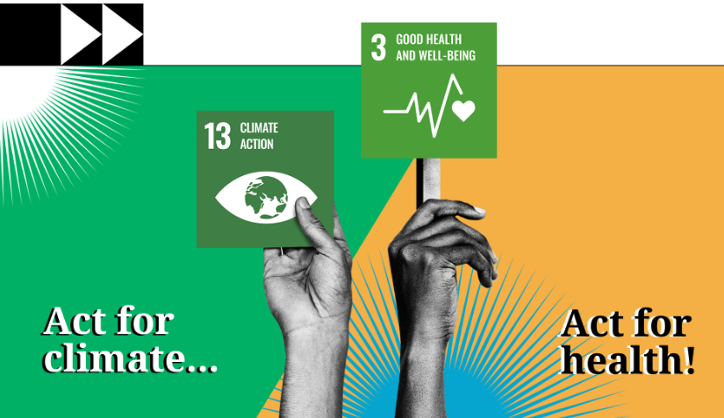
Relevance: SDG 3 and Cross-Cutting SDGs
SDG 3 focuses on good health and wellbeing for all.
SDG 13 (climate action) directly affects health determinants and outcomes.
International partnerships (WHO, Global Fund, Gavi) support UHC and pandemic preparedness (Takian et al., 2022).
National policy must translate SDGs to local actions and measurable targets (Ocloo et al., 2021).
Notes:
The Sustainable Development Goals offers an international context: SDG 3 establishes health objectives, and SDG 13 establishes a connection between climate action and health. The international organizations and alliances contribute significantly to the financing, technical support and coordination. However, global ambitions do not matter without countries transferring them to national and local policy, such as incorporating the resilience of climate into health policies or universal health coverage into national budgets. It is difficult to make commitments a part of regular funding when the needs are monitored and implemented locally to reach the vulnerable.

Slide 7

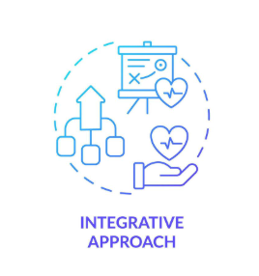
Integration: Why Integrated Approaches Matter
Integration addresses root causes, not only clinical symptoms.
Promotes intersectoral action across health, housing, education and environment (Dahlgren and Whitehead, 2021).
Reduces fragmentation, improves continuity of care and supports prevention.
Local initiatives demonstrate how brief, routine contacts can enable behaviour change (Parchment et al., 2023).
Notes:
The integrated approaches are necessitated by the fact that most of the health issues have their roots outside the clinical setting, in housing, employment or the environment. Integration implies action in coordination of action between sectors that address underlying causes and join up care pathways, which enhance prevention and continuity. Real-world examples on the local level such as Making Every Contact Count (MECC) demonstrate how daily interactions among services can provide short but effective behavioural interventions. Integration minimises duplication, utilises the limited resources, and tends to enhance patient experience as services are aligned with real-world needs of people.

Slide 8
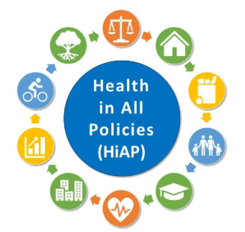
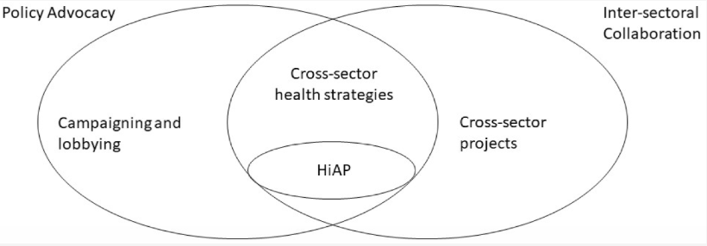
Integration Frameworks and Examples
“Health in All Policies” (HiAP) embeds health considerations across government policy (Stevenson et al., 2021).
Integrated Care Systems (ICS) align primary, secondary, and community services to support population health.
New Care Models and local wellbeing frameworks demonstrate a shift toward service redesign for prevention (Williams, 2025).
Cross-sector partnerships unlock resources and scale interventions (Bai et al., 2024).
Notes:
Integration is also structural in such frameworks as Health in All Policies and Integrated Care Systems. HiAP requests policymakers to take into account the health effects of every sector, transport, housing, and environment, as ICSs realign the health services at the local level to control population health and long-term disorders. These models focus on prevention, collective responsibility and collective resources. The partnership with local governments, NGOs and the business community can open the door to more funds and more implementation capacity, but those partnerships need to be well governed and must have common metrics to be successful.

Slide 9
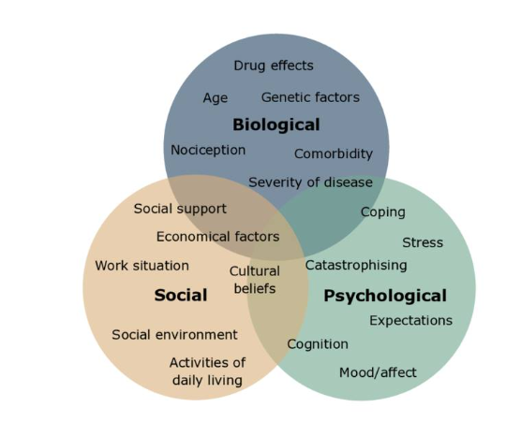
Theoretical Perspective: Biopsychosocial Model
Health results from biological, psychological and social interactions.
The model supports person-centred care and multi-disciplinary teams (Macassa, 2021).
Useful for explaining co-morbidities and social drivers of NCDs.
Guides measurement: clinical outcomes, as well as psychosocial and environmental indicators.
Notes:
The biopsychosocial model can make us get past the reductionist approach to disease. It acknowledged that biological factors co-exist with psychological condition and social situation, such as stress, poverty or isolation may aggravate chronic disease. Person-centred care is based on this theory which justifies the use of multi-disciplinary teams comprising social care, mental health and community services. It is also informative of evaluation: we need to assess beyond the clinical endpoints, including mental wellbeing and social/environmental indicators to obtain a comprehensive assessment of the effect of interventions.

Slide 10


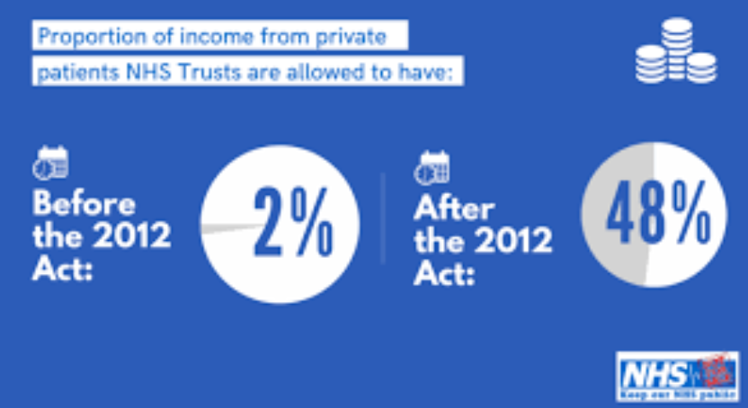
Policy and Governance Supporting Holistic Health
NHS Five Year Forward View and New Care Models promote prevention and integration (Ocloo et al., 2021).
Health and Social Care Act 2012 demanded greater responsibility for reducing inequalities (Robertson et al., 2021).
National strategies emphasise mental health and population-level prevention (Williams, 2025).
Governance must enable local flexibility while ensuring accountability.
Notes:
The national policy influences the priorities of services. The reforms in the Health and Social Care Act and the NHS Five Year Forward View and other documents focus on prevention, integrated care and addressing inequalities. Mental health and prevention on a population level seem to be more part of national strategy, yet to translate national standards into local flexibility of application, governance that is both national and local is needed. The policies require mechanisms of accountability, sustainable funding and workforce planning in order to provide better services instead of being statements of vision.

Slide 11


Challenges: Regulatory, Funding and Implementation Barriers
Austerity and constrained funding limit prevention and local delivery (Hick, 2022).
Fragmented commissioning and short-term contracts fragment services.
Regulatory complexity can slow innovation and cross-sector working.
Monitoring and evaluation gaps reduce evidence for scaling successful pilots (Rodrigues et al., 2024).
Notes:
Even with the effective presence of the policies, finance, organisation and regulation limits the reality. Prolonged prevention programmes are derailed by budget constraints and short contract cycles. The discontinuities of fragmented commissioning between health and social care and the complex regulations can make cross-sector innovation challenging and dangerous. Lastly, weak monitoring, which implies that evidence is patchy, implies that promising pilots are not usually scaled. Such barriers can only be overcome through the provision of long term unshaken funding, simplified governance structures and investment in sound evaluation systems that yield value and impact.

Slide 12


Service Delivery - Models and Tools
Wellness programmes and community initiatives support prevention and self-management (Parchment et al., 2023).
Telehealth expands access, particularly for remote and underserved populations (Lakioti et al., 2025).
Multidisciplinary community teams manage long-term conditions and frailty.
Data-driven planning (local JSNAs) improves targeting of services.
Notes:
Where policy meets people is service delivery. Community activities and wellness can be used to decrease the load on acute services by encouraging self-care. Telehealth has demonstrated its value in broadening access, particularly to remote or resource-challenged regions, although it requires the development of a fair roll-out to prevent the increase of digital disparities. The multidisciplinary teams comprising of primary care, community nursing and social care assist in the management of long-term complex conditions and frailty. The distribution of resources is informed by local needs assessments and data (including Joint Strategic Needs Assessments), which make sure that services are responsive to actual population trends as opposed to assumptions.

Slide 13


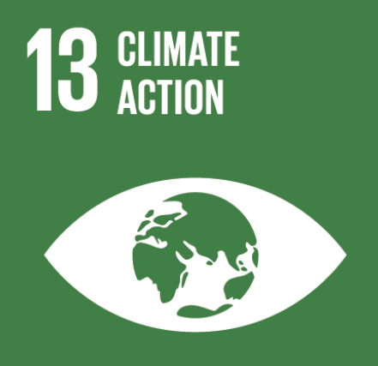
Case Examples - Holistic Care in Hospitals
Climate-resilient, low-carbon hospital initiatives link SDG13 and SDG3 (Whitmee et al., 2024).
New Care Models showed better coordination for patients with multiple long-term conditions.
MECC embedded in hospital trusts to promote prevention at every contact (Parchment et al., 2023).
Results include improved patient experience and reduced avoidable admissions.
Notes:
Hospitals are developing to provide holistic care and work on the sustainability. To safeguard services and mitigate the effect on the environment, some trusts implement low-carbon and climate resilient design. New Care Models and Integrated Care Pilots have enhanced patient coordination in which patients with numerous long-term conditions have improved coordination without being fragmented. Practical solutions, including incorporation of short behaviour change conversations (MECC) in inpatient and outpatient care settings, can assist clinicians to facilitate prevention within the normal care delivery. The above examples demonstrate that when governance, workforce training and funding of hospitals are in line, hospitals can be the centers of both clinical care and broader health improvements.

Slide 14
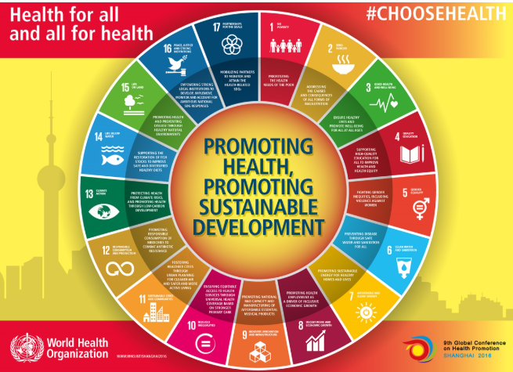

Public Health Initiatives and Population Impact
Health promotion campaigns (smoking, obesity, activity) reduce population risk factors (Droogers et al., 2020).
Air quality and urban design interventions improve respiratory and cardiovascular outcomes (Rentschler & Leonova, 2023).
School and workplace programmes support life-course wellbeing (Jiang et al., 2025).
Evaluation and long-term funding essential for sustained population effects.
Notes:
The population level deals with risk factors and the relevant attempts to shift them to establish healthier conditions in the form of public health initiatives. Conventional anti-smoking and healthy diet campaigns are still effective with support of the policy and services. Respiratory and cardiovascular benefits can be achieved by large through environmental activities, such as air quality or walking city design. There are school and work-based interventions that target individuals at various stages of life. However, the long-term financing and comprehensive assessment of the public health is necessary so that the short-term campaigns would lead to long-term behaviour modification and the quantifiable health benefits of the population.

Slide 15
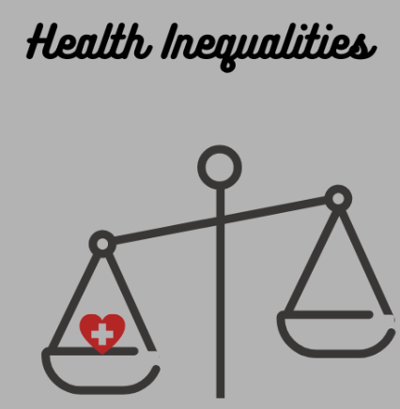
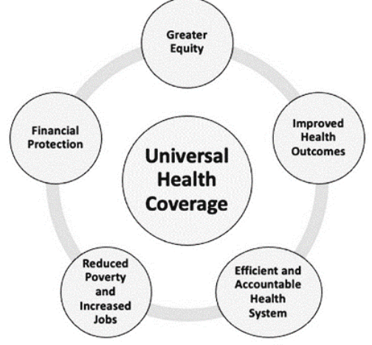
Equity and Access - Addressing Disparities
Health inequalities arise from unequal distribution of social determinants.
Poorer communities face higher pollution, worse housing and lower service access (Rentschler and Leonova, 2023).
Policies such as UHC and targeted local interventions can reduce gaps.
Community participation and anti-racism strategies are critical for inclusive services (Robertson et al., 2021).
Notes:
The focus lies on equity: the place of work, education, and residence has a significant impact on health. Environmental injustice implies that underprivileged communities have to carry a greater burden of pollution and lack of resources. Gaps can be bridged by universal health coverage and local interventions (such as funding the needy wards), but structural change is required, which is an investment in housing, education and employment. Significantly, the reduction of discrimination and community participation in the designing of the services enhances acceptability and uptake. Equity demands long-term political dedication, investment and desire to serve those who are in the neediest state.

Slide 16
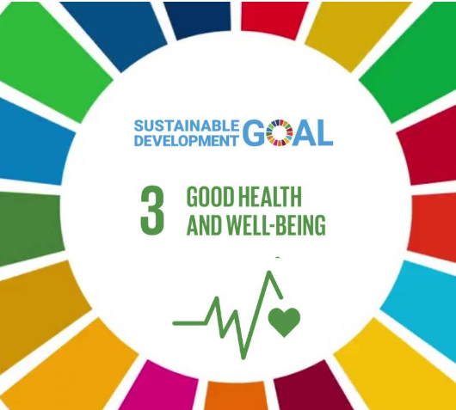



Conclusion and Practical Recommendations
Health, wellbeing and sustainable development must be integrated to secure long-term population health.
Invest in prevention, climate-resilient health systems and community programmes.
Strengthen governance: HiAP, ICSs and stable funding for local delivery (Stevenson et al., 2021).
Prioritise equity, strong evaluation and cross-sector partnerships for scalable impact (Parchment et al., 2023; Rentschler and Leonova, 2023).
Notes:
To conclude, evidence demonstrates that health, wellbeing and sustainability are three policy objectives that cannot separate. To shift aspiration to influence, the investments in prevention and climate-resilience are necessary, changes in governance towards making integration possible, and specific action to lessen inequities. Local delivery with the help of a stable financing, community involvement and effective assessment transforms strategy into results. Lastly, intersectoral, intergovernmental collaborations are necessary to achieve the scale of what works. These recommendations are based on the synthesis of evidence of global, national and local evidence in the report and are aimed at being practical levers to achieve sustainable and equitable population health.

Slide 17
References
Bai, Y., Lu, C., Dong, X. and Li, Y., 2024. Role of collaborative governance in unlocking private investment in sustainable projects. Humanities and Social Sciences Communications, 11(1), pp.1-9 Available at:. https://www.nature.com/articles/s41599-024-03175-2.pdf (Accessed: 20 October 2025)
Dahlgren, G. and Whitehead, M., 2021. The Dahlgren-Whitehead model of health determinants: 30 years on and still chasing rainbows. Public health, 199, pp.20-24. Available at: https://elevateni.org/app/uploads/2022/03/Dalgren-Whitehead-model-of-health-determinants-30-years-on-and-still-chasing-rainbows.pdf ( Accessed 21 October 2025)
Droogers, M., Jansen, D., Lindert, J., Saboga-Nunes, L., Rudén, M., Guichardon, M. and Zeegers Paget, D., 2020. Health-related Sustainable Development Goals: countdown on alcohol use, smoking prevalence, child overweight and suicide mortality. European journal of public health, 30(Supplement_1), pp.i10-i13.Available at: https://academic.oup.com/eurpub/article-pdf/30/Supplement_1/i10/33202739/ckaa027.pdf (Accessed 21 October 2025)
Filho, W.L., Wall, T., Salvia, A.L., Dinis, M.A.P. and Mifsud, M., 2023. The central role of climate action in achieving the United Nations' Sustainable Development Goals. Scientific Reports, 13(1), p.20582.Available at: https://www.nature.com/articles/s41598-023-47746-w.pdf ( Accessed 20 October 2025)
Hick, R., 2022. Austerity, localism, and the possibility of politics: Explaining variation in three local social security schemes between elected councils in England. Sociological Research Online, 27(2), pp.251-272.Available at: https://orca.cardiff.ac.uk/id/eprint/140313/1/Hick_Austerity%2C%20localism%20and%20the%20possibility%20of%20politics.pdf (Accessed 20 October 2025)
Jiang, D., Zhou, J., Zhu, Y., Abdin, E., Afifi, T.O., Andrade, L.H.S., Bendayan, R., van der Sprenkel, E.E.B., Bruffaerts, R., Catalá-López, F. and Colman, I., 2025. Research priorities on physical-mental comorbidity in children and adolescents: an international consensus. eClinicalMedicine, 89. Available at : https://scholar.google.com/scholar?output=instlink&q=info:vnjWTV7rySIJ:scholar.google.com/&hl=en&as_sdt=0,5&as_ylo=2019&as_yhi=2025&scillfp=5429220541212268687&oi=lle ( Accessed 30 October 2025)
Lakioti, E., Pagonis, N., Flegkas, D., Itziou, A., Moustakas, K. and Karayannis, V., 2025. Social Factors and Policies Promoting Good Health and Well-Being as a Sustainable Development Goal: Current Achievements and Future Pathways. Sustainability, 17(11), p.5063. Available at : https://www.mdpi.com/2071-1050/17/11/5063 ( Accessed 30 October 2025)
Macassa, G., 2021. Can sustainable health behaviour contribute to ensure healthy lives and wellbeing for all at all ages (SDG 3)? A viewpoint. Journal of Public Health Research, 10(3), pp.jphr-2021.Available at : https://journals.sagepub.com/doi/pdf/10.4081/jphr.2021.2051 (Accessed 30 October 2025)
Menton, M., Larrea, C., Latorre, S., Martinez-Alier, J., Peck, M., Temper, L. and Walter, M., 2020. Environmental justice and the SDGs: from synergies to gaps and contradictions. Sustainability science, 15(6), pp.1621-1636. Available at: https://link.springer.com/content/pdf/10.1007/s11625-020-00789-8.pdf ( Accessed 30 October 2025)

Slide 18
References
Ocloo, J., Garfield, S., Franklin, B.D. and Dawson, S., 2021. Exploring the theory, barriers and enablers for patient and public involvement across health, social care and patient safety: a systematic review of reviews. Health research policy and systems, 19(1), p.8.Available at: https://link.springer.com/content/pdf/10.1186/s12961-020-00644-3.pdf (Accessed 31 October 2025)
Parchment, A., Lawrence, W., Perry, R., Rahman, E., Townsend, N., Wainwright, E. and Wainwright, D., 2023. Making every contact count and healthy conversation skills as very brief or brief behaviour change interventions: a scoping review. Journal of Public Health, 31(7), pp.1017-1034. Available at :https://link.springer.com/content/pdf/10.1007/s10389-021-01653-4.pdf (Accessed 26 October 2025)
Rentschler, J. and Leonova, N., 2023. Global air pollution exposure and poverty. Nature communications, 14(1), p.4432.Available at : https://www.nature.com/articles/s41467-023-39797-4.pdf (Accessed 26 October 2025)
Robertson, R., Williams, E., Buck, D. and Breckwoldt, J., 2021. Ethnic health inequalities and the NHS. The King’s Fund, commissioned by the NHS Race and Health Observatory.Available at: https://healthwatchgreenwich.co.uk/sites/healthwatchgreenwich.co.uk/files/Ethnic-Health-Inequalities-Kings-Fund-Report.pdf ( Accessed 26 October 2025)
Rodrigues, A.M., Nichol, B., Wilson, R., Charlton, C., Gibson, B., Finch, T., Haighton, C., Maniatopoulos, G., Giles, E., Harrison, D. and Orange, D., 2024. Mapping regional implementation of ‘Making Every Contact Count’: mixed-methods evaluation of implementation stage, strategies, barriers and facilitators of implementation. BMJ open, 14(7), p.e084208.Available at: https://bmjopen.bmj.com/content/bmjopen/14/7/e084208.full.pdf (Accessed 30 October 2025)
Stevenson, S., Collins, A., Jennings, N., Köberle, A.C., Laumann, F., Laverty, A.A., Vineis, P., Woods, J. and Gambhir, A., 2021. A hybrid approach to identifying and assessing interactions between climate action (SDG13) policies and a range of SDGs in a UK context. Discover Sustainability, 2(1), p.43.Available at: https://link.springer.com/content/pdf/10.1007/s43621-021-00051-w.pdf ( Accessed 22 October 2025)
Takian, A., Raoofi, A. and Haghighi, H., 2022. COVID-19 pandemic: The fears and hopes for SDG 3, with focus on prevention and control of noncommunicable diseases (SDG 3.4) and universal health coverage (SDG 3.8). In COVID-19 and the Sustainable Development Goals (pp. 211-234). Elsevier. Available at: https://pmc.ncbi.nlm.nih.gov/articles/PMC9334993/pdf/main.pdf ( Accessed 23 October 2025)
Whitmee, S., Green, R., Belesova, K., Hassan, S., Cuevas, S., Murage, P., Picetti, R., Clercq-Roques, R., Murray, K., Falconer, J. and Anton, B., 2024. Pathways to a healthy net-zero future: report of the Lancet Pathfinder Commission. The Lancet, 403(10421), pp.67-110. Available at : https://researchportal.bath.ac.uk/files/312465810/Whitmee_et_al_Pathfinder_Commission_Report_Accepted_Manuscript.pdf (Accessed 22 October 2025)
Williams, B., 2025. The British NHS at 75: Past, contemporary, and future challenges. International Journal of Social Determinants of Health and Health Services, 55(1), pp.76-87. Available at: https://journals.sagepub.com/doi/pdf/10.1177/27551938241280175 ( Accessed 30 October 2025)

Slide 19



