Slide 1
Ethical Hacking
Lecture 5-6
Lecturer: Assoc. Professor Carlene Campbell
Email: carlene.campbell@uwtsd.ac.uk
Website: https://www.knowledgewithprofit.com

Slide 2
This lecture will look at:
Scanning Networks and Enumeration
  Explain Network Scanning Concepts
  Demonstrate Various Scanning Techniques for Host Discovery
  Demonstrate Various Scanning Techniques for Port and Service Discovery
  Demonstrate Various Scanning Techniques for OS Discovery
  Demonstrate Various Techniques for Scanning Beyond IDS and Firewall
  Explain Network Scanning Countermeasures
  Explain Enumeration Concepts
  Different Techniques for Enumeration
  Enumeration Countermeasures

Slide 3
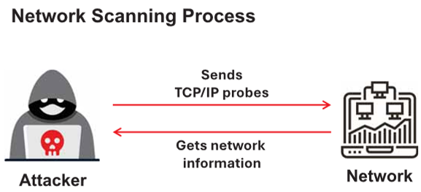
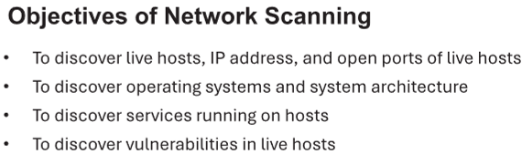
Overview of Network Scanning
Network scanning refers to a set of procedures used for identifying hosts, ports, and services in a network
Network scanning is one of the components of information gathering which can be used by an attacker to create a profile of the target organization
Attackers use tools such as Nmap, Hping3, Metasploit, and NetScanTools Pro to perform network scanning

Slide 4
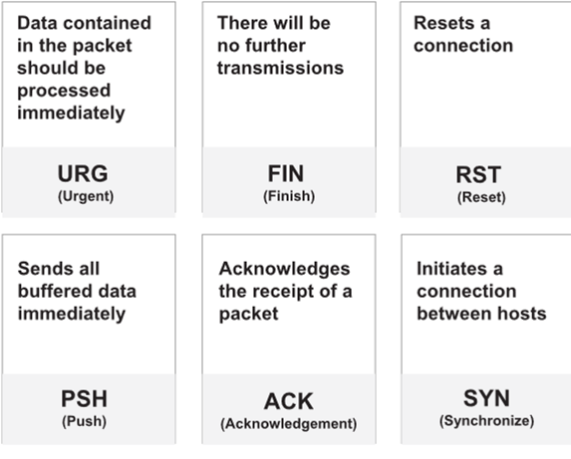
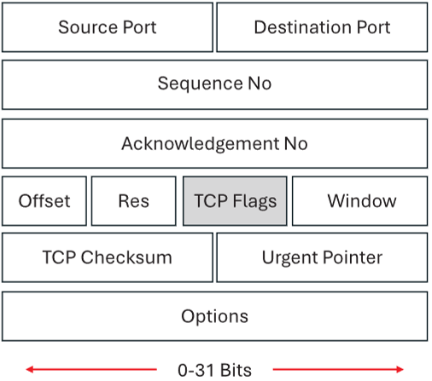
TCP Communication Flags
Standard TCP communications are controlled by flags in the TCP packet header

Slide 5
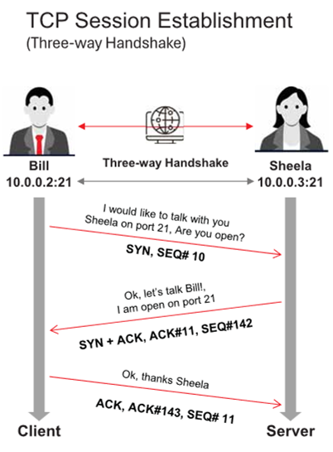
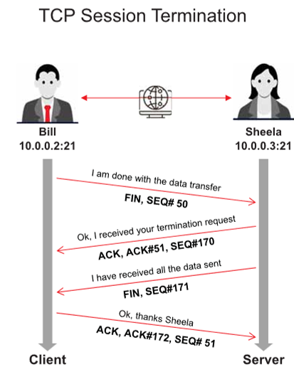
TCP/IP Communication

Slide 6
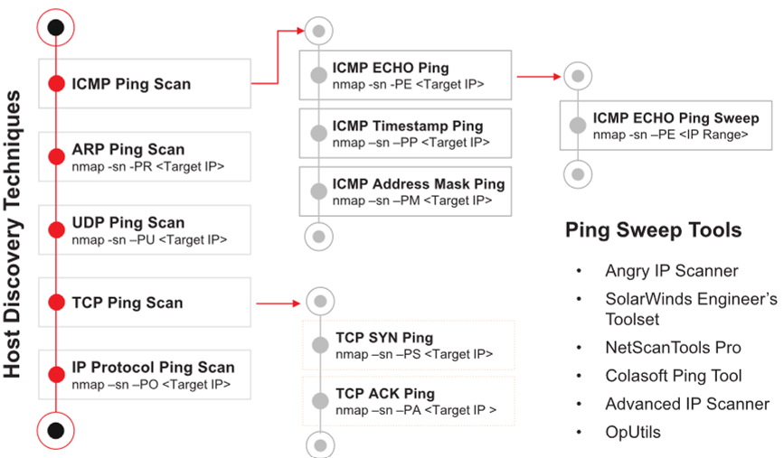
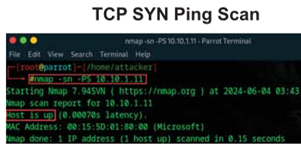
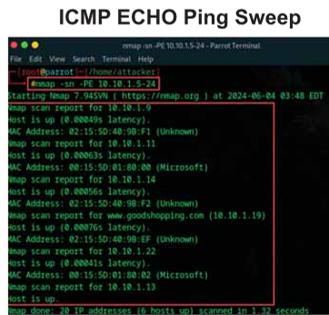
Host Discovery Techniques
Host discovery techniques are used to identify the active/live systems in the network
Notes:
Demonstrate Various Scanning Techniques for Host Discovery

Slide 7
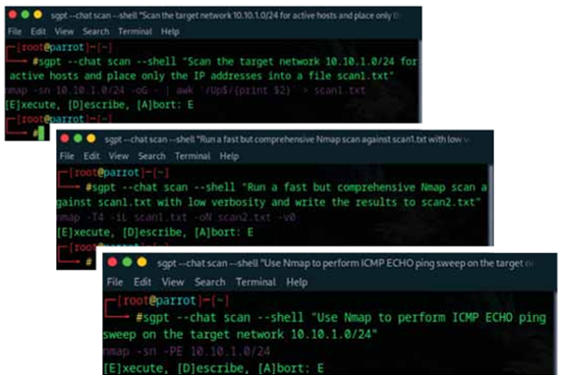
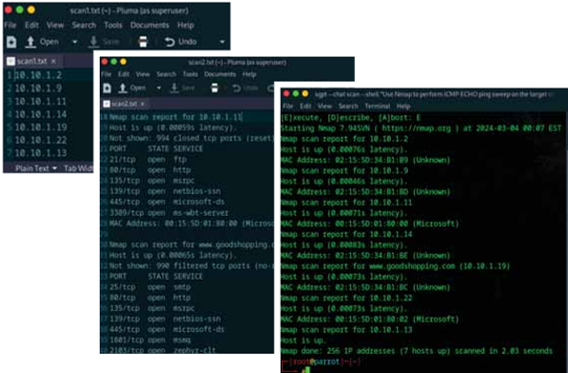
Host Discovery with AI
An attacker can also leverage AI-powered ChatGPT or other generative AI technology to perform this task by using an appropriate prompt such as
“Scan the target network 10.10.1.0/24 for active hosts and place only the IP addresses into a file scan1.txt”
“Run a fast but comprehensive Nmap scan against scan1.txt with low verbosity and write the results to scan2.txt”
“Use Nmap to perform ICMP ECHO ping sweep on the target network 10.10.1.0/24”

Slide 8
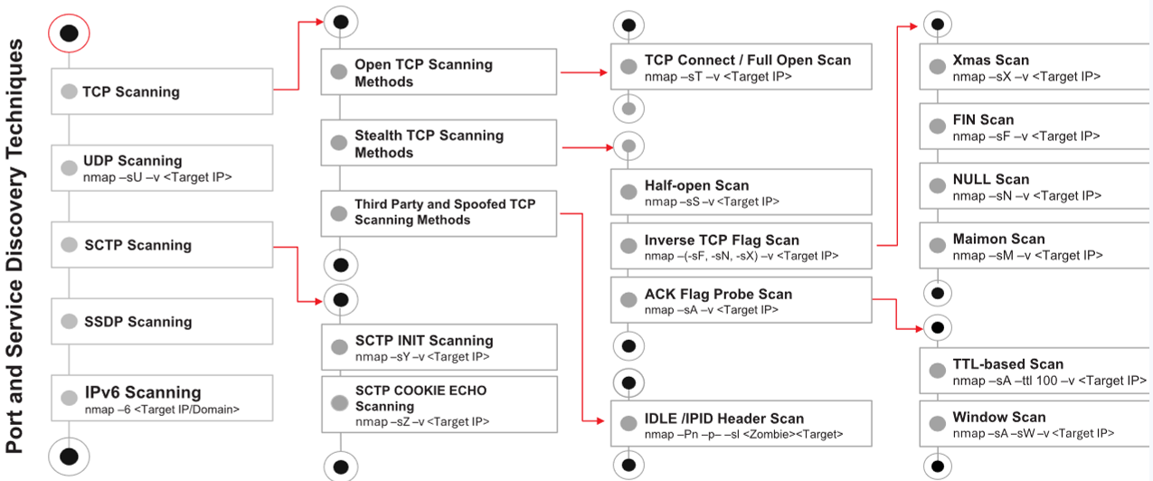
Port Scanning Techniques
The port scanning techniques are categorized according to the type of protocol used for communication
Notes:
Demonstrate Various Scanning Techniques for Port and Service Discovery

Slide 9
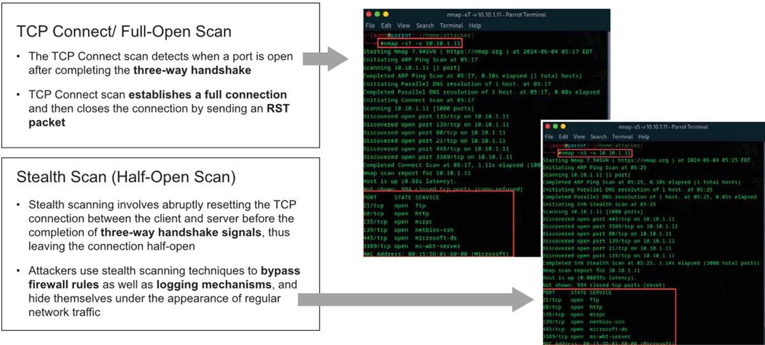
Port Scanning Techniques (Cont’d)

Slide 10
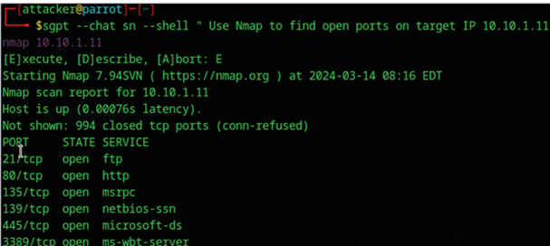
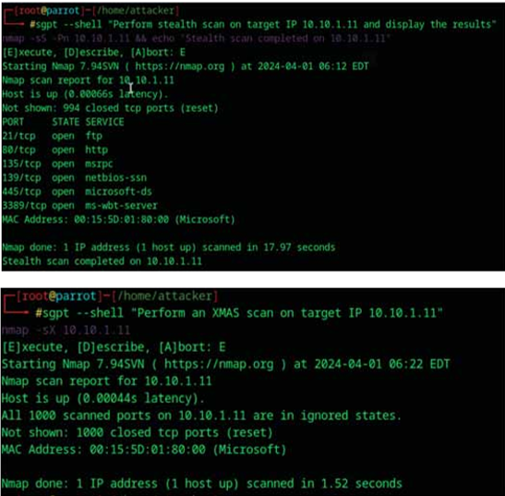
Port Scanning with AI
An attacker can also leverage AI-powered ChatGPT or other generative AI technology to perform this task by using an appropriate prompt such as:
“Use Nmap to find open ports on target IP 10.10.1.11”
“Perform stealth scan on target IP 10.10.1.11 and display the results“
“Perform an XMAS scan on target IP 10.10.1.11”

Slide 11
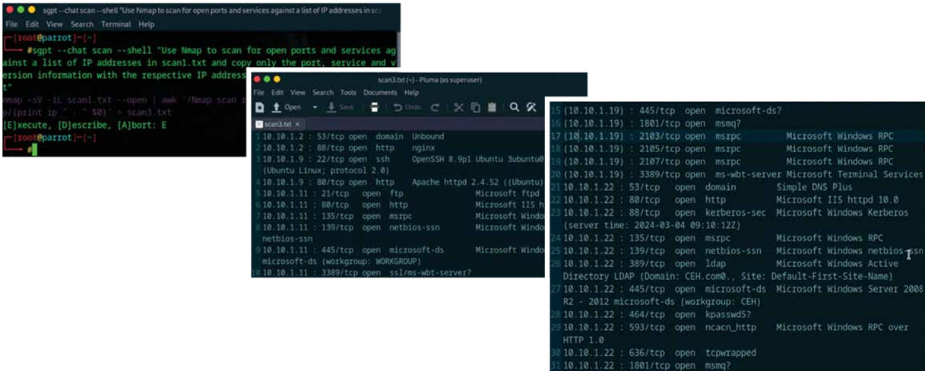
Port Scanning with AI (Cont’d)
“Use Nmap to scan for open ports and services against a list of IP addresses in scan1.txt and copy only the port, service and version information with the respective IP address to a new file called scan3.txt”

Slide 12
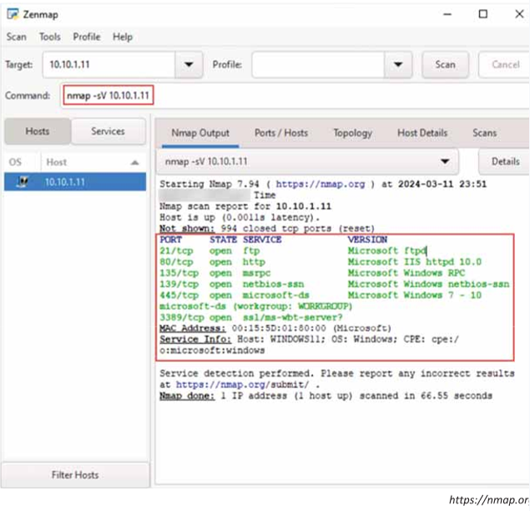
Service Version Discovery
Service version detection helps attackers to obtain information about running services and their versions on a target system
Obtaining an accurate service version number allows attackers to determine the vulnerability of target system to particular exploits
In Zenmap, the -sV option is used to detect service versions

Slide 13
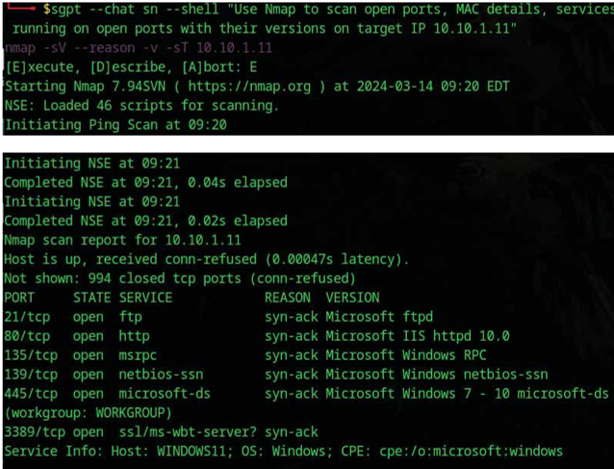
Service Version Discovery with AI
An attacker can also leverage AI powered ChatGPT or other generative AI technology to perform this task by using an appropriate prompt such as
“Use Nmap to scan open ports, MAC details, services running on open ports with their versions on target IP 10.10.1.11”

Slide 14
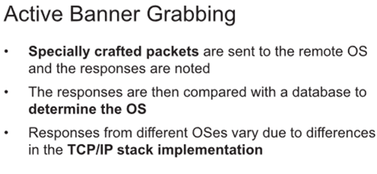
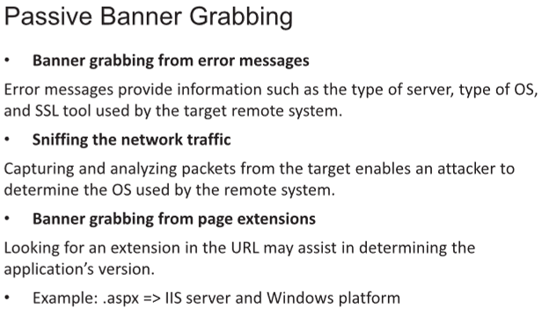
OS Discovery/Banner Grabbing
Banner grabbing or OS fingerprinting is the method used to determine the operating system running on a remote target system. There are two types of banner grabbing: active and passive
Identifying the OS used on the target host allows an attacker to figure out the vulnerabilities possessed by the system and the exploits that might work on a system to further carry out additional attacks
Notes:
Demonstrate Various Scanning Techniques for OS Discovery

Slide 15
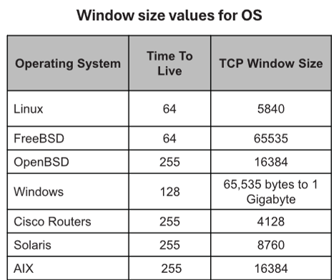
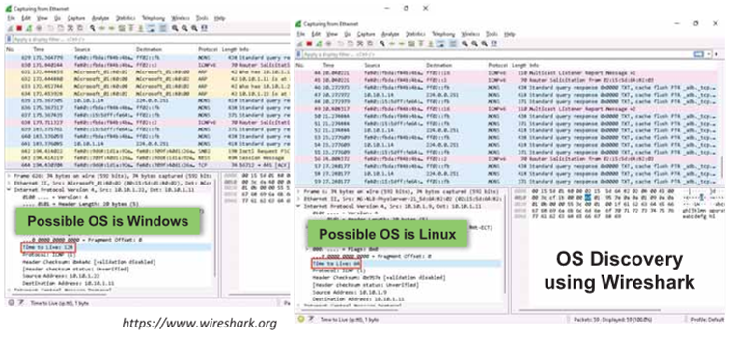
How to Identify Target System OS
Attackers can identify the OS running on the target machine by looking at the Time To Live (TTL) and TCP window size in the IP header of the first packet in a TCP session
Sniff/capture the response generated from the target machine using packet-sniffing tools like Wireshark and observe the TTL and TCP window size fields

Slide 16
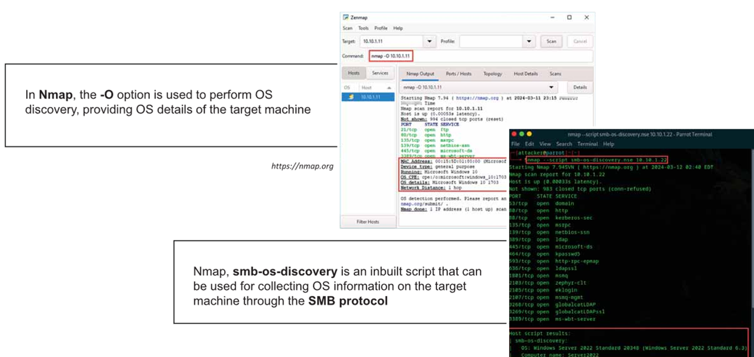
OS Discovery using Nmap and Nmap Script Engine

Slide 17
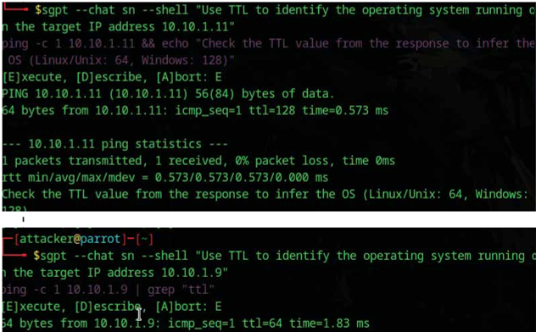
OS Discovery with AI
An attacker can also leverage AI-powered ChatGPT or other generative AI technology to perform this task by using an appropriate prompt such as
“Use TTL to identify the operating system running on the target IP address 10.10.1.11”
“Use TTL to identify the operating system running on the target IP address 10.10.1.9”

Slide 18
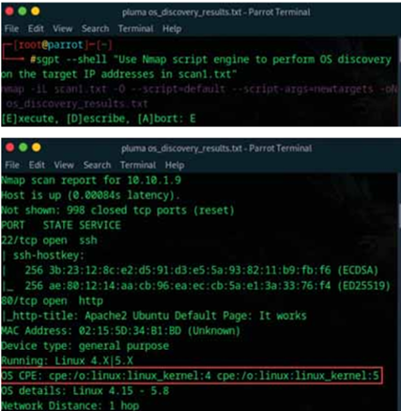
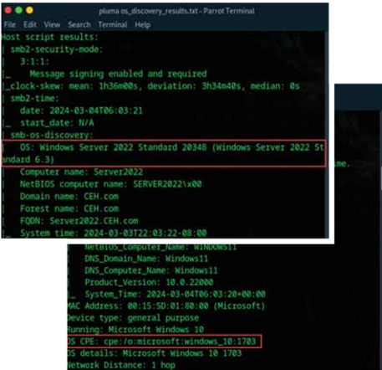
OS Discovery with AI (Cont’d)
“Use Nmap script engine to perform OS discovery on the target IP addresses in scan1.txt”

Slide 19
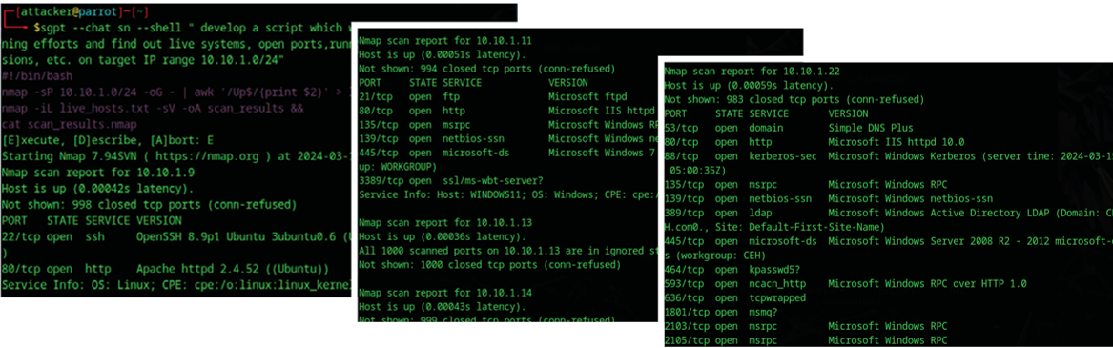
Create and Run Custom Script to Automate Network Scanning Tasks with AI
An attacker can also leverage AI-powered ChatGPT or other generative AI technology to automate various network scanning tasks by creating custom script that will run automatically and fetch the desired result. Attacker can use appropriate prompt like as follows to create custom scripts
“Develop a script which will automate network scanning efforts and find out live systems, open ports, running services, service versions, etc. on target IP range 10.10.1.0/24”

Slide 20
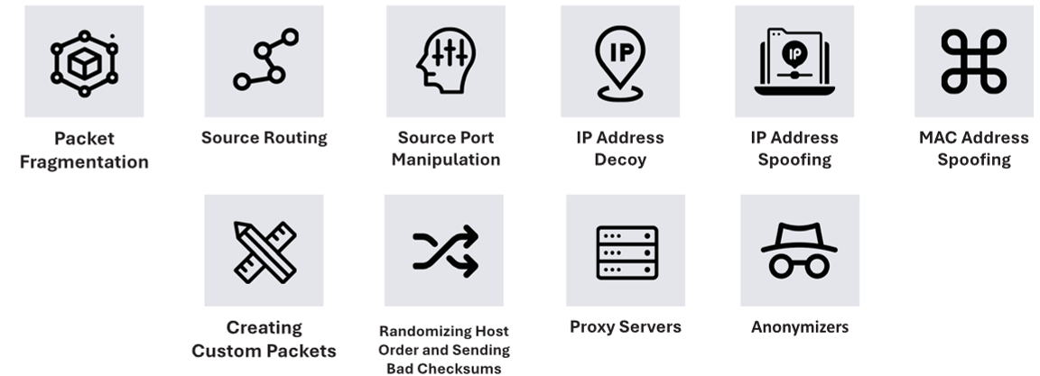
Scanning Beyond IDS and Firewall
Though firewalls and IDSs can prevent malicious traffic (packets) from entering a network, attackers can manage to send intended packets to the target by evading an IDS or firewall through the following techniques:
Notes:
Demonstrate Various Techniques for Scanning Beyond IDS and Firewall

Slide 21
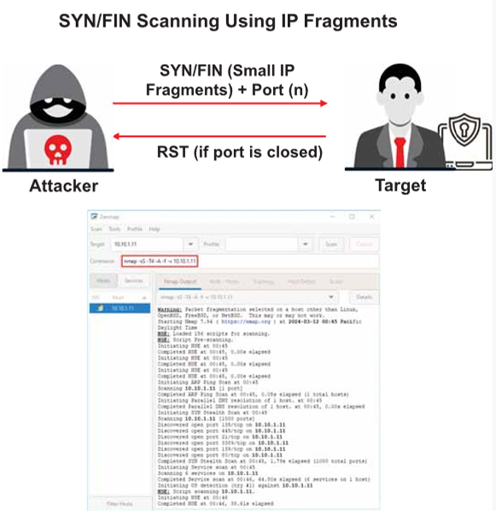
Packet Fragmentation
Packet fragmentation refers to the splitting of a probe packet into several smaller packets (fragments) while sending it to a network
It is not a new scanning method but a modification of the previous techniques
The TCP header is split into several packets so that the packet filters are not able to detect what the packets are intended to do

Slide 22
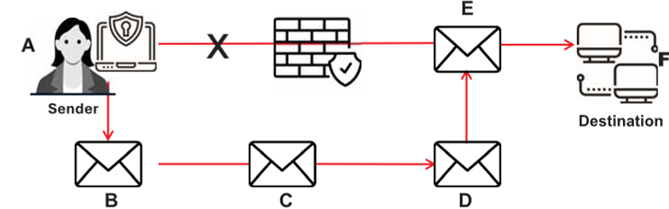
Source Routing
As the packet travels through the nodes in the network, each router examines the destination IP address and chooses the next hop to direct the packet to the destination
Source routing refers to sending a packet to the intended destination with a partially or completely specified route (without firewall-/IDS-configured routers) in order to evade an IDS or firewall
In source routing, the attacker makes some or all of these decisions on the router
This figure shows source routing, where the originator dictates the eventual route of the traffic

Slide 23
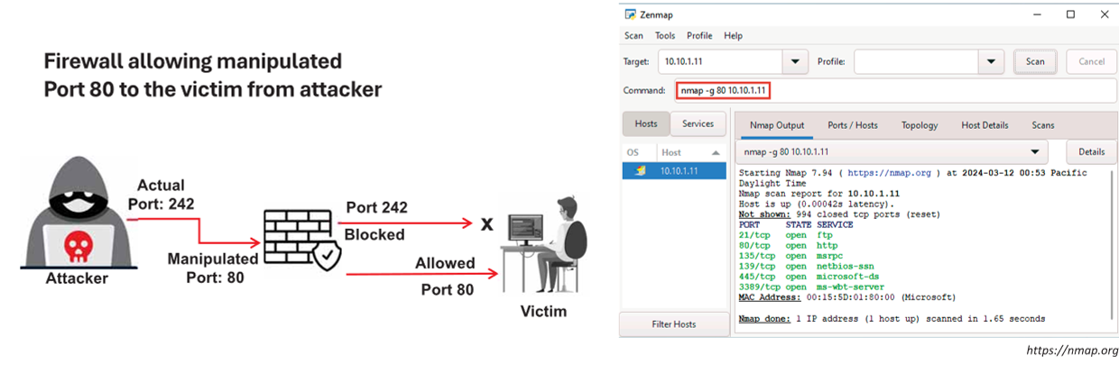
Source Port Manipulation
Source port manipulation refers to manipulating actual port numbers with common port numbers in order to evade an IDS or firewall
It occurs when a firewall is configured to allow packets from well-known ports like HTTP, DNS, FTP, etc.
Nmap uses the -g or --source-port options to perform source port manipulation

Slide 24
Take a break
We’ll rejoin in 10 minutes

Slide 25
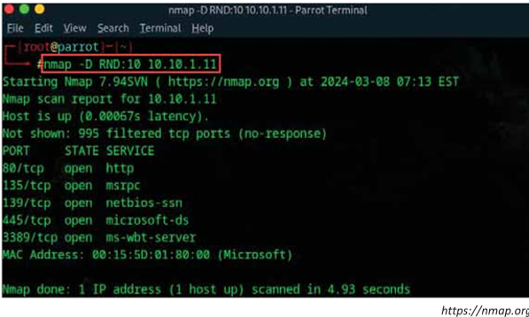
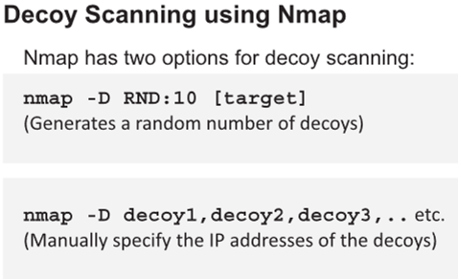
IP Address Decoy
IP address decoy technique refers to generating or manually specifying the IP addresses of decoys in order to evade an IDS or firewall
It appears to the target that the decoys as well as the host(s) are scanning the network
This technique makes it difficult for the IDS or firewall to determine which IP address was actually scanning the network and which IP addresses were decoys

Slide 26
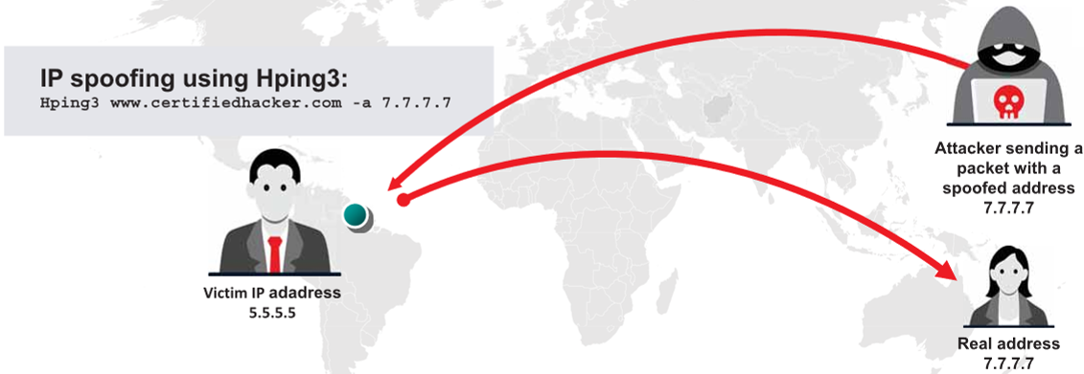
IP Address Spoofing
IP spoofing refers to changing the source IP addresses so that the attack appears to be coming from someone else
When the victim replies to the address, it goes back to the spoofed address rather than the attacker’s real address
Attackers modify the address information in the IP packet header and the source address bits field in order to bypass the IDS or firewall
Note: You will not be able to complete the three-way handshake and open a successful TCP connection with spoofed IP addresses

Slide 27
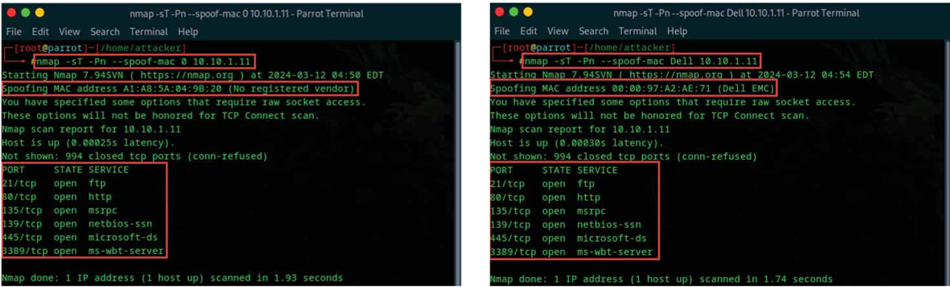
MAC Address Spoofing
The MAC address spoofing technique involves spoofing a MAC address with the MAC address of a legitimate user on the network
Attackers use the --spoof-mac Nmap option to set a specific MAC address for the packets to evade firewalls

Slide 28
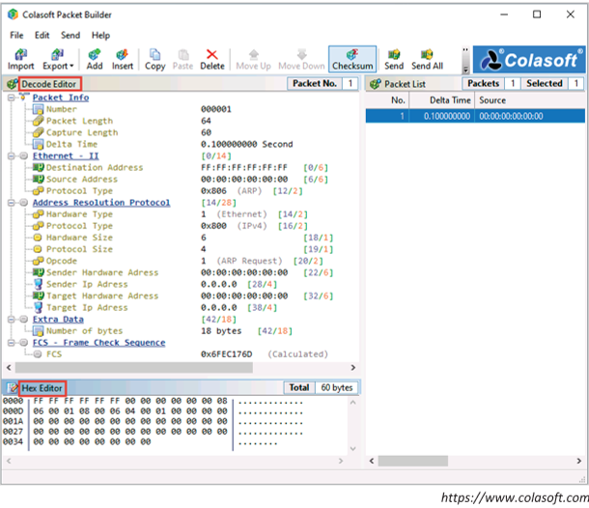
Creating Custom Packets
Creating Custom Packets by using Packet Crafting Tools
Attackers create custom TCP packets using various packet crafting tools like Colasoft Packet Builder, NetScanTools Pro, etc. to scan a target beyond a firewall

Slide 29
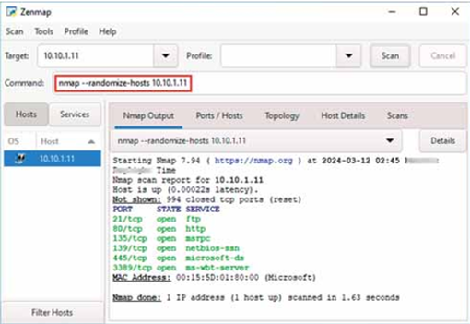
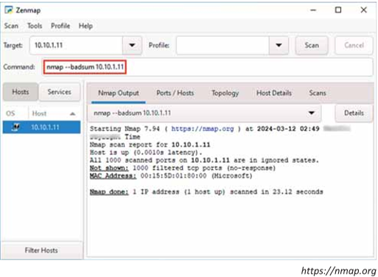
Randomizing Host Order and Sending Bad Checksums
Randomizing Host Order
Attackers scan the number of hosts in the target network in random order to scan an intended target that is behind a firewall
Sending Bad Checksums
Attackers send packets with bad or bogus TCP/UPD checksums to the intended target to avoid certain firewall rulesets

Slide 30
Proxy Servers
A proxy server is an application that can serve as an intermediary for connecting with other computers
Why Attackers Use Proxy Servers?
To hide the actual source of a scan and evade certain IDS/firewall restrictions
To mask the actual source of an attack by impersonating the fake source address of the proxy
To remotely access intranets and other website resources that are normally restricted
To interrupt all requests sent by a user and transmit them to a third destination such that victims can only identify the proxy server address
To chain multiple proxy servers to avoid detection
Note: A search in Google will list thousands of free proxy servers

Slide 31
Ping Sweep Countermeasures
Configure firewalls to block incoming ICMP echo requests from unknown or untrusted sources
Use intrusion detection systems (IDSes) and intrusion prevention systems (IPSes), such as Snort to detect and prevent ping sweep attempts
Carefully evaluate the type of ICMP traffic flowing through enterprise networks
Terminate the connection with any host sending more than 10 ICMP ECHO requests
Use a DMZ and allow only commands such as ICMP ECHO_REPLY, HOST UNREACHABLE, and TIME EXCEEDED in the DMZ
Limit ICMP traffic with access-control lists (ACLs) to the ISP’s specific IP addresses
Notes:
Explain Network Scanning Countermeasures

Slide 32
Port Scanning Countermeasures
Configure firewall and IDS rules to detect and block probes
Run port scanning tools against hosts on the network to determine whether the firewall properly detects port scanning activity
Ensure that the mechanisms used for routing and filtering at the routers and firewalls, respectively, cannot be bypassed using a particular source port or source routing methods
Ensure that the router, IDS, and firewall firmware are updated to their latest releases/versions
Use a custom rule set to lock down the network and block unwanted ports at the firewall
Filter all ICMP messages (i.e., inbound ICMP message types and outbound ICMP type 3 unreachable messages) at the firewalls and routers
Perform TCP and UDP scanning along with ICMP probes against your organization’s IP address space to check the network configuration and its available ports
Ensure that anti-scanning and anti-spoofing rules are properly configured

Slide 33
Banner Grabbing Countermeasures
Disabling or Changing Banner
Display false banners to mislead or deceive attackers
Turn off unnecessary services on the network host to limit the disclosure of information
Use server masking tools to disable or change banner information
For Apache 2.x with the mod_headers module, use a directive in the httpd.conf file to change the banner information header and set the server as New Server Name
Alternatively, change the ServerSignature line to ServerSignature Off in the httpd.conf file
Hiding File Extensions from Web Pages
File extensions reveal information about the underlying server technology that an attacker can utilize to launch attacks
Hide file extensions to mask the web technologies
Replace application mappings such as .asp with .htm or .foo, etc. to disguise the identities of servers
Apache users can use mod_negotiation directives
It is preferable to not use file extensions at all

Slide 34
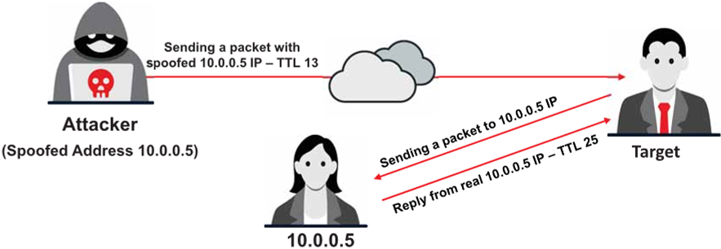
IP Spoofing Detection Techniques: Direct TTL Probes
Send a packet to the host of a suspected spoofed packet that triggers a reply and compare the TTL with that of the suspected packet; if the TTL in the reply is not the same as the packet being checked, this implies that it is a spoofed packet
This technique is successful when the attacker is in a different subnet from that of the victim
Note: Normal traffic from one host can contrast TTLs depending on traffic patterns

Slide 35
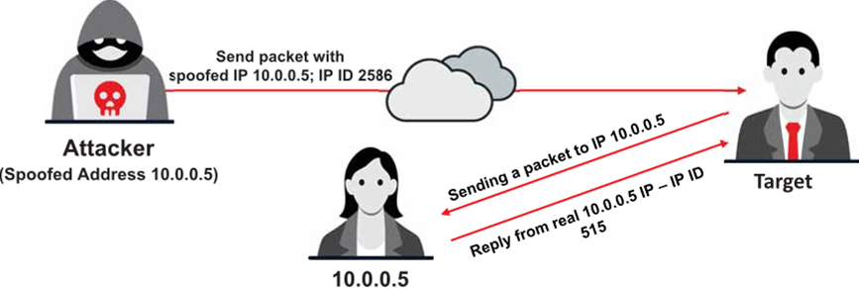
IP Spoofing Detection Techniques: IP Identification Number
Send a probe to the host of a suspected spoofed traffic that triggers a reply and compare the IPID with the suspected traffic
If the IPIDs are not close in value to the packet being checked, then the suspected traffic is spoofed
This technique is considered reliable even if the attacker is in the same subnet

Slide 36
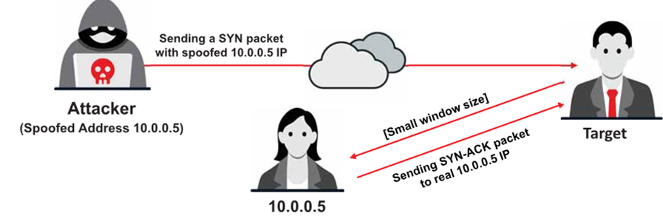
IP Spoofing Detection Techniques: TCP Flow Control Method
Attackers sending spoofed TCP packets will not receive the target's SYN-ACK packets
Therefore, attackers cannot respond to a change in the congestion window size
When received traffic continues after a window size is exhausted, the packets are most likely spoofed

Slide 37
IP Spoofing Countermeasures
Encrypt all the network traffic using cryptographic network protocols such as IPsec, TLS, SSH, and HTTPS
Use multiple firewalls to provide a multi-layered depth of protection
Do not rely on IP-based authentication
Use a random initial sequence number to prevent IP spoofing attacks based on sequence number spoofing
Ingress Filtering: Use routers and firewalls at your network perimeter to filter incoming packets that appear to come from an internal IP address
Egress Filtering: Filter all outgoing packets with an invalid local IP address as the source address

Slide 38
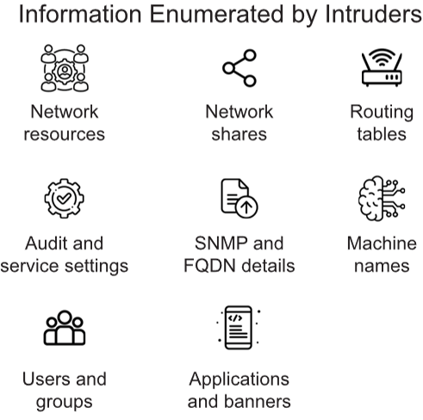
Enumeration
Enumeration involves an attacker creating active connections with a target system and performing directed queries to gain more information about the target
Attackers use the extracted information to identify points for a system attack and perform password attacks to gain unauthorized access to information system resources
Enumeration techniques are conducted in an intranet environment

Slide 39
Enumeration Techniques
NetBIOS Enumeration
SNMP Enumeration
LDAP Enumeration
NTP and NFS Enumeration
SMTP and DNS Enumeration
IPsec, VoIP, RPC, Unix/Linux, and SMB Enumeration

Slide 40
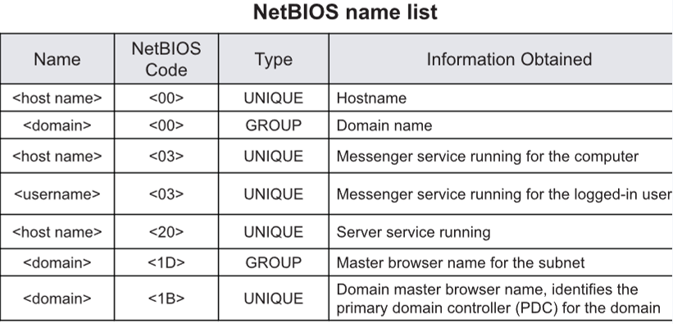
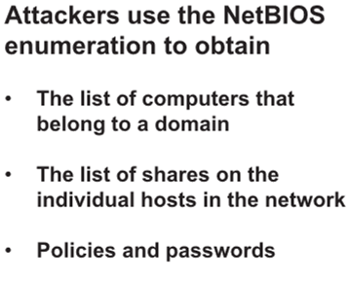
NetBIOS Enumeration
A NetBIOS name is a unique 16 ASCII character string used to identify the network devices over TCP/IP; fifteen characters are used for the device name, and the sixteenth character is reserved for the service or name record type
Note: NetBIOS name resolution is not supported by Microsoft for Internet Protocol Version 6 (IPv6)

Slide 41
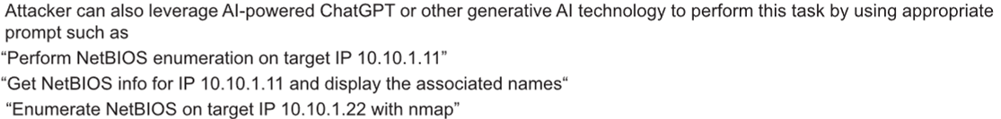
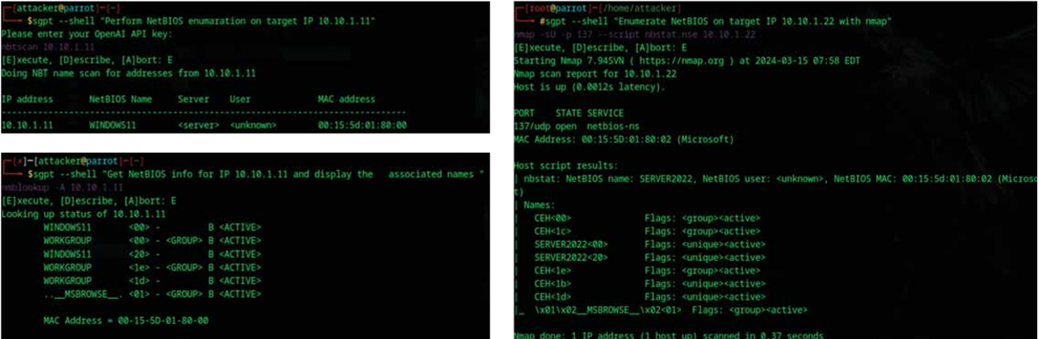
NetBIOS Enumeration (Cont’d)
NetBIOS Enumeration Tools:
Nbtstat Utility
Nmap https://nmap.org
Global Network Inventory https://magnetosoft.com
Advanced IP Scanner http://www.advanced-ip-scanner.com
Hyena https://www.systemtools.com
Notes:
Run the nbtstat command “nbtstat -a <IP address of the remote machine>” to obtain the NetBIOS name table of a remote computer
The Net View utility is used to obtain a list of all the shared resources of a remote host or workgroup
Net View Commands
net view \\<computername>  net view /domain:<domain name>

Slide 42
Enumeration Tools
SNMP using SnmpWalk and Nmap
snmp-check https://www.nothink.org
SoftPerfect Network Scanner https://www.softperfect.com
Network Performance Monitor https://www.solarwinds.com
OpUtils https://www.manageengine.com
Softerra LDAP Administrator https://www.ldapadministrator.com
ldapsearch https://linux.die.net
AD Explorer https://docs.microsoft.com
LDAP Admin Tool https://www.ldapsoft.com
https://nmap.org
https://www.metasploit.com
https://pentestmonkey.net
https://www.netscantools.com
DNS Enumeration Tools
Raccoon https://github.com
Subfinder https://github.com
Turbolist3r https://github.com
Notes:
Lightweight directory access protocol (LDAP) is an Internet protocol for accessing distributed directory services
A client starts a LDAP session by connecting to a directory system agent (DSA) on TCP port 389 and then sends an operation request to the DSA
Attackers query the LDAP service to gather information, such as valid usernames, addresses, and departmental details, which can be further used to perform attacks
Attackers query the NTP server to gather valuable information, such as list of connected hosts and Clients’ IP addresses in a network, their system names, and OSs
ntptrace
• Traces a chain of NTP servers back to the primary source • ntptrace [-n] [-m maxhosts] [servername/IP_address]
• ntpdc • Monitors operation of the NTP daemon, ntpd • ntpdc [-ilnps] [-c command] [host] [...]
ntpq
• Monitors NTP daemon (ntpd) operations and determines performance
• ntpq [-inp] [-c command] [host] [...]
The NFS system is generally implemented on the computer network, where the centralization of data is required for critical resources
NFS enumeration enables attackers to identify the exported directories, list of clients connected to the NFS server along with their IP addresses, and the shared data associated with the IP addresses
Attackers use tools such as RPSCan and SuperEnum to perform NFS enumeration
showmount command example: showmount –e 10.10.1.9
SMTP Enumeration
• SMTP provides 3 built-in-commands:  VRFY - Validates users  EXPN - Shows the actual delivery addresses of aliases and mailing lists  RCPT TO - Defines the recipients of a message
• SMTP servers respond differently to VRFY, EXPN, and RCPT TO commands for valid and invalid users, based on which we can determine valid users on the SMTP server
• Attackers can directly interact with SMTP via the telnet prompt and collect a list of valid users on the SMTP server
IPsec Enumeration
Most IPsec based VPNs use ISAKMP, a part of IKE, to establish, negotiate, modify, and delete Security Associations (SA) and cryptographic keys in a VPN environment
A simple scanning for ISAKMP at UDP port 500 can indicate the presence of a VPN gateway
Attackers can probe further using a tool, such as ike-scan, to enumerate sensitive information, including encryption and hashing algorithm, authentication type, key distribution algorithm, and SA LifeDuration
An attacker can also leverage AI-powered ChatGPT or other generative AI technology to perform this task by using an appropriate prompt such as “Perform IPsec enumeration on target IP 10.10.1.22 with nmap"
VoIP uses Session Initiation Protocol (SIP) protocol to enable voice and video calls over an IP network
SIP service generally uses UDP/TCP ports 2000, 2001, 5060, and 5061
VoIP enumeration provides sensitive information, such as VoIP gateway/servers, IP-PBX systems, client software (softphones)/VoIP phones, User-agent IP addresses, and user extensions
This information can be used to launch various VoIP attacks, such as Denial-of-Service (DoS), Session Hijacking, Caller ID spoofing, Eavesdropping, Spamming over Internet Telephony (SPIT), and VoIP phishing (Vishing)
Remote Procedure Call (RPC) allows clients and servers to communicate in distributed client/server programs
• Enumerating RPC endpoints enables attackers to identify any vulnerable services on these service ports
DNS Enumeration
Attackers use Nmap for scanning domains and obtaining a list of subdomains, records, IP addresses, and other valuable information from the target host
DNSSEC Enumeration
Attackers enumerate DNSSEC using Nmap dns-nsec-enum.nse or dns-nsec3-enum.nse scripts to obtain information related to domains and their sub-domains
Attackers use SMB enumeration tools, such as Nmap, SMBMap, enum4linux, and nullinux, to perform a directed scan on the SMB service running on port 445
 SMB enumeration helps attackers to perform OS banner grabbing on the target
SMB Enumeration with AI
An attacker can also leverage AI-powered ChatGPT or other generative AI technology to perform this task by using an appropriate prompt such as
“Scan the target IP 10.10.1.22 for the port using SMB with nmap”
An attacker can also leverage AI-powered ChatGPT or other generative AI technology to automate various network enumeration tasks by create custom script that will run automatically and fetch the desired result. They can use appropriate prompts to create custom scripts

Slide 43
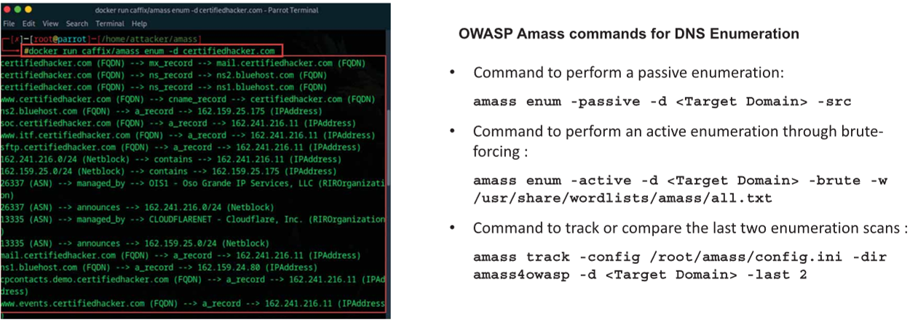
DNS Enumeration Using OWASP Amass
OWASP Amass is a DNS enumeration tool that allows attackers to map the target network and discover potential attack surfaces
Notes:
Create and Run Custom Script to Automate Network Enumeration Tasks with AI
 An attacker can also leverage AI-powered ChatGPT or other generative AI technology to automate various network enumeration tasks by create custom script that will run automatically and fetch the desired result. They can use appropriate prompts to create custom scripts, such as the one below: • “Develop and execute a script which will automate network enumeration tasks on target IP range 10.10.1.0/24”
Copyright

Slide 44
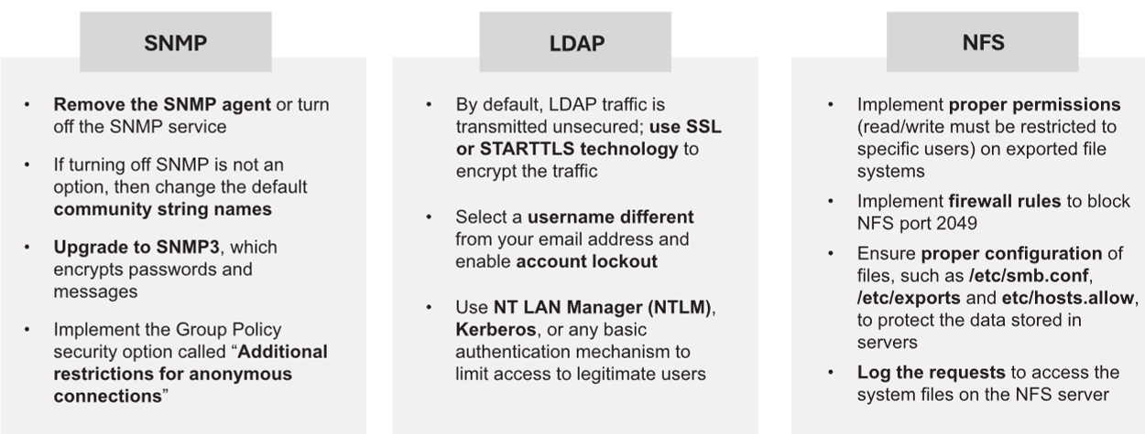
Enumeration Countermeasures

Slide 45
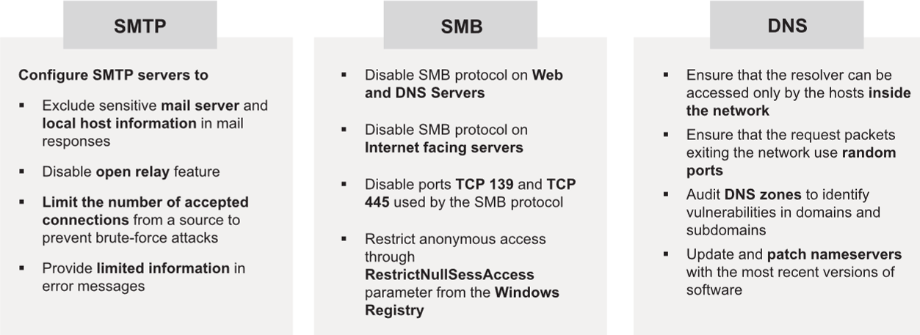
Enumeration Countermeasures (Cont’d)

Slide 46
Summary
How attackers discover live hosts from a range of IP addresses by sending various ping scan requests to multiple hosts
How attackers perform different scanning techniques to determine open ports, services, service versions, etc. on the target system
How attackers perform banner grabbing or OS fingerprinting to determine the operating system running on a remote target system
Various scanning techniques that attackers can employ to bypass IDS/firewall rules and logging mechanisms, and disguise themselves as regular network traffic
Network scanning countermeasures to defend against network scanning attacks
Enumeration concepts along with techniques, services, and ports used for enumeration
attackers perform enumeration using different techniques (NetBIOS, SNMP, LDAP, AD, NTP, NFS, SMTP, DNS, IPsec, VoIP, RPC, Linux/Unix, and SMB enumeration) to gather more information about a target
How organizations can defend against enumeration activities

Slide 47
Questions?

Slide 48
References
M. T Whitman, H. J. Mattford, Principles of Information Security, Cengage Learning, 4th ed 2012.
https://aspen.eccouncil.org/
https://attack.mitre.org
http://ceh.vn/
http://www.symantec.com/security_response/publications/threatreport.jsp

