Slide 1
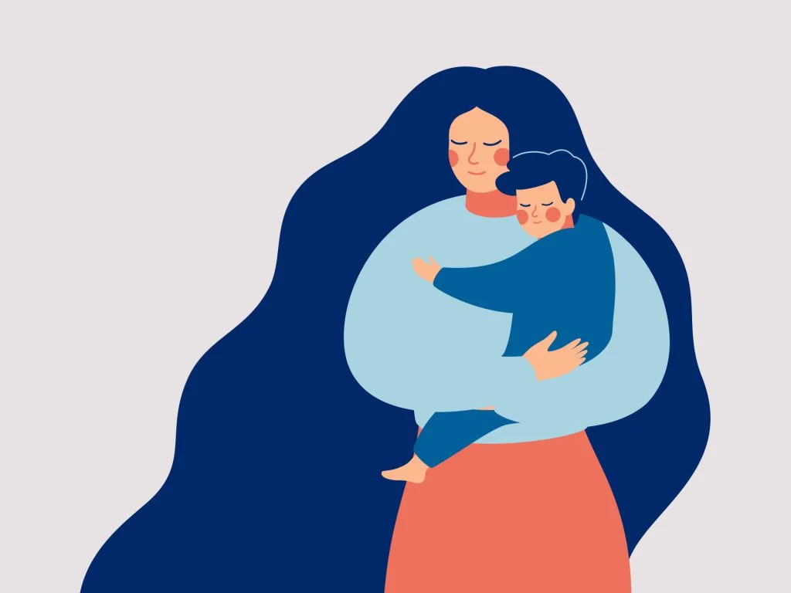
Jenny’s Development & Support Plan using Bowlby’s Attachment Theory
Name: Fatema Khatun
Student Number: 2432006
Module Code: LCHS4003
Module Name: Introduction to Health and Social Care
Assignment Title: Assessment 1: Individual Presentation

Slide 2
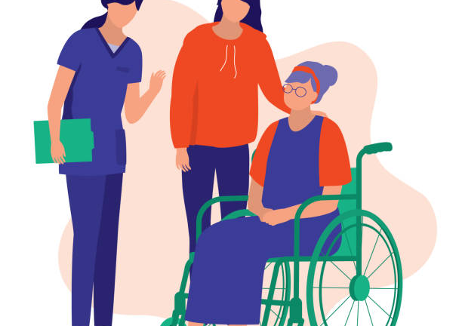
Introduction
Briefly explain the theory
Apply its to Jenny’s experiences
Suggest support strategies
Nature versus nurture
Evaluate the theory

Slide 3
Overview of Bowlby’s Attachment Theory
Bowlby’s Attachment Theory? (Bowlby. J,1988)
Common attachment patterns (Ainsworth. M. D. S, 2015)
Children are born needing close relationships with caregivers to feel safe and protected.
These early relationships help shape how we understand ourselves and others later in life (Cassidy. J, Shaver. P. R, 2016).
If care is reliable/caring (secure base) → Child will learn, “I am safe, people can be trusted.”
If care is inconsistent/unavailable → Child will learn, “I must cope alone” or “people may leave ”.
Secure – feels safe, trusts others, manages emotions well
Anxious – worries about being abandoned
Avoidant – hiding emotions, overly independent
Disorganised – confused or scared in relationships
These patterns often develop from early caregiving experiences.

Slide 4

Applying Attachment Theory to Jenny (Past 5 Years)
Loss and role change
Father died when Jenny was 11
Jenny became her mum’s carer
Normal caregiving was disrupted
Understanding Jenny as a teenager
Teenagers normally develop independence, identity and friendships. Jenny instead had adult responsibilities. (Ainsworth. M. D. S, 2015)
Jenny may show signs of:
Anxious attachment – worrying about abandonment
Avoidant attachment – hiding emotion, very independent
Disorganised attachment – feeling confused, under stress

Slide 5
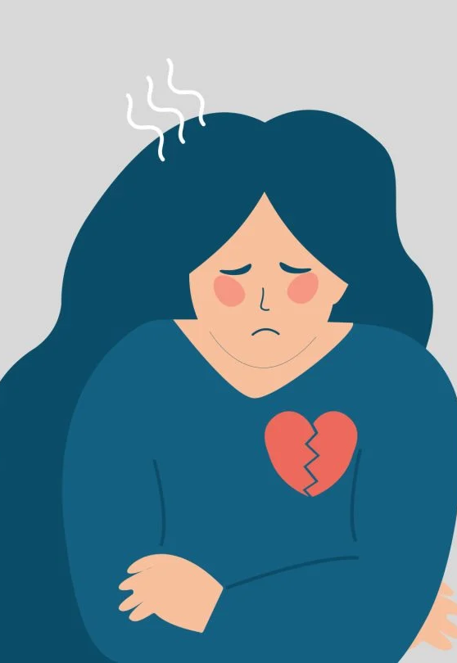
Continued
Impact on Jenny’s wellbeing
Because of this, Jenny may:
Feel emotionally unsafe
Put others first
Hide her own needs
Feel anxious or low
Loss and caring responsibilities can affect:
Emotional control
Self-esteem
Relationships
(Bowlby. J,1988)

Slide 6

Practical Strategies (Part 1: Support at Home)
Goal: Reduce Jenny’s caring role and rebuild a “secure base”
1. Young Carer Assessment + Home Support
2. Attachment-Based Family Therapy
Home-care, cleaning, meals, admin help
Reduces Jenny’s responsibilities
Helps her feel emotionally safe (Bowlby. J, 1988)
Agencies involved
Local Authority Adult Social Care
Young Carers Services
Carers Trust (Carers Trust, 2026)
Referral through CAMHS (Child and Adolescent Mental Health Services) (NHS, 2026)
Helps Jenny express feelings
Rebuilds trust with her mother
Agencies involved
CAMHS (NHS, 2026)
Family therapists

Slide 7

Practical Strategies (Part 2: Support Outside the Home)
Goal: Build emotional support outside the home
School Mentor / Key Adult
Pastoral lead checks in with Jenny (Academy21, 2025)
Provides emotional support
Gives Jenny a safe adult to trust
Attachment link: Compensatory attachment
Young people can form secure relationships with other adults when home life is difficult (Bowlby. J, 1988)
Agencies:
School pastoral team (Academy21, 2025)
Educational psychology

Slide 8
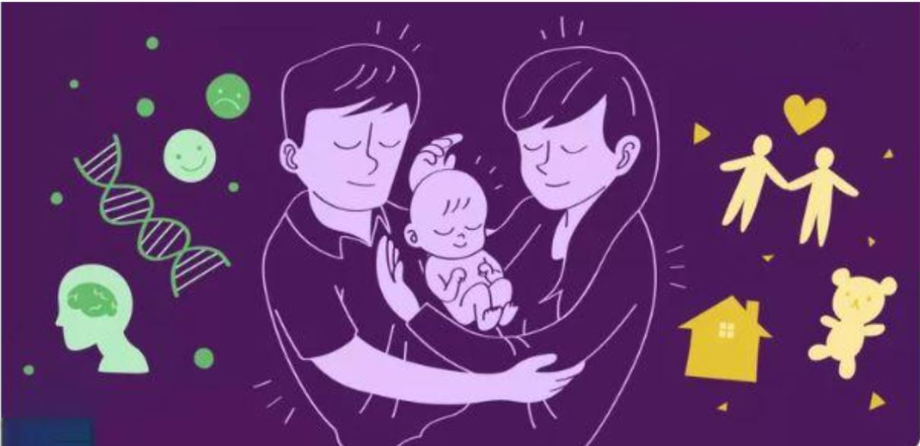
Nature vs Nurture: What Shapes Jenny’s Wellbeing?
Nurture (STRONG influence)
Nature (moderate influence)
Jenny’s wellbeing has mainly been shaped by her environment:
Loss of her father at age 11
Becoming a young carer too early
Ongoing stress at home
Less time for friends and school
Less emotional support from her mother
This may lead to anxiety or low mood and hiding her own needs (Bowlby. J,1988)
Biology also matters (Cassidy. J, Shaver. P. R, 2016) :
Teen brain still developing emotions
Long-term stress affects mood
Possible genetic risk
Together
Jenny’s wellbeing reflects:
A developing teenage brain + long-term stress = Higher emotional risk

Slide 9
Nature vs Nurture: Impact on support
Impact on effectiveness of interventions
Support is likely to work if it (Bowlby, 1988) :
Reduce her caring responsibilities
Provide stable adult support
Improve emotional safety
Are consistent and long-term
However:
Progress may be slow
Trust may take time
Change will not be instant
This is why Attachment-based support is needed, not quick fixes

Slide 10
Evaluation of Attachment Theory
Strengths
Limitations
Explains impact of early loss and caregiving
Highlights emotional needs in young carers
Supports relationship-based support
Strong evidence base
(Bowlby. J, 1988), (Cassidy. J, Shaver. P. R, 2016)
Focuses mainly on early childhood
Can ignore Jenny’s strengths and resilience
Limited focus on poverty, access to services and education
Based on Western family models
(Cassidy. J, Shaver. P. R, 2016)

Slide 11
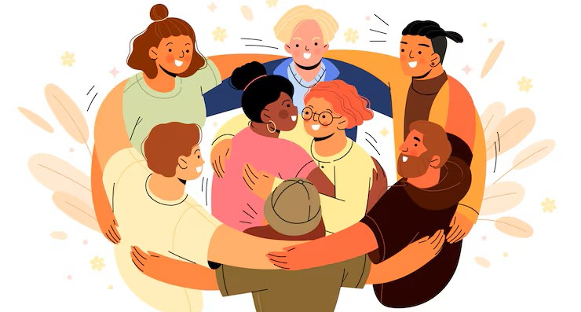
Alternative Theory: Lev Vygotsky’s Sociocultural Theory
Development is shaped by (Vygotsky. L.S, 1978) :
People around you
Support service
School and learning
Cultural and community
Why useful for Jenny
Professionals can scaffold her development
School mentors support emotional growth
Community services improve outcomes
Scaffolding = temporary support until someone can cope on their own.
Vygotsky explains social support while Bowlby explains emotional impact. Together they give a fuller picture

Slide 12
Conclusion
Attachment theory explains how loss and caring affected Jenny
Helps us understand her emotional needs
Supports relationship-based care
Guides effective support for young carers
Take-home message:
“Psychological theory helps professionals support emotional wellbeing, not just practical needs”
(Bowlby. J, 1988), (Cassidy. J, Shaver. P. R, 2016)

Slide 13

THANK YOU!
Any questions?

Slide 14
References
(Academy21, 2025). What is pastoral support in schools? Available at: https://academy21.co.uk/resource/blog/what-is-pastoral-support-in-schools/ (Accessed: 8 February 2026).
(Ainsworth. M. D. S, 2015). Ainsworth-patterns-of-Attachment.pdf. Available at: https://mindsplain.com/wp-content/uploads/2021/01/Ainsworth-Patterns-of-Attachment.pdf (Accessed: 8 February 2026).
(Bowlby. J,1988) A secure base parent-child attachment and Healthy Human Development. Available at: https://www.increaseproject.eu/images/DOWNLOADS/IO2/HU/CURR_M4-A13_Bowlby_(EN-only)_20170920_HU_final.pdf (Accessed: 8 February 2026).
(Carers Trust, 2026). Carers Trust: Transforming The Lives of Carers. Home - Carers Trust. Available at: https://carers.org/ (Accessed: 8 February 2026).
(Cassidy. J, Shaver. P. R, 2016). Handbook of attachment, third edition. Google Books. Available at: https://books.google.co.uk/books?hl=en&lr=&id=2L6CCwAAQBAJ&oi=fnd&pg=PA25&dq=Cassidy%2C%2BJ.%2Band%2BShaver%2C%2BP.R.%2B%282016%29%2BHandbook%2Bof%2BAttachment&ots=o08A7pqssl&sig=b840svnd8_DN_xSyCU8uxL9wMl8#v=onepage&q&f=false (Accessed: 8 February 2026).
(NHS, 2026). NHS choices. Available at: https://www.nhs.uk/mental-health/children-and-young-adults/mental-health-support/mental-health-services/ (Accessed: 8 February 2026).
(Vygotsky. L.S, 1978). Mind in society The development of higher Psychological processes. Available at: https://home.fau.edu/musgrove/web/vygotsky1978.pdf (Accessed: 8 February 2026).

