Slide 1
Professional Career Development within Health and Social Care – LCHS4009 Week 8
Writing a supporting statement

Slide 2
Aims
To understand the importance of a supporting statement
To know how to write a good supporting statement

Slide 3
What is a supporting statement?
A supporting statement is the part of your job application process This is where you can give evidence of how you meet specific job criteria.
Your supporting statement can also be a professional summary which shows how your skills and qualifications fulfil the job requirements.
Many employers spend only seconds scanning CVs, so writing a strong supporting statement is essential for distinguishing yourself from other candidates (Indeed, 2024)

Slide 4
Writing a supporting statement
When writing your statement, it is important to:
Use keywords from the job description
Describe how your qualifications fulfil the job requirements.
Give examples of past success in similar roles.
Show how you can contribute to the organisation.

Slide 5
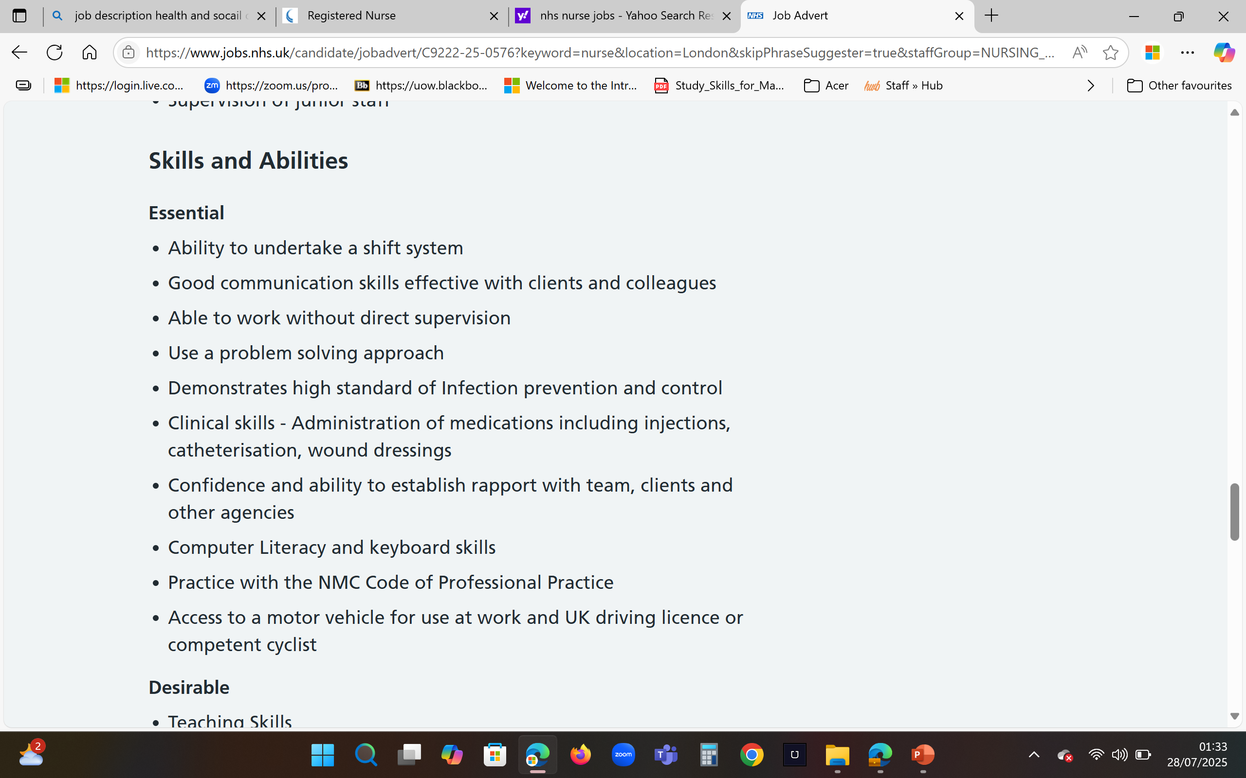
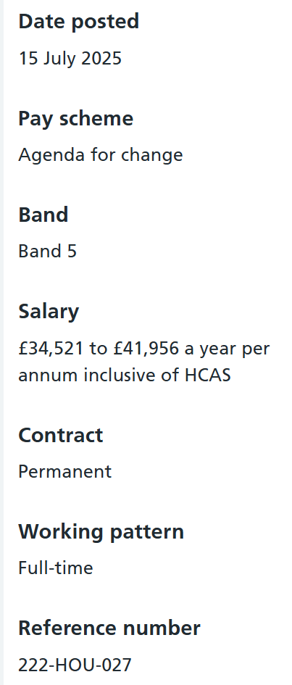
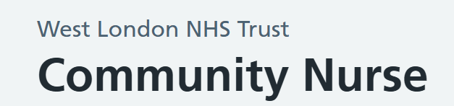
Writing a supporting statement
Use keywords from the job description

Slide 6
Writing a supporting statement
Describe how your qualifications fulfil the job requirements.

Slide 7
Writing a supporting statement
Give examples of past success in similar roles

Slide 8
Writing a supporting statement
Show how you can contribute to the organisation
HR Buzzwords
Adaptability?
Collegiality?
Criticality?
Autonomy?
Safe clinical practice?
Digital literacy?
NMC compliance?

Slide 9
How should you write a supporting statement?
Follow these steps to learn how to write a supporting statement:
1. Review the job description
Review the job description and highlight the keywords and phrases used by employers.
Incorporate these keywords into your supporting statement to clearly demonstrate how your skills and experience meet the role's requirements and contribute to the organisation's success (Indeed, 2024)

Slide 10
How should you write a supporting statement?
2. Include relevant skills and qualifications
After reviewing the job description, use your statement to highlight how your skills and qualifications fulfil the specific requirements.
Use keywords and phrases from the job details to describe your experience in the career field, so employers can understand how your expertise relates to the job criteria.
For instance, if an employer requires a specific degree and your credentials fulfil this requirement, do share this information in your supporting statement (Indeed, 2024).

Slide 11
How should you write a supporting statement?
3. Give examples of your success
Consider one or two examples of how you succeeded in past roles. Examples that demonstrate your experience and skills that relate directly to the job can give employers better insight into how you can achieve similar success for their team or department.
When highlighting achievements, be sure to offer examples that can show your organisational, interpersonal and teamwork skills alongside your ability to communicate effectively (Indeed, 2024).

Slide 12
How should you write a supporting statement?
4. Keep your supporting statement brief
Use up to three sentences for your statement to ensure your details will be brief and easy to read.
This will help gain employers' attention quickly when they scan your application. It will increase the chances of them reviewing your CV further and contacting you for an interview.
Include your most relevant traits that fulfil the requirements in your first sentence, with an example of a related achievement in the second sentence.
In your last sentence, describe how you plan to contribute to similar success for the organisation to which you are applying

Slide 13
How should you write a supporting statement?
5. Format your statement
Follow a format that is appropriate to the document. For example, a supporting statement on a CV is often only two to three sentences in length, whereas a supporting statement in a cover letter can be up to four or five sentences.
The most importantly, when formatting your statement, you should include relevant details that employers can see right away.
Place your statement at the top of your application or CV and as the first paragraph in a cover letter.

Slide 14
How should you write a supporting statement?
6. Proofread your statement
When you complete your supporting statement, ensure it is free from spelling and grammatical errors.
When applying to multiple jobs, tailor each supporting statement to match the specific requirements for each position to which you apply.
This ensures you highlight the relevant skills and qualifications with each application.

Slide 15
Tips for writing your supporting statement
Make your statements specific to each job application you submit so employers understand how you can benefit their organisations.
Use the company's name whenever applicable in your statement to help build rapport.
Give specific examples of your achievements to better show what you accomplished, such as percentages, amounts or numbers.
Reiterate how you plan to help the employer, so they understand your motivation to achieve results.
To show how well you have understood the organisation, mention one of their current challenges or projects you are excited to contribute to.

Slide 16
Activity 1
You will now view an expert’s advice on how to produce effective supporting statements for NHS application forms.
Do take notes as you view this advice with focus on:
The five things to include in your statement
The seven key words or phrases to include
You will then use these notes to work on follow-up tasks.

Slide 17

Notes:
https://www.youtube.com/watch?v=DQyXE_PhpXA
Available on Moodle page as well.

Slide 18
The supporting statement section of an NHS application should be used to explain why you are the best candidate for this role.
Aim to sell your professional brand by clearly demonstrating your suitability for the job. Match your skills, experience and knowledge with the person specification for this vacancy.
5 things to include in your supporting statement:
Your main duties and responsibilities from previous roles you have held. This information will help show your abilities for teamwork, exceptional service and adherence to rules and policies.

Slide 19
Detail your skills and knowledge that are relevant to this role. This showcases your abilities for leadership, communication and listening skills, managing stressful situations, dealing with difficult people, problem solving and adapting to change with a positive attitude.
Details of voluntary work you have carried out. This demonstrates your ability to be empathetic and have a caring nature.
Information about any presentations you have delivered, research work completed, or publications and dissertation you have written. This shows your abilities to communicate effectively, extract information and then apply it with confidence.

Slide 20
Details of gaps in your employment history, including:
caring for elderly/sick family members
raising a family
travelling abroad to learn about different cultures, ways of living and languages.
studying for a course, learning a new skill or developing an existing one.
7 words/phrases to include in a supporting statement:
NHS values. This shows you know the expected standard for delivering outstanding treatment and care to patients
Job description. This indicates you have read and fully understood the knowledge, skills and experience required and are confident about meeting all those requirements

Slide 21
Collaboration. This shows you can work well with other healthcare professionals to deliver effective care.
Commitment to quality of care. This shows you can provide exceptional care to meet patients’ needs.
Flexible and adaptable. This shows you can work additional hours and cover duties for colleagues.
Respect and diversity. This shows you are respectful to people of all backgrounds and shall represent the organisation well by exercising these values.
Taking ownership. This shows you can address challenges. You are also able to take on the responsibility of furthering your professional development.

Slide 22
Post-task discussion
‘Managing difficult people’ - How could you rephrase this so that you do not sound negative in tone?
*** ‘managing challenging situations involving people’***
*** ‘managing expectations’ ***
You can use the STAR model:
S – situation
T – task
A – action
R – result
Revisit the How to Complete a Job Application Form article (Indeed, 2023) - wk7 folder

Slide 23
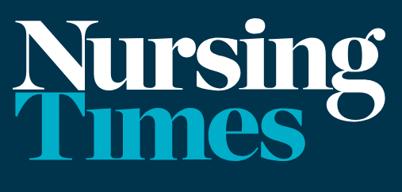
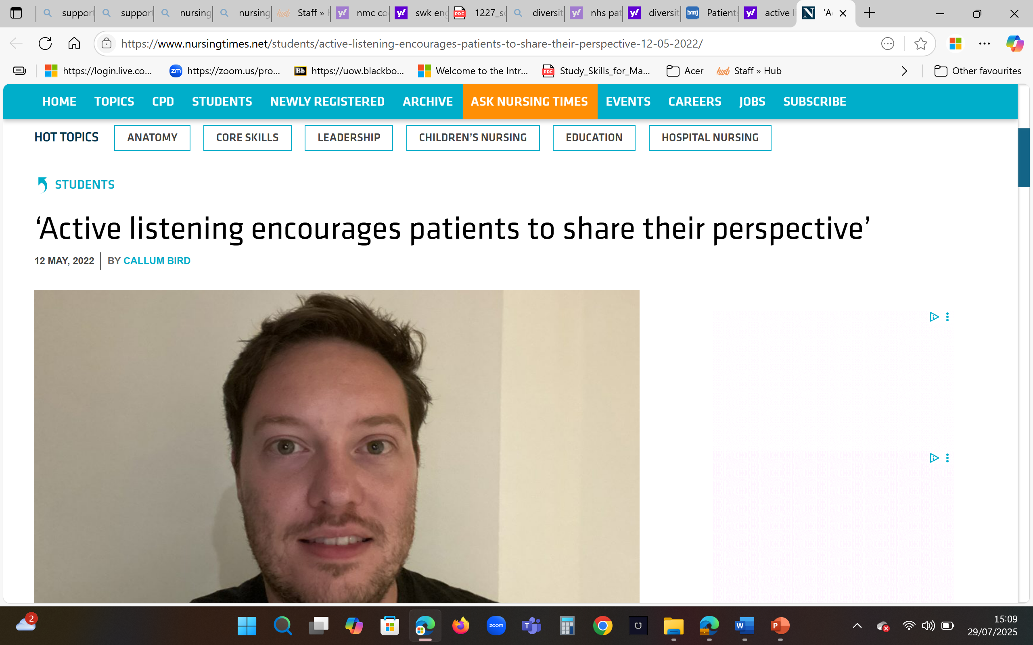
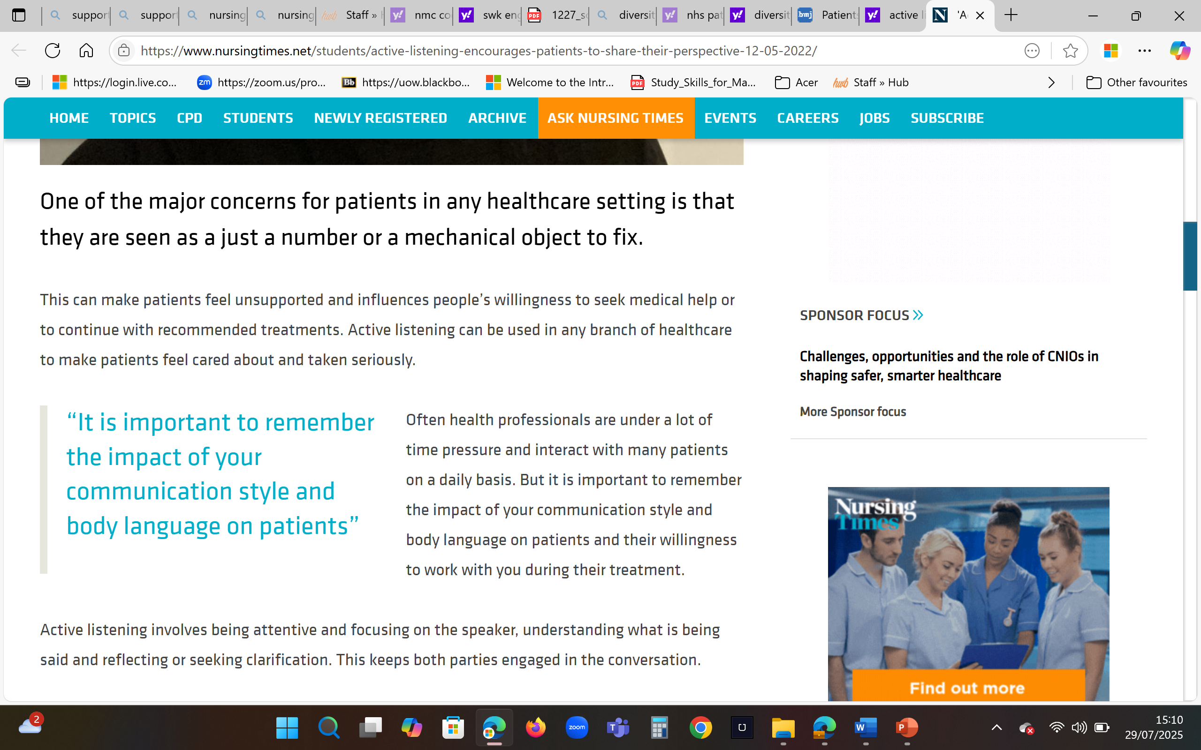
Post-task discussion
What is the specific type of listening skill that you should be promoting in your supporting statement?
*** active listening ***
Notes:
https://www.nursingtimes.net/students/active-listening-encourages-patients-to-share-their-perspective-12-05-2022/

Slide 24
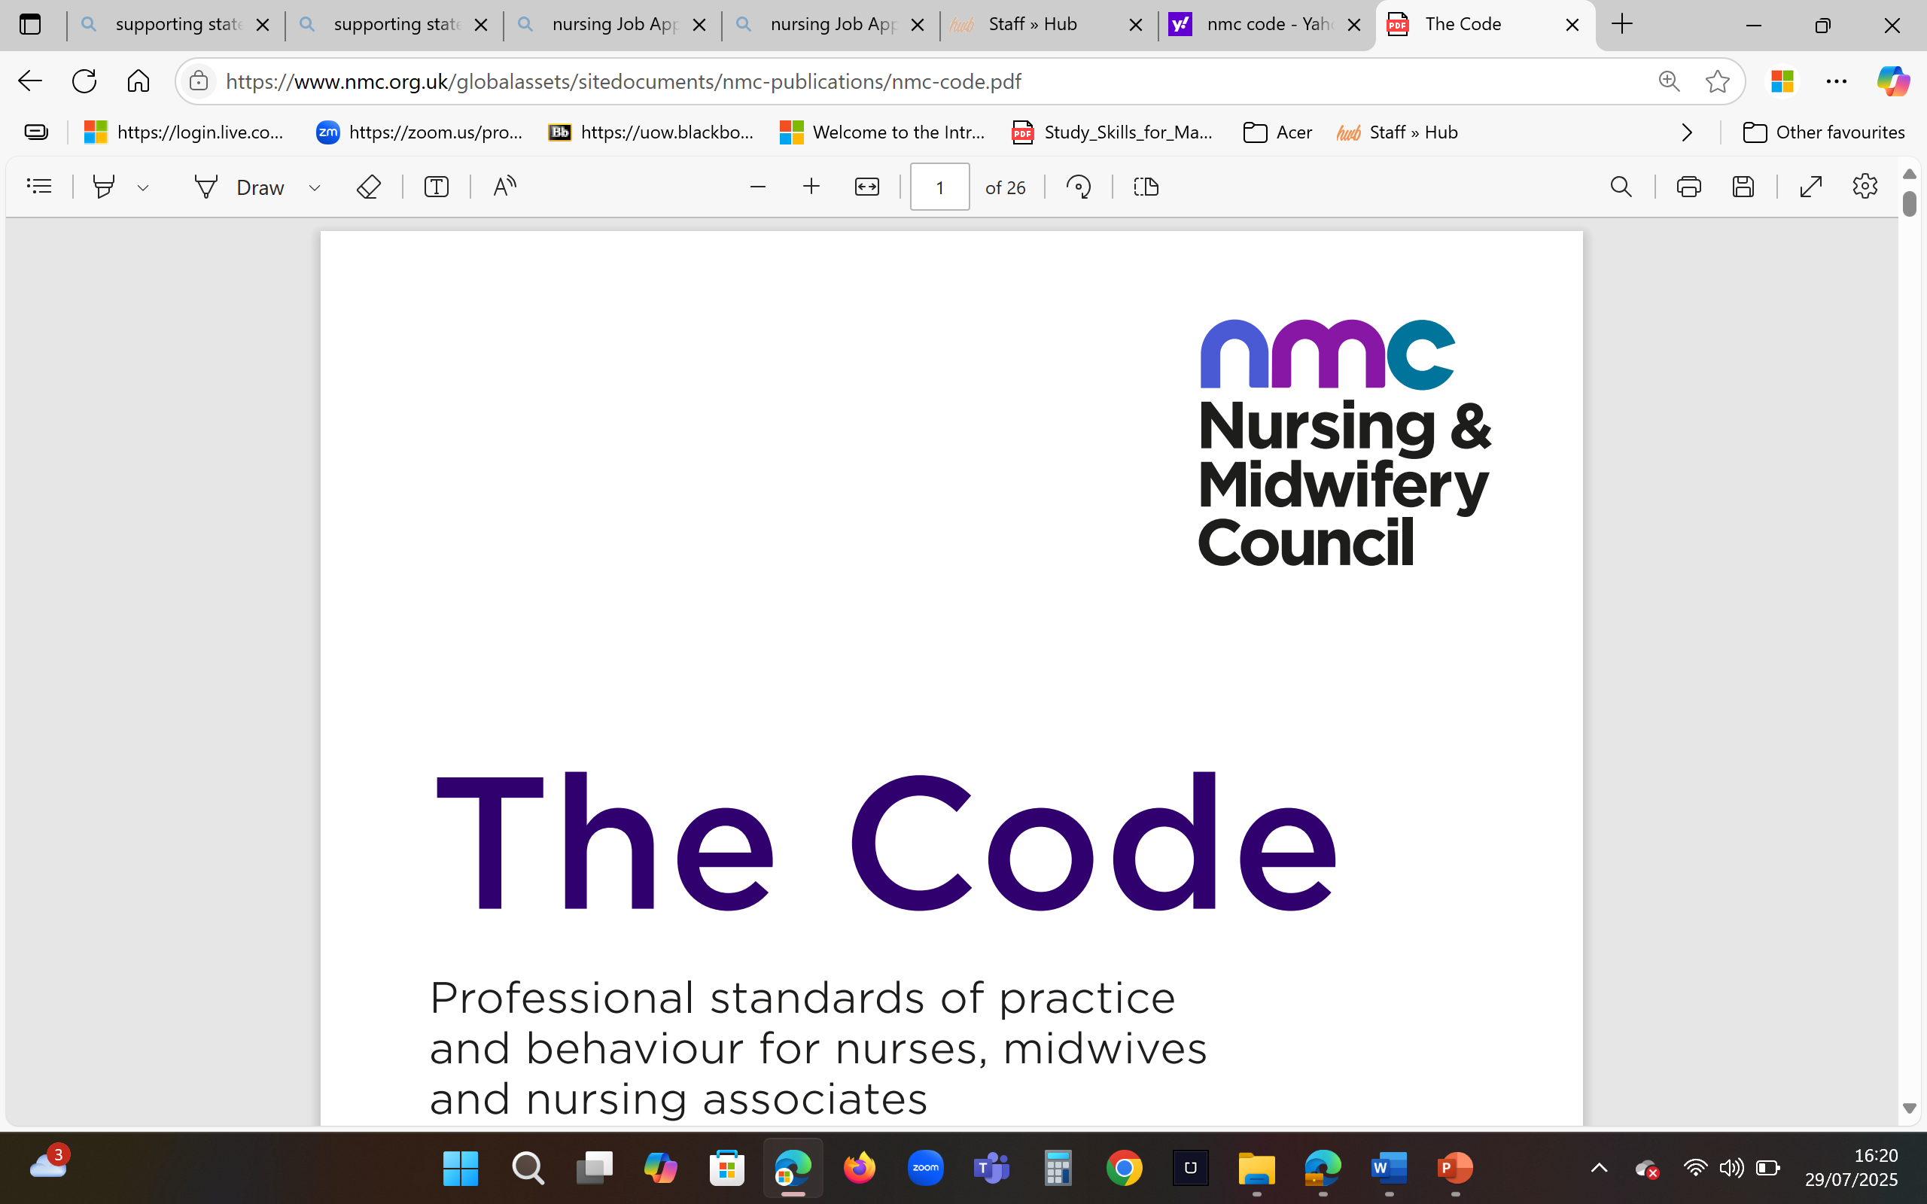
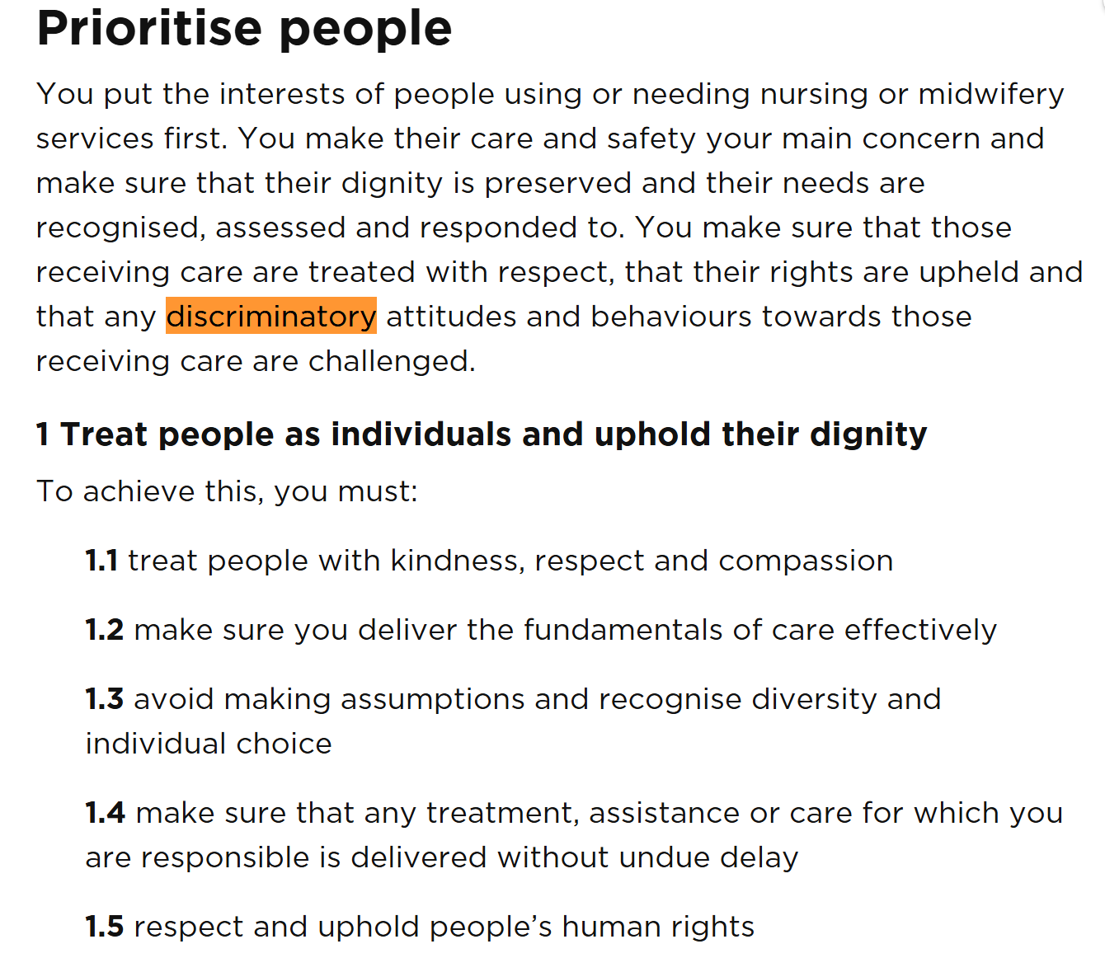
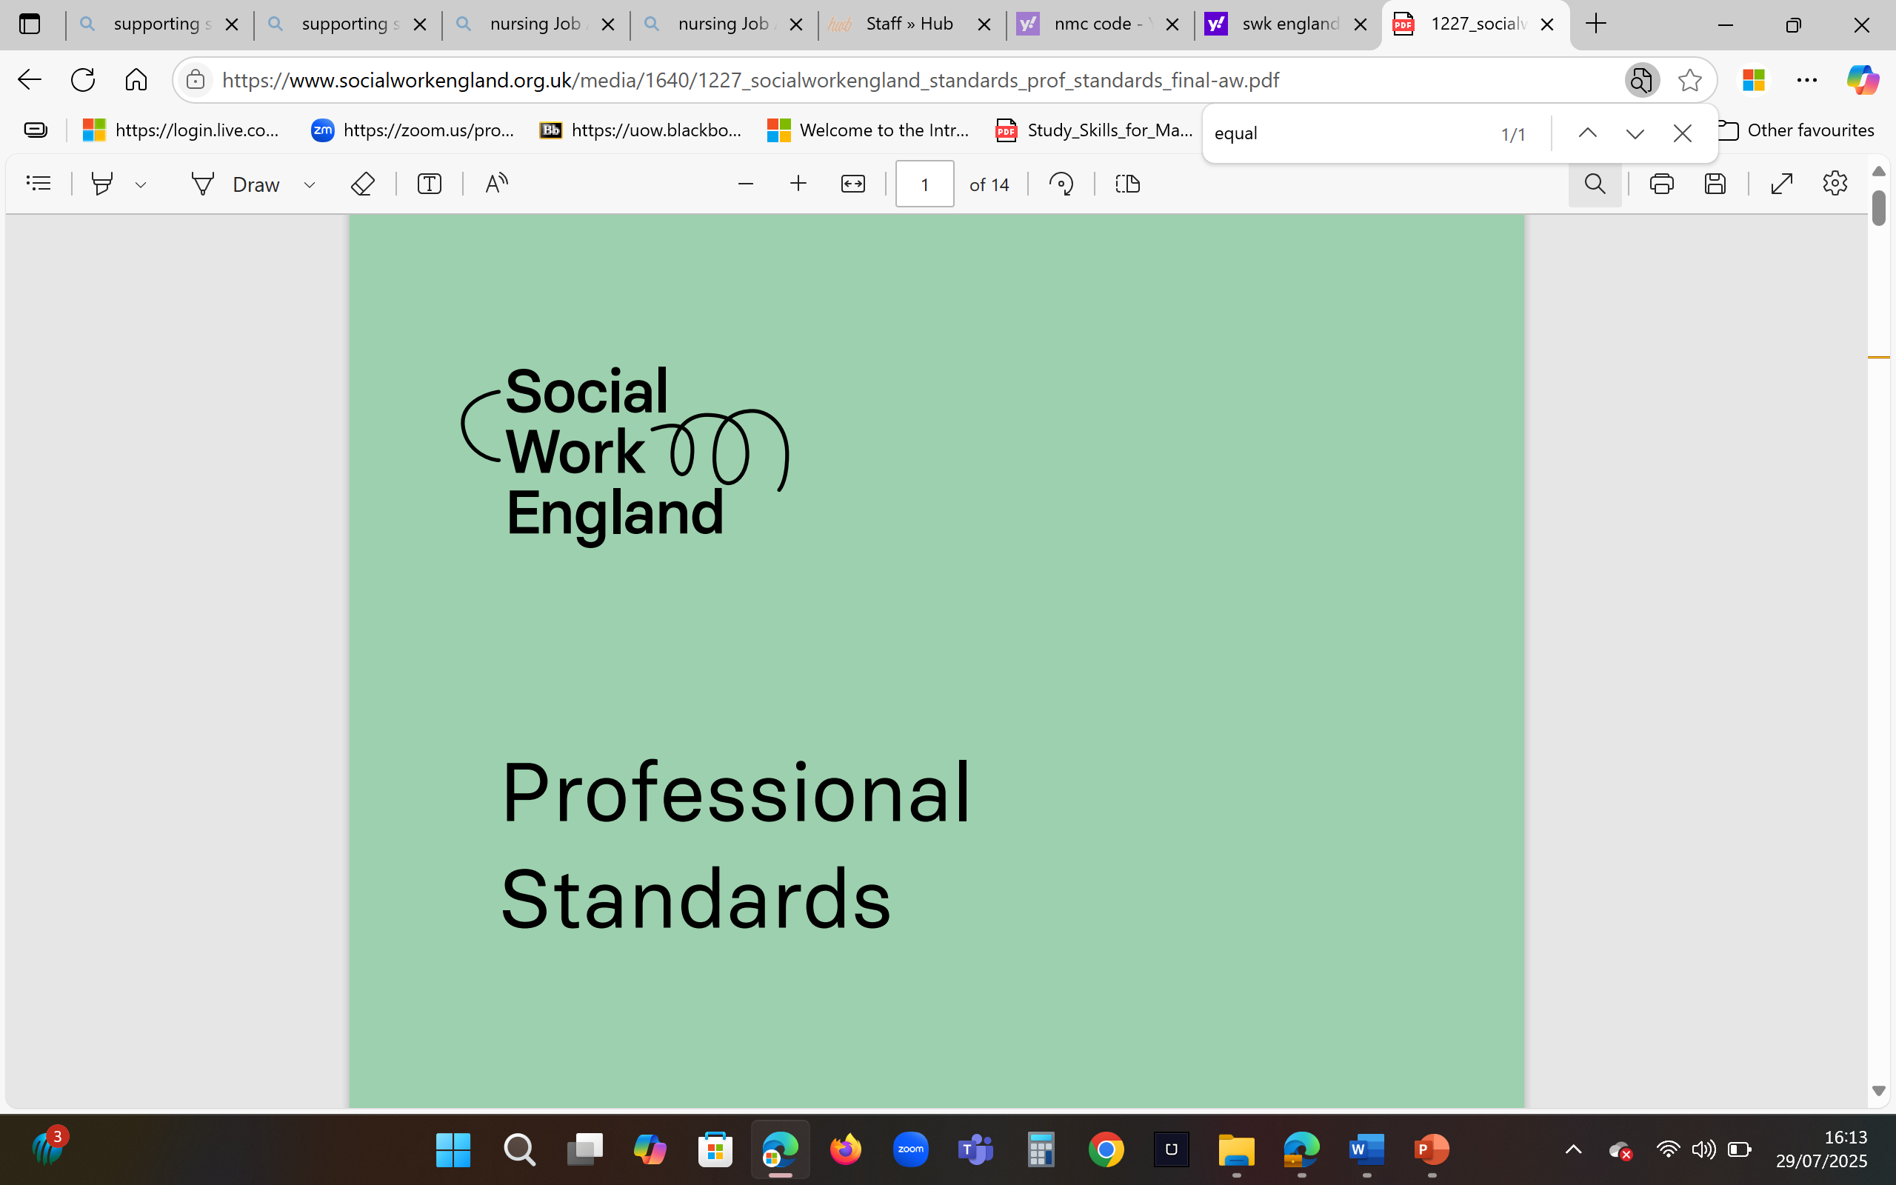
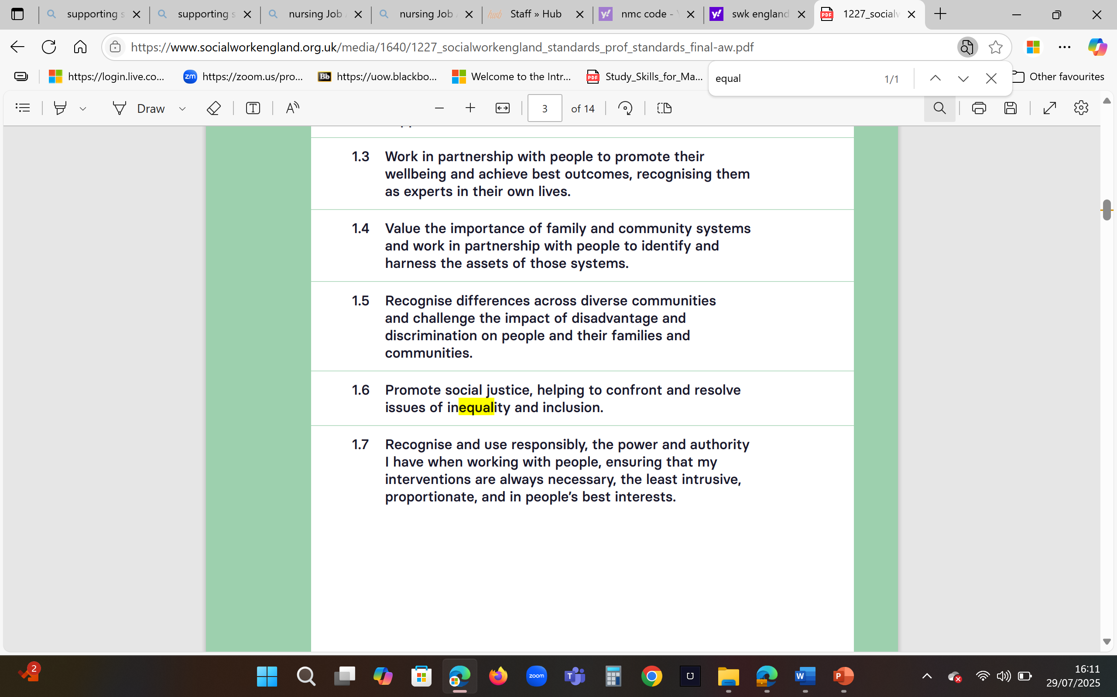

Post-task discussion
What have you understood about the need to demonstrate respect and diversity in the health and social care sector?
NHS workforce - GOV.UK Ethnicity facts and figures
Patients face discrimination in primary care, survey finds | The BMJ
NHS England » NHS equality, diversity, and inclusion improvement plan
Notes:
https://youtu.be/Yue1glAllAs

Slide 25
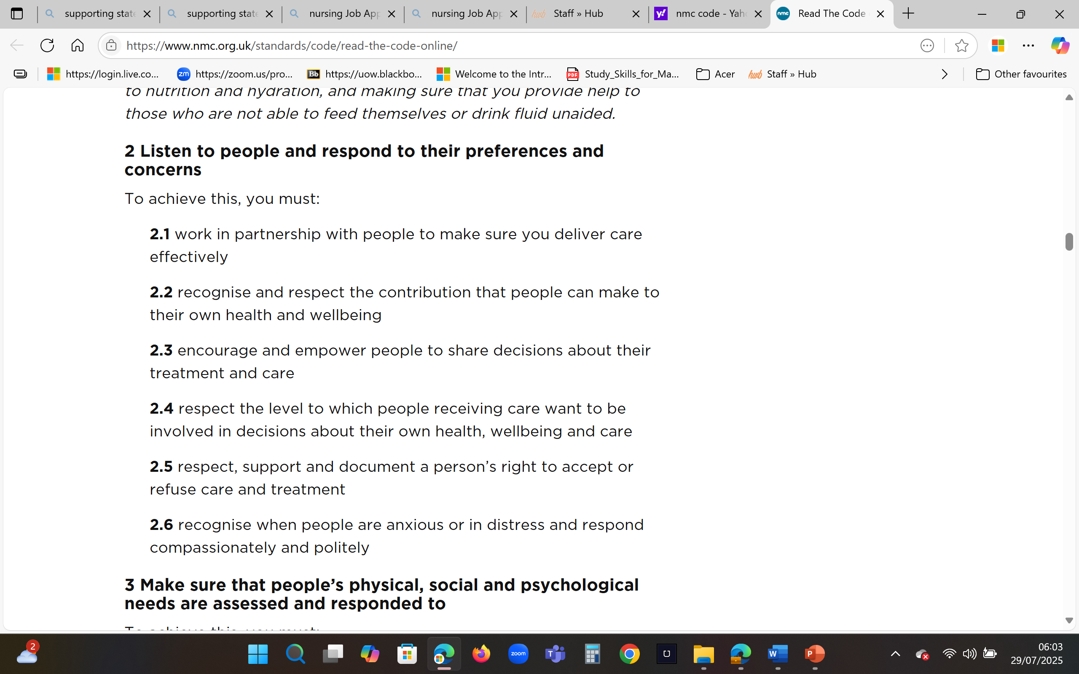
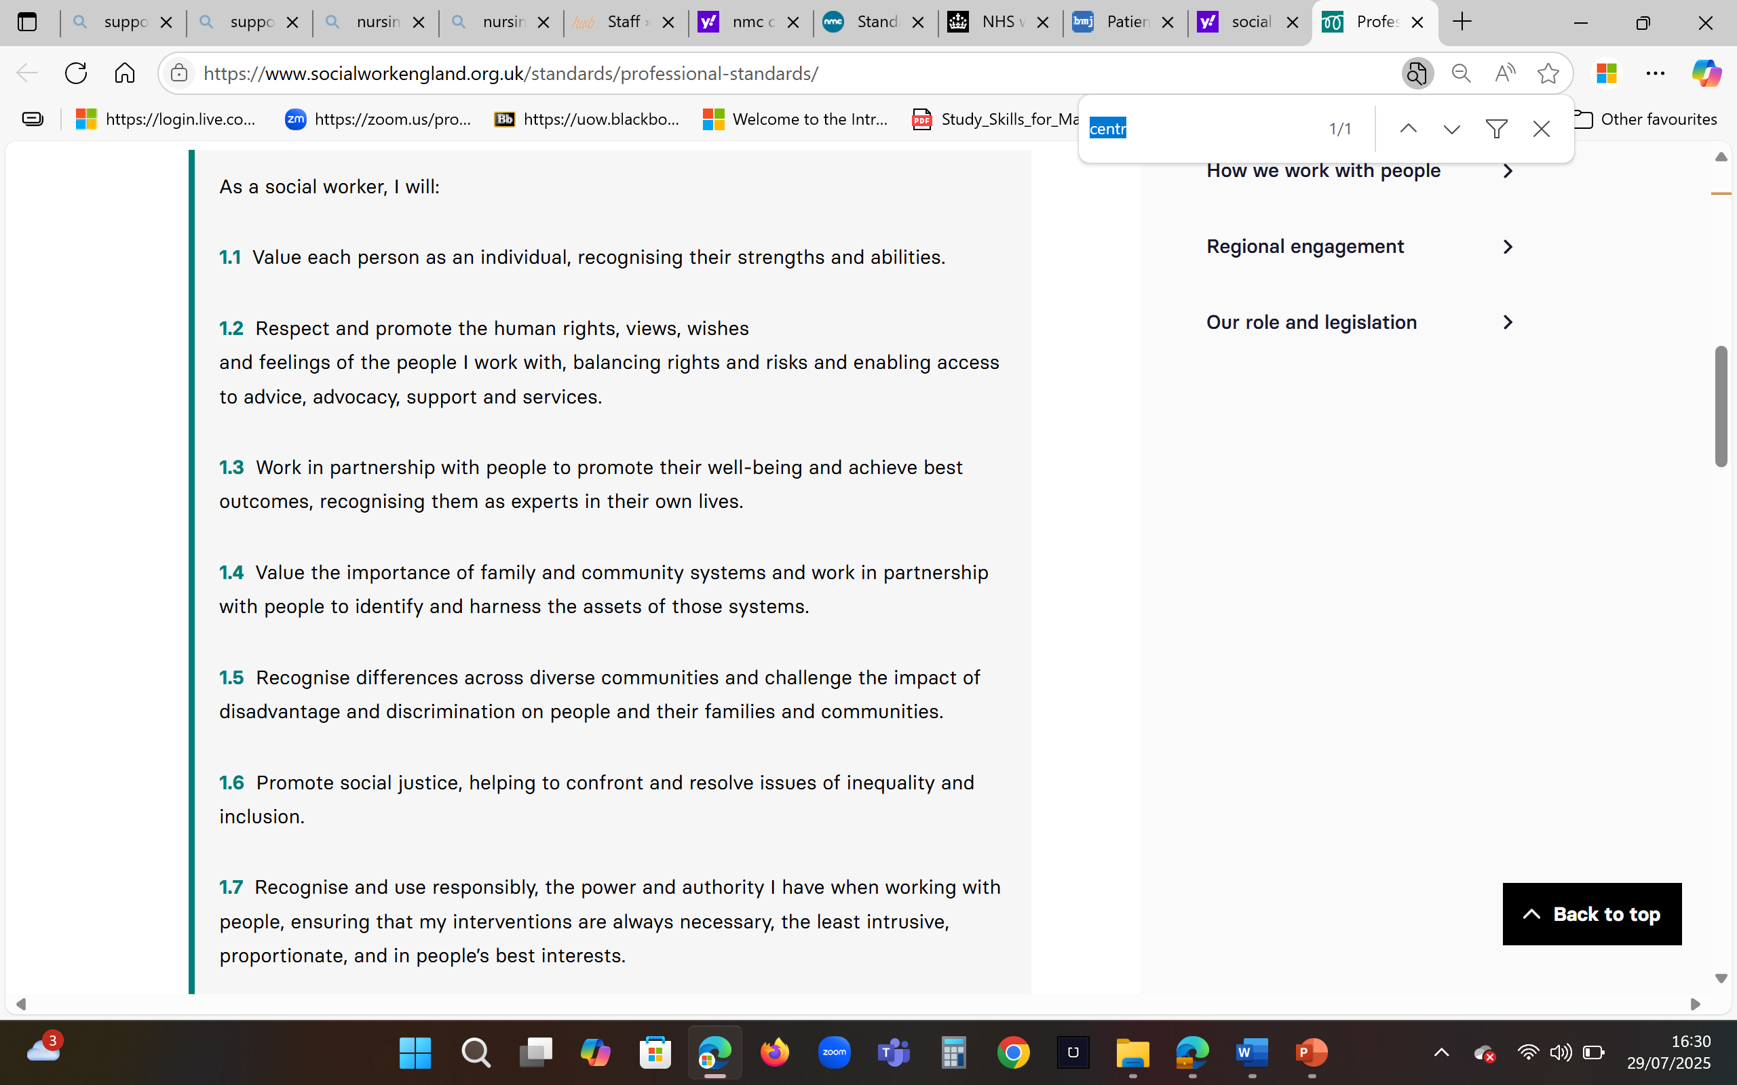
Post-task discussion
‘Why must you show that you can assess patients’ needs and respond accordingly?
*** health and social care professionals are committed to the delivery of person-centred care ***

Slide 26
Post-task discussion
Why are you being encouraged to promote research and dissertation work as a skill in your supporting statement?
Social Workers produce evidence-based Section 7 reports for court.
http://www.thecustodyminefield.com/socialservices/Section7_SubSectionContentGuide.pdf
Nurses and midwives will regularly produce evidence-based Quality Improvement reports to achieve efficiency.
1920-qof-quality-improvement-case-studies.pdf
Notes:
https://www.england.nhs.uk/improvement-hub/wp-content/uploads/sites/44/2011/06/service_improvement_guide_2014.pdf

Slide 27
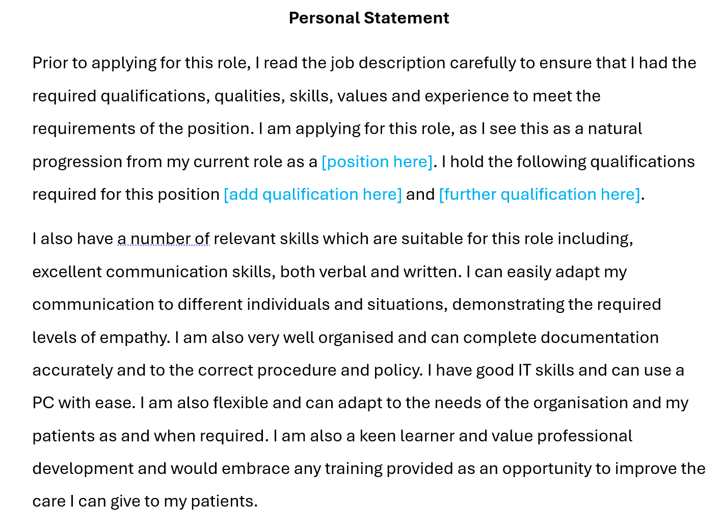
Confirms JD fully understood. Indicates confidence to meet requirements
See week 8 folder
Gives reason for application, showing alignment with role
Confirms educational achievements required for role
Confirms possession of skills required for role and makes links to healthcare

Slide 28
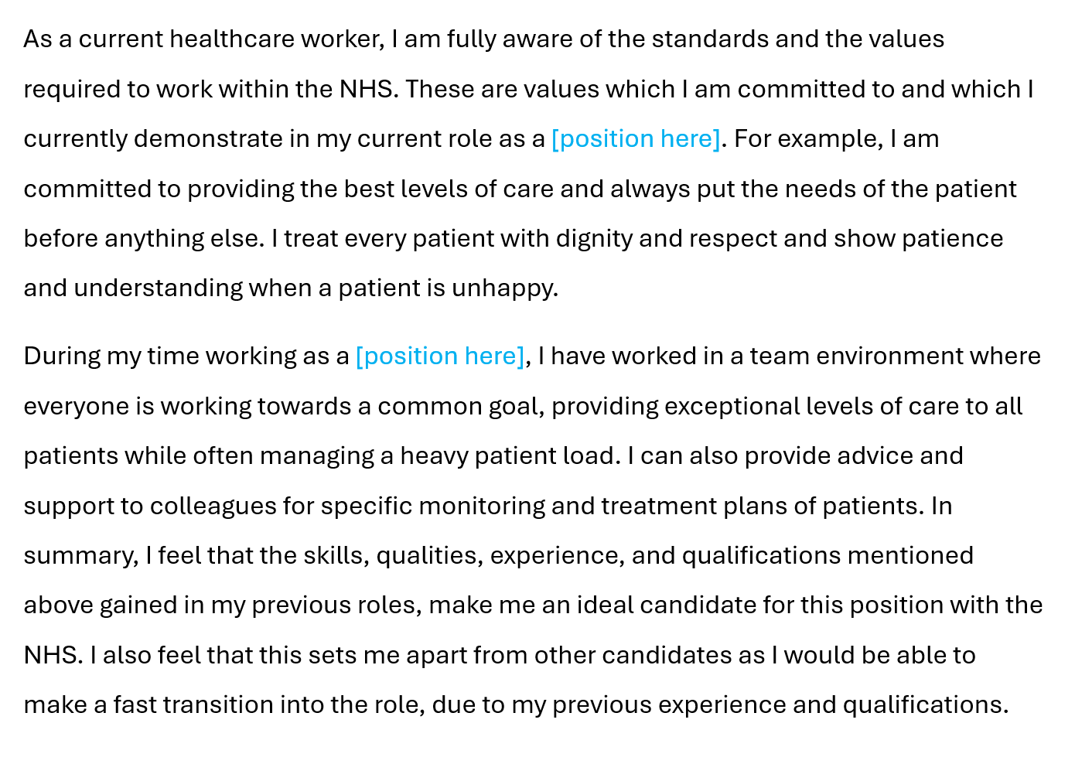
Shows evidence of understanding and applying good clinical practice
Links key skills to work experience: teamwork + care giving + organisational skills + communication + critical thinking
Summarises key qualities to stand out as a candidate
States USP to stand apart from other candidates

Slide 29
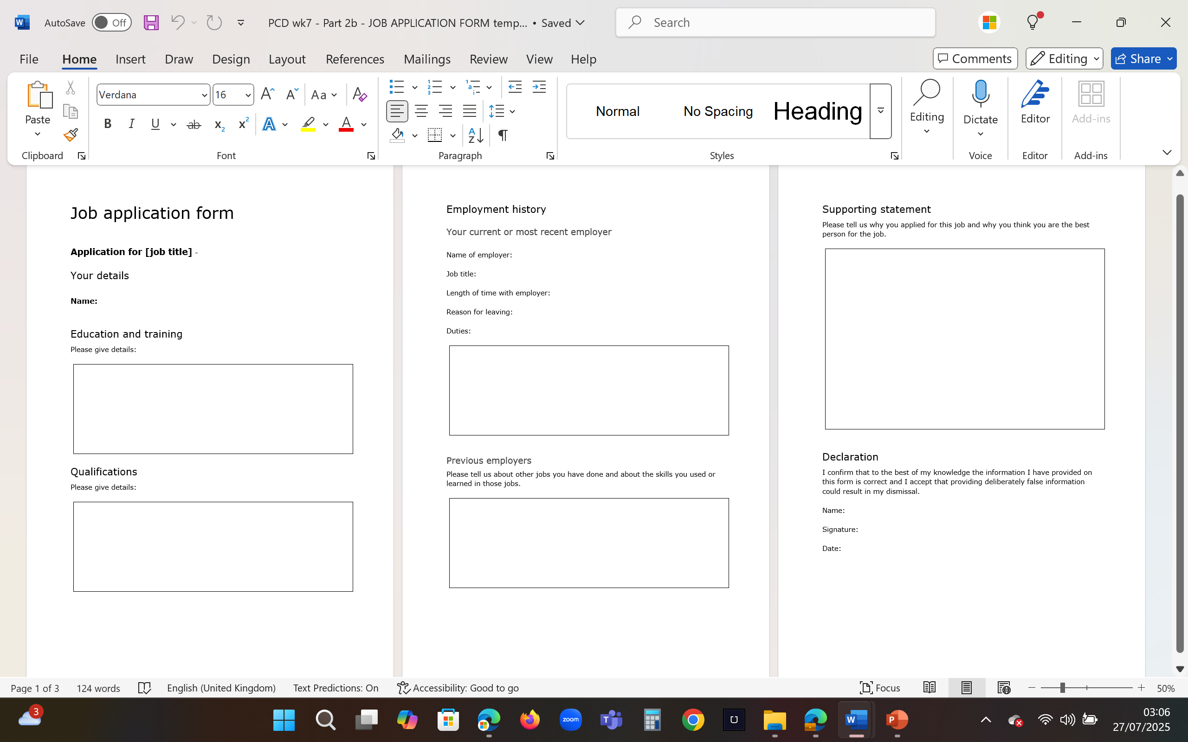
Activity 2
Write a supporting statement considering the position you are interested in applying for (related to Task 2).
If you have already written this statement, then conduct a review. Be prepared to edit parts where required.
Relevant?
Specific?
Concise?
With examples?

Slide 30
References
Indeed (2024) Writing a supporting statement when applying to a job. Available at: https://uk.indeed.com/career-advice/cvs-cover-letters/how-to-write-a-supporting-statement (Accessed: 20 November 2024)
If you have found further useful sources, then please do share them as recommendations with your peers.

